Slide 1
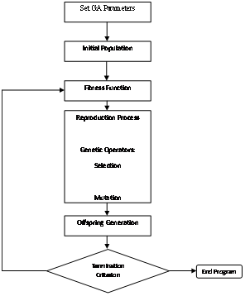
Genetic Algorithm
Search and optimization method that mimics the natural selection
Terms to define
  Chromosome – a set of numbers representing one possible solution
  Generation – a single loop within GA loop search
Loops through the reproduction, mutation, and adaptation process to obtain best fit model

Slide 2
Genetic Operator - Mutation
Effects of Mutation
  Introduce variance to search
  Aid the search for global minimum by directing gradient search out of the local minima
Mutation Operator
  Uniform Mutation – randomly replace with a new value
  Non-uniform mutation – add or subtract a random value

Slide 3
Genetic Operator - Crossover
Benefits of Crossover
  Aid the search for elites
  Optimize the search by keeping the optimal folding segments
Crossover Operator
  Random 2-point Crossover – randomly exchange between parents 2 angles at a time
  Multiple Entries Crossover – multiple random exchange

Slide 4
Genetic Operator - Crossover
Crossover Operator
  Blending
  P_{offspring} = a P_{mother} +(1-a) P_{father}

Slide 5
Genetic Operator - Selection
Benefits of Selection
  Aid the Elitism Search
Selection Operator
  Ranked Selection – higher the rank higher the probability of being chosen
Higher rank or better fitness
Lower rank or worse fitness

Slide 6
Genetic Operator - Adaptation
Adaptation Operator
  Gradient search applied to each chromosome
Benefits of Adaptation
  Provide the local minima search

