Slide 1
Instructions
This slide deck contains narration. A transcript is available here.
To play the slide show, go to the Slide Show menu and choose Play from Start.
To play the narration:
  Find the speaker icon in the bottom left corner of the slide.
  Move your mouse over the speaker icon. A progress bar will appear.
  Click the Play button (triangle at left side of bar).
  After a few seconds, the progress bar will disappear. Moving the mouse over the speaker icon will cause the progress bar to reappear.
When the narration ends, advance to the next slide by pressing the right arrow key on your keyboard.
If you prefer to listen to the audio without using the slide deck, download the mp3 file here.

Slide 2


Mentor Training
Module 4: Advising, Teaching, & Storytelling
Notes:
Hello, Mentors, and welcome to the fourth module in the Jerry Holmes Leadership Program mentor training series. I’m Kim Wolfinbarger, director of the program. Today we’re going to continue our discussion of the CATSU toolbox, which we introduced in Module 1. We’ve already talked about the Coaching element. Today, we’re going to discuss additional mentoring activities: advising, teaching, and storytelling.

Slide 3
CATSU Model
C | A | T | S | U
Coaching | Advising | Teaching | Storytelling | Undefined
Activating the the brain through the Coaching Mindset: Holding people to be naturally creative & resourceful and the Coaching Skillset: • Deep listening • Asking curious, open-ended, powerful questions | Giving advice or directing others while continuing to activate and open and receptive brain state by using the three Rs: • Being in a Relationship • Mutual Respect • Exercising Restraint | Explaining critical distinctions and processes, sharing technical know-how, and doing this skillfully by using the three Rs of advising and adding two more: • Being certain of Relevance • Providing the Just Right amount | Sharing your own and others’ experience for the sake of the mentee’s learning and growth, and doing this using all five Rs (see Advising and Teaching). | Other aspects of development as needed, such as referral to counseling, technical training beyond your capacity, etc.
Source: Ann Betz, “This Is Your Brain on Mentoring,” presented at the 10th Annual UNM Mentoring Institute Mentoring Conference, Albuquerque, New Mexico, October 2018.
Notes:
Although we’ve discussed coaching in depth, very quickly, I’d like to remind you that mentoring always starts with a coaching mindset. When you’re getting started with a mentee, when you’re stuck, when your trying to figure out a path forward, coaching is always a place you can return to, because that is the place where you’re showing your mentee that you believe they are creative and resourceful; you’re giving the mentee the opportunity to solve their own problem. You'll remember that when you’re in coaching mode, you’re asking curious and open-ended questions, listening deeply and intently, but you’re not giving advice. The time will come, though, when your mentee will really press you for advice in a particular situation and if you’ve already gone through the coaching steps, it might be the right time to give advice.

Slide 4


Activating the Brain
An activated brain is like a wet sponge.
Source: Ann Betz, “This Is Your Brain on Mentoring,” presented at the 10th Annual UNM Mentoring Institute Mentoring Conference, Albuquerque, New Mexico, October 2018.
Notes:
You’ll remember from Module 1 that your mentee first has to be ready to receive what you say. If their brain isn’t activated and ready, any advice you give will bounce off. You want to be sure that your mentee is prepared to receive that advice. So how do you do this? In Module 1, we discussed the importance of brain activation. Remember that the brain is like a sponge. When a sponge is dry, it can’t pick up any dirt, but when the sponge is wet, it picks up messes much more effectively. Similarly, an activated brain is ready to receive advice. You can facilitate an activated state by making sure that you’ve built a strong relationship with your mentee, that you are showing respect, and that you are exercising restraint.

Slide 5
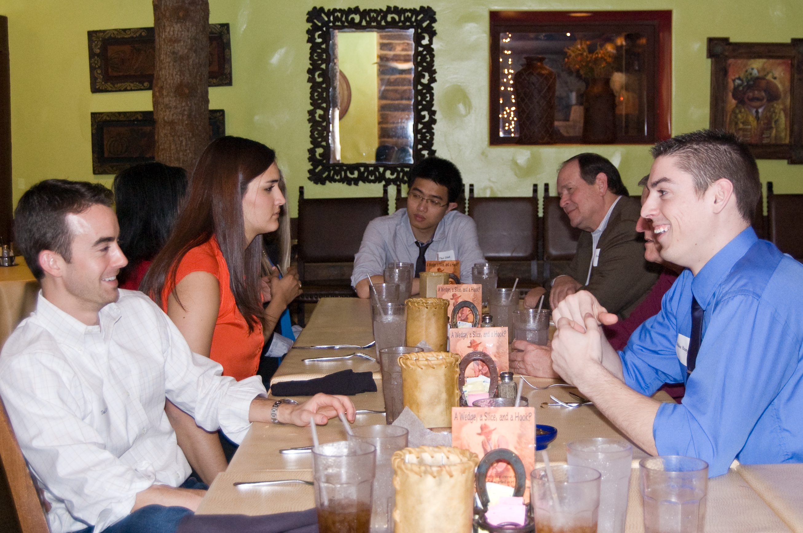
Relationship
Source: Ann Betz, “This Is Your Brain on Mentoring,” presented at the 10th Annual UNM Mentoring Institute Mentoring Conference, Albuquerque, New Mexico, October 2018.
Notes:
Building a strong relationship requires investing time and interest beyond the issue at hand. Your mentee will have questions and concerns they want to discuss with you, but make sure you are getting to know them as a whole person, not simply checking off a to-do list of mentorship tasks.

Slide 6
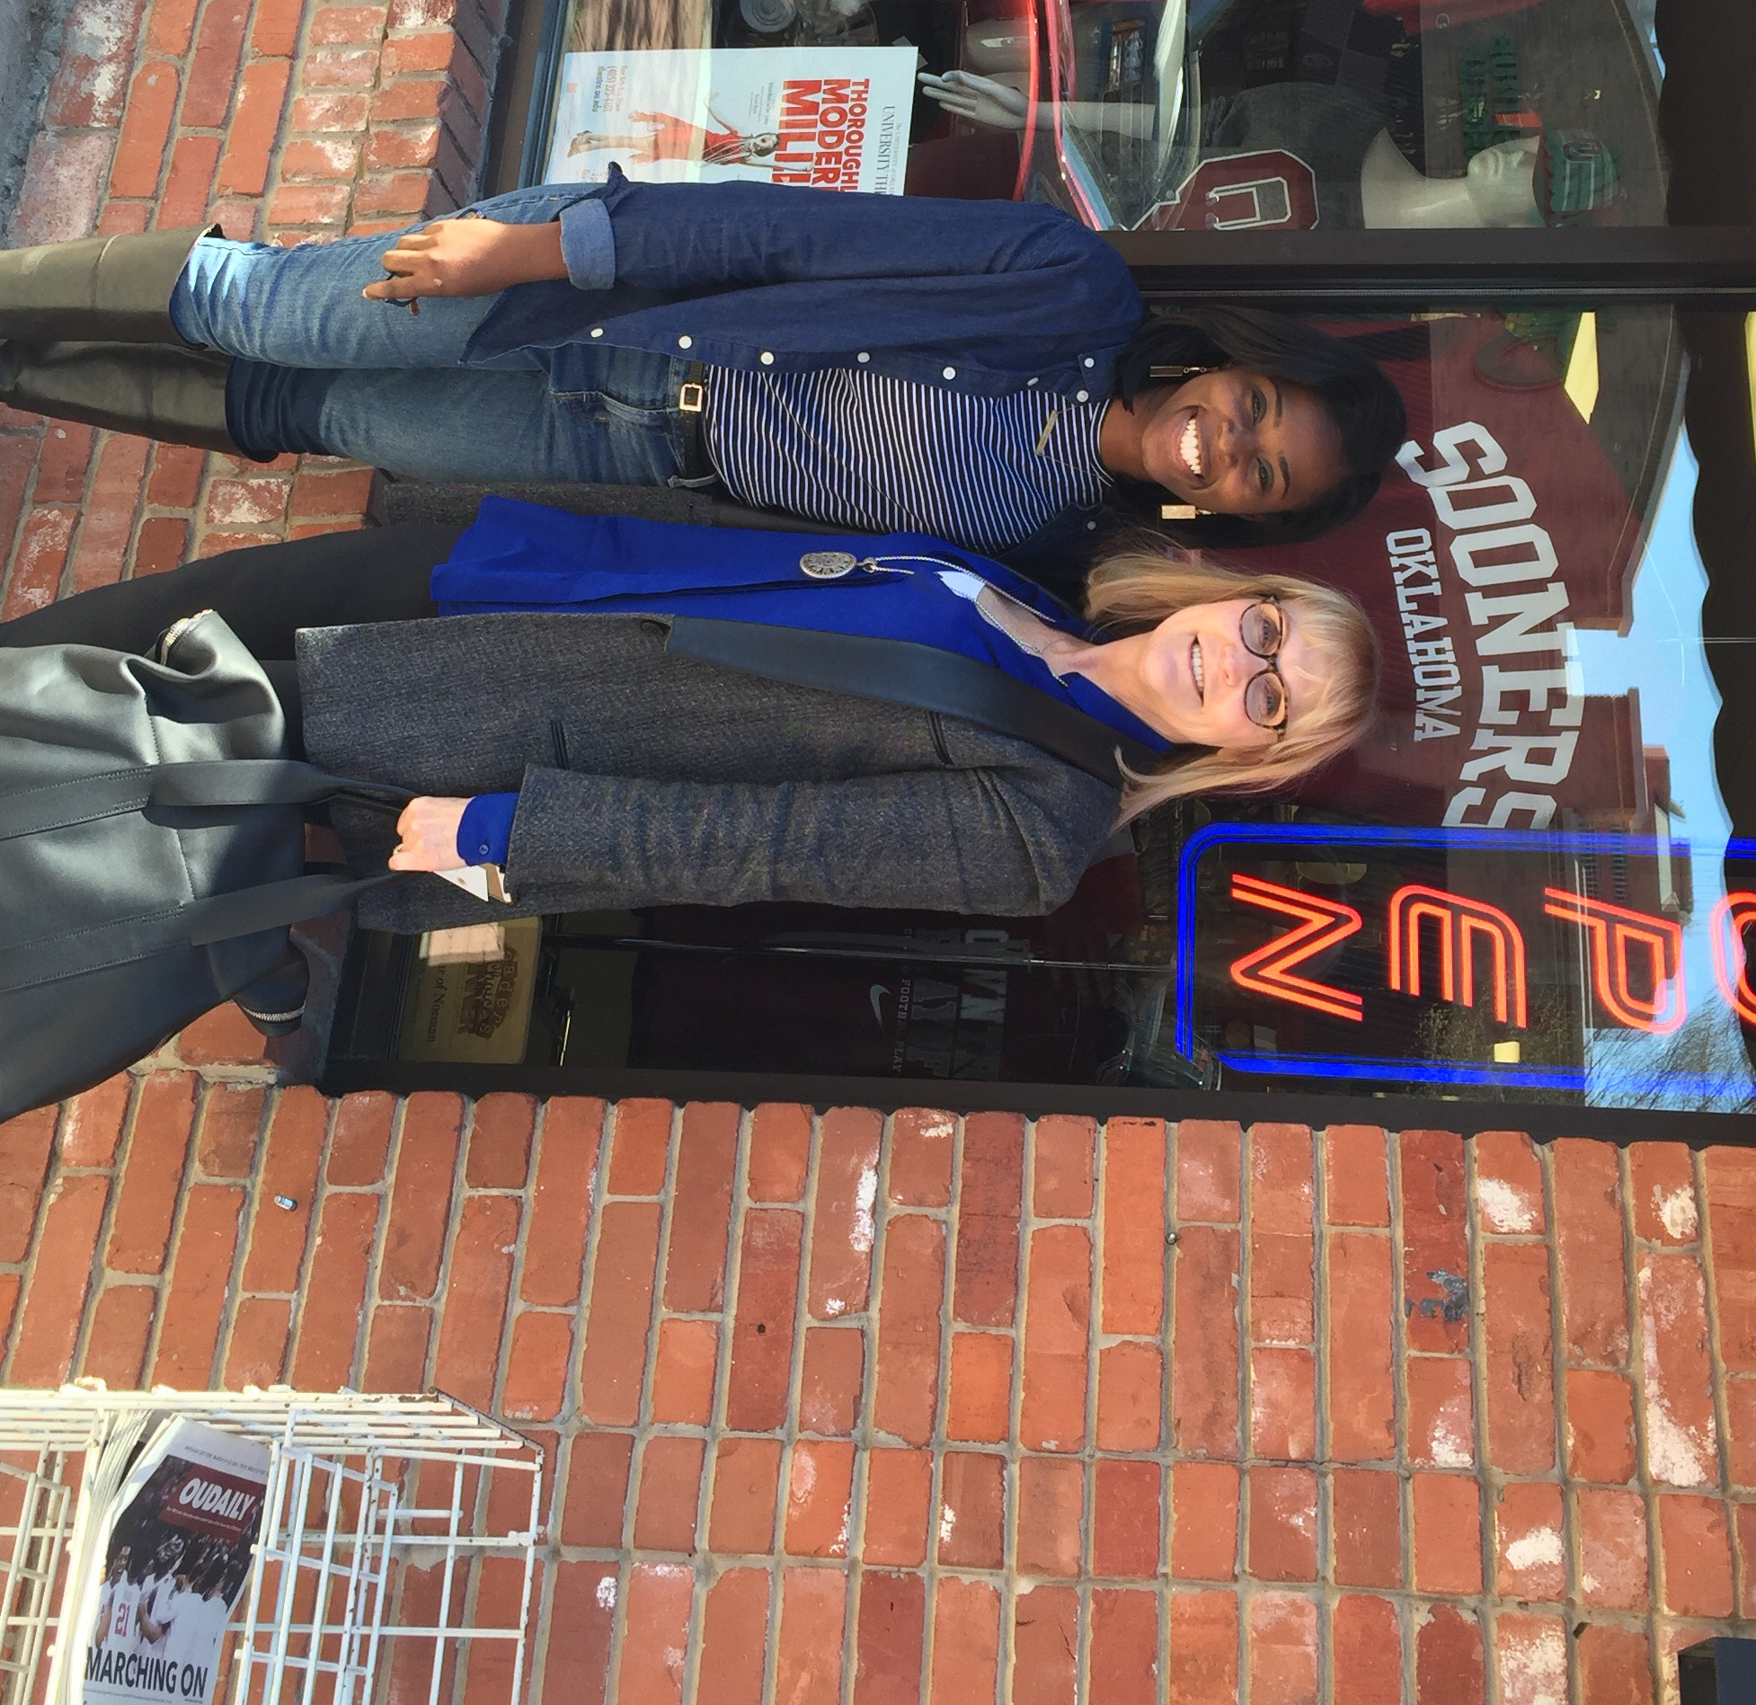
Respect
Source: Ann Betz, “This Is Your Brain on Mentoring,” presented at the 10th Annual UNM Mentoring Institute Mentoring Conference, Albuquerque, New Mexico, October 2018.
Notes:
You can show respect for your mentee by remembering that mentoring is a two-way street, a mutual learning process. By demonstrating that you believe your mentee is creative and resourceful, you show that you are not offering advice to bolster your own ego.

Slide 7

Restraint
Image Source: https://www.rei.com/learn/expert-advice/belay.html
Notes:
You exercise restraint in two ways: by making sure your mentee’s brain is activated before you give advice, and by being careful—Because once activated, they may do whatever you tell them!

Slide 8
Advising
Make sure your mentee’s brain is activated
  If not, return to Coaching mode
Make sure you understand the situation
  Ask questions
  Reflect: “Let me make sure I understand…”
Ask “Do you want my advice?”
Present options
Don’t exceed your expertise
  Know when to refer your mentee to someone else
Notes:
Once the brain is activated, it’s ready for the advising, teaching, and storytelling parts of the CATSU model. So, let’s talk about advising first. If your mentee’s brain is not activated, you want to go back into the coaching mode. If you start giving advice and you sense some resistance, shift back, start asking questions of the mentee, open-ended questions, and get them to continue talking about the problem. You also want to make sure that you understand the situation. Sometimes we give advice really quickly, and we don’t really have the lay of the land. Again, asking questions can be helpful, saying things like “Let me make sure I understand what’s going on…” and giving the mentee an opportunity to confirm or correct your perceptions. Next, ask, “Do you want my advice?” because even if you think they are ready, they might not be. Sometimes, they just want to vent, sometimes they want to tell you how they feel, sometimes they want to tell you what they’ve already decided to do. Always ask, “Do you want my advice?” before you give it. If the person says yes, then you’re in a good position and can start to present some options.
I really like the method of presenting options rather than just saying, “This is what you should do”. Here are some ways you can do that. You could say, “You could do X or Y. If you choose X, here’s what could happen…” You could also give advice by saying, “If I were in your situation, here’s how I would approach it”. That slightly less directive wording is often easier for the other person to hear, because they’re less likely to feel like they’re disappointing you if they don’t follow your advice. And make sure they know it’s their choice to follow the advice or not. If the relationship is solid, you and the mentee will be able to maintain the relationship even if they don’t do what you suggested. It’s also important not to exceed your expertise. If your mentee comes to you for advice in a situation where you don’t know what to do, it’s OK to say, “I don’t know”. That’s a good point to return to the Coaching mode, where you and your mentee can co-create potential solutions. Or you might say, “I don’t know what you should do here, but I know someone we could ask.” Don’t feel like you have to give advice simply because they ask you because, as I said earlier, once their brain is activated, they may do whatever you tell them.

Slide 9
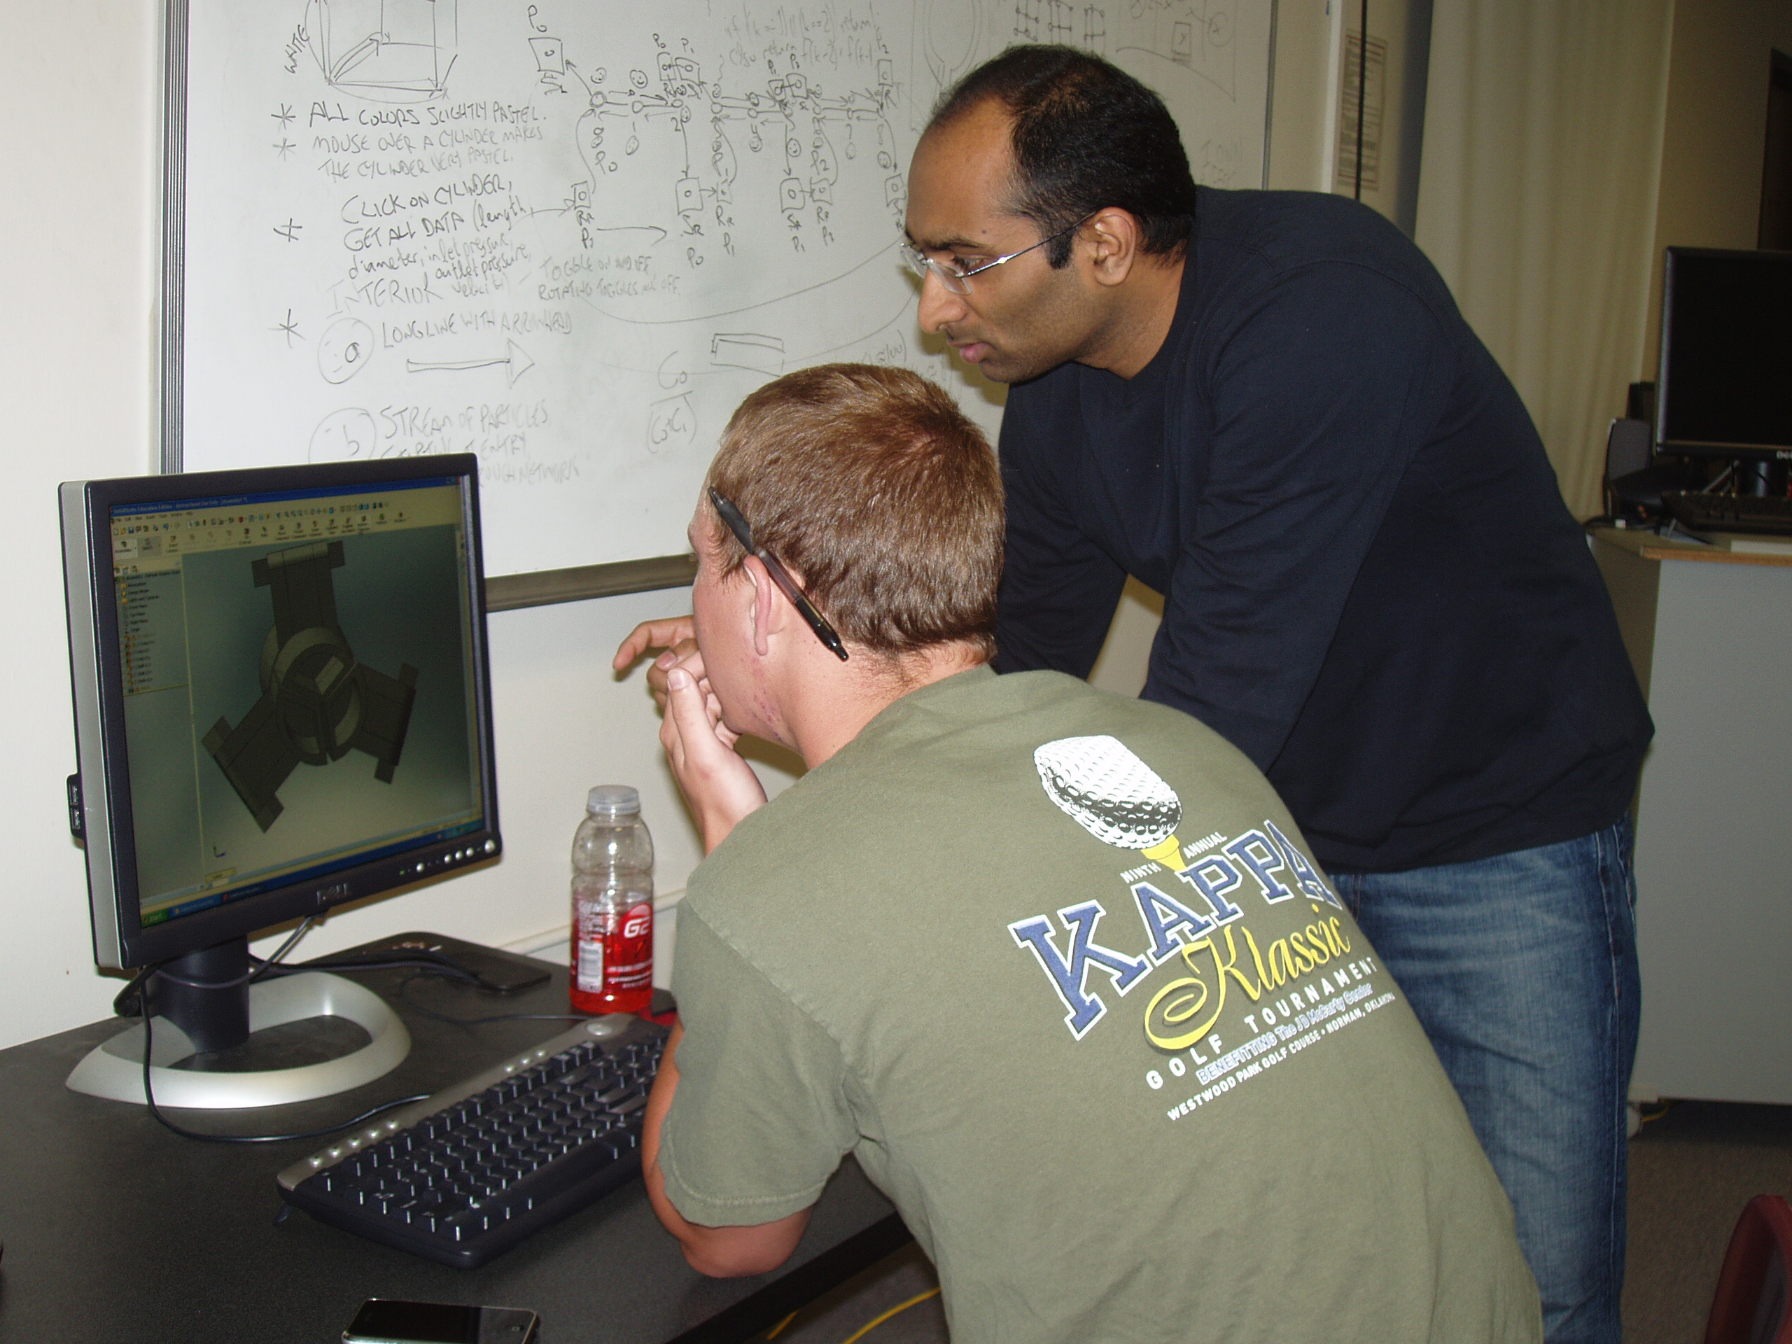
Teaching
Notes:
The next tool in your box is the teaching tool. When you’re teaching your mentee, you might be sharing some technical knowledge, such as how to use project management software, or you might be sharing some interpersonal knowledge, such as best practices for interviewing or how to give feedback. Some mentoring pairs read a book together—this is a good way to learn new material along with your mentee.

Slide 10
Teaching
Use the 3 Rs of Advising
  Respect: Your mentee is creative & resourceful
  Let your mentee teach you a skill
Add two more
  Be sure of Relevance
  Give just the Right Amount
Notes:
It’s important when you’re in teaching mode to remember to use the three R’s of advising and the one I want you to particularly remember here is respect. One way you can show respect is to remember that your mentee is creative and resourceful. Another way you can show respect is to let your mentee teach you something. Mentorship is a two-way street, and as Lois Zachary tells us, it is a mutual learning process. Letting your mentee teach you a skill can help build the relationship and help reinforce that mutual respect.
Now besides the first three R’s, you want to add two more when you’re teaching. You want to be sure that what you’re teaching is relevant and that you’re giving just the right amount of information. Sometimes mentors think they know what their mentees need, and they want to jump right in and teach them how to do a certain process. Make sure that what you want to teach your mentee actually matches the mentee’s needs, and that the timing is right. It may be that your mentee does need to learn this skill but perhaps now is not the right time. And remember to give just the right amount. Engineering and science students are taught at for hours a week. Many of them are still in classes where the professor is standing up and lecturing the whole hour, and then they are going home and reading their textbooks and taking in information, and it can be overwhelming to be taught too much. So be sure that you aren’t over-teaching when you’re in this mode, and that they are ready to learn.

Slide 11
Storytelling
Ancient
Powerful
  Can produce results when advising and teaching risk resistance
  “Here’s what I did in a similar situation…”
Use all the Rs
  Relevance and Right Amount are very important
Photo credit: Frans Lanting, https://www.smithsonianmag.com/smart-news/late-night-conversations-around-fire-might-have-shaped-early-human-cognition-and-culture-180952790/
Notes:
Now we’re going to talk about my favorite part of this model, storytelling. Storytelling is ancient and powerful. It is the way that humans have transmitted technical knowledge, cultural knowledge, moral beliefs, decision-making processes, and given advice as long as humans have been able to talk. Our brains are wired to tell stories and to learn from stories. I love storytelling because it can produce results when advising and teaching end up with resistance because when you tell a story, you’re not telling a student what to do, you are abstracting the situation, you’re letting the mentee draw their own conclusions, and they feel more like they have options about what way to go. So, one way you can use storytelling rather than advising is when a mentee comes to you with a situation and they want to know, “what should I do?”, instead of saying, “Well, here’s what I think you should do,” you could try this. Say, “Well, here’s what I did” or, “Here’s what a friend of mine did, in a similar situation”. Tell your story, and then let the mentee talk. You’d be surprised how often the mentee comes to the conclusion you think they should, but they are more likely to take action because they feel like the decision was their own. Now when you tell a story, you want to use all the R’s. I think that relevance and the right amount are particularly important here. Occasionally, I will hear from a student that their mentor mostly just tells stories about their college days or their early days on the job, and the mentee doesn’t feel like the mentor is really interested in what the mentee wants to discuss. So, make sure that your stories are always relevant to what your mentee is dealing with, avoid telling long, drawn-out stories, and don’t tell too many stories. Storytelling is a powerful tool, and you want to use it judiciously.

Slide 12
Summary
Coaching: Ask open-ended questions
Advising: Build the relationship, show respect, exercise restraint
Teaching: Ensure relevance, provide just the right amount
Storytelling: Powerful but can be overused
Undefined: Training, referrals, counseling, etc.
Notes:
Let’s quickly recap. As a mentor, you have several tools for helping your mentee: you can coach by asking open-ended questions; you can advise, remembering to first build the relationship, show respect, and exercise restraint; you can teach, remembering to ensure that what you are teaching is relevant; and you can tell stories, a powerful way to communicate as long as it isn’t overused; and finally, you may find that sometimes you need to do something that isn’t coaching, advising, teaching or storytelling. Maybe the mentee’s needs exceed your expertise. In that case, you might help them find a training to take, you might refer them to a person you know who has some expertise in the subject, or maybe they need to see someone for counseling. Make sure you know what your limits are as a mentor and don’t be afraid to refer the mentee elsewhere if you don’t have the expertise to address that particular problem.
If you do refer the student elsewhere, remember to loop back. At your next meeting, ask them how it went so that you know what the outcome was. This way, you can both hold the student accountable and make sure that their needs are being met.
That’s all for Module 4. Remember, audio files and transcripts for all our mentor training materials are available on the JHLP website. Thanks for listening!

Slide 13
Links
Audio file without slides (mp3)
Transcript (docx)

