Slide 1
Instructions
This slide deck contains narration. A transcript is available here.
To play the slide show, go to the Slide Show menu and choose Play from Start.
To play the narration:
  Find the speaker icon in the bottom left corner of the slide.
  Move your mouse over the speaker icon. A progress bar will appear.
  Click the Play button (triangle at left side of bar).
  After a few seconds, the progress bar will disappear. Moving the mouse over the speaker icon will cause the progress bar to reappear.
When the narration ends, advance to the next slide by pressing the right arrow key on your keyboard.
If you prefer to listen to the audio without using the slide deck, download the mp3 file here.

Slide 2


Mentor Training
Module 2: Leadership Capabilities
Notes:
Hello and welcome to the second module in the Jerry Holmes Leadership Program mentor training series. I’m the director, Kim Wolfinbarger.
In the first module, we discussed getting started with mentorship. So, if you haven’t listened to that module, I encourage you to go back and check it out after you’ve listened to this one.
Today, we’re going to discuss the core of the Jerry Holmes Leadership Program: our Leadership Capabilities. As mentors, you serve a critical role in helping our Holmes Leadership Associates develop as leaders. In order for you to do that, it’s helpful for you to know the principles that we hold and the philosophies that we’re teaching within the program.

Slide 3
JHLP Leadership Tenets
Leadership can be taught.
Leadership is an influence process and can be exercised by anyone in an organization.
Leaders promote change and create the environment in which change can take place.
Management is a part of leadership.
Leadership preferences are influenced by culture.
There is no such thing as a "complete" leader.
Notes:
Let’s start with the leadership tenets, our fundamental beliefs about leadership. JHLP’s mission is to teach students how to make positive change through the exercise of technical expertise, collaboration, and ethical practice. We believe first of all that leadership can be taught. You might have heard that leaders are born and not made. We don’t believe that. We believe that people can be born with certain tendencies that might help them to be good leaders, but leadership is fundamentally a skill set, and whether a person becomes a leader often depends on their motivation or willingness to lead. I like to think of our approach as filling the student’s leadership toolbox. As they practice leadership skills, they become more confident in their abilities and more willing to accept the challenge of leadership.
Second, leadership is an influence process. This is a modern view of leadership. The idea originated about 100 years ago, but it didn’t get much attention until later in the 20th century. Leadership is not merely directive and authoritative. The modern collaborative workplace is characterized by shared leadership and often by flat structures. Success depends on influence and relationships at all levels of the organization, to a degree unimaginable a generation ago. By teaching people how to use influence to lead, we are expanding their skillset to meet the challenges of modern organizations. Furthermore, this idea of leadership as an influence process means that leadership isn’t restricted to those in positions of power. People can provide leadership from any place in the organization, at any point in their career.
Third, we believe that leaders promote change and create an environment in which change can take place. That’s probably the biggest difference between someone who is a leader and someone who is merely an administrator. The leader is going to identify areas in which change needs to happen, they’re going to encourage change to happen, and they’re going to create an environment that welcomes, accepts, and facilitates change.

Slide 4
JHLP Leadership Tenets
Leadership can be taught.
Leadership is an influence process and can be exercised by anyone in an organization.
Leaders promote change and create the environment in which change can take place.
Management is a part of leadership.
Leadership preferences are influenced by culture.
There is no such thing as a "complete" leader.
Notes:
Number four: Management is a part of leadership. It is not an oppositional concept. This one is really close to my heart. Back in the 1970s an influential article by a professor named Abraham Zaleznik was published in the Harvard Business Review. In this article, called “Managers and Leaders: Are They Different?” Zaleznik presented a view that leaders and managers are fundamentally different people. And he really made managers look bad and petty and small-minded and too focused on process. And that philosophy has very much permeated American leadership thought. At the Jerry Holmes Leadership Program, we believe in a different approach. We ascribe to a model called Functional Leadership, that looks at what leaders actually do in their day-to-day lives. And it turns out that most leaders do a fair amount of managing. The basic idea of functional leadership comes from Joseph McGrath, who wrote: “A leader’s job is to do, or get done, whatever is necessary for group needs.” That encompasses a lot of different activities. So, in this program, instead of setting management in opposition to leadership, we say, management skills are a subset of leadership skills. There’s more to leadership than just management, but management is an important set of skills. It is not the lesser cousin of leadership, and people who are good managers are not somehow lesser people than those who are seen as “leaders”. Under the functional leadership model, management is very much a part of leadership. You’ll see examples of that in just a moment when we move into the discussion of our leadership capabilities.
The fifth tenet: Leadership preferences are influenced by culture. This is something we don’t always know until we have experienced leadership that is different from what we expect. Most leadership teaching in the United States and certainly the leadership you see in popular movies and books has a Western business bias and it also has a very American bias. This isn’t bad, but it’s important to know that there is not one way to lead. Leadership styles that work in one country may not be accepted in another country, or even in another region of the same country. Leadership approaches that work in a for-profit business may run into a lot of legitimate resistance in a not-for-profit business or any university. Understanding that leadership is largely culturally informed is helpful. So, part of what we try to do in our program is help students see how an understanding of culture can help us be better leaders.
The final tenet that we hold is based on an article by Deborah Ancona and her colleagues at MIT, “In Praise of the Incomplete Leader”. We believe that there is no such thing as a complete leader. No leader has all the skills and attributes necessary for leadership. Your job as a leader of a team is to figure out what skills you don’t have, what talents you don’t have, and to find people who are good at those things so that your team’s leadership is complete. I encourage you to read Anacona’s article. It is currently available for free on the Harvard Business Review website, so I’ll put a link to it at the end of the slide deck.

Slide 5
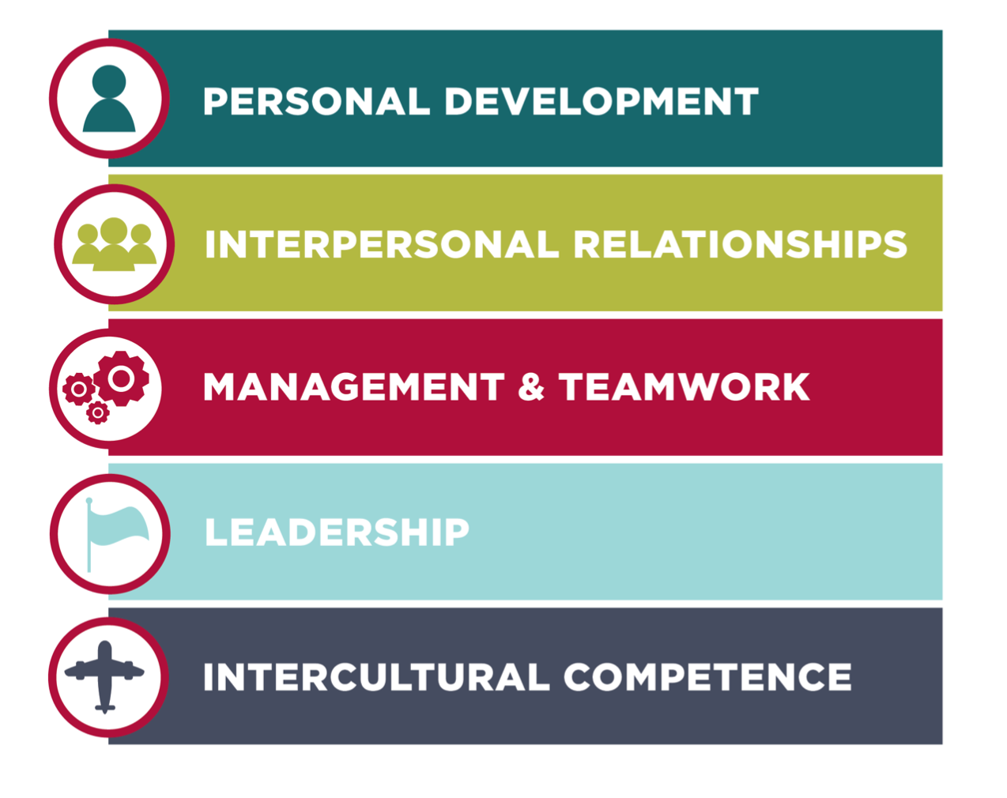
JHLP Leadership Capabilities
Notes:
Now that we’ve covered the tenets, let’s see how they are put into practice. The Jerry Holmes Leadership Program curriculum is organized around five pillars: Personal Development, Interpersonal Relationships, Management and Teamwork, Leadership, and Intercultural Competence. Each of these pillars contains a set of leadership capabilities: skills and attributes we believe technical leaders should possess. This concept is common among collegiate engineering leadership programs. In fact, many of our capabilities are modeled after those espoused by the Gordon Engineering Leadership Program at MIT and the Rice Center for Engineering Leadership at Rice University.
So how do we use these leadership capabilities? The Jerry Holmes Leadership Program organizes all of our programming around these ideas. Every event, every lesson can be connected to at least one capability. But of course, with 26 capabilities, there’s no way we can cover all of them every year, and furthermore there’s no way for us to know exactly what each student needs. That’s where the personal leadership development plan comes in. At the beginning of the academic year, each Holmes Leadership Associate creates a personal leadership development plan based on these capabilities. They rate their own level of competence in each capability, and they then choose three capabilities to develop during the year. We call these their target capabilities. I’ll explain more about the leadership development plan in module three, but first I’d like to discuss each of the five pillars. You’ll find more details about each capability and our sources in the Leadership Capabilities document on the JHLP website.

Slide 6
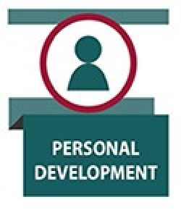
Developing self-awareness
Setting and achieving goals
Problem-solving and decision-making
Building technical and financial expertise
Notes:
The first pillar is Personal Development. As the saying goes, you can’t lead others until you lead yourself. Under this pillar, we have four capabilities: developing self-awareness, setting and achieving goals, problem-solving and decision-making, and building technical and financial expertise. Fortunately, here in our college of engineering and college of earth and energy, students have a lot of opportunity within the regular curriculum to build technical expertise. JHLP helps students develop their skills with the other items in this list. I’m not going to go through all the underpinnings of each capability because you can read those in the leadership capabilities document. I would, however, like to highlight one capability, Setting and Achieving Goals. Goal-setting is a critical part of making progress in any life endeavor, and it’s important to the leadership development plan because the plan itself requires setting goals. We use the SMART goals process. SMART, in case you aren’t familiar with the acronym, stands for Specific, Measurable, Actionable, Realistic, and Timely. Since it is the focus of the second discussion that we ask students to have with their mentors, we’ll talk more about SMART goals in the module three.

Slide 7
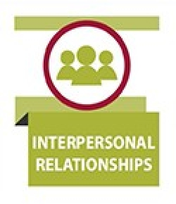
Practicing good followership
Building positive relationships
Practicing inclusivity
Collaboration
Managing conflict and negotiation
Communicating effectively
Notes:
The next category is Interpersonal Relationships. Under this pillar we include the capabilities of practicing good followership, building positive relationships, practicing inclusivity, collaboration, managing conflict, and communicating effectively. We’ve learned that, in general, students struggle a lot with building trust, an important ingredient in positive relationships, and with managing conflict. Your mentee’s needs may be different, but I suggest at least asking some questions about these capabilities.

Slide 8
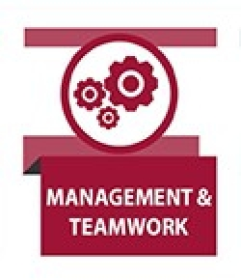
Organizing
Working in a team
Staffing
Managing projects
Training and mentoring
Empowering and delegating
Notes:
The third pillar is Management and Teamwork. These concepts really go hand in hand. Our students get a lot of practice working in teams here at the University, but they—like you—may not have had a lot of training in learning how to work effectively in a team. We cover this a bit in our professional development course, in the leadership course that I teach, and in some capstone courses, but it’s still often a struggle. So, this is an area that students may choose to work on as a target capability. Under this category we have organizing; working in a team; staffing; understanding how to manage a project; and empowering and delegation.
I will tell you that one place where students have particular difficulty is in empowering and delegating. They often don’t know how to trust other people to do their parts of the project, and they don’t know how to check up on other people. In other words—How do you trust but verify? How do you effectively delegate a task, keep up and make sure that task is being done without seeming like a nag—in a situation where the only penalty is a poor peer evaluation? Students work hard to figure this out. You can probably give your mentee some advice on how you manage and delegate in a team. Another area where students struggle is how to manage a project. They simply don’t have the skills yet to be able to predict how long different parts of a project are going to take and—as you might remember from being a student—they tend to not do enough work in the early stages of the project. They wait too long to start. So, helping your student understand how to create a real project management plan at a level of detail appropriate to the project they are doing would be great way to provide some leadership training to your mentee.

Slide 9

Creating a shared vision
Motivating and inspiring others
Adapting leadership styles
Building power & influence
Boundary spanning
Leading change
Notes:
The fourth pillar is recursively named leadership. This is the category of skills most often associated with leadership. I will reiterate that we believe all twenty-six of these capabilities are leadership capabilities. The capabilities that fall specifically under the leadership pillar are creating a shared vision—not just a vision but a shared vision; motivating and inspiring others; adapting leadership styles as appropriate; learning how to build power and influence; boundary spanning—which is connecting your group to people and resources outside the group—and of course, leading change.

Slide 10

Understanding the cultural dimensions of leadership
Intercultural communication
Understanding the global context of engineering practice
Working with other professions
Notes:
The final pillar is intercultural competence. As I said in the tenets, we know that leadership is informed and influenced by the culture in which it operates. And as engineers and scientists are increasingly more likely to work in other countries, to work with people from other backgrounds, and to work with other professions, we believe it’s important to understand and value other cultural perspectives. Capabilities under this pillar include understanding the cultural dimensions of leadership—which parts of leadership might look different in your culture than they do in another; understanding some basics of intercultural communication; understanding the global context of engineering practice—really how do you fit in to the world as an engineer. And finally, working with other professions, which, as those of you who work with people who are not engineers know, engineering has its own culture. Even if two people are from the same hometown, if their profession is different, they may sometimes feel like they aren’t even speaking the same language. So, getting comfortable and being able to work with people who are different from you on a number of dimensions is the idea behind our intercultural competence pillar.

Slide 11
Resources & Links
JHLP Leadership Philosophy & Capabilities
  https://www.ou.edu/coe/explore/student-life/leadership/about-the-jhlp-program#philosophy
Resources by Capability
  https://www.ou.edu/content/dam/coe/docs/jhlp/JHLP%20Capabilities%202017.pdf
In Praise of the Incomplete Leader
  by Deborah Ancona et al.
  https://hbr.org/2007/02/in-praise-of-the-incomplete-leader
Notes:
Now you know our philosophy and our Leadership Capabilities framework. A partial list of resources for many of the capabilities is available on our webpage. Students have access to additional content through our course management system. We are continually adding to this list and would love to know what materials and approaches you and your mentee are using.
Thanks for listening!

