Slide 1
Instructions
This slide deck contains narration. A transcript is available here.
To play the slide show, go to the Slide Show menu and choose Play from Start.
To play the narration:
  Find the speaker icon in the bottom left corner of the slide.
  Move your mouse over the speaker icon. A progress bar will appear.
  Click the Play button (triangle at left side of bar).
  After a few seconds, the progress bar will disappear. Moving the mouse over the speaker icon will cause the progress bar to reappear.
When the narration ends, advance to the next slide by pressing the right arrow key on your keyboard.
If you prefer to listen to the audio without using the slide deck, download the mp3 file here.

Slide 2


Mentor Training
Module 3: The Leadership Development Plan
Notes:
Hello and welcome to the third module in the Jerry Holmes Leadership Program mentor training series. In this module, we’ll discuss a key component of our program, the Leadership Development Plan. I’m the director, Kim Wolfinbarger.

Slide 3
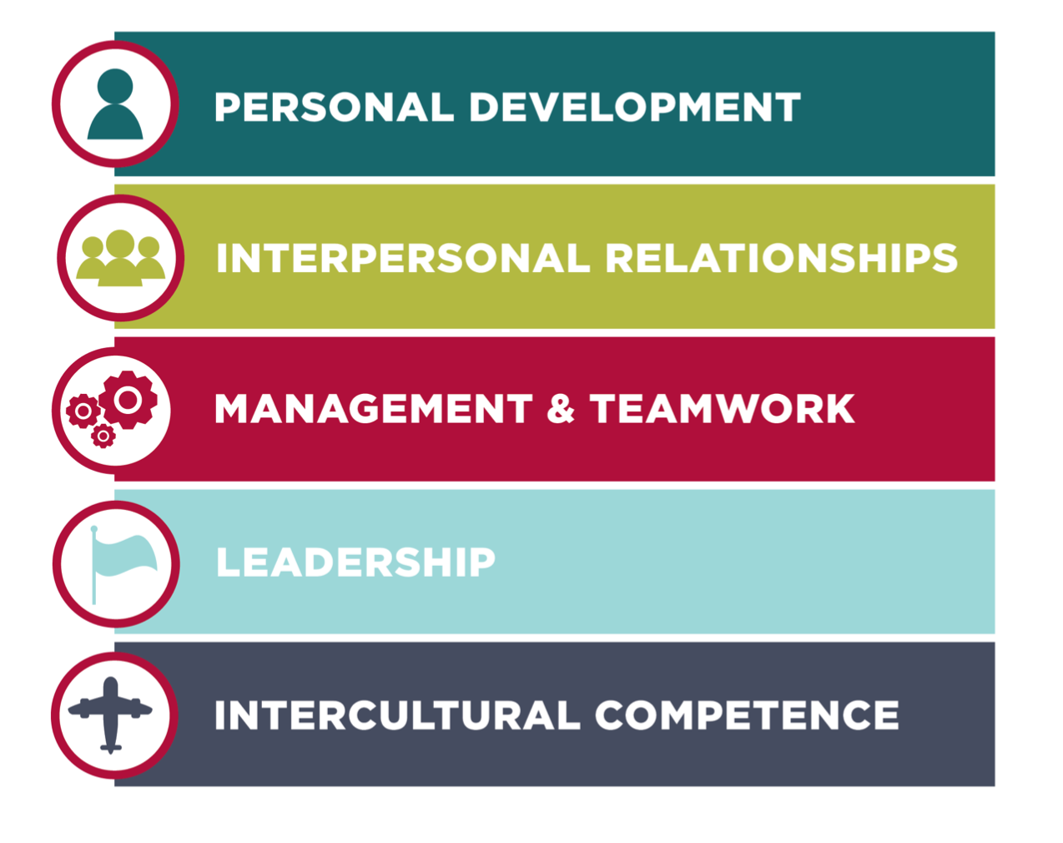
JHLP Leadership Capabilities
Notes:
In Module two, we discussed our leadership philosophy and the Leadership Capabilities framework. Our program is organized around 5 pillars: Personal Development, Interpersonal Relationships, Management and Teamwork, Leadership, and Intercultural Competence. Each pillar contains a set of leadership capabilities: skills and attributes we believe technical leaders should possess. While we cover several capabilities each year through our event programming, Holmes Leadership Associates also get to personalize their leadership development experience by creating an individual leadership development plan. Today, we’ll discuss the personal leadership development plan in detail and talk about how you can help your mentee reach their goals. If you’d like to review the capabilities associated with each pillar, you’ll find that information on our website.

Slide 4
The Leadership Development Plan: Capability Ratings
Rating | Definition
Does Not Possess | I don’t know anything about this capability, or I’ve heard a little about it, or I don’t see the value.
Introductory | I know something about this capability. I can describe it and realize why I might need it, but I need to learn a lot more and practice more to be good at it.
Intermediate | I can understand and discuss this capability. I am beginning to internalize these concepts, and I am actively practicing them. I need to learn and practice more in order to become proficient.
Advanced | I know enough to explain and demonstrate this capability. I could coach someone else. I embrace this idea completely.
Source: Bernard M. Gordon MIT Engineering Leadership Program (2013), GEL Student Handbook, v. 3.0, p. 35.
Notes:
At the beginning of the fall semester, each HLA creates a personal leadership development plan, called “LDP” for short. Using an online survey, they read about each capability and rate their own level of competence. There are four levels: Does Not Possess, Introductory, Intermediate, and Advanced. We use MIT’s definitions of each level; the descriptions below are modified only slightly from their Gordon Engineering Leadership Program Handbook. Let’s take a look at each level:
• Does Not Possess means ”I don’t know anything about this capability, or I’ve heard a little about it, or I don’t really see the value.”
• Introductory means “I know something about this capability. I can describe it and realize why I might need it, but I need to learn a lot more and practice to be good at it.”
• Intermediate means “I can understand and discuss this capability. I’m beginning to internalize these concepts, and I am actively practicing them. I need to learn and practice more in order to become proficient.”
• Advanced means “I know enough to explain and demonstrate this capability. I could coach someone else. I embrace this idea completely.”
Advanced, though, does not mean perfect. Just like sports, arts, or math, even at the Advanced level, more practice is always necessary. Leadership development is a continuous improvement process.
Now remember, the ratings are subjective and personal, so one person’s “Intermediate” may be another person’s “Advanced.” This is OK. Our goal is for each HLA to identify opportunities for personal growth. Once the student has completed ratings for each of the 26 capabilities, they choose three capabilities as their focus for the year. We call these “target capabilities.”

Slide 5
Target Capabilities:
A Fictionalized Example
Capability 6: Building Positive Relationships
Initial Rating: Introductory
Mentee’s Reason for Initial Rating
  I’m not a people person
Mentee’s Plan to Develop Capability
  Be more approachable, open up
Notes:
Here we have an example of a fictional student’s LDP. We’ll call this student Cameron. Cameron has chosen “Building Positive Relationships” as one of their target capabilities. Now for each target capability, in addition to listing an initial rating, they also need to provide the reasoning for that initial rating and a create a plan to develop that capability. As you can see on this slide, Cameron’s plan has some weaknesses. It is not SMART.

Slide 6
SMART Goals
Specific
Measurable
Action-oriented
Realistic
Timely (or time-bound)
Read more about SMART goals in Chapter 5 of The Mentor’s Guide.
Notes:
We encourage students to use the SMART goals process to help them set goals and develop an action plan. So, what do we mean by SMART? The acronym stands for Specific, Measurable, Action-oriented, Realistic, and Timely, or Time-bound, depending on how you apply the model. You can read more about SMART goals in Chapter 5 of your mentor’s guidebook. So how might a mentor help Cameron create a SMART plan for building positive relationships?

Slide 7
Target Capabilities:
A Fictionalized Example
Capability: Building Positive Relationships
Initial Rating: Introductory
Mentee’s Reason for Initial Rating
  I’m not a people person
Mentee’s Plan to Develop Capability
  Be more approachable, open up
Not SMART.
Notes:
Cameron’s rationale is vague, and their plan lacks detail. What do they mean by “not a people person” and how are they are going to “be more approachable”? Having a plan that isn’t SMART, is not unusual. Over the years, we’ve found that students struggle with being specific about their goals and creating a realistic plan with action steps. This is a place where mentors can help.

Slide 8
A SMART Plan
Specific Action | By When?
Read Ch. 1–4 of People Styles at Work by Bolton & Bolton. | Oct. 15
Take the People Styles Assessment (p. 26–27). | Oct. 15
Read Ch. 6–7. Discuss with mentor. | Oct. 22 (Next mentor meeting)
Read Ch. 8–9. | Oct. 29
Pay attention in social settings. How are you using your strengths? What happens when you are stressed? Make notes in your journal. | Between Oct. 29 and Nov. 12 (next mentor meeting).
Discuss with mentor; create next steps for plan. | Nov. 12
Notes:
Here is one example of a SMART action plan. Let’s say that you and Cameron decided to read a book together. Notice that all the steps listed on this table are specific actions and each one has a due date. You and Cameron should collaborate on selecting actions and setting due dates. As a mentor, you should not be dictating assignments. You should, however, help Cameron make sure that the tasks and the due dates are realistic. They should neither be ambitious nor too loose.
Now, how are these tasks going to be measured? The answer for a few of these is obvious. It’s easy to track to how much of the book you’ve read for example, but what about qualitative assessments? In this case, Cameron wants to become more approachable. That’s inherently a qualitative judgement. So how might Cameron know whether they’ve made progress? We suggest using a journal. Reflecting on behaviors and the outcomes will help Cameron more accurately assess what they are doing and why and the journal provides a good reference and accountability tool for use during midterm meetings. Over time, Cameron will have a record of what worked and what didn’t, and they can experiment with different approaches. Note that this plan isn’t completely fleshed out. It may not be realistic to build a full plan for each target capability at the beginning of the semester. So here, Cameron and their mentor decided to update the plan during their meeting on November 12th.
Defining goals clearly and establishing a road map for progress is essential, but just as essential is follow-up. We encourage the students to talk about their goals with their mentors early, but we also want mentors to check with students on their progress. Discussing their progress on the target capabilities should be a part of every mentor meeting.

Slide 9
CATSU Model
C | A | T | S | U
Coaching | Advising | Teaching | Storytelling | Undefined
Activating the the brain through the Coaching Mindset: Holding people to be naturally creative & resourceful and the Coaching Skillset: • Deep listening • Asking curious, open-ended, powerful questions | Giving advice or directing others while continuing to activate and open and receptive brain state by using the three Rs: • Being in a Relationship • Mutual Respect • Exercising Restraint | Explaining critical distinctions and processes, sharing technical know-how, and doing this skillfully by using the three Rs of advising and adding two more: • Being certain of Relevance • Providing the Just Right amount | Sharing your own and others’ experience for the sake of the mentee’s learning and growth, and doing this using all five Rs (see Advising and Teaching). | Other aspects of development as needed, such as referral to counseling, technical training beyond your capacity, etc.
Source: Ann Betz, “This Is Your Brain on Mentoring,” presented at the 10th Annual UNM Mentoring Institute Mentoring Conference, Albuquerque, New Mexico, October 2018.
Notes:
As you help your mentee define their goals and create an action plan, keep the CATSU model in mind. We covered that in the first training module. CATSU, you’ll remember, stands for the key mentoring activities of Coaching, Advising, Teaching, Storytelling, and the catch-all term, Undefined. Helping your mentee create an action plan for their target capabilities falls under the Coaching and Advising portions of the model. When you’re helping the student identify their goals, you’ll use the Coaching skillset—asking curious and open-ended questions. Making the goals SMART will require skills from the Coaching and Advising skillsets. We’ll talk more about the Advising skillset in a future module. For now, just remember to exercise restraint. Don’t do all the work for the student and remember that your mentee is creative and resourceful.

Slide 10
The LDP Schedule
HLAs rate themselves three times during the year
  October
  Late January/early February
  April
Ask your mentee about their LDP
  during Meeting 2 (SMART Goals)
  and at every meeting thereafter
Notes:
HLAs rate themselves three times during the year: in October, in late January or early February, and in April. So, ask your mentee about their LDP at every meeting.
This focus on a leadership development plan is what distinguishes our mentorship program from other professional mentorship efforts. As a JHLP mentor, you’re not just giving advice about careers and coursework, you are guiding our Holmes Leadership Associates as they develop as leaders

Slide 11
Resources
SMART Goals
  The Mentor’s Guide by Lois Zachary, Chapter 5
JHLP Leadership Philosophy & Capabilities
  https://www.ou.edu/coe/explore/student-life/leadership/about-the-jhlp-program#philosophy
Resources by Capability
  https://www.ou.edu/content/dam/coe/docs/jhlp/JHLP%20Capabilities%202017.pdf
Notes:
A partial list of resources for many of the capabilities is available on our webpage. Students have access to additional content through our course management system. We’re continually adding to this list and would love to know what materials and approaches you and your mentee are using.
That’s it for module three. Thank you for listening.

