Slide 1
Preparing Students with Significant Developmental Disabilities for Post-secondary Education, Employment and Adult Living
What THEY Want YOU to know!

Slide 2
Who are you and what do you want to gain from this session?
Parents?
Students?
Teachers?
  Special Ed
  General Ed
DRS/Vocational Rehabilitation? Job coaches?
Related Services Providers?
  OT, PT, SLP….others?
Others?

Slide 3
Who are we?
Marie Habrock, recent HS graduate and mom
  shabrock@sbcglobal.net
  Sherri Habrock <SHabrock@fred-jones.com>
Chuck Roberts, OUHSC
  Chuck-roberts@ouhsc.edu
  Jessica Tsotsoros, MS, OTR/L ATP
    Jessica-tsotsoros @ouhsc.edu
Lorrie Sylvester, PT, PhD
  Lorraine-sylvester@ouhsc.edu

Slide 4
What we hope to accomplish today
1. Participants will identify at least 3 barriers that students with significant disabilities encounter when planning and pursuing post-secondary competitive employment, adult living, or education.
2. Participants will identify at least three solutions/strategies that professionals/IEP teams can use to enhance post-secondary competitive employment, adult living, or educational achievement.
3. Participants will identify at least three employment options for youth with significant disabilities that do not begin with sheltered employment.

Slide 5
Handouts
Case/story
Resources – many of which are FREE!
  Transition Assessment Websites
  Timeline for Implementing Transition Assessments
  Supports for College Students with ASD
  Community-Based Skills Assessment
  Independent Living, Career, and Self-determination Assessments/programs
Examples
  OSDE Memo – Secondary Transition Planning for Young Adults with Significant Disabilities (2008) – age update

Slide 6
Transition planning is…
Growing Up – with a little more support!
One more thing…we plan to stop & allow the last 30 minutes for small group discussion – you may have to review resources on your own!

Slide 7
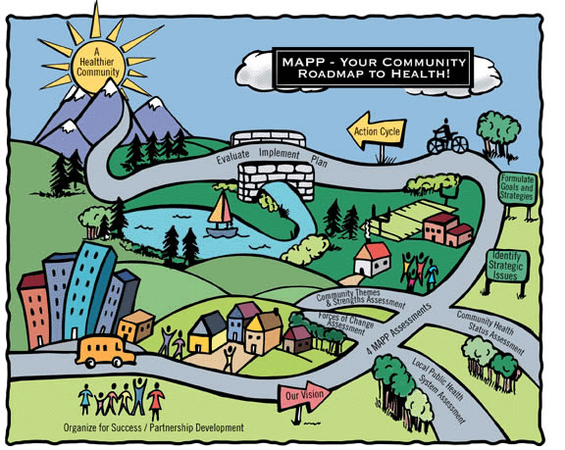
Health,
Happiness
Success!
Roadmap for Success – a lot to juggle!
SUPPORTS
Quality Life
Seniors
Adult +
Young Adult
Medical
High School
PT & OT
Fitness
Elem/Middle school
Birth/early childhood
Detour
Live – Play – Work – School - FAMILY
Notes:
I would like to do a group juggling exercise here…maybe with candy, maybe with beanbags…I can bring the stuff. Will make a neat point…

Slide 8
Students with Severe and Multiple Developmental Disabilities (SMDD)
Demonstrate diverse skills, strengths, limits, and support needs
Multiple system impairments that impact the student, family, community participation, and severity of associated health conditions
Two or more simultaneously occurring impairments
Supports are usually pervasive and extensive in order to achieve community living, employment, and self-sufficiency.
Notes:
Who are we talking about today?

Slide 9
Description - continued
Severity Continuum
Severity Supports
Communication issues - frequently
Self-care issues – almost always
Intellectual issues – often, but not always
“Multiple” systems - always
Mild Moderate Severe Profound

Slide 10
What is the Purpose of Special Education?
“To ensure that all children with disabilities have
available to them a free and appropriate public
education that emphasizes special education and
related services designed to meet their unique needs and prepare them for further education, employment, and independent living”
(Section 300.1, IDEA 2004).

Slide 11
Special Education is based on student strengths, preferences, interests and needs, and includes:
  Instruction
  Related services
  Community experiences
  Development of employment and post-school adult living objectives
  Acquisition of daily living skills and functional vocational evaluation
PT, OT, & SLP
Included here!!

Slide 12
Do WE Promote Lifelong Gains?
Therapies are intense from infancy through childhood
Legislative mandates are strong and promote transition focused education for students, but….
OT & PT services tend to decrease as students near graduation!
High school ends before students gain the skills they still need to address critical lifespan issues
    Shepherd & Inge, 1999; Inge, 1995;
    Stewart, Law, Rosenbaum, & Willms, 2001
Notes:
Shepherd, J. and Inge, K.J. in deFur, S.H. & Patton, J.R. (eds). (1999). Transition and school-based services: Interdisciplinary perspectives for enhancing the transition process. Austin, Texas: PRO-ED, Inc., pg. 117-166.
Stewart, D., Law, M.C., Rosenbaum, P., & Willms, D.G., (2001). A qualitative study of the transition to adulthood for youth with physical disabilities. Physical & Occupational Therapy in Pediatrics, 21, 3-21.

Slide 13
Postsecondary Goals
Each student of transition age on an IEP, must have a postsecondary goal/vision listed on the top of the transition services plan page of the IEP.
Transition services in Oklahoma must be addressed and in effect not later than the beginning of the student's ninth grade year or upon turning 16 years of age, whichever comes first.
This postsecondary goal must address: Education/training and employment. Independent living goals (as needed)…
  It must be observable.

Slide 14
Postsecondary Transition Planning – What does the data tell us?
Students with DD - not expected to attend college; < 10% achieve competitive employment.
Post high school expectations - stereotypical jobs at sub-minimum wages - sheltered employment
    U.S. Department of Education, 2004; Wills & Leucking, 2003; Cameto, et al., 2004; Inge & Moon, 2006)

Slide 15
National Longitudinal Transition Study
1990 - 2010
Positive trends for young adults with disabilities for postsecondary employment, education, and adult living outcomes
Not so for those with Severe Multiple Developmental Disabilities (SMDD)
15 years and not much difference
    Newman, Wagner, Cameto, Knokey, & Shaver, 2010

Slide 16
NLTS – Goals Identified while in School for Youth with SMDD
Compared to youth with singular impairments like LD, youth with SMDD identified fewer goals for competitive employment and more identified sheltered employment as the first option out of high school.
Fewer youth with SMDD identified postsecondary education goals to attend either a 2 or 4-year college
Fewer youth with SMDD expressed the desire or ability to live independently. Why?
(Newman, Wagner, Cameto, Knokey, & Shaver, 2010; Cameto, et al, 2004)

Slide 17
Achieved Postsecondary Outcomes for Youth with SMDD
Youth with SMDD – less involved in employment, postsecondary education, and independent living (Newman et al., 2009; Cameto et al., 2004).
Youth with cerebral palsy - less likely to be employed compared to those with spina bifida and TBI (Young et al., 2006)
1/10 youth with SMDD worked in integrated settings; 5/10 waiting for adult employment supports; most earned < $2.40/hour in sheltered employment (Wills & Leucking, 2003; U.S. Dept. of Education, 2004)

Slide 18
Achieved Postsecondary Outcomes for Youth with SMDD - continued
Youth with SMDD – live with parents, due to intensity of support needs.
Recent higher rates of postsecondary education enrollment - actual opportunity or reporting differences about training?

Slide 19
Community Engagement
35% of youth with multiple disabilities reported NO community engagement at all.
15.8% reported engagement in postsecondary education and employment
4% reported engagement in postsecondary education, employment, & job training
Youth with MR/ID combined with Multiple Disability were even less engaged.
    Newman, Wagner, Cameto & Knokey (2009)

Slide 20
Transition Planning Starts Early and Continues Over Time!
It’s never TOO EARLY to start planning!

Slide 21
Relevant Timelines:
Primary Level: Grades 1-4
Focus
    Employability, independent living skills and
    Self-determined attitudes.
Needs
  Develop positive work and Activities of Daily Living (ADL) habits
  Appreciate all types of work
  Develop an understanding of disability & support
OT/PT Interventions
  Relate to educational goal achievement
  Promote relevance of your interventions now and future
    Mobility, ADLs, strength, fitness, health/wellness, accommodations, AT interventions

Slide 22
So what is YOUR role?
Student –
Parent –
OT –
PT –
SLP –
Can you think of other examples?
Notes:
We all provide examples here – audience discussion too.

Slide 23
Middle School: Grades 5-8
Focus
  Career Exploration and transition planning relative to course of study; independent living (ADLs)
Needs
1. Understand relationship of school to work
2. Understand interests, preferences, aptitudes.
3. Understand work, education, independent living, and community options.
4. Determine a general course of secondary study.
5. Identify needed accommodations and supports for secondary education.

Slide 24
Middle School – Continued
6. Specify transition services needed to participate in desired course of study by no later than age 16.
OT/PT Interventions
  Relate to educational goal achievement
  Promote relevance of your interventions now and future
  Provide training on accommodations
  Mobility, ADLs, strength, fitness, health/wellness, AT interventions

Slide 25
The Middle School IEP
Student IEP participation
Tentative postsecondary dreams or statement like…
  “By the end of 8th grade, the student will have identified an area of interest and related this interest to a postsecondary goal and a course of study for high school”.

Slide 26
So what is YOUR role – Middle School?
Student –
Parent –
OT –
PT –
SLP –
Can you think of other examples?
Notes:
We all provide examples here – audience discussion too.

Slide 27
High School: Grades 9-10
Focus
  Career exploration and transition.
Needs
  Develop meaningful and realistic postsecondary goals.
  Develop work, education, residential, and community participation skills and supports relevant to goals.
  Learn to manage disability technology and request accommodations.
OT/PT Interventions
  Relate to educational goal achievement
  Promote relevance of your interventions now and future
  Provide training on accommodations
  Mobility, ADLs, strength, fitness, AT, health/wellness

Slide 28
High School: Grades 11 and up
Focus
  Transition and overlap into postsecondary environments desired by the student.
Needs
Test goals through experiences and activities.
Secure options for postsecondary education and/or employment.
Develop residential and community participation supports and contacts.
Develop linkages with adult services
Empower families to function in adult service environments.

Slide 29
High School – Grade 11 and up…into adult life
OT/PT Interventions
  Relate to educational/postsecondary goal achievement
  Promote relevance of your interventions now and future
  Provide training on accommodations, mobility, ADLs, strength, fitness, AT, health/wellness
  Assess alternate environments
  Summary of performance input

Slide 30
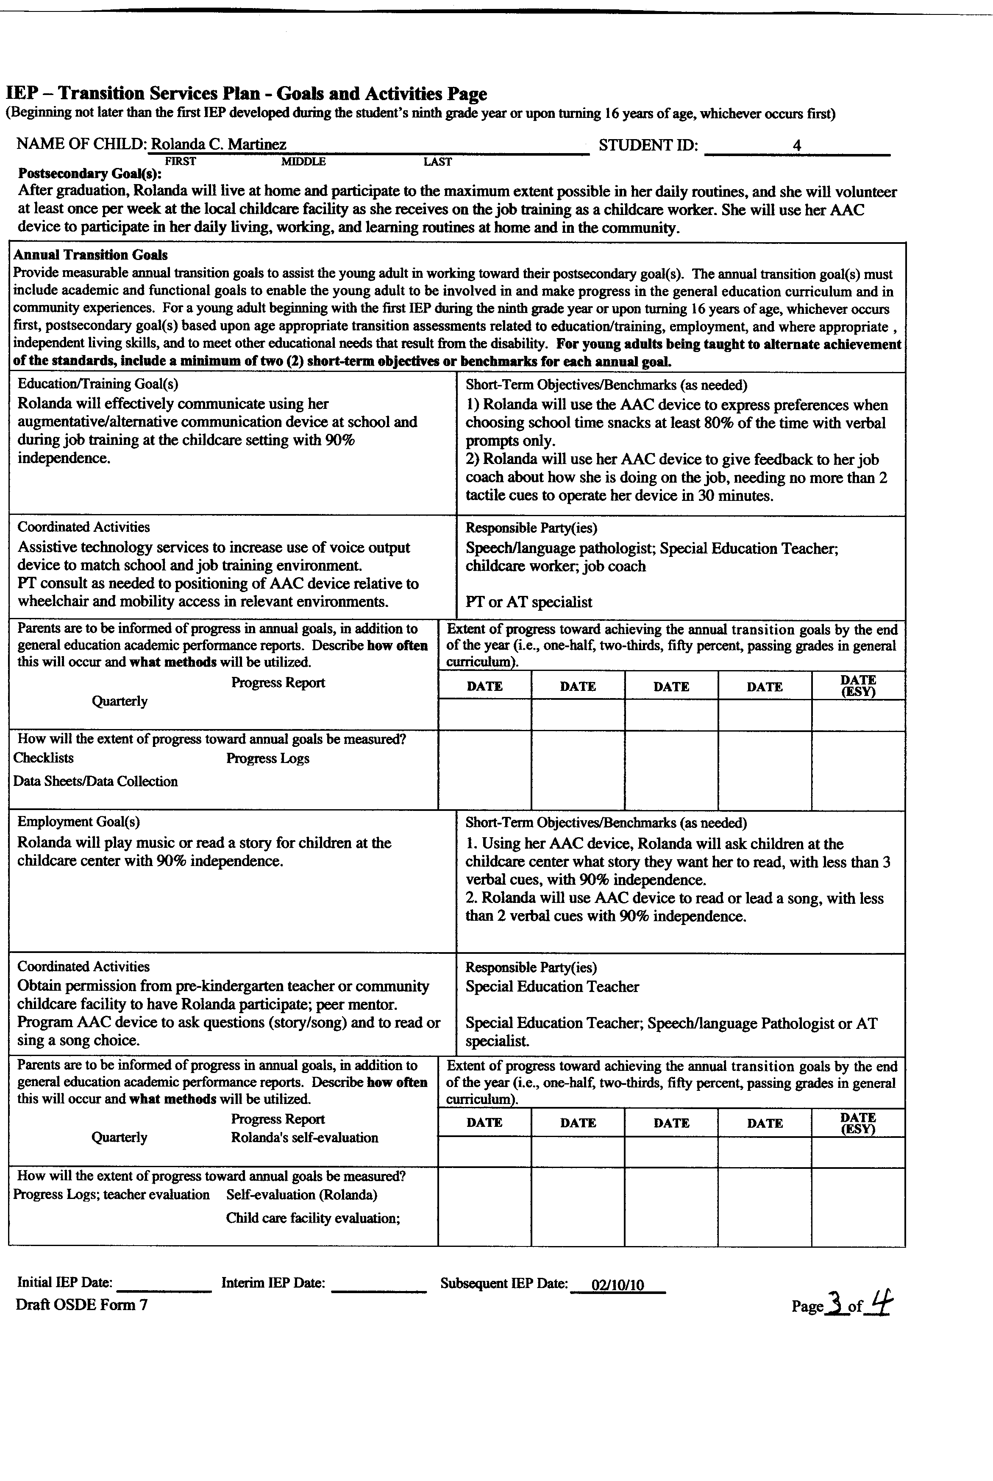
Sample Transition IEP

Slide 31
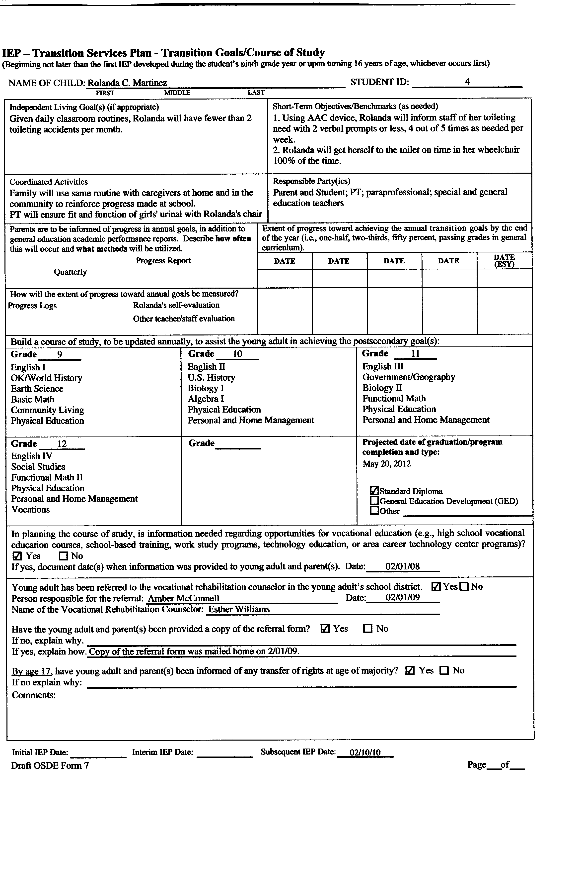
Sample Transition IEP

Slide 32
So what is YOUR role – High school and beyond?
Student –
Parent –
OT –
PT –
SLP –
Can you think of other examples?
Notes:
We all provide ideas and examples here…

Slide 33
Postsecondary Goals
This postsecondary goal must address: Education/training and employment. Independent living goals (as needed)…
  It must be observable.

Slide 34


Sample Postsecondary Goals
Education/Training: Jessie will audit childcare/early childhood classes at the local Career Tech Center with a full-time HTS.
Employment: With the help of a full-time HTS, Jessie will volunteer 3 afternoons a week at a childcare program.
Independent/Adult Living: Jessie will live in a group home and utilize public transportation to participate in her classes and job shadowing experiences.
Notes:
Screen shot – These should have been some of Jessie’s postsecondary goals…she states them now.

Slide 35
Annual Transition Goal
Matches postsecondary goal
Measureable and be accomplished in a year

Slide 36
After high school, Calvin will live and participate as he can at home, volunteer at his church weekly, and work with job coach in supported employment project.
Using customized computer applications (auditory reader and voice activation) Calvin will complete a resume and job application with 90% accuracy.
After graduation, Kelly will take one journalism class at the Career Tech and have 3 intern experiences with publishers
Kelly will describe 5 accommodations she needs in the general education setting and why she needs them with 100% accuracy.

Slide 37
Transition Planning Is Not One Time Thing – it’s
IEP development, led by student or at least driven by student’s interests and preferences
Family involvement and support
Student leadership
Interagency collaboration
Community Resources
Career Goal Setting
Self-Esteem Building
Self-Advocacy Strengthening
Independent Decision-Making
Personal Life Planning
Additional education/training

Slide 38


Transition
Assessment Model Components
Independent Living Assessment
Vocational Interest and Skills Assessment
Self-Determination Assessment
Most are informal and lack
valid & reliable studies.
They ARE good for
instructional planning!!
Notes:
I put some examples and names a number, but do not expect to have time to go through them…can urge audient to look through on their own.

Slide 39
Independent Living Assessments
Part 1 of the 3-Part Transition Assessment Model
This is the area that often impacts so many other postsecondary pursuits for students with severe and multiple disabilities.
We’ll show examples if there is time!

Slide 40
Our Belief
The law states that an independent living goal be addressed “when appropriate.”
We believe that to determine if an independent living goal needs to be written, an adaptive behavior assessment needs to be given. This provides evidence of needing an independent living goal or not. How else would a team determine if an independent living goal is needed?
Need to be functionally easy to use!
Notes:
Lauren, give a brief comment about the importance of addressing an INDEPENDENT LIVING GOAL for you while in high school. Did you?

Slide 41
Independent Living Assessments – Here are a Few
Personal Preference Indicators (PPI)
  Adult Living and Employment Versions
Supports Intensity Scale
Enderle-Severson Transition Rating Form
  Great tool for students with significant support needs
  www.estr.net
Life Skills Inventory
  Informal and free
  http://www.dshs.wa.gov/pdf/ms/forms/10_267.pdf
Casey Life Skills
  www.caseylifeskills.org

Slide 42
Career Assessments
Part 2 of the 3-Part Transition Assessment Process

Slide 43



Functional Vocational
Assessment
Over time
Repeated Measures Situational Assessment
Apply what you
already know – PPI
Employment Version

Slide 44
Belief
Work benefits individuals emotionally and socially
Enables individuals to contribute to society and to their own well being
Can be done without fear of losing social security or other benefits
Adds meaning to life
What is the best predictor of post-secondary work success?

Slide 45
Employment Options
Individual Competitive Employment
Individual Supported Employment
Group Supported Employment
At Home or Community-Based Entrepreneurial Jobs

Slide 46
Career Development Stages
Awareness
Exploration
Preparation
Assimilation
Advancement
Exiting

Slide 47
Choice Making
Logical choice making occurs when chosen preferences match available jobs.
Discrepancy problems occur when
  Chosen job, task, and characteristics do not match specific jobs
Discrepancy problems diminish when job site characteristics match preferences
Task is to provide ample opportunities for students to determine matches and non-matches.

Slide 48
Functional Vocational Assessments – Some Examples
Personal Preference Indicators (PPI)
  Adult Living and Employment Versions
Choose and Take Action Vocational Assessment Software
Community Situational Assessments
Choice Making
Pictures / Reading
Videos/Career Clusters
We’ll show examples if there is time!

Slide 49

Community based skills assessment
http://www.autismspeaks.org/family-services/community-based-skills-assessment
(link to assessment and instructions)

Slide 50
Self-Determination & Self-Advocacy Assessments
Part 3 of the 3-Part Transition Assessment Model
We’ll show examples if there is time!

Slide 51
Self-determination
Self-Advocacy is under the umbrella of Self-Determination.
  The right to decide for yourself—make your own decisions/Make choices
  Solve problems
  Take control
Self-awareness, assertiveness, creativity, and pride, and self-advocacy skills
You must be able to set goals, evaluate options, make choices and then work to achieve your goals.
Self-determination tools can be found at:
http://www.ou.edu/content/education/centers-and-partnerships/zarrow/self-determination-assessment-tools.html

Slide 52
Learning to be a Self-Advocate
Provide opportunities for youth to make choices, starting in the elementary grades.
Promote active involvement in educational planning (student-led IEP) and decision-making, especially Transition Planning.
Promote Career Awareness.
Choose a Vocational Goal (vocational evaluation).
What will it take to reach your goal?
Work towards achieving your goal.
Know what you want and then go get it.

Slide 53
Self-Determination Constructs
• Self-awareness
• Self-advocacy
• Self-efficacy
• Decision-making
• Use of self-management strategies to attain plan
• Self-evaluation
• Adjustment

Slide 54
Why SD Assessment?
Improved postsecondary outcomes
  Goal setting during early adolescence
  Awareness of disability
  Goal attainment
Improved academic performance
  Limited studies so far

Slide 55
Self –Determination Assessments – Here are a few
Guide to Assessing College Readiness
AIR Self-Determination Assessment
  Student, Parent, Teacher Versions
Self-Advocacy Checklists
  Student, Parent, Teacher Versions
ARC Self-Determination Assessment
  Student Version

Slide 56

The Oklahoma Department of Rehabilitation Services (DRS)
Thanks, Larry Hartzell
405-635-2759
lhartzell@okdrs.gov

Slide 57
What Does DRS Do?
DRS helps individuals with disabilities prepare for work, obtain work, and maintain work.
Starting with youth at age 16; there is no upper age limit.
Eligibility is based on:
  having a documented disability;
  disability creates barriers to employment; and
  rehabilitation services would be necessary for and benefit the client in obtaining employment.
  A critical piece in that is the ability and the desire to work independently in a competitive job in the community.

Slide 58
Application Process
Referral is made (but not necessary—could simply apply)
Application is submitted
Disability documentation is submitted
Counselor determines eligibility within 60 days.
Priority Group Placement (PG 1, 2, and 3)
Individualized Plan for Employment (IPE) is developed within 90 days.
Service implementation begins
Notes:
Many people apply one week and begin calling the VR office the next week asking if they are eligible. According to their policy, VR has 90 days to determine eligibility. If they wait 61 days, call me (Client Assistance Program), and I will get involved.

Slide 59
High School Students who are 16 or Older
Eligible students to apply are those who:
  Are receiving special education services and on an individualized education program (IEP) through their school,
  Are on a Section 504 plan, OR
  Any student that can document a disability according to eligibility purposes (e.g., arthritis, asthma, sickle cell, orthopedic impairments, mental health conditions, Diabetes).

Slide 60
What else is considered?
We have 3 priority groups (PG) for services.
  PG 1: those with the most significant disabilities (a mental or physical disability resulting in serious limitations in 3 or more functional capacities and requiring multiple services over an extended period of time); followed by
  PG 2 and PG 3 which both have fewer functional limitations.
If under order of selection, PGs may be closed and applicants that are eligible would be put into delayed status for a period of time.

Slide 61
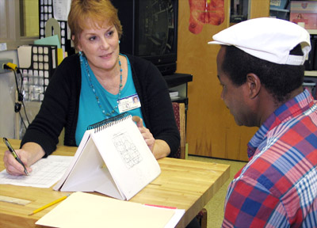
Services Provided
Referral, Application, Eligibility
Assists persons with disabilities in developing appropriate career goals.
Vocational Counseling,
Guidance, and
Assessment/Evaluation
Helps determine employment-related strengths and
interests.
Develop an
IPE
Photo of evaluation

Slide 62
What is an IPE?
The individualized plan for employment (IPE) is a plan for employment that takes into consideration the person’s needs, strengths, and interests, and assists in obtaining employment skills and experiences to reach employment.

Slide 63
Call 1-800-487-4042 to find the counselor nearest you, or visit the web site at http://www.okrehab.org/directory/Schools.asp.
Just enter the name of your high school (e.g., Norman North) or zip code, and the office that serves you will be displayed.
To access VR services in Oklahoma
Notes:
Follow the automated prompts giving the student’s address including zip code. The caller will be routed to the nearest VR counselor with the name, address and phone number of that counselor. Request an application for VR services be sent to the student’s home. Complete that application and return it to the counselor. Do this well in advance of the school Individual Education Plan (IEP). You want to plan for the VR counselor to be at that IEP meeting if at all possible. They need to be a part of the IEP Team.

Slide 64
Online Application
Applications are available at the DRS home page: http://okrehab.org/ .
At the bottom of the home page, click on Apply for services.
We recommend that referral to DRS occur at age 15 ½.
If determined eligible, services begin at age 16.

Slide 65
What About Persons with More Significant Disabilities?
Can my student/family member achieve integrated, competitive, employment in the community?
We don’t assume they can or cannot.
We find out by providing them the opportunity to demonstrate if they can work in an integrated, competitive setting in the community.
Refer to DRS at age 15 ½ to start the process of answering this question.

Slide 66
Oklahoma
Developmental Disabilities Services
Administered by OKDHS – Developmental Disabilities Services Division
First Home and Community-Based Waiver for people with mental retardation was approved in 1988.
Currently 4 waivers under direction of DDSD
  Homeward Bound Waiver
  Community Waiver (full waiver)
  In-home Support Waiver – Adult
  In-home Support Waiver - Children

Slide 67
DD Services in Oklahoma
Waiting list
Includes a comprehensive array of services
  Residential
  Vocational/employment and
  Habilitation services and supports
Services and supports outlined in a plan of care
  Individualized plan
  Annually developed
  Person-centered approach

Slide 68
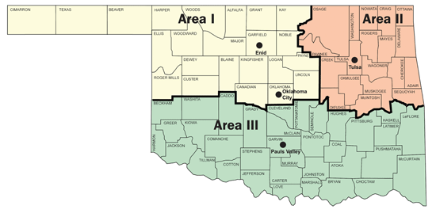
DD Services in Oklahoma

Slide 69
Oklahoma developmental Disabilities History – Transition of another sort…
On November 1, 2012, the Human Services Commission passed a resolution directing the Oklahoma Department of Human Services (OKDHS) to close the remaining two state run facilities:
  Southern Oklahoma Resource Center (SORC) in Pauls Valley by April 30, 2014
  Northern Oklahoma Resource Center of Enid (NORCE) by August 31, 2015.

Slide 70
DDS Individualized Plans
Person-centered approach
  Ensures quality of life
    Provides for:
      personal control
      safety
      self-efficacy
      health
    While honoring
      Personal tastes
      Treasured possessions
      Meaningful experiences
      Valued activities

Slide 71
Person-Centered Planning Involves
Respecting each person with a disability while understanding their unique and valued characteristics (Individualization)
Consider the rights and privileges of the person over those of service providers (remember who is in charge)
Developing services and supports that address needs and wants of the person with a disability
Limiting costs to those that are based on the person’s needs.

Slide 72
Individualized Plans
Person-centered approach
  Who is in charge?
    Level of involvement will vary depending on age, ability, and preferences
  Focus on the person
  Natural supports first
  Prioritize
    Immediate needs versus future goals and plans
    Coordination of intervention and services

Slide 73
Goals of Person-Centered Planning
Consumer should not only be present in community but should also have the opportunity to participate in the community.
Gaining and maintaining satisfying relationships
Expressing preferences and making choices in everyday life
Having opportunities to fulfill respected roles and to live with dignity
Opportunities to develop skills
ANY OF THE ASSESSEMENTS HEREIN CAN BE USED WITH THESE ADULT TOO?

Slide 74
Oklahoma Department of Human Services (DHS)
Developmental Disability Services (DDS)
Community Integrated Employment (CIE) is a service program that provides placement, job training and short-term or long-term supports to assist service recipients in achieving and maintaining employment within the community. Services are delivered in integrated settings in the community by contracted providers. Could be for work or volunteering.

Slide 75
Supported Employment
Supported Employment (i.e., job coaching or supports) means competitive employment in an integrated setting, or employment in integrated settings in which individuals are working toward competitive employment consistent with strengths, resources, priorities, concerns, abilities, capabilities, interests, and informed choice with ongoing support services for individuals with the most significant disabilities. Must be PG 1.

Slide 76
Oklahoma Department of Human Services (DHS)
Developmental Disability Services (DDS)
For more information, go to:
http://www.okdhs.org/programsandservices/dd
(405) 521-6267
To apply for services, go to: http://www.okdhs.org/programsandservices/dd/docs/areacontactinfo.htm
Click on Applications

Slide 77
Employment First
Employment First is a concept to facilitate the full inclusion of people with the most significant disabilities in the workplace and community. Under the Employment First approach, community-based, competitive, integrated employment is the first option for employment services for youth and adults with significant disabilities.
Start with Employment First as the Goal, and then begin planning activities and experiences that will help your young adult or adult reach that goal! It’s never too early to start planning!!

Slide 78
Moving Toward Employment First
Become Informed and Involved:
YOU are Attending the Oklahoma Transition Institute (OTI)-October 27, 28 & 29 at Embassy Suites in Norman, sponsored by the Oklahoma Transition Council (OTC). (https://www.ou.edu/content/education/centers-and-partnerships/zarrow/oklahoma-transition-council.html)
Attend the Oklahoma Statewide Autism Conference-November 14 & 15 at Embassy Suites in Norman. (http://www.okautism.org/default.asp)

Slide 79
Moving Toward Employment First
Attend an On the Road Family Perspective Conference
A one day conference that assists families in navigating a complex system, sponsored by Sooner Success (http://soonersuccess.ouhsc.edu/ParentContactSystem.asp)

Slide 80
Free Resources
Transition Planning Resources-Transition: School to Work brochure, Transition: School to Work checklist, Transition Planning Folder http://www.okdrs.org/drupal/students/transition
Timeline of Transition Activities http://www.ou.edu/content/education/centers-and-partnerships/zarrow/timeline-of-transition-activities.html
Career Planning Folder http://www.okcareertech.org/educators/career-and-academic-connections/career-information-resources/CACCareerDevfolder3_15_13.pdf
OK Money Matters http://www.oklahomamoneymatters.org/Resources/Modules/TTI/Intro.shtml

Slide 81
Free Resources
Transition Care Notebook http://oklahomafamilynetwork.org/okfn/training
Tools to Help Career Planning
  http://www.careeronestop.org
  http://www.onetcenter.org/tools.html
OK Transition Education Handbook http://ok.gov/sde/sites/ok.gov.sde/files/documents/files/Handbook.pdf
Transition Services, IEP Requirements, Student Participation http://oklahomaparentscenter.org/youth/transition-school-to-work/
Student-Directed Transition Planning and Self-Directed IEP http://www.ou.edu/content/education/centers-and-partnerships/zarrow/trasition-education-materials.html
Community Based Skills Assessment http://www.autismspeaks.org/family-services/community-based-skills-assessment

