Slide 1

Functional
Transition Skills Bell-Ringers
Handouts & Activities
BY: Josh Fearing
Adapted from the ME! Fundamental Bell Ringers
UNIVERSITY OF OKLAHOMA

Slide 2
I am good at
List or draw all the things you are good at!
1

Slide 3
LIST 3 THINGS YOU LIKE DOING AT SCHOOL
_____________________________________________________________________________________
Because _________________________________________________________________________________
2. _____________________________________________________________________________________
Because ________________________________________________________
2a

Slide 4
LIST 3 THINGS YOU LIKE DOING AT SCHOOL
3._____________________________________________________________
Because________________________________________________________
2b

Slide 5
I DO NOT LIKE
1.___________________________________________________________________________________________
Because___________________________________________________________________________________
2.________________________________________________________________________________________
Because___________________________________________________________________________________
3.________________________________________________________________________________________
Because___________________________________________________________________________________
3

Slide 6
What People Like About Me
1._____________________________________________________________________________
2._____________________________________________________________________________
3.______________________________________________________________________________
4

Slide 7
What People Like About Me
1._____________________________________________
2._____________________________________________
3._____________________________________________
Draw a picture of yourself!
4

Slide 8
WHAT CAN YOU GET BETTER AT?
I would like to improve _________________________________________________
___________________________________________________________________
____________________________________________________________________
5

Slide 9
WHAT SHOULD YOU STOP DOING?
I need to stop _________________________________________________
___________________________________________________________________
____________________________________________________________________
6

Slide 10
Name: _______________
At school, I like and admire _______________.
I admire ______________ because he/she is:
______________________________________
______________________________________
______________________________________
_______________________________________
_______________________________________
7

Slide 11
Name: _______________
Not at school, I like and admire_______________.
I admire ______________ because he/she is:
______________________________________
______________________________________
______________________________________
_______________________________________
8

Slide 12
Name: _______________
My favorite character is _________________.
I admire ______________ because he/she is:
______________________________________
_______________________________________
______________________________________
_______________________________________
9

Slide 13
What People Like About Me
1._____________________________________________________________________________
2._____________________________________________________________________________
3.______________________________________________________________________________
10

Slide 14
Write one thing you wish you could do better at school:
What are 2 things you can do right now to get better at your goal?
____________________________________________________________________
____________________________________________________________________
11

Slide 15
What is your favorite class?
My favorite class is __________________________________, because:
_______________________________________________________________
________________________________________________________________
12

Slide 16
What is your least favorite class?
My least favorite class is __________________________________, because:
_______________________________________________________________
________________________________________________________________
13

Slide 17
Being Patient
What does it mean to be patient?
Patient means waiting without being upset.
Are you patient? (circle one)
Yes No
14a

Slide 18
Being Patient
What are three things you can do to calmly wait your turn?
_____________________________________________________________________
_____________________________________________________________________
_____________________________________________________________________
14b

Slide 19
Being Quiet
Are you a quiet person?
Do you talk too much? Do you talk too loud?
How do you know?
Are you a quiet person? (circle one)
Yes No
15a

Slide 20
Being Quiet
What are three things you can do to calmly wait your turn?
__________________________________________________________________
2.__________________________________________________________________
3.__________________________________________________________________
15b

Slide 21
Asking for Help
When I need help, I know I can ask my parents, friends, or teachers for help.
I know to ask for help when I need to do something I can’t do it my myself.
I should also ask for help when:
_________________________________________
_________________________________________
_________________________________________
_________________________________________
_________________________________________
Name: ___________________
16

Slide 22
I Need Help
16a

Slide 23
I can use this sign when I need help. My teachers and friends will know to help me.
I will use this sign when I need help with:
1. ___________________________________________________________
2. ___________________________________________________________
3.___________________________________________________________
I know I can ask for help with these 3 things.
I can ask for help with other things too!
16b

Slide 24
Finishing your work
Name:________________
Are you good at finishing your work? _________________
Being efficient means to do something quick, easy, and correct.
What can you do to be more efficient?
To work more efficiently and finish my work, I can let others help me. Other things I can do to finish my work:
____________________________________________________________________
____________________________________________________________________
17

Slide 25
Free Time
Name:________________
Free time is when you are done with everything you have to do, and can do something you want to do.
What do you like to do with your free time? Draw pictures below to show your favorite things!
18

Slide 26
What is a disability?
Name:________________
19
A disability is a physical or mental condition that limits a person's movements, senses, or activities.
It is something someone has that makes certain things harder to do. Sometimes, a disability in one things makes you better at something else.
Do you have a disability?
Yes, I have a disability No, I do not have a disability
One disability is Dyslexia. Dyslexia makes it harder for a person to read.
Can you name any disabilities?
________________________________________________________________________________________________________
________________________________________________________________________________________________________

Slide 27
Happiness
Being Happy means:
_______________________________________________________________________________________________________________
What makes you happy? You can write or draw a picture, or even find a picture in a magazine.
Could a person with a disability do that too?
Yes! No, I don’t think so
20

Slide 28
Disability at School
People with disabilities go to school like everyone else, and there are a lot more kids at your school with a disability than you might think.
What is your disability? ______________________________________________________________
How does your disability make school harder?
________________________________________________________________________________
21

Slide 29
Disability at Home
People with disabilities go to school like everyone else, and there are a lot more kids at your school with a disability than you might think.
What is your disability? ______________________________________________________________
How does your disability make life at home harder?
________________________________________________________________________________
22

Slide 31
Living with Disability
Disability is when you have something that makes certain things hard to do
What is one way that people can help you at school?
___________________________________________________________________________________
What is one thing you can do to make school easier for yourself?
___________________________________________________________________________________
23

Slide 32
Living with Disability
Disability is when you have something that makes certain things hard to do
What is one way that your family can help you at home?
___________________________________________________________________________________
What is one thing you can do to make being at home easier for yourself?
___________________________________________________________________________________
24

Slide 33
IEP
What does IEP mean? (circle one)
Intelligent Elephant Program Interesting Electrical Problem Individualized Education Problem
Ice Energy Proton Individualized Education Program
Do you know anyone who uses an IEP?
__________________________________________________________________________________
Have you heard of an IEP before?
_________________________________________________________________________________
25

Slide 34
IEP
25
IEP means Individualized Education Program.
Individual means: for one person
Education means: all about school and learning
Program means: all the stuff an individual is going to do
It is a like a book that is all about a person and tells what they can do, what they can’t do yet, and what they will be able to do in the future.
Everyone in this class has an IEP all about them.
This means that your teachers and your family, and one day you too, will meet to talk about what you can do, what you can’t do yet, and what you will learn and be able to do in the future.

Slide 35
Others Talking About YOUR IEP
Have you heard other people talking about your IEP? YES NO
People talk about you to make a program to help you learn.
How do you feel when other people talk about you?
Draw a picture of how you feel.
26

Slide 36
Who’s who of your IEP?
Every person with an IEP has a teacher who is in charge of the IEP. Do you know who is in charge of YOUR IEP?
The person in charge of my IEP is ____________________.
My IEP is all about _________________.
Besides that person, many other people help make my IEP. Those people are my teachers, my therapists, my Principal or Counselor, and me.
27a

Slide 37
Who’s Who of your IEP?
The people who get together to make up YOUR IEP are called the “IEP Team.”
Do you know who is on your team? Write their names below or write “I don’t have one”
My Principal: _______________________
My Special Education Teacher: __________________________
My Speech Teacher: ____________________________
My Physical Therapist:__________________________
My Occupational Therapist: __________________________
27b

Slide 38
Who’s Who of your IEP?
The people who get together to make up YOUR IEP are called the “IEP Team.”
Do you know who is on your team? Write their names below or write “I don’t have one”
My General Education Teacher: _______________________
Me!!!__________________________________
My Mom
My Dad
Other Special People in my life: ____________________________
__________________________________________________________
27c

Slide 39
Student Statement
YOUR IEP has a statement all about you!
Let’s write your statement!
First, plan your statement by answering a few questions. Then write a statement, or sentence, about you!
Your statement will include your name, age, grade, and at least three things you like to do.
What is your name? ________________________
How old are you? _________________________ 4. Where do you go to school?
What grade are you in? ______________________ _________________________
28a

Slide 40
Student Statement
YOUR IEP has a statement all about you!
Let’s write your statement!
Choose (at least) three things you like to do.
I like _______________________________________________________________
I like _______________________________________________________________
I like _______________________________________________________________
28b

Slide 41
Student Statement
YOUR IEP has a statement all about you!
Let’s write your statement!
Your statement will be:
Your name is a 1. how old are you boy or girl in the 2.what grade are you in at 3.where do you go to school. 1. Your name likes to __________________, ___________________, and _________________.
Example:
Timmy is a 12 year old boy in the 6th grade at Whittier Middle School. Timmy likes making good choices, Youtube videos, and hanging out with his friends.
28c

Slide 42
Student Statement
YOUR IEP has a statement all about you!
Let’s write your statement!
28d
Your statement:
__________________________________________________________________________________
__________________________________________________________________________________
__________________________________________________________________________________

Slide 43
My Strengths
29
In school I am good at:
Circle what you care good at!
Talking to others Listening to others Helping others
Math Making friends Doing my chores
Reading Art Being kind to others
Spelling Music Working by myself
Social Studies Walking Science

Slide 44
My Areas to Improve
29
In school I am not that good at:
Circle what you can get better at!
Talking to others Listening to others Helping others
Math Making friends Doing my chores
Reading Art Being kind to others
Spelling Music Working by myself
Social Studies Walking Science

Slide 45
IEP Goals
A goal is something you want to do.
YOUR IEP has goals for the different things you are going to learn in one year.
Do you have any goals for the next year? What do you want to do?
Let’s brainstorm some goals!
30a

Slide 46
IEP Goals
Next year, in Math I want to learn: (circle at least one, or write your own)
To add and subtract without a calculator
To do all my work
To learn all my times tables
To count money better
To do algebra (whatever that is)
To do all my work by myself
To be a better student
30b

Slide 47
IEP Goals
30c
Next year, in Math I want to learn: (circle at least one, or write your own)
_______________________________________________________________________________
_______________________________________________________________________________
_______________________________________________________________________________

Slide 48
IEP Goals
Next year, in Reading I want to learn: (circle at least one, or write your own)
To read by myself for 5 minutes
To read by myself for 10 minutes
To read by myself for 15 minutes
To learn 100 new words
To do all my work by myself
To be a better student and a better reader
To be able to read a book to my family
31a

Slide 49
IEP Goals
31b
Next year, in Reading I want to learn: (circle at least one, or write your own)
_______________________________________________________________________________
_______________________________________________________________________________
_______________________________________________________________________________

Slide 50
IEP Goals
Next year, in Writing or Typing I want to learn: (circle at least one, or write your own)
How to type a sentence by myself
How to write a letter by myself
How to open a Word document and type by myself
How to type with both hands
To be able to write words that everyone can read
To spell all my words correctly
To do all my work by myself
32a

Slide 51
IEP Goals
32b
Next year, in Writing or Typing I want to learn: (circle at least one, or write your own)
_______________________________________________________________________________
_______________________________________________________________________________
_______________________________________________________________________________

Slide 52
IEP Goals
Next year, in Science I want to learn: (circle at least one, or write your own)
To be able to name different kinds of weather
To safely complete some awesome Science Experiments
To learn about recycling
To learn about robots and computers and crazy stuff!
To learn about bugs and gross stuff
To be able to make things!
To do all my work by myself
33a

Slide 53
IEP Goals
33b
Next year, in Science I want to learn: (circle at least one, or write your own)
_______________________________________________________________________________
_______________________________________________________________________________
_______________________________________________________________________________

Slide 54
IEP Goals
Next year, in Social Studies I want to learn: (circle at least one, or write your own)
To be able to name 50 different countries
To name all 50 States
To know about other cultures
To name all the different US Presidents
To know about landforms
To be able to sit and watch a whole History documentary
To do all my work by myself
34a

Slide 55
IEP Goals
34b
Next year, in Social Studies I want to learn: (circle at least one, or write your own)
_______________________________________________________________________________
_______________________________________________________________________________
_______________________________________________________________________________

Slide 56
IEP Goals
Next year, I want to improve my behavior by: (circle at least one, or write your own)
I will always say “please” and “thank you”
I will talk in a quiet voice when I'm inside
I will not run in the hall
I will listen to and respect adults
I will do my best to be a Whittier R.O.C.K.S. Warrior!
I will follow directions
I will be kind to others and keep my hands to myself
35a

Slide 57
IEP Goals
35b
Next year, I want to improve my behavior by: (circle at least one, or write your own)
_______________________________________________________________________________
_______________________________________________________________________________
_______________________________________________________________________________

Slide 58
Who’s Your Team mate?
36
One day, you will go to YOUR IEP meeting. A whole bunch of people wearing nice pants are going to talk about you. Your mom and dad will be there, and your teacher.
If you could pick someone to be there, who would you choose?
I want ______________________________________ to be on my team, because: _________________________________________
_______________________________________________________________________________________________________________________

Slide 59
What is an Accommodation
An accommodation is when a person has a hard time doing something, so they need help.
Sometimes an accommodation can mean changing the job or work.
Sometimes an accommodation can mean using a different tool.
Sometimes accommodation can mean changing the place you’re in, like turning volume down in a loud room.
37a

Slide 60
Think about a person who uses a wheelchair to move. We’ll call this person Tyler.
Tyler wants to go to a baseball game. What accommodations will Tyler need?
(circle the accommodations Tyler will need)
Tyler will need a private game
Tyler needs a ramp
Tyler needs an elevator to get to the top of the stadium
Tyler needs someone to talk about the game
Tyler needs a private meeting with the team
Tyler needs free hot dogs
Tyler needs an ipad to watch the game
Tyler needs a lower sink to wash hands
Tyler needs glasses
Tyler needs a free hat
37b

Slide 61
Date: ____________________________ Name:_____ __________________________
Can I accommodate ya’ mate?
Math
To accommodate someone means to make a change, give a tool, or just help out, so that person can do something.
To accommodate someone does not mean you do the work for them or give them extra help. To accommodate gives a person the chance to do the same things everyone else is doing.
How can I accommodate you so you can do your best at math? DO NOT circle the answer that is (339 - 139) / 20!
1. I need larger fonts to help me see
3. I need to use a calculator.
5. I like shorter assignments.
7. I work best in a quiet space
9. I need to do my work a few questions at a time
2. I need a big pencil to help write
4. I need a small pencil to help write
6. I like to type my work
8. I need a person to help me
10. Math is dumb and I don’t need math
38a

Slide 62
Date: ____________________________ Name:_____ __________________________
Can you accommodate, mate?
Reading
To accommodate someone means to make a change, give a tool, or just help out, so that person can do something.
To accommodate someone does not mean you do the work for them or give them extra help. To accommodate gives a person the chance to do the same things everyone else is doing.
How can I accommodate you so you can do your best at reading?
1. I need larger fonts to help me see
3. I like to read on a computer or tablet
5. I like shorter assignments.
7. I work best in a quiet space
9. I need to do my work a few questions at a time
2. I like to read white words on black paper
4. I like pictures
6. I like to type my work
8. I need a person to help me
10. I dunt ned no dumm reedign
38b

Slide 63
Date: ____________________________ Name:_____ __________________________
Can you accommodate, mate?
Reading
To accommodate someone means to make a change, give a tool, or just help out, so that person can do something.
To accommodate someone does not mean you do the work for them or give them extra help. To accommodate gives a person the chance to do the same things everyone else is doing.
How can I accommodate you so you can do your best at reading?
1. I need someone to write for me
3. I like to write inside pre-drawn boxes
5. I like to write over-top highlighter
7. I work best in a quiet space
9. Don’t count off for spelling
2. I need a different kind of pencil
4. I prefer to type on a computer
6. I prefer to type on an Ipad
8. I need a person to help me
10. I da besstest at wrting. Dnt neeed help none?
38c

Slide 64
Lean on me! Who, me?
School can be hard. Sometimes adults tell you it’s easy to be a kid, but that’s not true. You are growing, changing, and learning and it is really hard sometimes.
It’s okay to need help. Who can you ask for help when you need help or have questions?
Name at least two people not school you can ask for help, two adults at school, and two kids at school you can ask for help.

Slide 65
Lean on me! Who, me?
At school I can talk to two kids:
___________________________, ___________________________
At home I can talk to:
___________________________, __________________________
At school I can talk to two kids:
___________________________, ___________________________

Slide 66
When I need help...
40
I don’t always like asking for help because I like to do things by myself, but when I forget something about my work, I know I need to ask for help.
Circle the options you might use to ask for help
HEY, HELP ME NOW!!!
Pwetty pwease, I need heeeeelp.
Excuse me, I need help please.
I need help.
I need a ______ please.
Write what you will say to ask for help:
__________________________________________________________________________________________________________________________________
__________________________________________________________________________________________________________________________________

Slide 67
Help! I need somebody...
41
When I don’t like my class schedule and I want a change, I can:
Scream, shout, and cry until my problem is magically fixed. Tell my friends.
Punch a wall, break my hand, and go to the doctor. That will fix my schedule!
Tell a teacher ro counselor and ask for help. Tell my parents and ask for help.
My favorite class right now is: ____________________________________________________________________________________________
My least favorite class right now is: _______________________________________________________________________________________

Slide 68
Talking to friends
43
Sometimes talking to other people is hard. It’s easy to get mad sometimes.
When you get mad, you know it’s not okay to yell, hit, or scream.
You know it’s better to talk. You could say “ I am upset, I need a break.”
___________________________________________________________________________________________________________________________________
What could you say when you are mad at a friend?
What could you say when you’re mad at a teacher?
Fill out the back of this page, then practice talking to 2 friends and 1 teacher.

Slide 69
When I am mad at friends I will say:
_________________________________________________________________
_________________________________________________________________
When I am mad at teachers I will say:
_________________________________________________________________
_________________________________________________________________
Friend
Check off the boxes after you talk to 2 friends and 1 teacher
Friend
Teacher

Slide 70
My Future!
Next year I will be in the ______________ grade.
What classes do you want?
What do you want to do for fun next year?
Fill out the schedule on the back page to help plan your year!
43

Slide 71
Work, work, work
44
Working is when you do something and get paid for it. A Job is work you do everyday to earn money.
If you could have any job in the world, what would it be?
_________________________________________________________________
What can you do at school to get ready for this job?
_________________________________________________________________

Slide 72
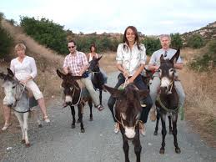
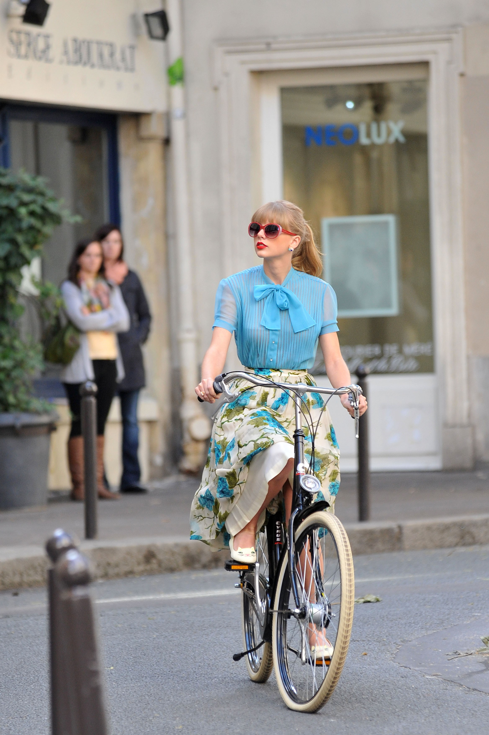
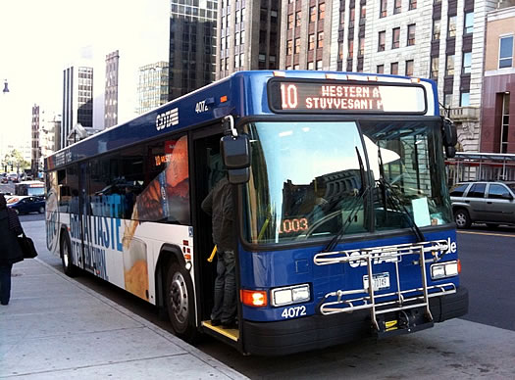
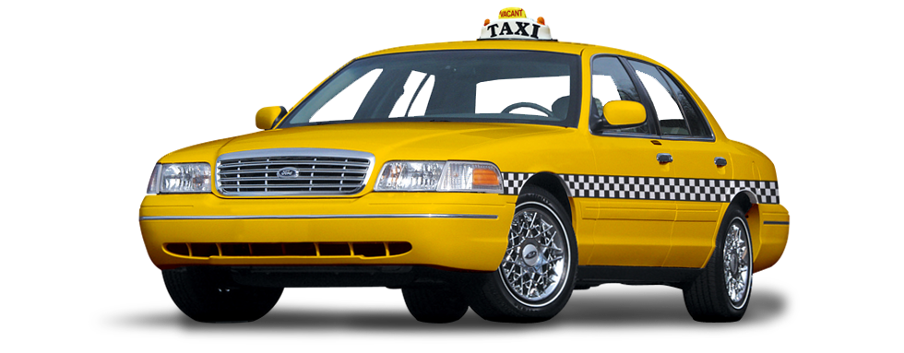
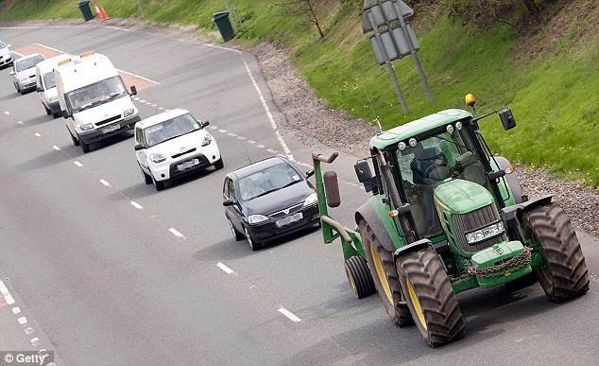
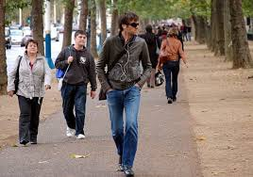
Planes, Trains, and Automobiles
There are lots of different ways to get places!
When you’re older, you might drive a car or ride a bike. Do you plan to drive a car or ride a bike?
Yes, Bike
Yes, drive
No
How will you get places?
Circle the different ways you will get places. Put an “X” through the ways you will not use.
Tractor
Walk
Taxi
Donkey
Bus
Bike

Slide 73
Graduation
48
After middle school, you will go to high school! After high school, you will graduate.
What does it mean to graduate?
Graduate means: _______________________________________________
How do you think you will feel and why?
Happy Sad Nervous Excited

Slide 74
Graduation
48
When I graduate I will feel __________________________ because
_________________________________________________________________.

Slide 75
After Graduation
49
After you graduate you will get a job!
List your top three most wanted jobs!
1._____________________________________________________________________________________
2._____________________________________________________________________________________
3._____________________________________________________________________________________
What is a class at school you can take to help get ready for this job?
_______________________________________________________________________________________

Slide 76
Dirty Jobs...
50
After you graduate you will get a job!
List three jobs you know you DON’T want.
1._____________________________________________________________________________________
2._____________________________________________________________________________________
3._____________________________________________________________________________________
On the back of this page, write at least one word for each job to explain why you don’t want it.

Slide 77
50
Write at least one word or sentence that tells why you DON’T want your least favorite job choices.
examples: 1. The job is boring.
2. not fun
3. lame
Job 1. ___________________________________________________________________________________________________________
Job 2. ___________________________________________________________________________________________________________
Job 3. ___________________________________________________________________________________________________________

Slide 78
After High School...
51
When I’m done with high school, I plan to…
(circle all that apply)
Work
Learn More
Full Time
Online
At College
At Work
Part Time
In Person
At Career School
At Home
Online

Slide 79
Here I go, again...
52
After High School, where will you live? Will you live by yourself? With Joey and Chandler? With your parents?
When I am finished with high school, I will live… (circle at least one)
By myself
With roommates
With my boyfriend or girlfriend husband or wife
My parents
On the streets

Slide 80
Adults Just Want to Have Fun
What will you do for fun, when you are an adult? (Check at least one. You can write your own ideas on the back page.)
53
Computer all day!
Video Games
Chores
Hiking
Work on my novel at Starbucks
Sports
Play music
Draw, paint, or other art
Listen to music
Watch cat videos
Hang out with friends
Hang out with family
Hang out with my significant other

Slide 81
Adults Just Want to Have Fun
53
--------------------------------------------------------------------------------------------------------------------------------------
--------------------------------------------------------------------------------------------------------------------------------------
--------------------------------------------------------------------------------------------------------------------------------------
--------------------------------------------------------------------------------------------------------------------------------------

