Slide 1
Unit 4:
Understanding my Rights and Responsibilities

Slide 2
Bell Ringer Activity 1
Read the following story:
You have just started your first semester at the University of Oklahoma and are very excited about all of the fun things that go along with being a college student. Three weeks into the first semester, you fail your History exam and do poorly on your Algebra test. You are concerned about your GPA and you know you need some accommodations on your exams. You are confused because there are no special education teachers at college and none of your professors are asking you if you need help.
What are some problems you are facing in this story?
What are some solutions that can be done to improve your situation?
Why are the professors not helping you?

Slide 3
Bell Ringer Activity 2
What does the word IDEA mean?
There is a law called the Individuals with Disabilities Education Act. What do you think it does?
Do you think this is important to you?

Slide 4
Bell Ringer Activity 3
Define the following terms in your own words:
Rights
Responsibilities
What are some behaviors specific to “Responsible” people?
What are some behaviors that are not responsible?

Slide 5
Bell Ringer Activity 4
What are some reasons that it is important to take responsibility for yourself?
What are some responsibilities that you have right now?
What are some consequences of not following through with your responsibilities?

Slide 6
Bell Ringer Activity 5
Write down the definitions of the following Special Education Laws:
The IDEA is the law that outlines the rights of students in special education. It describes how schools must provide special education to students during elementary, middle, and high school.
Child Find is the part of IDEA that states that school districts are responsible for identifying students with disabilities. If the school believes that a student has a disability, they test the student. If the student is found to have a disability, the school must provide special education
The acronym FAPE stands for Free Appropriate Public Education. It means that schools must provide students with disabilities an education. Sometimes special education services can be very expensive, but because of FAPE, schools cannot make families pay for special education.

Slide 7
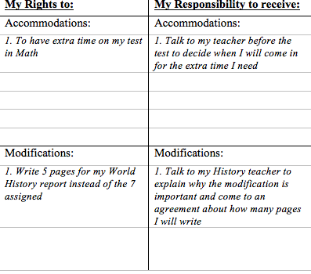
Bell Ringer Activity 6
Fill out the following chart (See example)

Slide 8
Bell Ringer Activity 7
Define the following terms *GO back in your notebook*
FAPE
Child Find
Accommodations
Modifications
Discrimination
Why are these important to you?

Slide 9
Bell Ringer Activity 8
Write down the following two Anti-Discrimination laws
Section 504 is an anti-discrimination law. That means that schools cannot discriminate against students for having a disability. Schools must provide students with disabilities access to education. (For example: wheelchair ramps, Braille, handicap accessible bathrooms.)
ADA is a civil rights law that protects people with disabilities by requiring places to be accessible to people with disabilities. ADA is different than Section 504 because it applies to more places, such as transportation (public buses), telecommunication, as well as schools.

Slide 10
Bell Ringer Activity 9
Do students in college have rights to modifications?
Do workers at a job have rights to modifications?
Do students in college have rights to accommodations?
Do workers at a job have rights to accommodations?

Slide 11
Bell Ringer Activity 10
List some differences between accommodations in high school and in college:
High School
College

Slide 12
Bell Ringer Activity 11
Name at least 3 people in high school that you could talk to about your disability and getting help
Name at least 3 people in college you think you can talk to about your disability and getting help
Name at least 3 people at a job that you could talk to about your disability and getting help

Slide 13
Bell Ringer Activity 12
What information do you need to tell people about your disability?
Fill in these 4 blanks:
1. Name of your disability
2. How your disability affects your learning
3. The accommodations you need for school
4. What forms you could use to show proof

Slide 14
Bell Ringer Activity 13
Where do you want to live two years after high school?
Where do you want to be working two years after high school?
Where do you want to be learning two years after high school?

Slide 15
Bell Ringer Activity 14
Go back to that story we looked at earlier this month:
You have just started your first semester at the University of Oklahoma and are very excited about all of the fun things that go along with being a college student. Three weeks into the first semester, you fail your History exam and do poorly on your Algebra test. You are concerned about your GPA and you know you need some accommodations on your exams. You are confused because there are no special education teachers at college and none of your professors are asking you if you need help.
What do you do? What things can you ask for? Who do you talk to?

Slide 16
Bell Ringer Activity 15
Turn your paper horizontally.
I want you to draw 3 circles:
In the first circle, I want you to draw a representation of your life NOW, then in the middle circle draw in 5 Years and in the last circle in 10 Years.

Slide 17
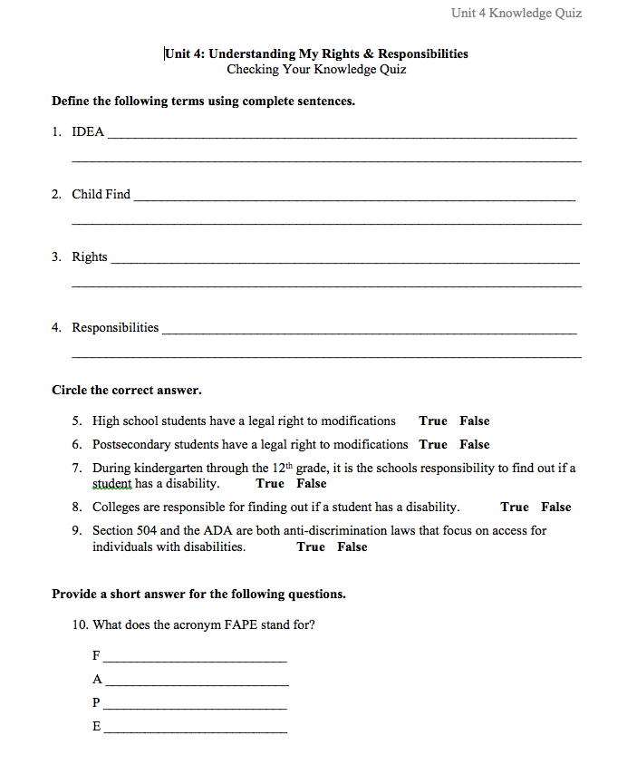
Unit 4 Quiz

Slide 18
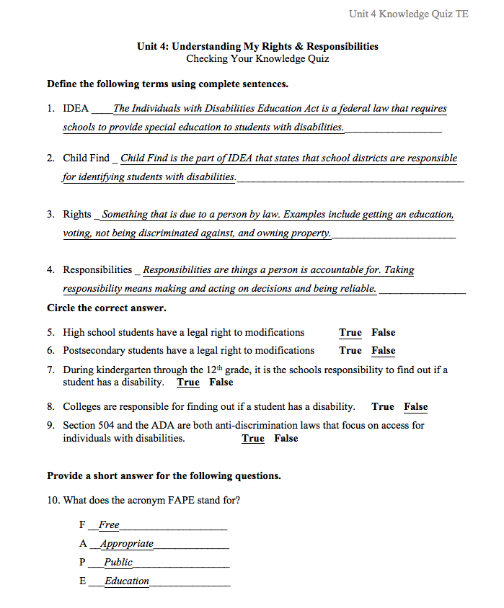
Unit 4 Answers

