Slide 1
Units 7 & 8:
Advocating for my needs in & After High School

Slide 2

Bell Ringer Activity 1
Define the following words:
Self-Awareness
Self-Advocacy
Self-Determination
Disability
Accommodations
Modifications
Secondary (School) *Look it up*
IEP
Transition

Slide 3
Bell Ringer Activity 2
Look at your Self-Awareness Project and the section of your notebook that says “My Disability Information”
Think of your teachers at this high school…
Which one of those teachers do you feel the most comfortable asking for accommodations?
Why do you think it is easiest to talk to that one adult?

Slide 4
Bell Ringer Activity 3
Name three accommodations that you feel are appropriate to ask for in that particular teacher’s class.
1. __________________
2. __________________
3. __________________

Slide 5
Bell Ringer Activity 4
Get a partner!
Each of you take turns and discuss your accommodation requests with each other.
Give each other some Constructive Criticism *Look it Up* (at least 3 things)
In your notebook, write down the three suggestions from your partner and indicate whether or not you adjusted your requests.
1.
2.
3.

Slide 6
Bell Ringer Activity 5
Write down the name of the teacher you identified earlier this week.
You will need to schedule a meeting with that teacher to talk about your accommodations.
When you do schedule that meeting, write down the date, time, and who else is coming.

Slide 7
Bell Ringer Activity 6
Write down the S.H.A.R.E acronym again:
Sit/stand up straight
Have a pleasant tone of voice
Activate your thinking
Relax
Engage in eye communication
Why do you think these things are important for your meeting with your teacher?
Have you set up your meeting yet?

Slide 8
Bell Ringer Activity 7
Kid President Video
What was one thing you liked in this video?

Slide 9
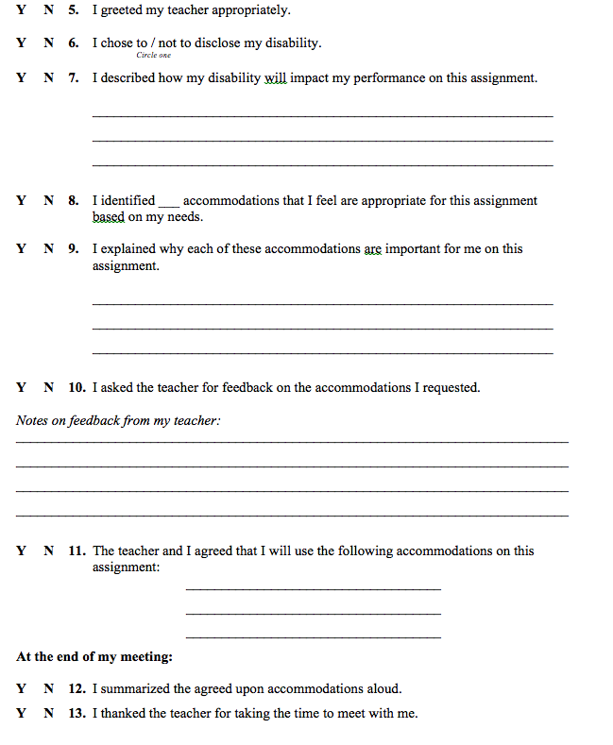
Bell Ringer Activity 8
Answer the following questions in your notebook about your meeting with your teacher.
*This should be done by now ☺*

Slide 10
Bell Ringer Activity 9
Today you will be writing a reflection paragraph over your experience with your teacher. The paragraph should be at least 5 sentences long and answer the following questions:
1. What went well?
2. What did not go well?
3. What could you have done differently?
* I am handing out a Teacher Report Form. Get these to your interviewed teacher and ask them to return it back to you or turn it into my box by February 16th (4 days over weekend).

Slide 11
Bell Ringer Activity 10
Think about your meeting:
Did the teacher agree with the accommodations you suggested?
How do you feel about the final result of your meeting?

Slide 12
Bell Ringer Activity 11
Please fill out the acronym S.H.A.R.E.
S
H
A
R
E

Slide 13
Bell Ringer Activity 12
Take a look at your “Teacher Report Form”
Was there anything that you agreed with?
Disagreed with?
What were their suggestions to you?
What will you do differently based on their suggestions?

Slide 14

Bell Ringer Activity 13
Drew’s Story (3:30):
What is something Drew could have done differently to change the outcome in this story?
Have you ever had to disclose *look it up* your disability during a job interview?
Notes:
Drew’s Story: Drew is a 28 year old man working for a large company that produces chemicals for pest control services. Drew grew up in a small town in Oklahoma and attended college after high school graduation. Having dyslexia made school difficult for Drew and he often had to work twice as hard as his friends to pass his classes. Drew worked hard and earned a degree in fire safety and protection. During his last semester of college, Drew began applying and interviewing for jobs. He sometimes worried about how dyslexia would affect his future career, but he never considered disclosing his disability during a job interview or after being hired for a job. Drew was excited when he received a job offer and an opportunity to move to a new place.
Drew’s new job required him to supervise a large warehouse containing 16 large chemical tanks and a crew of six people. Each day the crew members would read gauges on the tanks, complete a check list, and take notes about the gauge information which was then given to Drew. He would use the information to calculate the amounts of different ingredients each tank needed to have added. Drew always read the information as soon as it was given to him. If he had questions about the written information, he would ask the crew member to clarify the information before they left his office.
For the first six months, his new job went well, then the company upgraded the gauge system on the tanks. Drew began receiving computer generated reports via email instead of handwritten reports from crew members. Drew had to read the reports and then email each crew member instructions on the ingredients to be added to each tank.
The new reports Drew received were written in numbers and symbols, which were extremely difficult for him to read because of his dyslexia. Drew had an especially difficult time distinguishing the greater than and less than signs on the report. To make things worse, he no longer had a crew member there to ask clarifying questions—everything was to be completed via email. As a result Drew frequently made mistakes reading the information and in the instructions he gave to his crew. Before long, crew members began to complain to Drew about the mistakes. He was very stressed out about his situation, but decided he would just have to do his best to deal with it if he wanted to keep his job.
During the first couple of weeks, Drew’s boss was understanding about the mistakes and assumed they would stop once Drew adjusted to the new system. Eventually, the mistakes became dangerous and costly to the company. In one case, Drew’s mistake resulted in an employee receiving chemical burns from mixing the wrong ingredients together as well as ruining thousands of dollars worth of chemicals in the tank. Drew felt terrible and his boss was furious.
The next morning, Drew’s boss called him into his office and fired him. He told Drew that he was disappointed with his recent job performance and had expected more from him based on his performance early on with the company. Drew apologized for the problems he had caused and explained that the combination of having dyslexia and the new system had made his once easy job almost impossible. His boss was surprised to hear this, because he never suspected that Drew had any type of disability.

Slide 15
Bell Ringer Activity 14
What are some reasons a person might have for disclosing his/her disability on the job?
What are some reasons a person might have for NOT disclosing his/her disability on the job?
Tell me one positive outcome and one negative outcome of disclosing disability on the job.

Slide 16
Bell Ringer Activity 15
Disclosing your disability on the job is a personal choice. There are valid reasons for disclosing and valid reasons for not disclosing to others. Either way, you need to have a plan on how to handle the situation. Part of that plan includes knowing answers to the following questions. Think about the job you want and *write these answers down for future reference*
What skills do you need for the job?
Does your disability prevent you from performing the job requirements?
If yes, could accommodations make the job doable for you?
If so, what accommodations would you need?
  Remember, you must disclose your disability if you expect your employer to provide accommodations.
What are your legal rights as an employee with a disability?

Slide 17
Bell Ringer Activity 16
According to ADA, employers are not allowed to ask you questions about your disability on job applications or during job interviews.
Employers can ask you specific questions about your abilities and skills required to perform the job.
Examples:
We are looking for someone who is able to do complicated math on a regular basis. Will this be a problem for you?
Lifting 50 to 100 pounds several times a day is part of this job. Are you able to do so?
What if a job interviewer asks you questions about your disability?

Slide 18
Bell Ringer Activity 17
What are some ways to handle illegal questions about your disability on a job application or during a job interview?
What are some reasons a person might have for disclosing their disability on the job?
What are some reasons a person might have for not disclosing their disability on the job?
What are some benefits of disclosing your disability at work?

Slide 19
Bell Ringer Activity 18
You have learned how to advocate for yourself during high school and on the job.
What about colleges and technology centers?
Do you plan to go to college or a tech center?
Do you have rights to accommodations at tech centers and colleges?

Slide 20
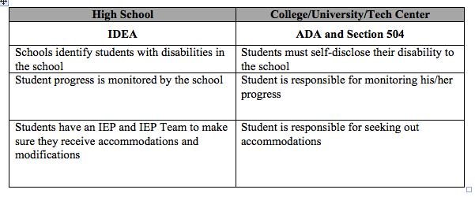
Bell Ringer Activity 19
What do you think the Office of Disability Support Services does for students?
What is something you as the student are responsible for doing in order to get assistance from an Office of Disability Support Services?
You will not have an IEP or IEP Team in college. However, there are people who can assist you. These people work in an office called the Office of Disability Support Services. The name of this office varies from school to school, but it is usually named something very similar to Office of Disability Support Services.

Slide 21
Bell Ringer Activity 20
List 3 schools that you wish to go to once you are done with high school.
Look up on your phone or later on a computer, the contact information for that school and put it in this entry.
Write down these three questions:
What do I need to do to receive accommodations at your school?
Who is the person I should speak to if I have questions?
How long does the process take?

Slide 22
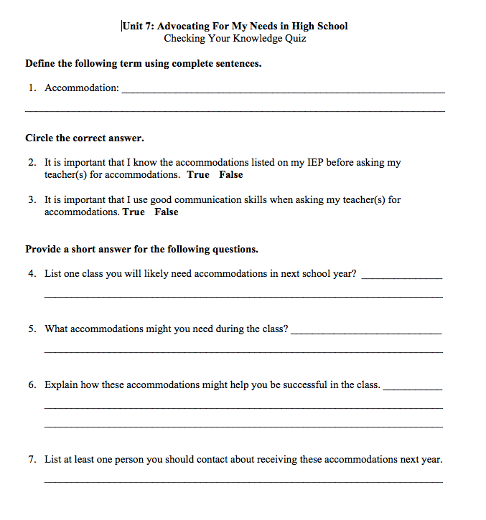
Unit 7 Quiz

Slide 23
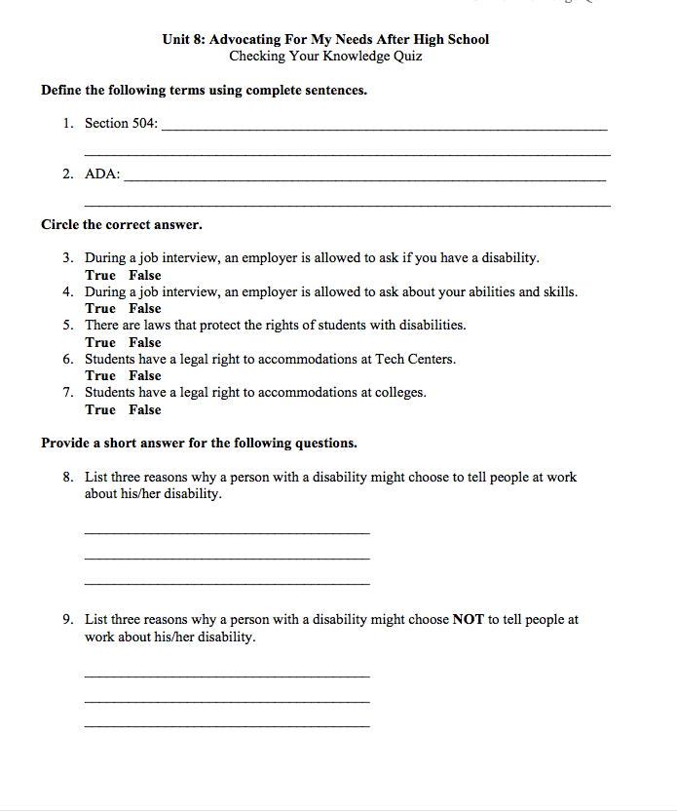
Unit 8 Quiz

Slide 24
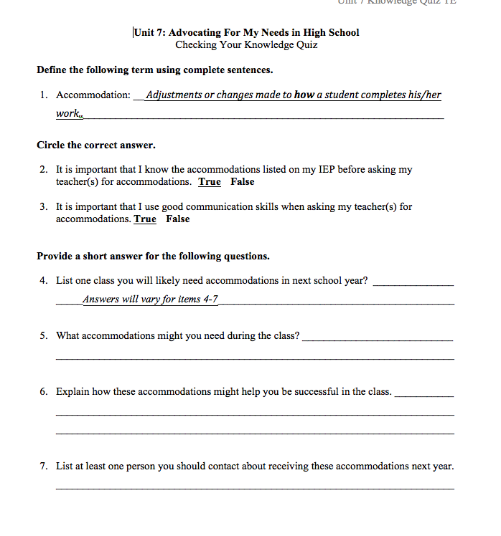
Unit 7 Answers

Slide 25
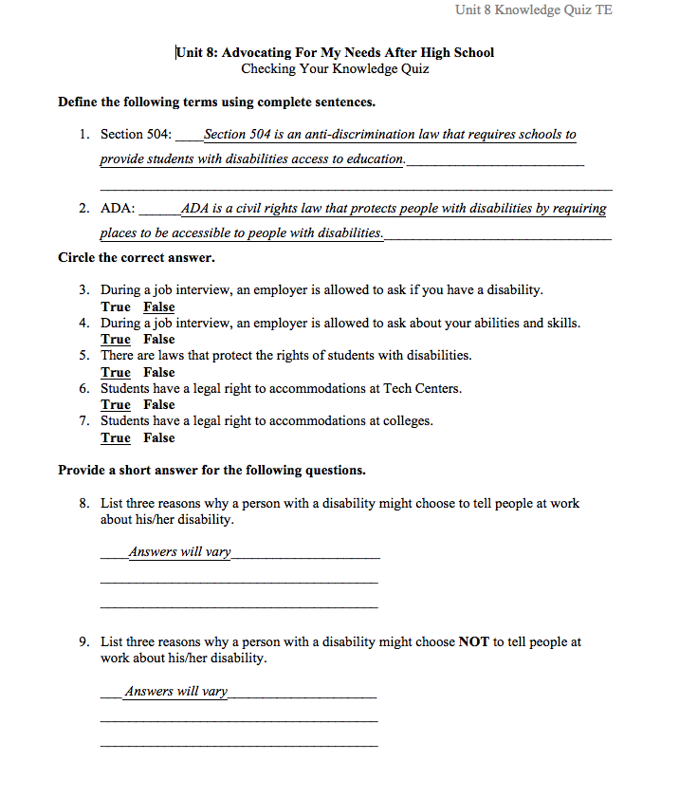
Unit 8 Answers

