Slide 1
Units 9 & 10:
Summary of Performance
ME! Scales
Wrap-Up

Slide 2
Bell Ringer Activity 1
Define the following terms:
Goal
Self-Determination
Self-Advocacy
Summary *look it up*
Performance *look it up*
Why are these words important?

Slide 3
Bell Ringer Activity 2
When you are nearing graduation, in your final IEP meeting, the principal/IEP Teacher will look at a document called a “Summary of Performance”. This document will provide a summary of your high school experience.
What are some of the categories or questions you think this document would ask for? Give at least 3.

Slide 4
Bell Ringer Activity 3
What is the reason (disability) that you have an IEP?
What are some common characteristics of that struggle?
How do you overcome that struggle in the classroom?

Slide 5
Bell Ringer Activity 4
How do you address your struggles with teachers?
What are some accommodations you ask from teachers in the classroom?

Slide 6
Bell Ringer Activity 5
Think about our End of The Year Summary scenario. What would be some things that you would tell the principal that you did well through this year so far?
What would be some things you could work on?

Slide 7
Bell Ringer Activity 6
What are your greatest strengths outside of school?
What are some of your biggest weaknesses?
Who helps you overcome the weaknesses and emphasizes your strengths?

Slide 8
Bell Ringer Activity 7
Finish this sentence: “One year after high school, I plan to live ____________________.”
Finish this sentence “Ten years after high school, I plan to be living (in/at/with)_____________________.”

Slide 9
Bell Ringer Activity 8
What are 3 goals/steps/ways you can achieve your independent living goals this year?
1.
2.
3.

Slide 10
Bell Ringer Activity 9
Who could help you achieve your self-appointed goals for this year? Name 3 people.

Slide 11
Bell Ringer Activity 10
One year after high school, I plan to be learning in the following place.. (College/military/tech school/etc.). Name 3 options.

Slide 12
Bell Ringer Activity 11
In order to reach that Post-Secondary Learning Goal, I will need to do these things this year….
1.
2.
3.

Slide 13
Bell Ringer Activity 12
Where will you work one year after high school?
If you had the choice, what would be your ultimate dream job?

Slide 14
Bell Ringer Activity 13
Name three things that you can do THIS year that would help you get closer to your dream job.
1.
2.
3.

Slide 15
Bell Ringer Activity 14
Watch the following video: LINK!
How could the communication between the employer and employee have gone better?

Slide 16
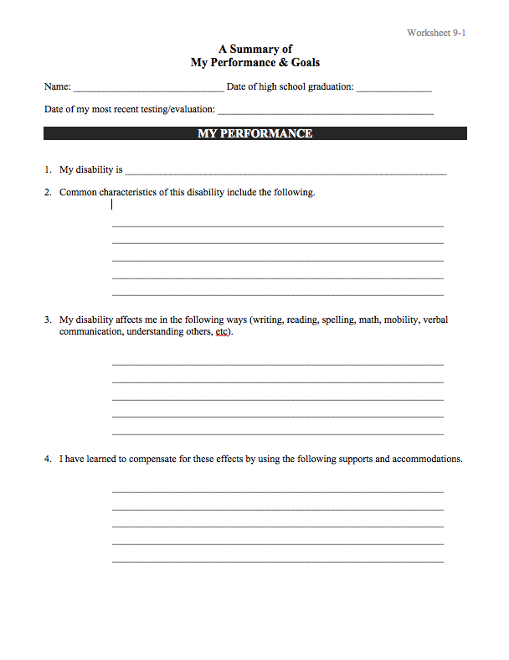
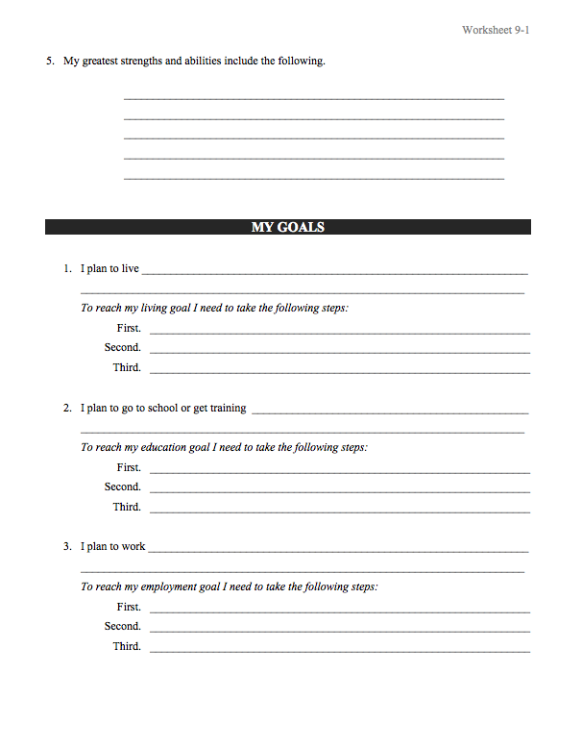
Bell Ringer Activity 15 Answer the Following Questions

Slide 17
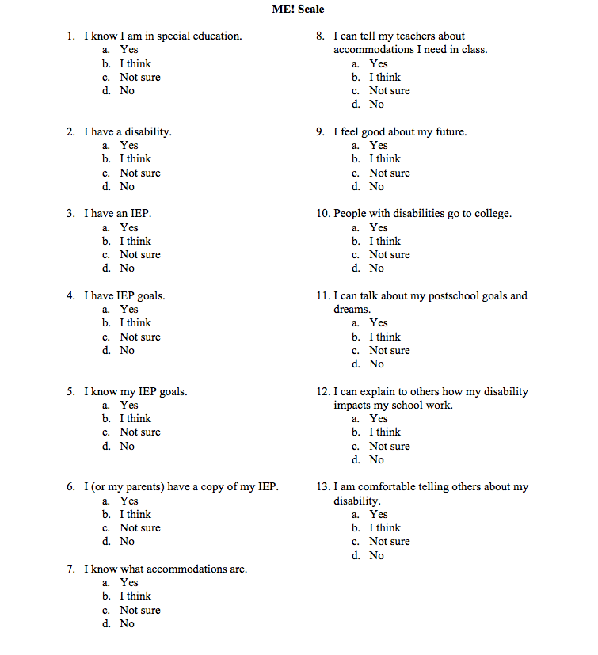
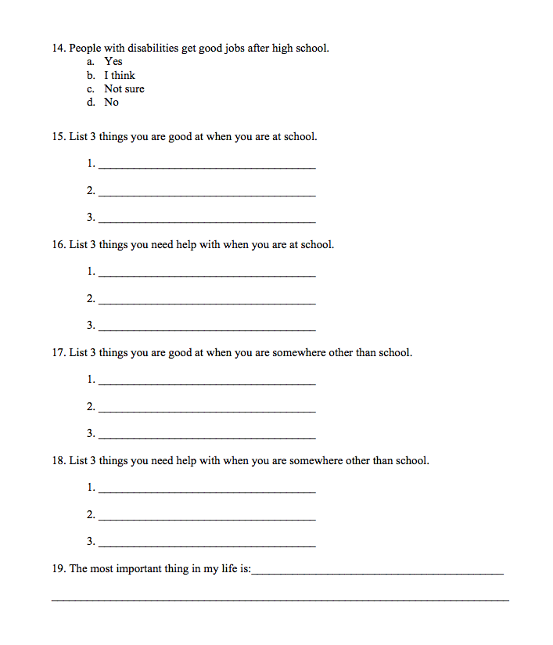
ME! Scales- Answer the Questions Bell Ringer Activity 16
Also Consider Comparing YOU! Scales (Parent Involvement)

Slide 18
Bell Ringer Activity 17
Look at your ME! Scale answers from yesterday…
What are 3 things you need to improve on?
Look at the beginning of your journals when you answered these questions before, are these improvement areas the same?

Slide 19
Bell Ringer Activity 18
Draw this Diagram on your paper.
Fill in each circle
Family/Friends (Close)
Acquaintances (Not as close)
Professionals that help you
Professional
Relationships
Acquaintance
Relationships
Close
Relationships

Slide 20
Bell Ringer Activity 19
Think back to our End of The Year Summary scenario. Imagine if this was the workplace and you are having a yearly performance review.
What would be some things that you would tell your principal (boss) that you were doing to be successful in high school (i.e. strengths, overcoming weaknesses, accommodations).
What do you bring to the table to be an asset *look it up* to the school (job)?

Slide 21

Bell Ringer Activity 20-23: (Final Quizzes)

Slide 22
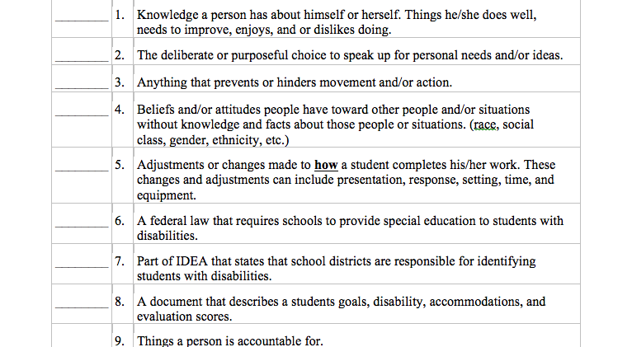
Bell Ringer Activity 20

Slide 23
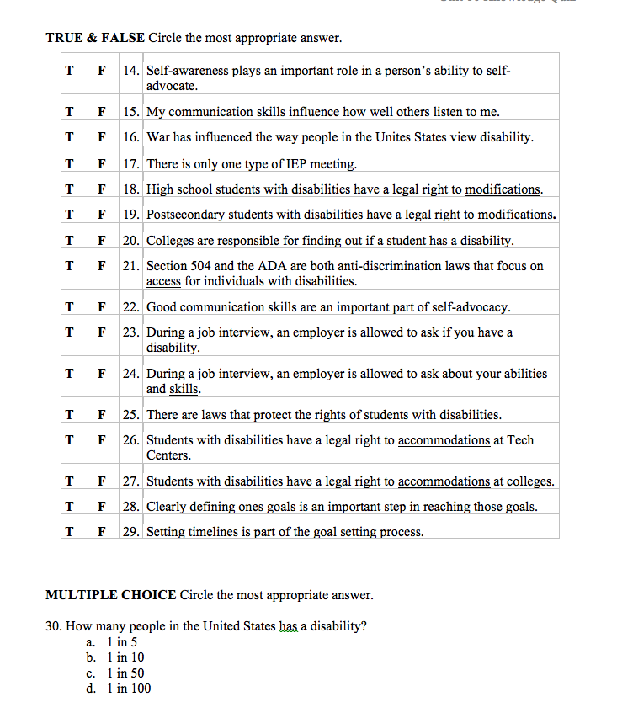
Bell Ringer Activity 21

Slide 24
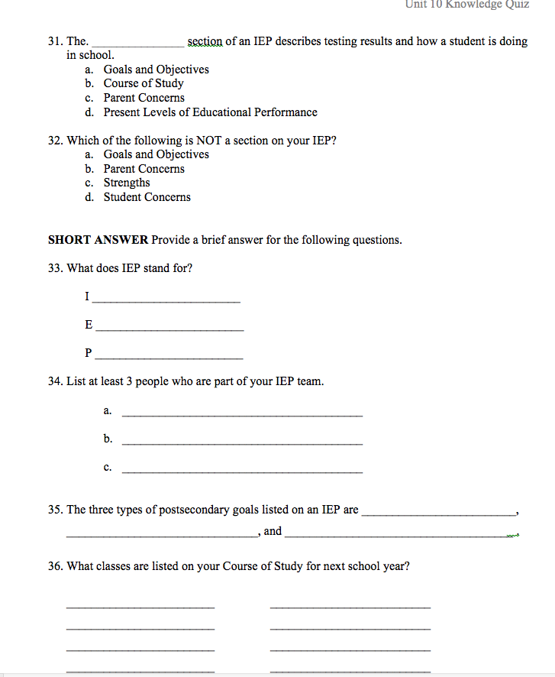
Bell Ringer Activity 22

Slide 25
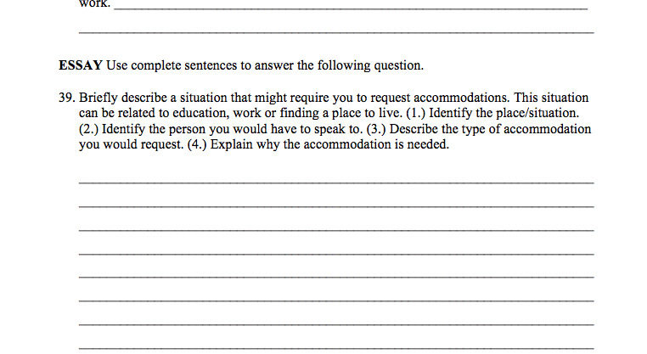
Bell Ringer Activity 23

Slide 26
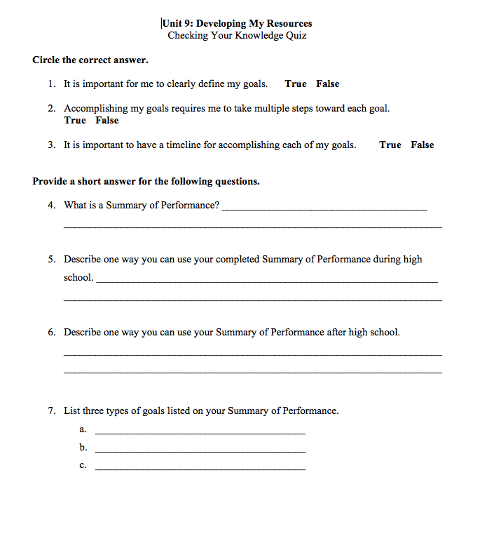
Unit 9 Quiz

Slide 27
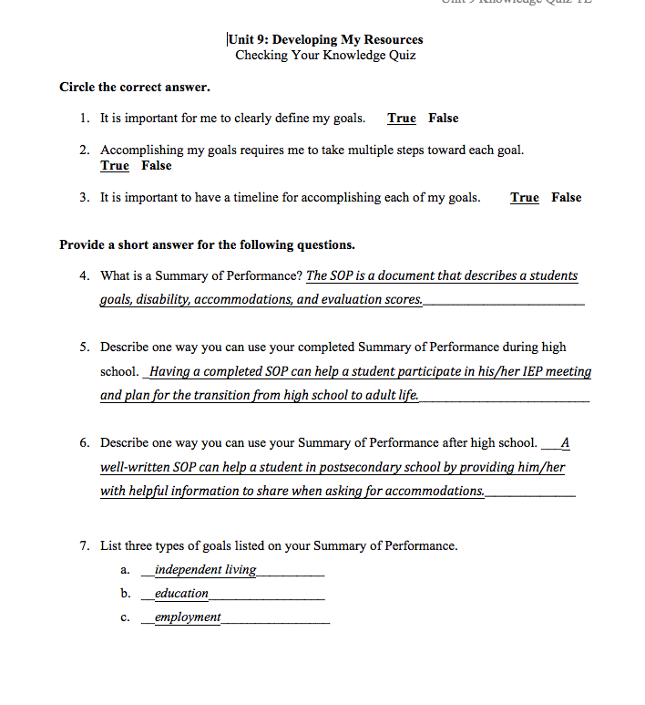
Unit 9 Answers

