Slide 1
Unit 2: Learning About Special Education
Understanding the IEP Process

Slide 2
Bell Ringer Activity 1
In your own words answer the following questions in 2 sentences:
1:What does the word DISABILITY mean?
2: How do you treat people with disabilities?
3. How does society as a whole treat individuals with disabilities?
4. Do you think over the course of history people with disabilities have been treated better or worse?

Slide 3
Bell Ringer Activity 2
Write down the following words: barrier, prejudice, low expectations
Write down your definitions of those words.
*look them up if you’re stuck*
How do those words relate to people with disabilities?

Slide 4
Bell Ringer Activity 3
Find a partner
Brainstorm on the following two questions. Be prepared to present your thoughts!
What are some examples of low expectations towards individuals with disabilities?
What are some examples of barriers?
Did you know that 1 in 5 people in the world have some type of disability?

Slide 5
Bell Ringer Activity 4
Ableism
Video
Write down at least one thing that impacted you from the video.

Slide 6
Bell Ringer Activity 5
My Life
Think about the barriers and prejudice people with disabilities have faced over the years.
Have you experienced barriers and prejudice in your life?
If so, describe at least one example of prejudice or a barrier you have experienced in your life.
If not, explain why you think you have not experienced barriers or prejudice.

Slide 7
Bell Ringer Activity 6
In the late 1700’s, a boy named Victor was found wandering around in the woods in France. He was about 12 years old when he was found. It is believed that Victor had been alone in the woods for at least 7 years. A man named Itard took the boy home and taught him how to read, write and live around people. Some people say this was the first time in history that an “IEP” was used. Itard wrote out goals and objectives based on Victor’s needs. Many people have studied the information Itard wrote about Victor and believe that if Victor were alive today he would be diagnosed with Autism.
What is an “IEP”?

Slide 8
Bell Ringer Activity 7
War has been a reoccurring event in history which has forced society to reevaluate how people view individuals with disabilities. The Vietnam War (1957-1975), The Gulf War (1990-1991), and the current wars in Iraq and Afghanistan--one thing all of these wars have in common is that many veterans returned home with disabilities from their injuries. Many people began to change their attitude toward people with disabilities because they now had friends and/or family who returned home from war with a disability.
Several examples of this include: The Revolutionary War (1775-1783), The Civil War (1861-1865), WW I (1914-1920), WWII (1939-1945),
https://www.youtube.com/watch?v=OhKlZWLiPSk
Do these men and women have disabilities?

Slide 9
Bell Ringer Activity 8
Civil Rights Movement
The civil rights movement in the 1960’s also changed the way many people felt about people with disabilities. This was a time when minority groups, including Native Americans, Black Americans, and people with disabilities strongly advocated for equal rights.
How do you think the Civil Rights movement impacts YOU?

Slide 10
Bell Ringer Activity 9
Since the 1970’s, other important legislation has been passed that has helped improve the lives of people with disabilities. Legislation that has impacted education includes:
Individuals with Disabilities Education Act
Americans with Disabilities Act
Rehabilitation Act Section 504
Video
Write down 6 facts or ideas from the video

Slide 11
Bell Ringer Activity 10
Video- What can you do?
In 3 sentences, describe some things that YOU can do well.
Write down the definitions of:
Barrier
Prejudice
Low Expectation

Slide 12
Bell Ringer Activity 11
Define barrier, prejudice, and low expectation
Now what is the definition of the following words *look them up if you need to*:
Acronym-
Accommodations-
Modifications-
Goals-
Objectives-

Slide 13
Bell Ringer Activity 12
What do you think are the meanings of the following Acronyms
1. LOL
2. ROFL
3. SMH
4. IDEA
5. IEP
6. ITP
7. ADA

Slide 14
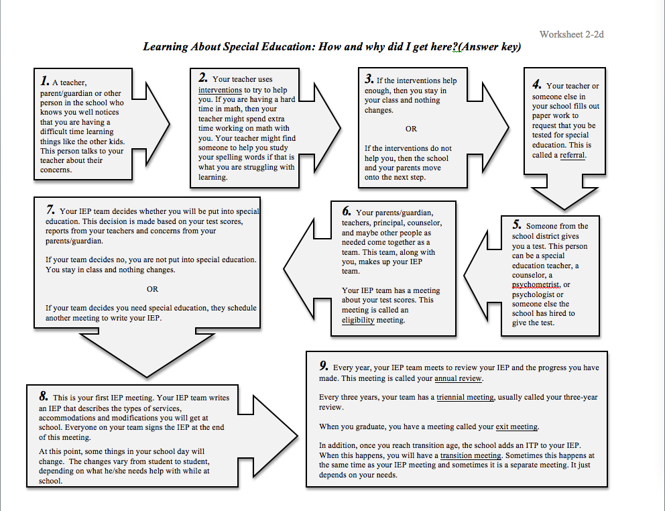
Bell Ringer Activity 13
Look at the following graph
What are the following meetings *in your own words*
1. Eligibility Meeting
2. Annual Review
3. Triennial Meeting
4. Transition Meeting
5. Exit Meeting

Slide 15
Bell Ringer Activity 14
Why do you think you were considered ELIGIBLE (what does that mean?) to receive Specialized Education Services?
How far back do you remember receiving help in school from Special Education?
Do you even know what your IEP says? If not, why not?

Slide 16
Bell Ringer Activity 15
What is an IEP?
Take a look at the following *Video*.
List all of the things that you did not know about the IEP as presented in this video.

Slide 17
Bell Ringer Activity 16
What does it mean to have a disability?
Are you alone? Does anybody become successful with a disability?
Here’s your answer

Slide 18
Bell Ringer Activity 17
Go back in your notebook and find the definitions of the following words and write them down.
Self-Advocacy
Self-Determination
Self-Awareness
Prejudices
Barriers
IEP
IDEA
Accommodations
Modifications

Slide 19
Bell Ringer Activity 18
Creating My Story (2-3 sentences per question)
Did you or your parents/guardians know you had a disability before you started school? How did they know?
What grade were you in when you first realized that you had a difficult time with your schoolwork or being at school?

Slide 20
Bell Ringer Activity 19
Creating My Story (2-3 sentences per question)
Who do you believe was the first person to notice you were having a difficult time in school? What do you think they saw that no one else saw?
Can you remember some of the INTERVENTIONS *look it up* that your teacher used with you before you were tested for Specialized Education?

Slide 21
Bell Ringer Activity 20
Creating My Story (2-3 sentences per question)
What are some things you remember in elementary or middle school that could have been the result of being in special education.
Did you go to a different classroom for part of the day?
Did a different teacher come into your classroom to help you with work?
Did you have a different reading or math book than the other students?
What is the first thing you can remember about being in special education? How did it make you feel?

Slide 22
Bell Ringer Activity 21
Creating My Story (2-3 sentences per question)
Do you remember anyone telling you what type of disability you have? Who told you? How did this make you feel?
Do the people in your family talk about your disability or Special Education? How does it make you feel?
Do your friends know you are in Special Education? Do they say anything about it? How does that make you feel?

Slide 23
Bell Ringer Activity 22
Creating My Story (2-3 sentences per question)
How does being in Special Education make your school day different from other students who are not in Special Education?

Slide 24
Bell Ringer Activity 23
Creating My Story (2-3 sentences per question)
What are your education (college, tech center, military, etc.) plans for after high school graduation?
Where do you want to be living one year after graduation?
What kind of job do you want to have during your education time period? What is the dream job for the rest of your life?
Poster Activity (One class period for projects)

Slide 25
Poster Project!
For the bell work the last few days you have been compiling information about your history.
You are now going to create a poster that shows three primary areas.
1.) Where you came from (History)
2.) Where you are now (Who are you currently) and
3.) Where are you going to be in the future (Think: Graduation, one year after, and finally “The rest of your life”)
You may draw, create a chart, a timeline, a comic strip, whatever you want. But make something that you would be proud to display.

Slide 26
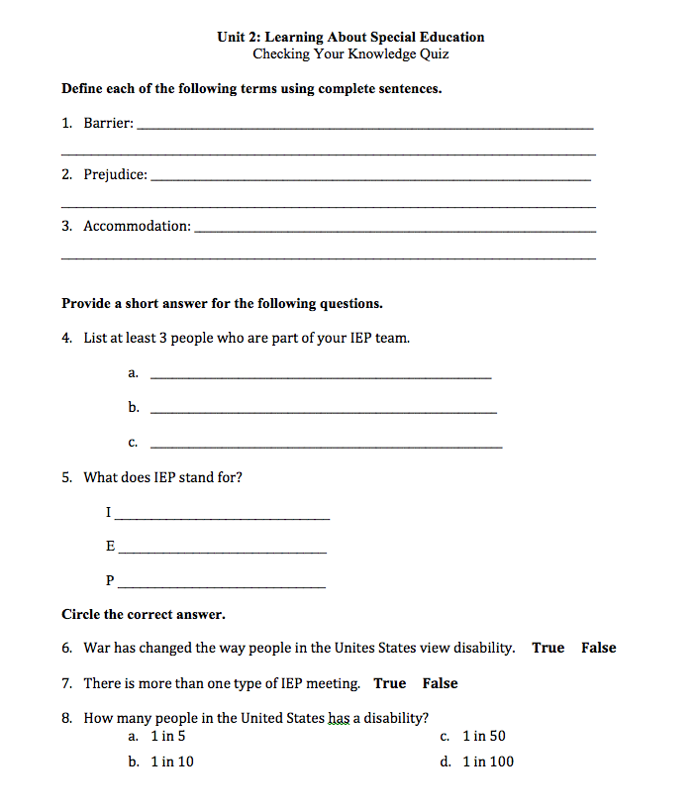
Unit 2 Quiz

Slide 27
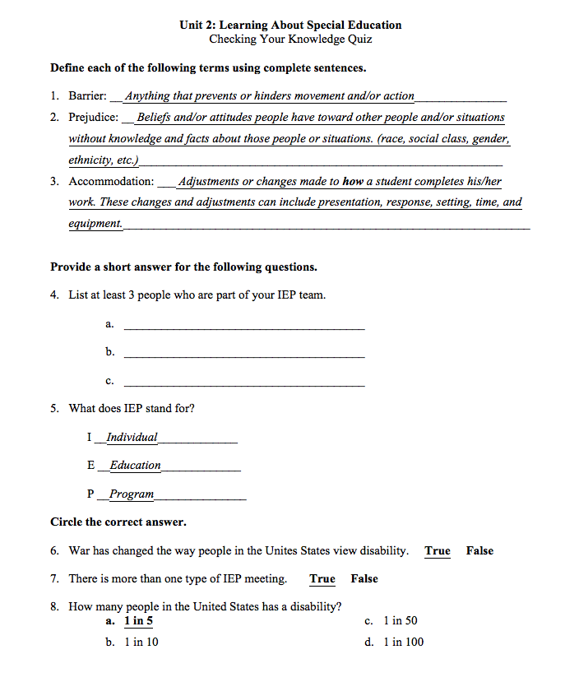
Unit 2 Answers

