Slide 1
Unit 5 & 6:
Improving Communication Skills
&
SELF-AWARENESS

Slide 2
Bell Ringer Activity 1
Define the following words:
Self Advocacy Self-Awareness
Accommodations Modifications
Self-Determination Disability
Communication *Look it up*
Decorum *Look it up*

Slide 3
Bell Ringer Activity 2
Read the following and identify 3 problems and solutions.
Chris has been called to the office due to his recent tardies and absences in 3rd period. He knows he is in trouble and will likely be assigned Saturday school or trash duty during lunch as punishment. He is angry because he feels his reasons for the tardies and absences are valid. However, Chris has an angry tone of voice and is slouched down in his chair with his arms crossed while he is telling the principal his reasons for the tardies and absences. Chris also rolls his eyes every time the principal starts talking. As a result, the principal gets irritated with Chris and assigns him three weeks of Saturday school and refuses to listen to any more of Chris’s excuses.

Slide 4
Bell Ringer Activity 3
Define “non-verbal communication” *In your words*
What messages do the following actions tell about someone?
Folded arms Shaking legs and feet
Hands in pockets Blank stare
Rubbing your neck/head Slouching
Sitting up straight Keeping eye contact
Mumbling your speech Speaking loud and clear

Slide 5
Bell Ringer Activity 4
Define “verbal communication”
What are some ways that you verbally communicate with others? *Remember it doesn’t happen with JUST voices (i.e. THINK TECHNOLOGY).
What are some benefits of good verbal communication?

Slide 6
Bell Ringer Activity 5
Think about the following groups of people:
Parents Teachers Friends Coaches
Bosses Classmates Professors Interviewers
What would be a situation where you would need to practice good verbal and non-verbal communication skills?

Slide 7
Bell Ringer Activity 6
Write down this acronym: S.H.A.R.E.
Sit/stand up straight
Have a pleasant tone of voice
Activate your thinking (being engaged in conversation)
Relax
Engage in eye communication

Slide 8
Bell Ringer Activity 7
Look at the following video clip:
Video 1
What was one thing you remember that was effective?
What was one thing you remember that was ineffective (not effective)?
Did the speakers succeed in their intended purpose?

Slide 9
Bell Ringer Activity 8
Look at the following video clip:
Video 2
What was one thing you remember that was effective?
What was one thing you remember that was ineffective (not effective)?
Did the speakers succeed in their intended purpose?

Slide 10
Bell Ringer Activity 9
Look at the following video clip:
Video 3
What was one thing you remember that was effective?
What was one thing you remember that was ineffective (not effective)?
Did the speakers succeed in their intended purpose?

Slide 11
Bell Ringer Activity 10
What do you want to do as a future career?
Where do you want to live in 10 years?
What university/training center/academy do you want to attend in order to achieve your career choice?
Name one accommodation you receive in your classes.

Slide 12
Bell Ringer Activity 11
Who are the people that meet on your IEP team?
How often do you communicate with them?
What things do you share with those people when you do communicate?

Slide 13
Bell Ringer Activity 12
Now, let’s think about after high school.
Who do you think you might have a lot of contact with or see a lot if you were attending college?
What if you were going to a Tech Center program?
What if you decide to get a full time job right after you graduate, who do you think you would see frequently at your job?

Slide 14
Bell Ringer Activity 13
Think about a time that something (job, class, relationship, etc.) did not go well for you. What did you do to make it better? Or, what did you learn in that experience that you used in the future to avoid similar problems?

Slide 15
Bell Ringer Activity 14
Read this story:
One of my former students, Jason, had a lot of difficulty reading and writing. He took a job at a garage working on cars and was also getting trained to be a mechanic. Often, he would be in the office at the garage and answer the phone. He would talk to customers and would then try to remember the messages and did not write them down. Jason had a learning disability and writing was very difficult for him. Sometimes he didn’t see the garage manager to tell him the messages and he forgot, or the customers would call back and say that they had left a message with Jason. But, Jason had not written them down, and had not told his garage manager that he needed help with this. Jason had recorded the teacher lectures in his high school classes because he had an IEP. He probably could have recorded the messages at work using his cell phone or PDA. However, Jason did not know how to ask about this or even that he could ask for help. He eventually got fired and had to find another job.
Who could Jason have spoken to so that he could have gotten help?
What would Jason have needed to tell this person about how and why he needed help?
Would he need to be able to explain his disability to this person? Why or why not?

Slide 16
Bell Ringer Activity 15
Answer the following questions in complete sentences, and be as detailed as possible:
1. What is the name of your disability?
2. People with this disability usually have trouble with_______.

Slide 17
Bell Ringer Activity 16
Answer the following questions in complete sentences, and be as detailed as possible:
In school, I have trouble with _____________.

Slide 18
Bell Ringer Activity 17
Answer the following questions in complete sentences, and be as detailed as possible:
It helps me if (accommodations) _____________.

Slide 19
Bell Ringer Activity 18
Answer the following questions in complete sentences, and be as detailed as possible:
I am good at _________________________.
*What are you good at in school?*

Slide 20
Bell Ringer Activity 19
Think about this story again:
Chris has been called to the office due to his recent tardies and absences in 3rd period. He knows he is in trouble and will likely be assigned Saturday school or trash duty during lunch as punishment. He is angry because he feels his reasons for the tardies and absences are valid. However, Chris has an angry tone of voice and is slouched down in his chair with his arms crossed while he is telling the principal his reasons for the tardies and absences. Chris also rolls his eyes every time the principal starts talking. As a result, the principal gets irritated with Chris and assigns him three weeks of Saturday school and refuses to listen to any more of Chris’s excuses.
What are some things that Chris can change in order to get a better result from the principal?
How would you handle this situation (with your newly acquired knowledge)?

Slide 21
Bell Ringer Activity 20 Self-Awareness Project
So far, we have learned about self-awareness, self-advocacy, special education, IEP’s, communication skills, and some history of disability. Now, we will start talking about different types of disabilities and some of the people who have disabilities, including the people in this classroom.
Think about things that you are very good at doing or are easy for you, maybe a talent you have, a school subject, a sport… “I know I am great at-----------.” (insert something that is easy for you to do and discuss it). Someone else share an example of something you do well.
Now, let’s think of something that is difficult for you to do. “I know that I have to work very hard at------------------.”
Sometimes things can be difficult for a person because of a disability they have. Different disabilities affect people in different ways. Do you know enough about your disability to know how it affects your abilities at school, home, or anywhere else you spend time? Take a minute and think about that question.

Slide 22
Bell Ringer Activity 21 Self-Awareness Project
During Unit 2 you had the opportunity to take the information you learned and combine it with what you know about yourself. The “Creating My History” activity gave you the chance to combine some of that information and write a brief history about you. I want you to take a minute and think about these questions.
While you were working on your history, did you include a description about your disability?
Did you feel like you knew a lot about your disability?
Did you find yourself wanting to know more about your disability?
Did you spend much time wondering how having a disability would affect your life now and in the future?

Slide 23
Bell Ringer Activity 22
You will have a chance to learn more about people with disabilities who have accomplished great things as you work on your project. Right now, I am going to introduce you to a few of these people .
http://www.authorstream.com/Presentation/eckre-251306-celebrities-disabilities-final2-final-entertainment-ppt-powerpoint/
http://www.disabilityresources.org/FAMOUS.html (multiple links of famous people)
http://www.increasebrainpower.com/famouspeoplewithlearningdisabilities.html (list of famous people with ADD, ADHD and LD)
http://www.waisman.wisc.edu/ (multiple links to resources on famous people with disabilities and listed by the disabilities)
http://www.iidc.indiana.edu/cedir/kidsweb/fpwdinfo.html
http://www.disabled-world.com/artman/publish/article_0060.shtml

Slide 24
Bell Ringer Activity 23
Who are some of the more famous people that we’ve discussed that have disabilities?
What are some of those disabilities?
Did their disabilities prevent them from achieving what they wanted to in life?

Slide 25
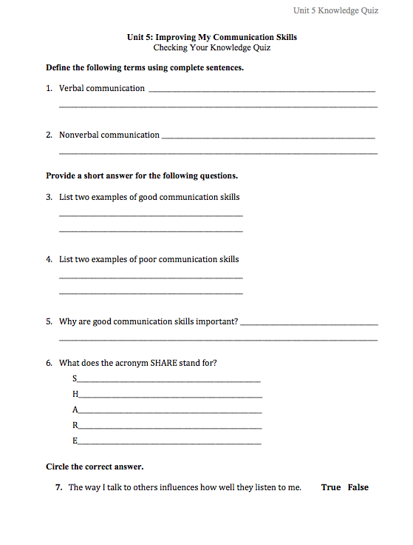
Unit 5 & 6 Quiz

Slide 26
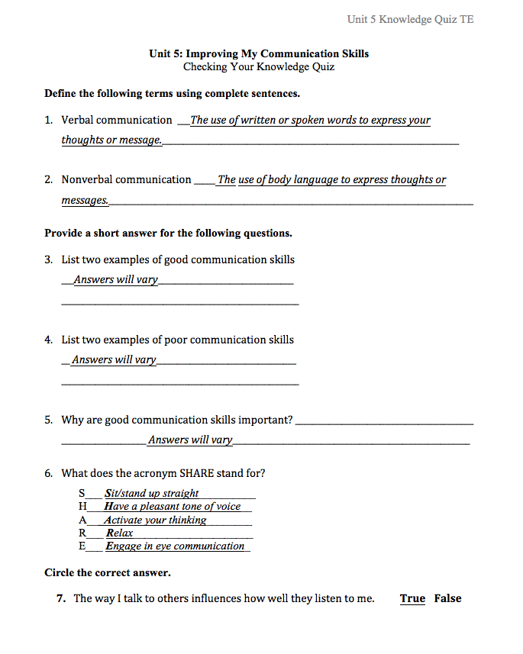
Unit 5 & 6 Answers

