Slide 1
Transition Assessment for Students with Significant & Multiple Disabilities
Jim Martin
Amber McConnell
Jennifer Burnes
University of Oklahoma
Zarrow Center

Slide 2
Agenda
Review web links
Description of students with Significant and Multiple Disabilities
Legal Requirements – in Brief
Satisfying Life and Example Postsecondary Goals
Transition Assessments
Combo Assessments Covering Two or More Transition Areas
Living & Leisure Assessments
Vocational Interest and Skill Assessments
Self-Determination Assessments
Further Education Assessments
Wrap-Up and Final Question Time

Slide 3
Web Links
Handout lists all the web sites used today
Easy to read
See us afterward to transfer files to USB drive

Slide 4
Description of Students with Significant and Multiple Disabilities
Demonstrate diverse skills, strengths, limits, and support needs
Multiple system impairments that impact the student, family, community participation, and severity of associated health conditions
Two or more simultaneously occurring impairments
Supports are usually pervasive and extensive in order to achieve community living, employment, and self-sufficiency.
Notes:
Who are we talking about today?

Slide 5
Description - continued
Severity Continuum
Severity Supports
Communication issues - frequently
Self-care issues – almost always
Intellectual issues – often, but not always
“Multiple” systems - always
Mild Moderate Severe Profound

Slide 6
Recognizing Ability
Unrecognized potential and ability in public school can result in wasted time and delayed or NO access to postsecondary dreams and goals…
Meet Sherri and Tolby. See their impairments and needs; LOOK for their abilities. Sherri is post-high school and Tolby is still in high school.
Sherri – post high school

Slide 7


Tolby
Tolby – 18 years old
Tolby has DD, CP, multiple disabilities, no fine motor skills, dependent on others for mobility in and out of his manual wheelchair; requires full-time assistance for all daily personal needs. He is non-verbal; it is difficult understanding what he needs, wants and knows. Tolby enjoys interacting with children, especially his cousins. Tolby’s mom wants him to be able to communicate things to her…what’s going on in his head, safety, etc. She wants him to remain healthy, and she wants to care for him, with help.
Notes:
Lauren: Again, Tolby is a lot like Nate….if you want to make a brief comment here that’s ok.

Slide 8

The Purpose of SPED
. . . a free appropriate public education that emphasizes special education and related services designed to meet students’ unique needs and to prepare them for further education, employment, and independent living.
2004 IDEA Changed Secondary SPED
Notes:
Lauren, did your special education program prepare you for college, employment, or independent living? Keep it short.

Slide 9

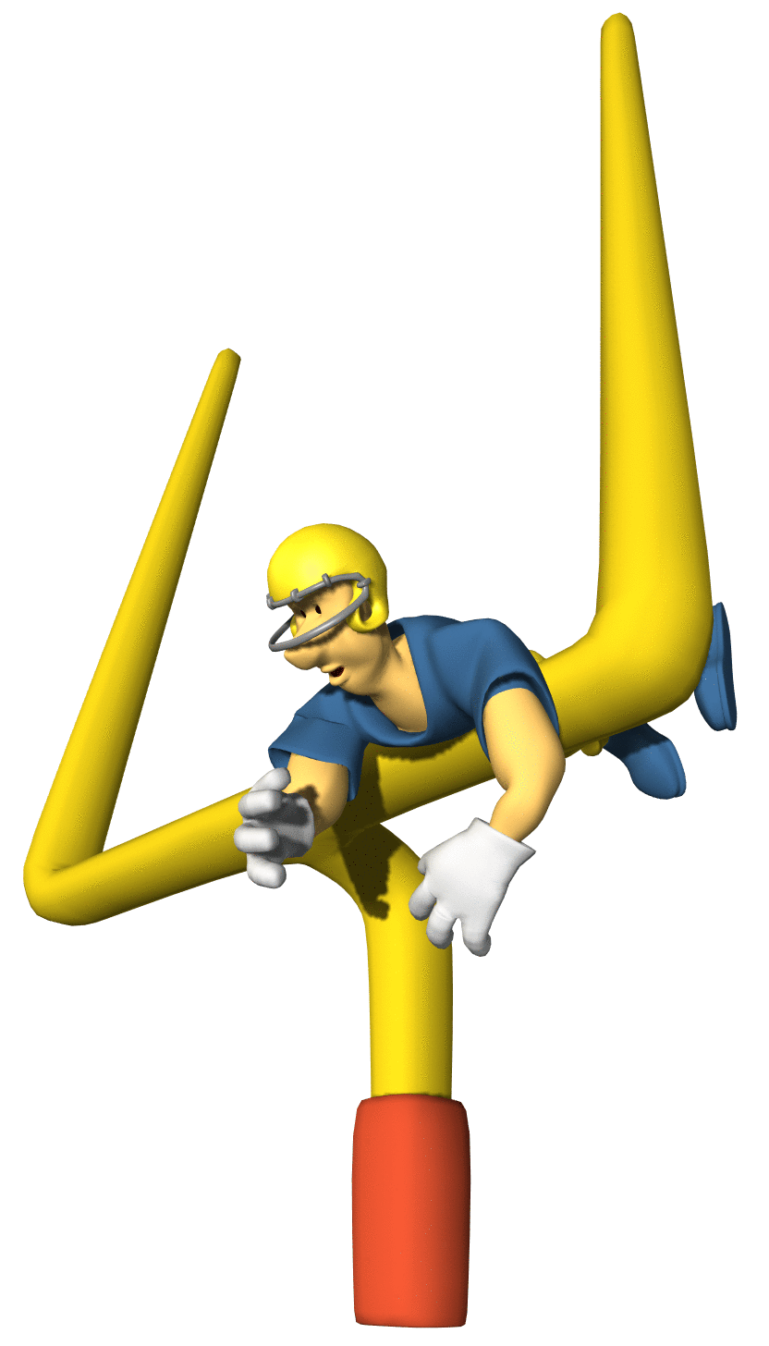
IDEA 2004 Post-Secondary Goals
IEPs must include appropriate measurable postsecondary goals
based upon age-appropriate transition assessments
related to training, education, employment, and when appropriate, independent living

Slide 10
Student Transition Questions
Postschool Goal Questions
Where do I want to live
Where do I want to work?
Where do I want to learn?
Annual Transition Goal Question
What do I need to learn now to live where I want?
What do I need to learn now to do the career I want?
What do I need to learn now to be able to learn where I want?
Greene, G., & Kochhar-Bryant, C. A. (2003). Pathways to successful transition for youth with disabilities. New Jersey: Merrill Prentice Hall.

Slide 11
Transition Assessment Results help Answer Students’ Questions
Present Levels of Academic Achievement and Functional Educational Performance
Current assessment data
Transition strengths
Transition needs
Address with annual transition goals
Transition Assessment Results
Name of assessment, date given, and results
Used to develop postsecondary goals and transition goals

Slide 12

What is a satisfying life for you?
What is a satisfying life for people with disabilities?
Notes:
Have the audience talk about what makes a satisfying life for them. Then have Lauren speak.

Slide 13
A Satisfying Life is…
Home, career, social life, community lifestyle, spiritual well being (Romer, Frantangelo, & Fanjoy, 2009)
Personal Fulfillment?
Right mix of opportunities and support to nourish the presence and contribution of a human being (Kendrick, 2009)
Outcome of high quality supports
A life that is uniquely ones own! (Simpson, 2009)
Notes:
Research says…..Satisfaction in work Determined by a balance of barriers and resources (van Camen & Cardol, 2009).

Slide 14
Satisfying Participation in Life includes…
Realizing societal roles, with or without support, in a meaningful and satisfying way
Work participation and being satisfied with life is broader than just job satisfaction…
(Van Campen & Cardol, 2007)
Four years after high school, youth with multiple disabilities were least engaged in their communities (NLTS-2)

Slide 15
Tolby’s satisfying life…
Healthy
Be with his family
Communicate what’s going on in his head with others
Consistent care
Operable equipment

Slide 16
What’s a satisfying life for Sherri?
Sherri’s satisfying life
Josh’s satisfying life

Slide 17
Guiding Questions for Secondary Transition Planning for Youth with Significant Disabilities
Can the young adult express interests? If no, get information from parents and caregivers to develop transition plan.
What are special health care needs?
What are needs/challenges preventing the young adult from working outside the home?
Notes:
Lauren: Are these valid questions?

Slide 18
Guiding Questions for Secondary Transition Planning for Youth with Significant Disabilities
Who can provide education/training to assist the young adult?
What can the young adult accomplish without assistance?
What else could the young adult accomplish if assistance were provided by a job coach, habilitation training specialist (HTS), or other caregiver?
Notes:
Were these questions asked when you were planning for life after high school? Do they make sense?

Slide 19
Tolby
Tolby has DD, CP, multiple disabilities, no fine motor skills, dependent on others for mobility in and out of his manual wheelchair; requires full-time assistance for all daily personal needs. He is non-verbal; it is difficult understanding what he needs, wants and knows. Tolby enjoys listening to music and interacting with children, especially his cousins. Tolby’s mom wants him to be able to communicate things to her…what’s going on in his head, safety, etc. She wants him to remain healthy, and she wants to care for him, with help.
Notes:
Lauren: Again, Tolby is a lot like Nate….if you want to make a brief comment here that’s ok.

Slide 20
Tolby’s Postsecondary Goals
Tolby will live at home with his mother and, with the support of a job coach, will volunteer at a local childcare facility where he will play music during dance and nap times.

Slide 21
Sample Scenarios and Postsecondary Goals
Clarification Tolby’s Case
Although Tolby may not earn an hourly wage for his job work experience at a childcare facility, he is still accomplishing something he set out to do in terms of employment.
Although Tolby requires assistance and support with everything, staying healthy and helping at home with his cousins and nieces/nephews contributes to achieving his adult living goal.

Slide 22
NSTTAC can help!
National Secondary Transition Technical Assistance Center (NSTTAC) offers examples and non examples of postsecondary goals. Go to:
http://www.nsttac.org/content/nsttac-indicator-13-checklist-form-b-enhanced-professional-development
See Examples for Kevin and Rolanda

Slide 23

Transition Assessment Areas
Combo Assessments Covering Two or More Transition Areas
Living & Leisure Assessments
Vocational Interest & Skills Assessments
Self-Determination Assessments
Further Education Assessments

Slide 24
Combo Assessments Covering Two or More Areas
Part 1 of the 5-Part Transition Assessment Model
A General Transition Assessment Examines Two or More Transition Domains

Slide 25
Assessments Covering Two or More Areas
Personal Preference Indicators (free)
Enderle & Severson’s ESTR-S
Transition Planning Inventory 2 (TPI – 2) Supplement for Students with Significant Needs
Transition Assessment and Goal Generator (TAGG)

Slide 26
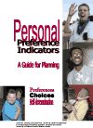
Personal Preference Indicators
Interview format
Family members, friends, professionals who know student well
Likes, dislikes, social indicators, choices
http://www.ou.edu/content/education/centers-and-partnerships/zarrow/transition-assessment---severe-disabilities/preference-indicators.html
Cost: free

Slide 27
Enderle-Severson Transition Rating Form
ESTR-J
Students with mild disabilities
Parent (available in Spanish) and Teacher version
Five Transition areas
ESTR-III
Students with “more” disabilities
Parent and Teacher version
Five Transition areas
ESTR-S
Students with severe/multiple impairments
Parent and Teacher (on-line only) versions
Employment, Rec/leisure, home living, community participation, and adult life
Estr.net (each costs $2.00)

Slide 28
ESTR-S Example Items
Sample Report From Estr-S

Slide 29
TPI-2
Transition Planning Inventory -2
Modified Form for Students with Significant Needs
Student, teacher, and parent versions
57 items
Working, Learning, Living
Divided into 11 sub-categories
Available From
Pro-Ed Publishers
http://www.proedinc.com/customer/productView.aspx?id=6063
Cost for Entire TPI-2: $343.00

Slide 30
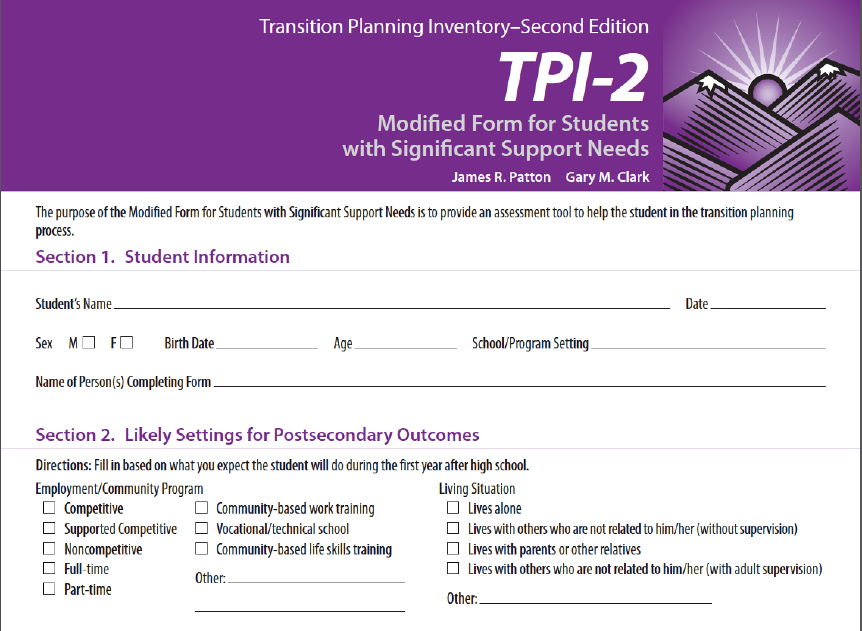

Slide 31
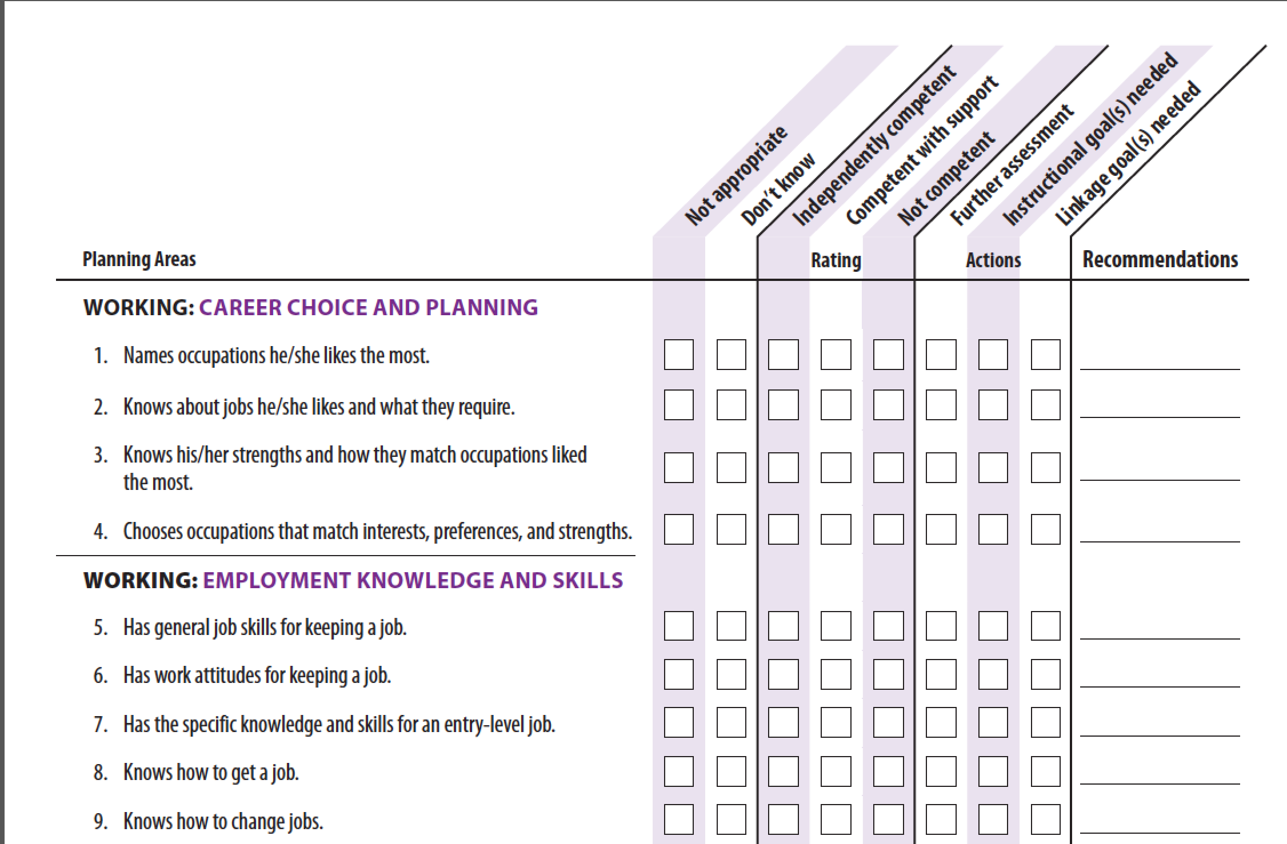

Slide 32
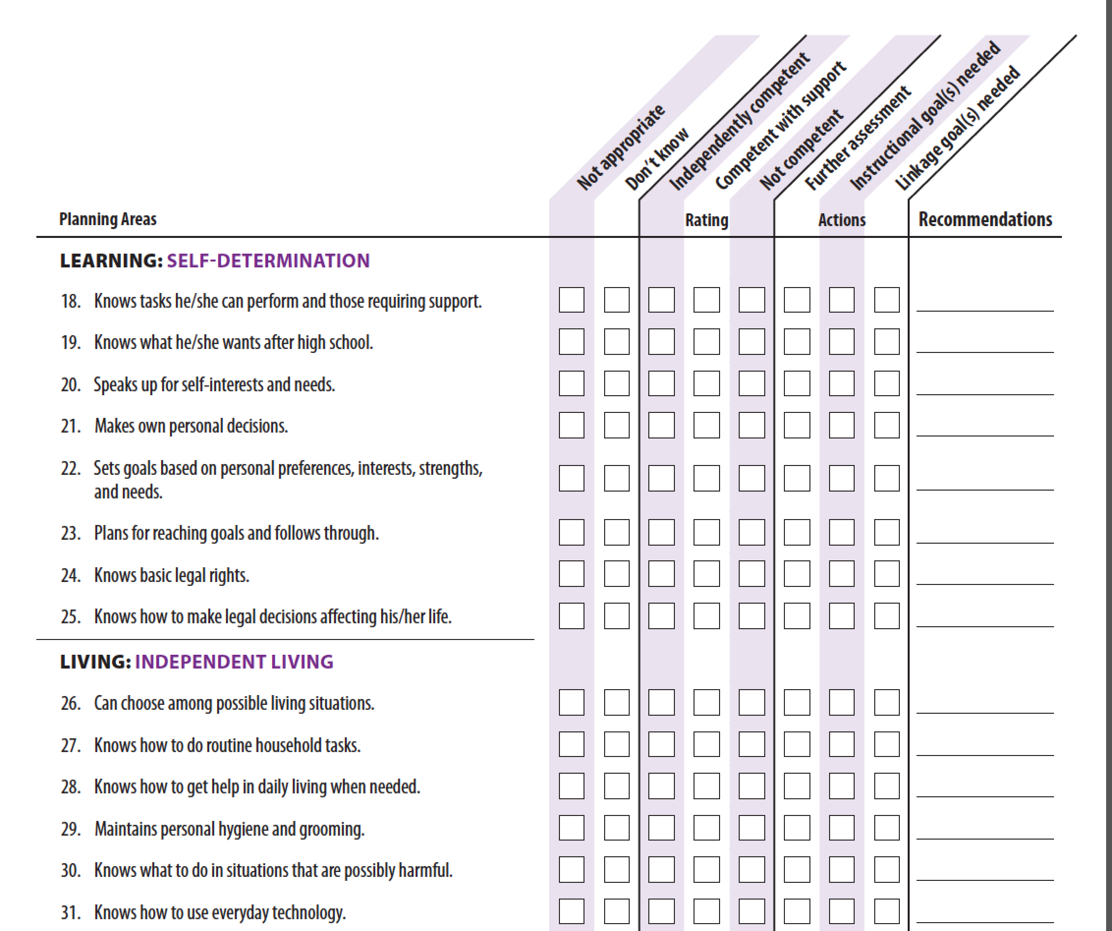

Slide 33
Transition Assessment and Goal Generator (TAGG)
Designed to assess students who will be competitively employed or engaged in postsecondary education
Three versions: Professional, Student, and Family
Online administration
Profile automatically scored using IRT-derived algorithms
Embedded Audio and ASL videos

Slide 34
Users purchase TAGG sets. Each set contains Professional, Student, and Family version and access to the generated Profile for 7 years.
Cost: $3.00 per set • Payment: Credit cards or Purchase
https://TAGG.ou.edu/tagg

Slide 35
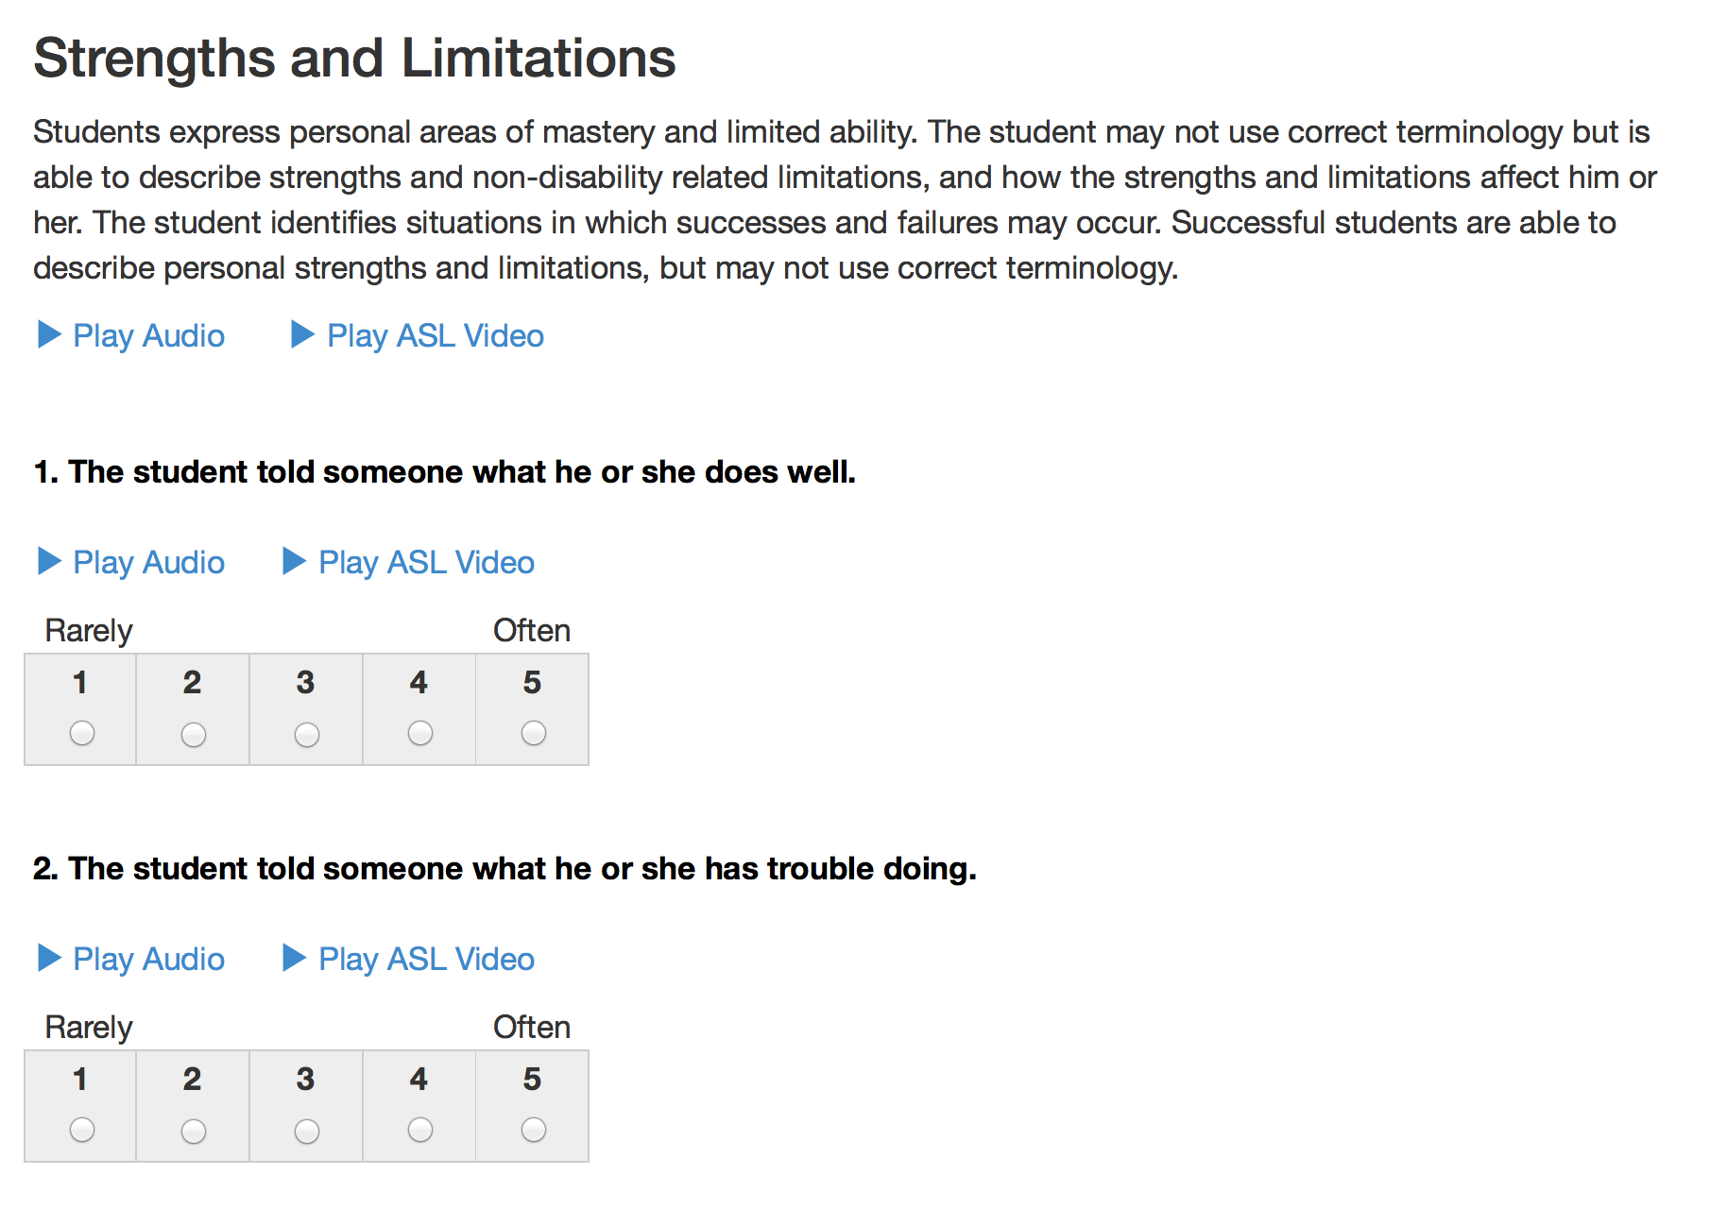

Slide 36
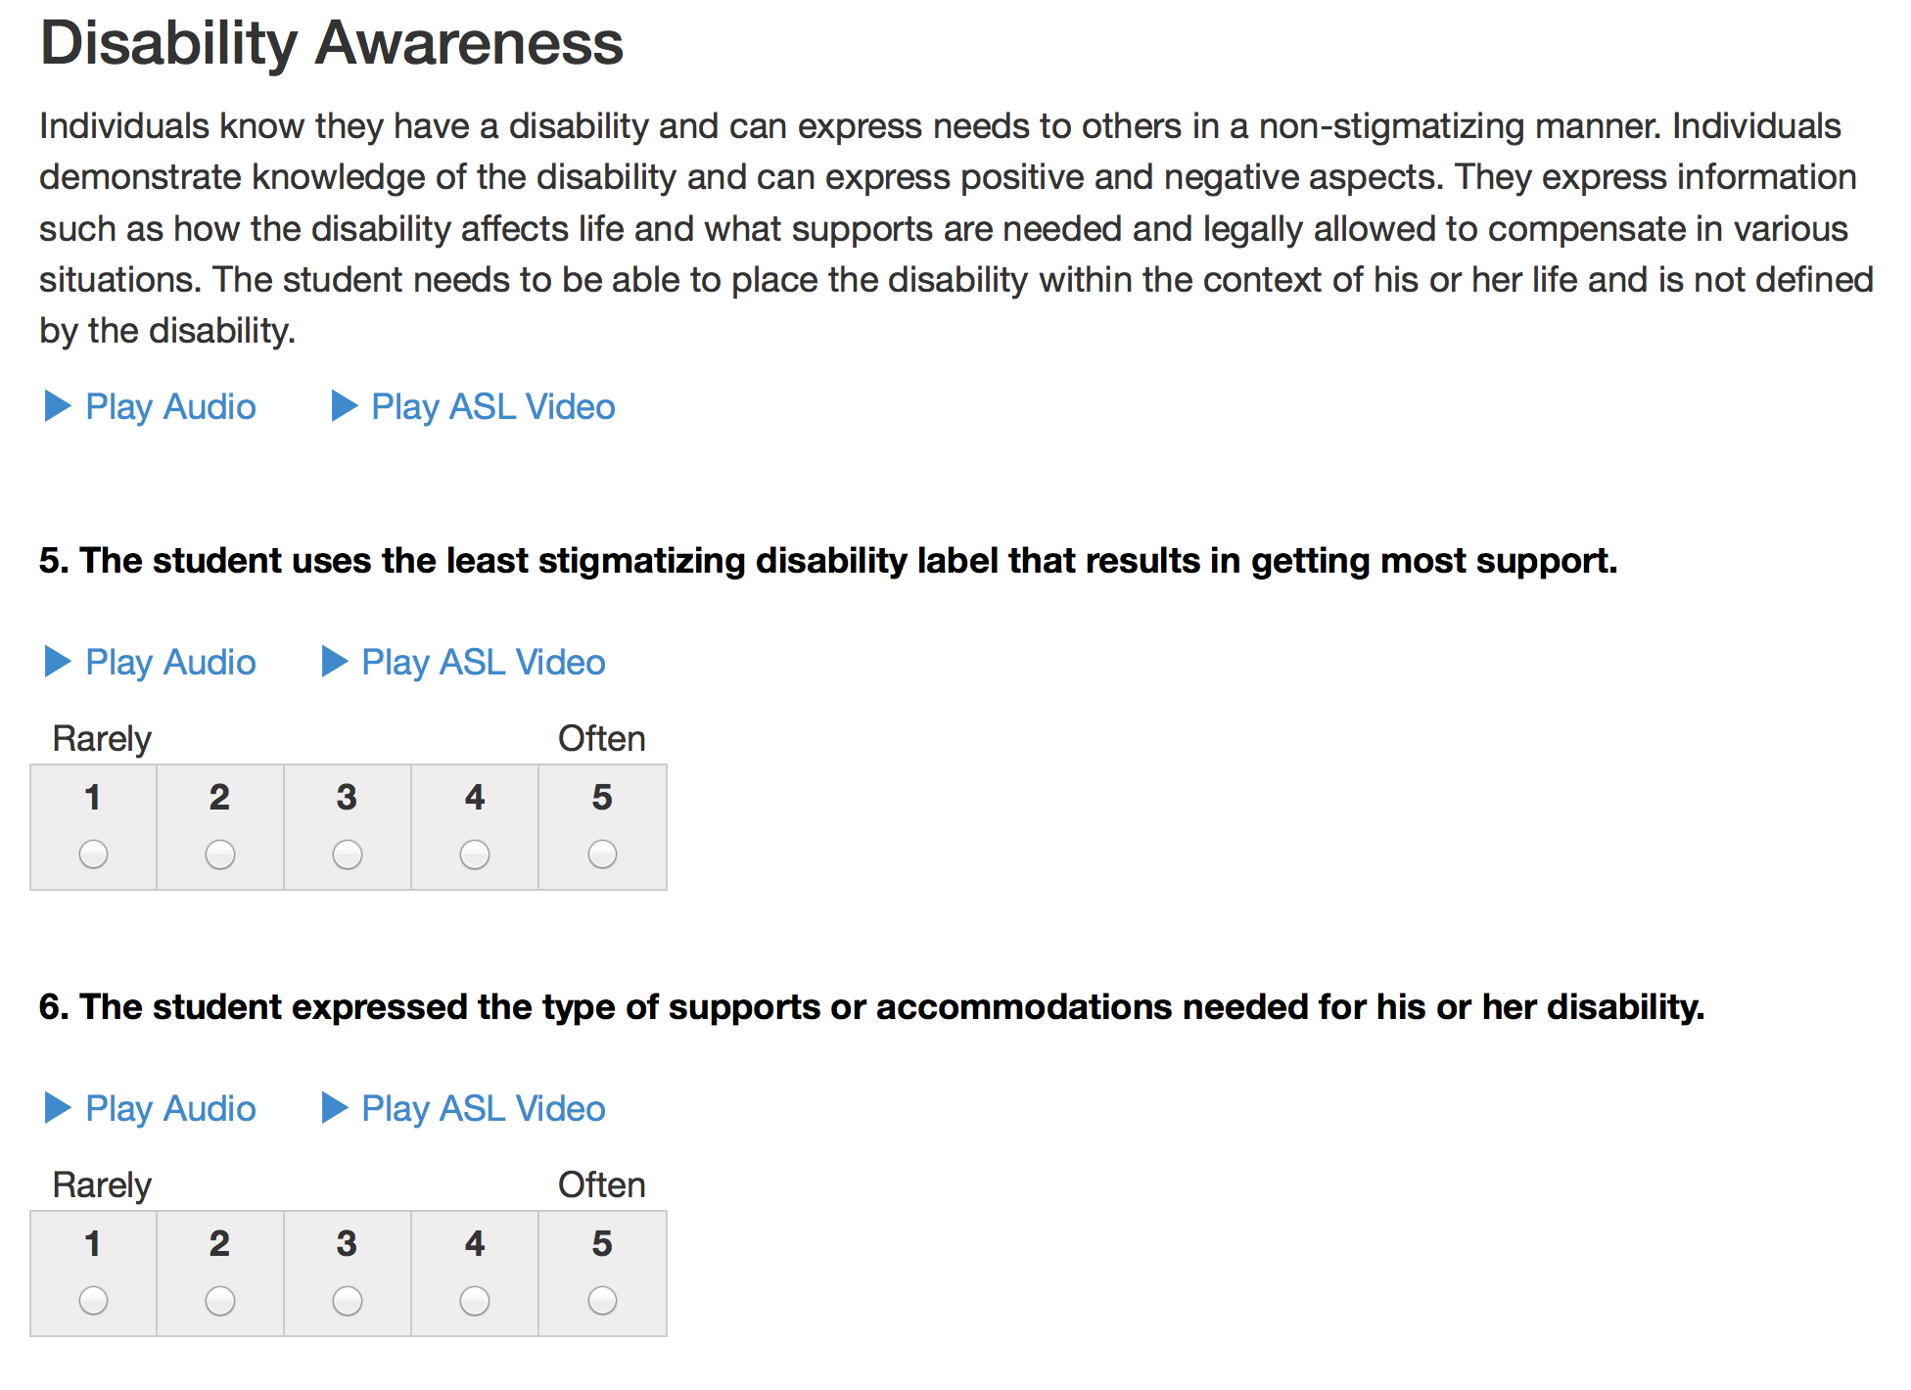

Slide 37
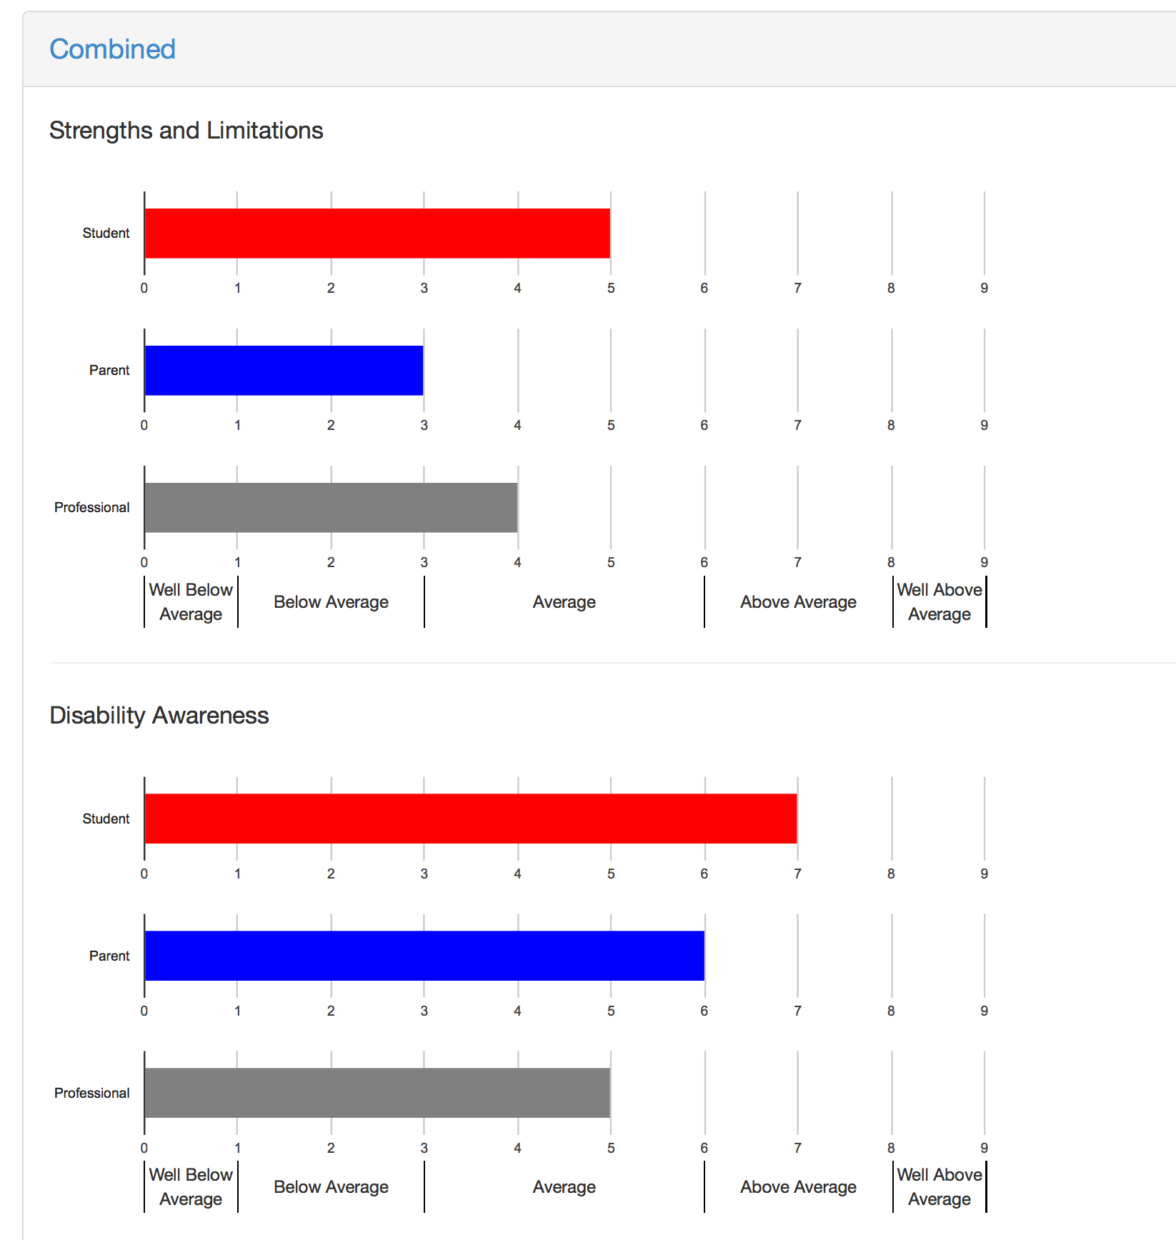

Slide 38
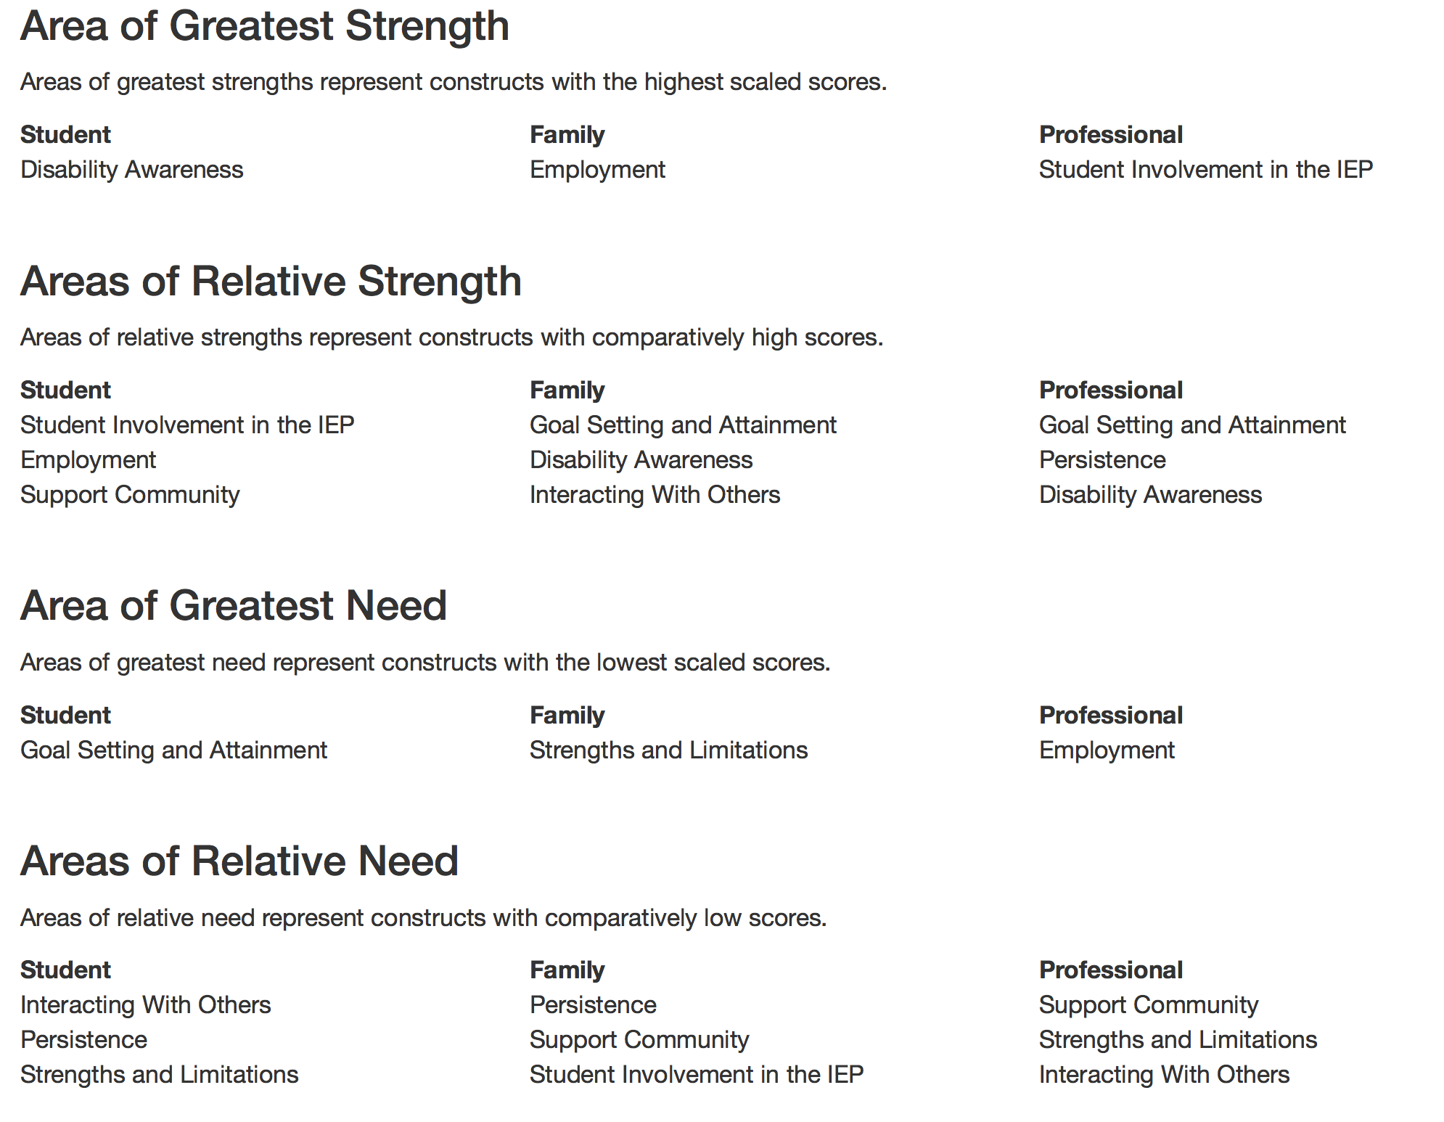

Slide 39
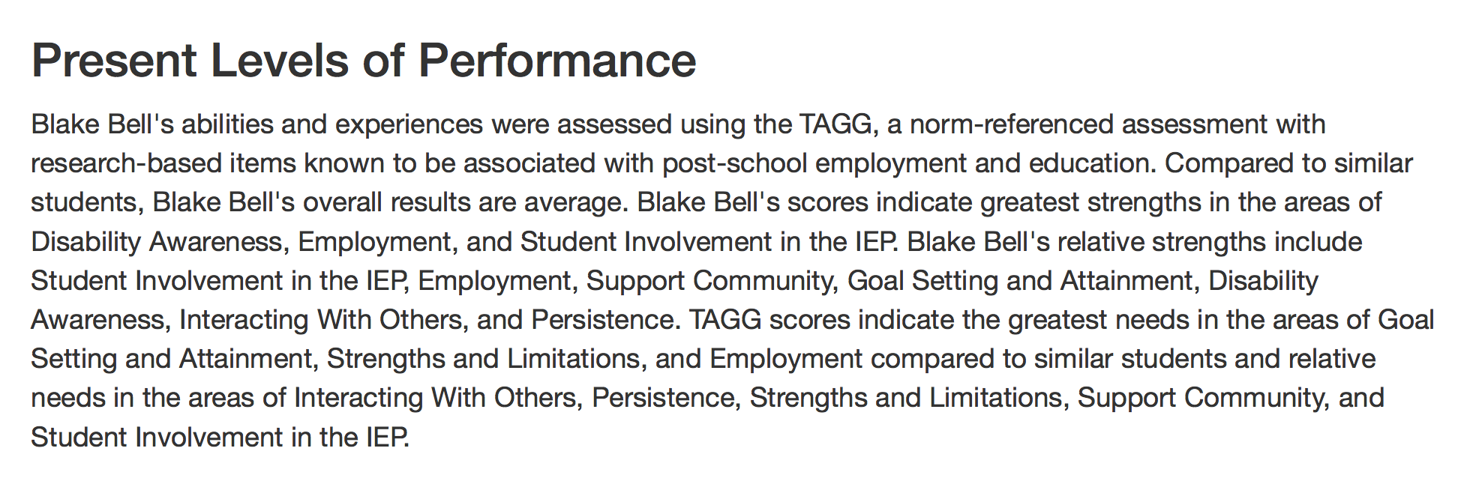

Slide 40
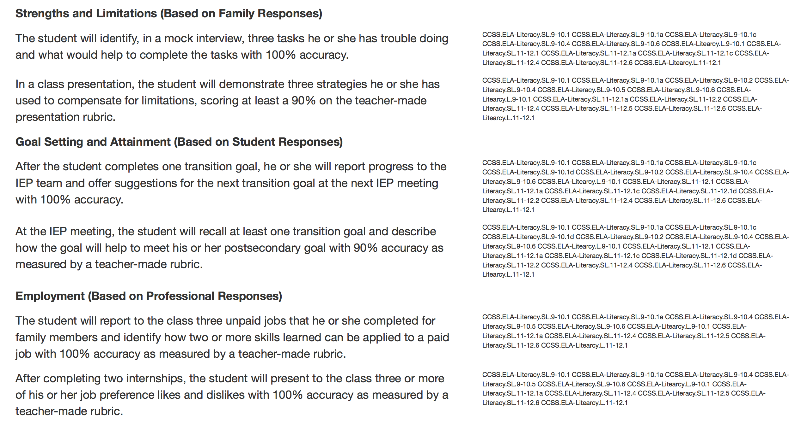

Slide 41
Annual Goals Need to Include
Condition
involve the application of skills or knowledge and describe the materials and environment necessary for the goal to be completed.
Behavior
identifies the performance that is being monitored.
Criterion
how much, how often, or to what standards the behavior must occur

Slide 42
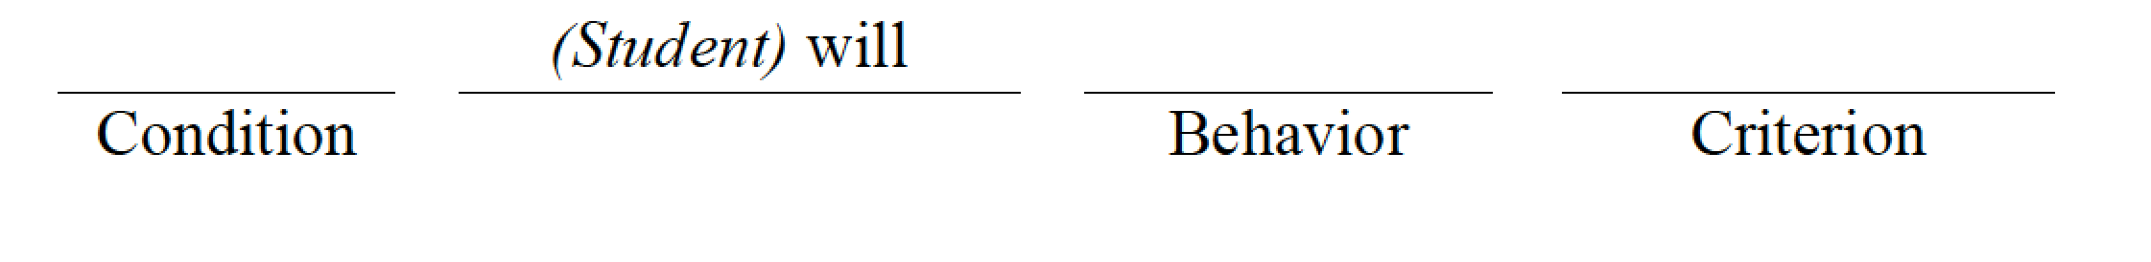
Annual Transition Goal Formula

Slide 43
Sample Annual Goal TPI 2 Modified
Education/Training: Given information from the local CareerTech, Jane will report admission requirements and deadlines, name of disability service provider at CareerTech to her IEP team, and set up an appointment with the CareerTech disability provider with 100% accuracy.

Slide 44
Living & Leisure Assessments
Part 2 of the 5-Part Transition Assessment Model

Slide 45
Living & Leisure Assessments
Life Skills Inventory (free)
Casey Life Skills (free)
Adaptive Behavior Scale
Vineland Adaptive Behavior Scale
Support Intensity Scale

Slide 46
Life Skills Inventory
15 domains (money, hygiene, safety, etc)
Four levels: basic, intermediate, advanced, exceptional
Must know 3 of 5 to advance from basic to intermediate
Must know the person or have family member complete
Cost: free
Available at:
www.dshs.wa.gov/word/ms/forms/10_267.doc

Slide 47
Casey Life Skills
Level 1
33 item assessment
Appropriate for individuals with reading or developmental disabilities
5 areas of
Communication
Daily living
Home life
Self-Care
Work and study skills
Cost: Free
Available from: http://lifeskills.casey.org

Slide 48
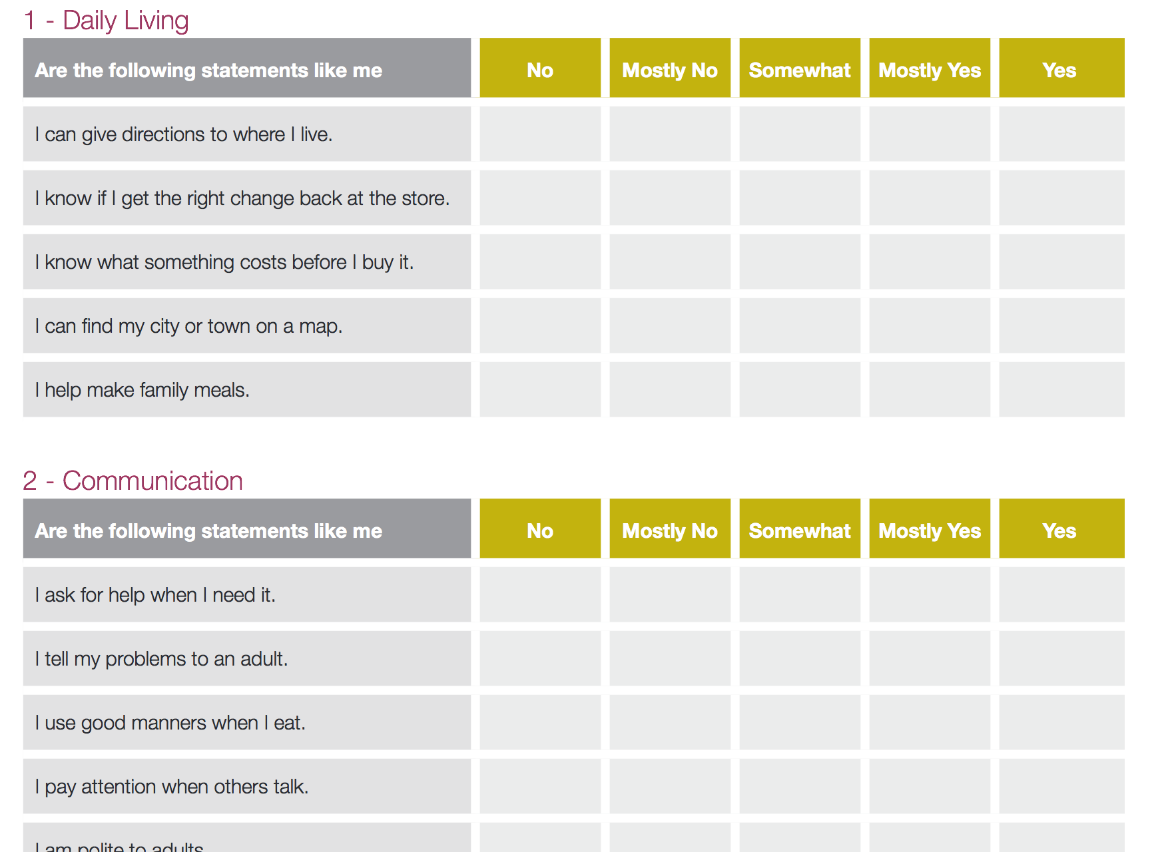

Slide 49
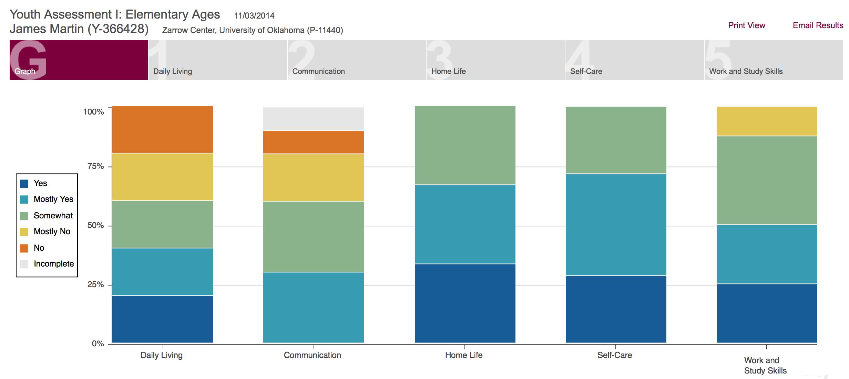

Slide 50
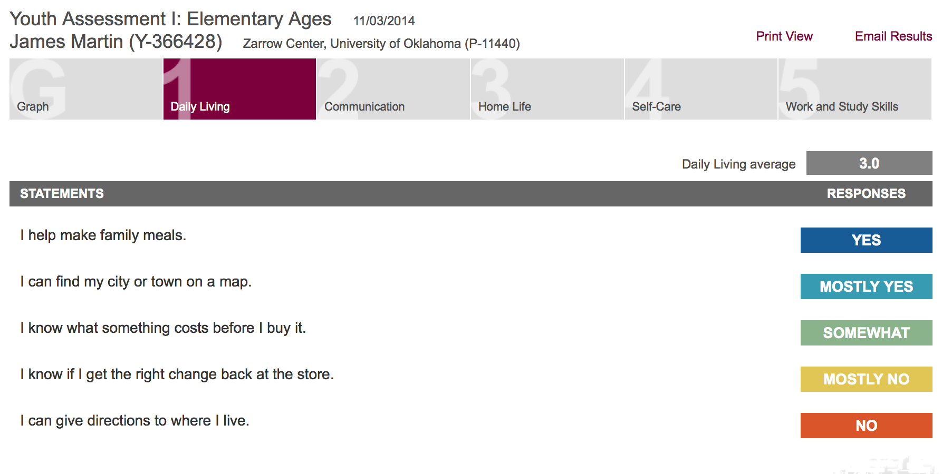

Slide 51

ABS-S:2 Adaptive Behavior Scale - School 2nd Ed.
Cost
ABS-S:2 25/pkg $76
Available from
https://ecom.mhs.com/%28S%28pmlcywvhxue20x55pthvrs45%29%29/inventory.aspx?gr=edu&prod=abss2&id=pricing&RptGrpID=abc

Slide 52
ABS School - 2
Adaptive skills necessary for educational and residential settings
Designed to make diagnostic, placement and programming decisions for students with ID and ED
Assesses 10 areas of adaptive skills grouped under three domains
School version standardized on 3,288 students
Home version standardized on 1,998 students

Slide 53
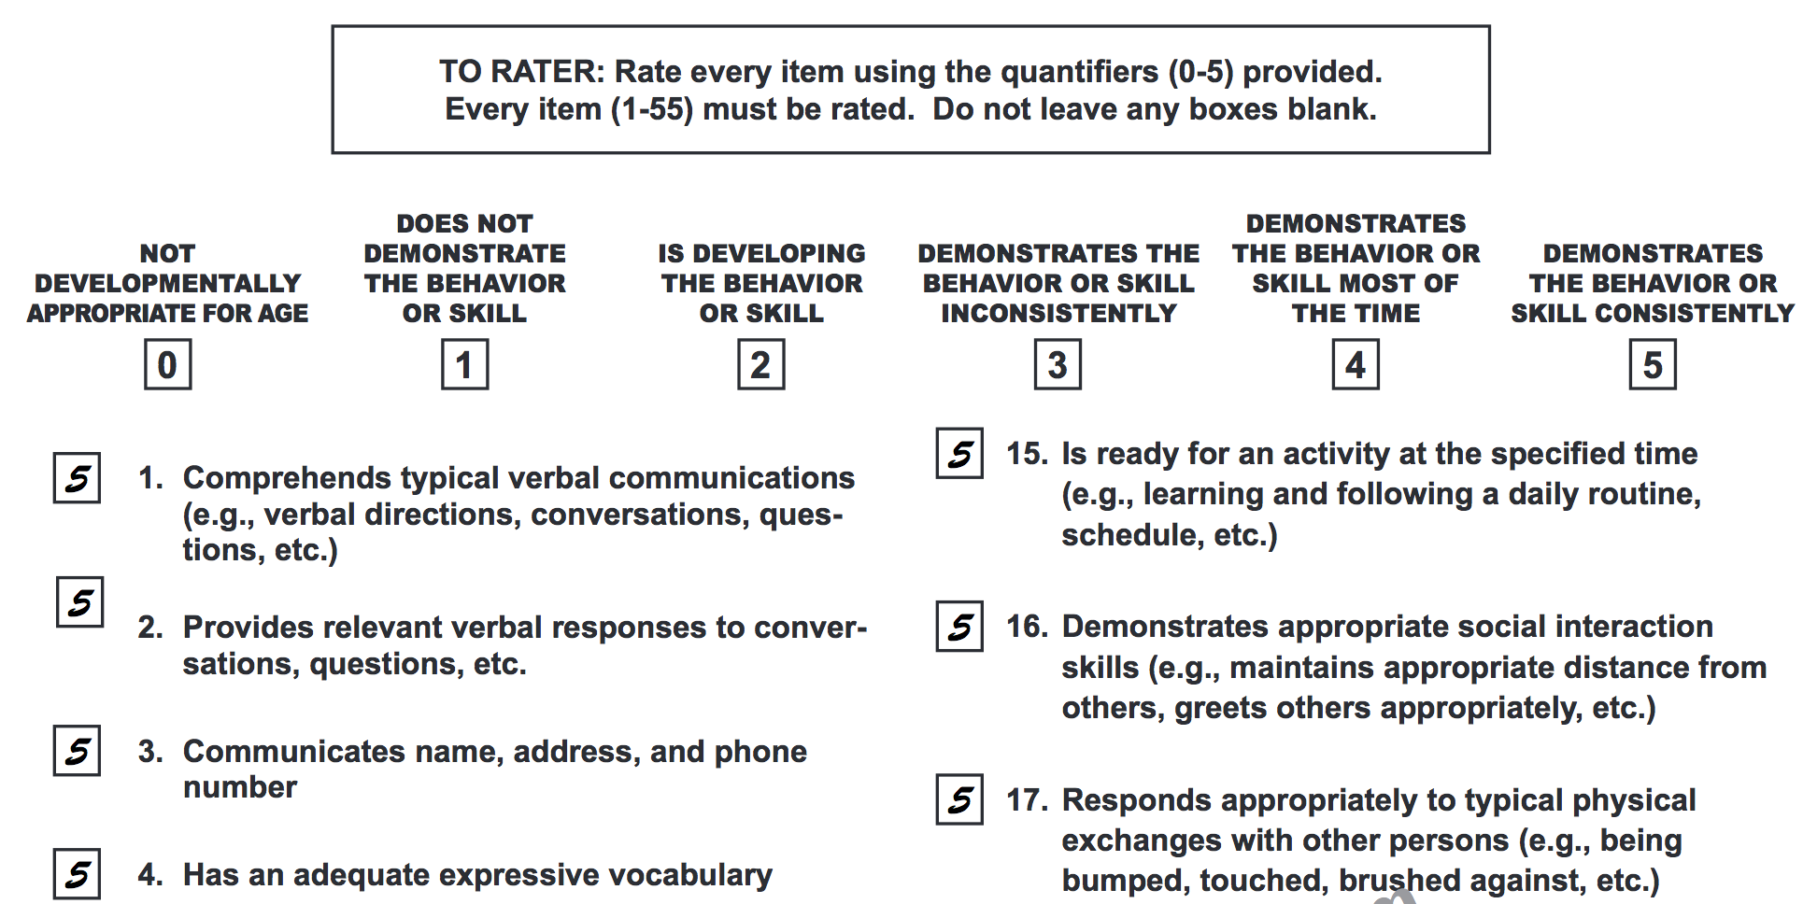

Slide 54
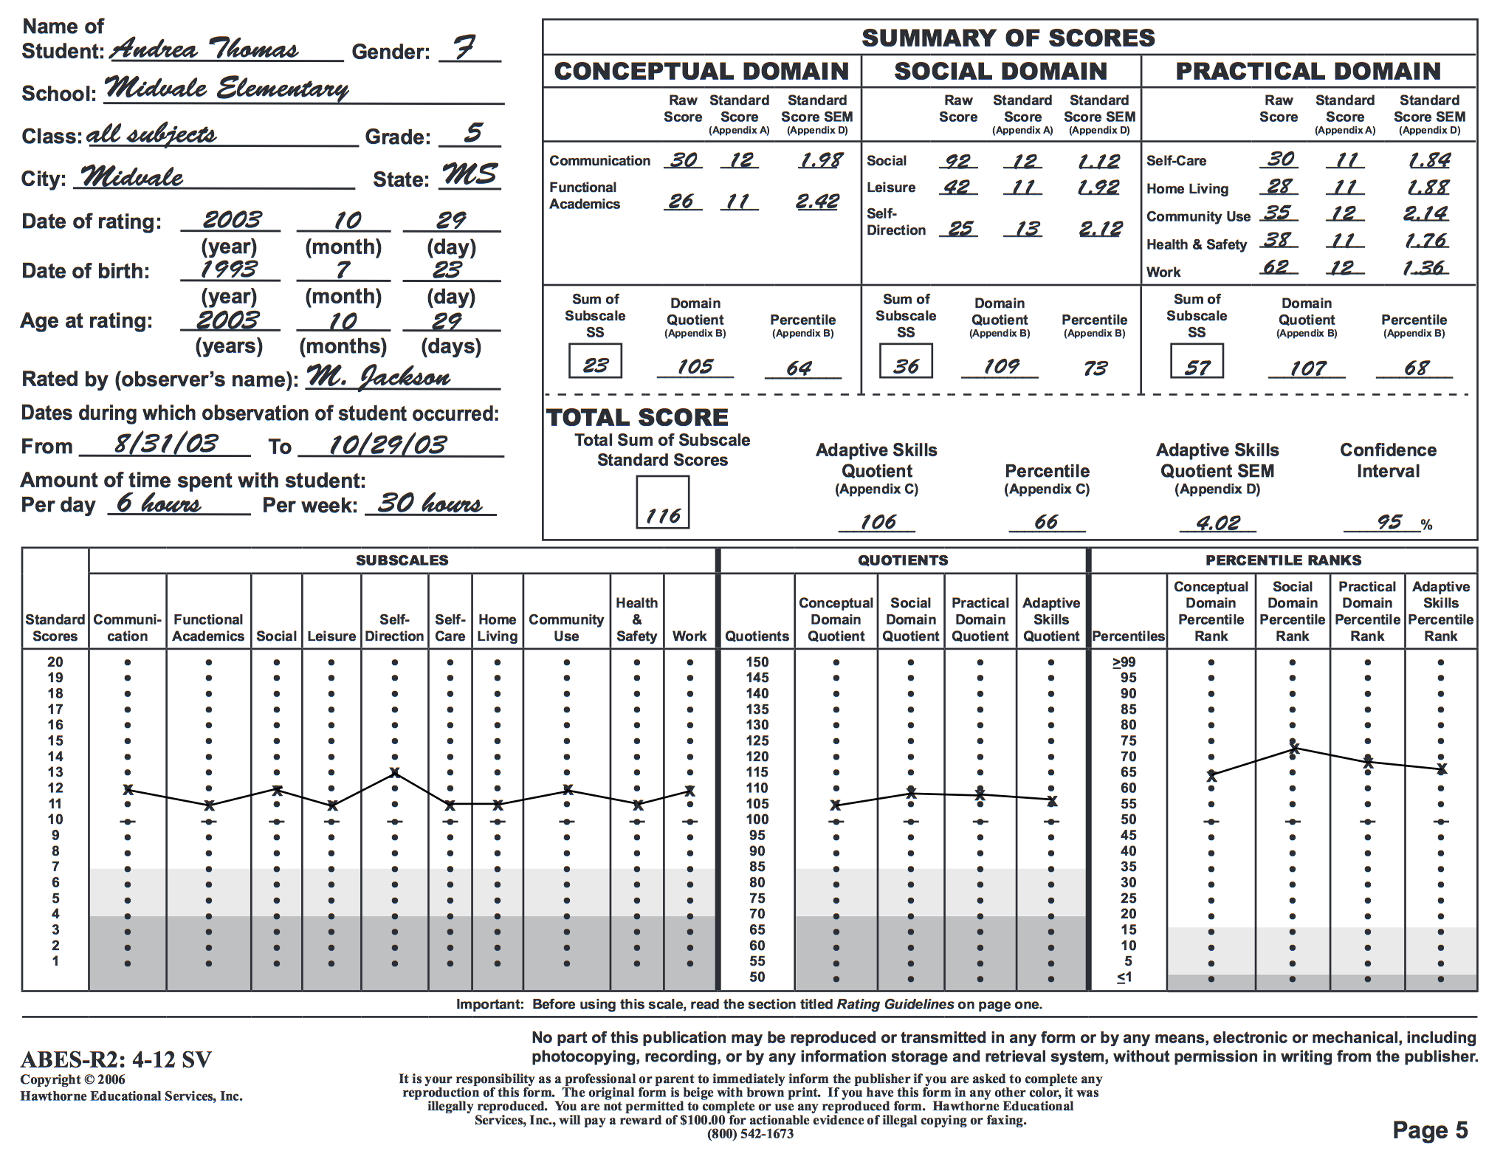

Slide 55
Vineland Adaptive Behavior Scales Second Edition (2005)
Norm Referenced, thus aids in classifying and diagnosing intellectual and developmental disabilities
Norm Referenced, Ages: Birth – 90
Spanish version
Time
Survey interview and parent/caregiver rating forms: 20 – 60 minutes
Expanded interview form: 25 – 90 minutes
Teacher rating form: 20 minutes
Main Domains: Communication, daily living skills, socialization
Optional Domains: motor skills, maladaptive behavior index
Price: About: $420 to $1,095
Available From: http://www.pearsonclinical.com/psychology/products/100000668/vineland-adaptive-behavior-scales-second-edition-vineland-ii-vinelandii.html#tab-resources

Slide 56
Supports Intensity Scales (SIS)
Norm-referenced
Over 1,200 individuals with intellectual and developmental disabilities
Ages 16 - 72
8-page interview and profile form measures:
Support needs in 87 areas
57 life activities
28 medical and behavioral areas
Areas of home living, community living, lifelong learning, employment, health and safety, social activities, and protection and advocacy
Conducted through interview and with consumer and those who know the individual well
Identifies frequency of support, amount of support, type of support for various home, work, and community tasks.
Supports Intensity Scale is generated from scores from all items
FAQs: http://aaidd.org/sis/product-information/faqs#.VFfGqb72pcA
Cost: 25 interview forms and technical manual: $150
Available at www.aaidd.org/sis

Slide 57
Annual Goals Need to Include
Condition
involve the application of skills or knowledge and describe the materials and environment necessary for the goal to be completed.
Behavior
identifies the performance that is being monitored.
Criterion
how much, how often, or to what standards the behavior must occur

Slide 58
Annual Transition Goal Formula

Slide 59
Sample Annual Goal Life Skills Inventory
Given community-based instruction on grocery shopping and a grocery list, Phil will independently navigate the grocery store, locate items on the grocery list, and purchase items 3 out of 4 times.

Slide 60
Sample Annual Goal Personal Preference Indicators
Employment: After completing job shadowing experiences at a local flower shop and/or party store, John will communicate to the IEP team his preference and why with 100% accuracy.

Slide 61
Vocational Interests & Skills Assessments
Part 3 of the 5-Part Transition Assessment Model
Pre-Made Commercial & Free Assessments
Functional Community-Based Assessment

Slide 62
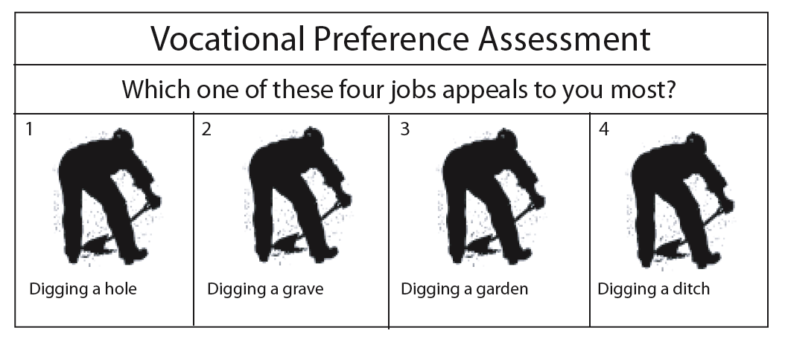

Slide 63
Employment Outcomes
Individual Competitive Employment
Individual Supported Employment
Group Supported Employment
At Home or Community-Based Entrepreneurial Jobs

Slide 64
List of Assessments
Examples
Pictorial Interest Inventory (free)
Illustrated Interest Inventory (free)
COPS-PICS
Non-Examples
Reading Free Interest Inventory
Functional Community-Based Assessments

Slide 65
Pictorial Interest Inventory
Color Photos presented 3 per page
User places mark below liked picture
Count marks by type of jobs
Eight types of entry-level or minimal training jobs
Five or more jobs for each area
Simple score sheet
Cost: free
Available at: http://www.capregboces.org/ProgramsServices/EdSupportServices/RSE-TASC/PDFs/PictoralInterestInventory.pdf

Slide 69
Career Interest Inventory - Illustrated
6 career areas with interesting names
Realistic: The Doer
Investigative: The Thinker
6 jobs per each career area
User checks preferred jobs under each area
Summary identifies set of pictures enjoyed the most
Free
Available from: http://www.capregboces.org/ProgramsServices/EdSupportServices/RSE-TASC/PDFs/PictureCareerInterest_Inventory.pdff

Slide 71
Scoring System
Career Interest Inventory -- Pictorial Version

Slide 72


COPS-PIC
Non-Verbal Assessment of Occupational Interest
EDITS / P.O. Box 7234 / San Diego, CA 92167
800-416-1666 / 619-222-1666 / Fax 619-226-1666
25 copies for $50.90

Slide 73
Non-Example: Reading Free Interest Inventory
Published by Pro Ed
http://www.proedinc.com/customer/productView.aspx?ID=3052
Price: $110

Slide 74
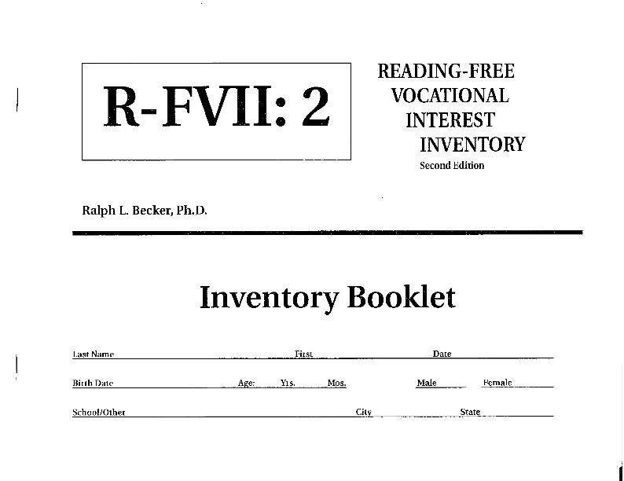

Slide 75
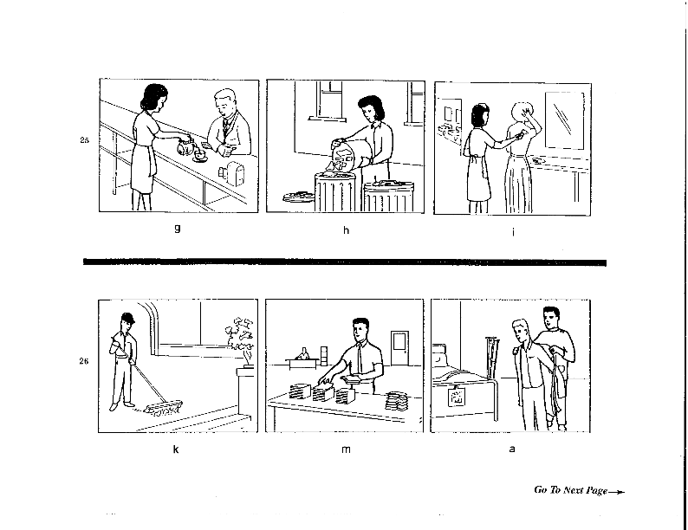

Slide 76
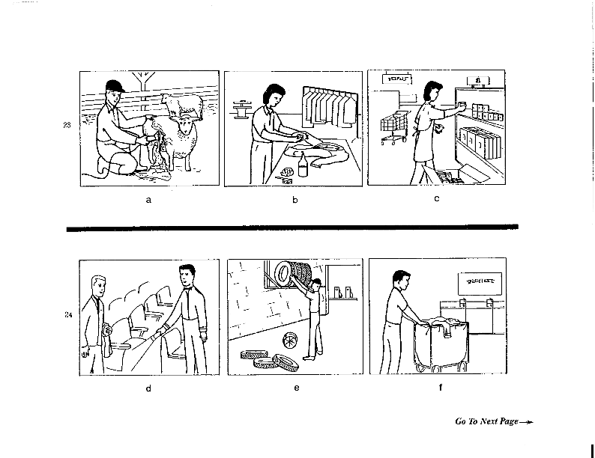

Slide 77

Functional Community-Based Assessment
Most Reliable and Valid Method for Many Students with Significant and Multiple Disabilities

Slide 78
What Does the Law Say?
. . . and when appropriate . . . functional vocational evaluation.
When to consider what’s appropriate?
When paper-pencil or computer-based interest inventories simply do not work
What is it?
Tools that student’s use to make a job match.

Slide 79



Functional Assessment Process
Takes Place in the Community
Over time
Repeated Measures

Slide 80
Takes Advantage of Discrepancy Problems
Logical choice making occurs when chosen preferences match available jobs.
Discrepancy problems occur when
Chosen job, task, and characteristics do not match specific jobs
Discrepancy problems diminish when job site characteristics match preferences
Task is to provide ample opportunities for students to determine matches and non-matches.

Slide 81
Job Characteristics I Like
Teach Job Characteristics
Introduces Match Concept between
What I like
What’s at their job
Computes % of Matches

Slide 82
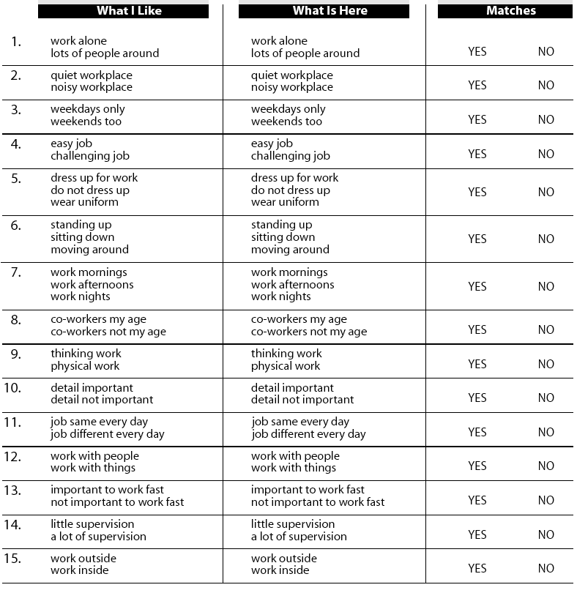
Key: Determine Match Between What I Like and What’s At Their Site

Slide 83
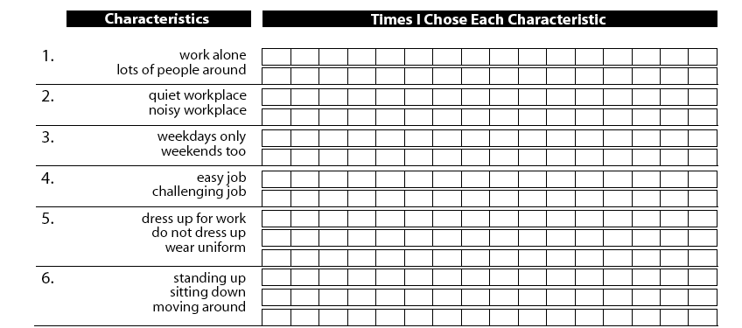
Each time student chooses a characteristic one more cell on the graph is marked

Slide 84
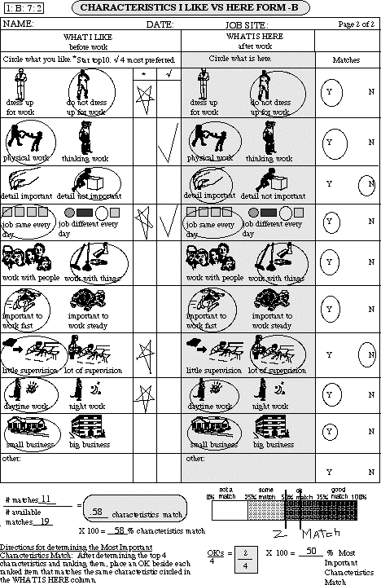
Characteristics I Like vs Here
Compares initial preferences to those experienced at a particular job site.

Slide 85

Job Duties I Like
Identifies job duties
Based upon current job or work experience
Assess preferences for job duties
Calculate % of Job Duties I Like

Slide 86
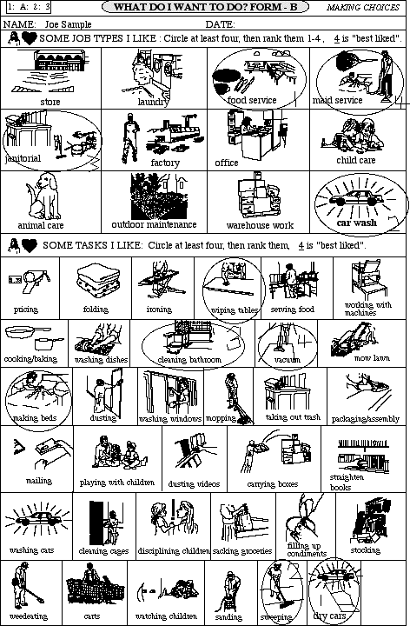
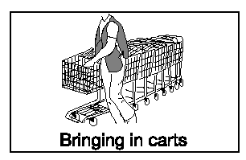

What Do I Like?

Slide 87
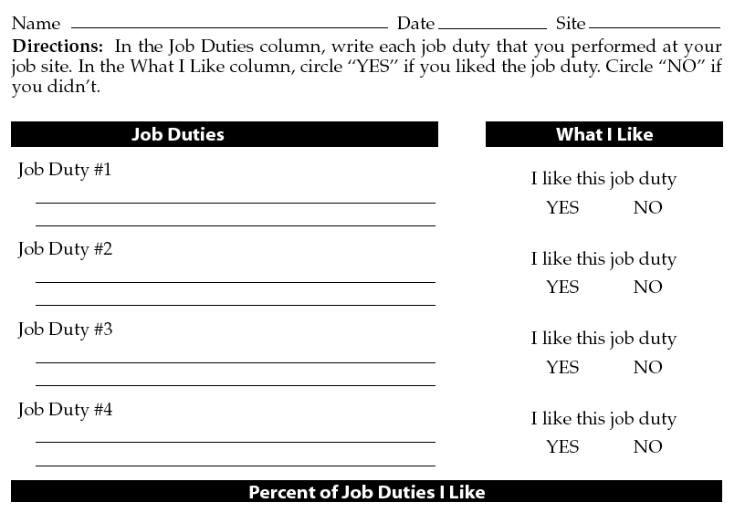

Slide 88

Job Duties - How I Did
Job duties identified and written onto form
Student evaluates speed, independent performance, and accuracy
Supervisor evaluates speed, independent performance, and accuracy
Match made between student and supervisor

Slide 89
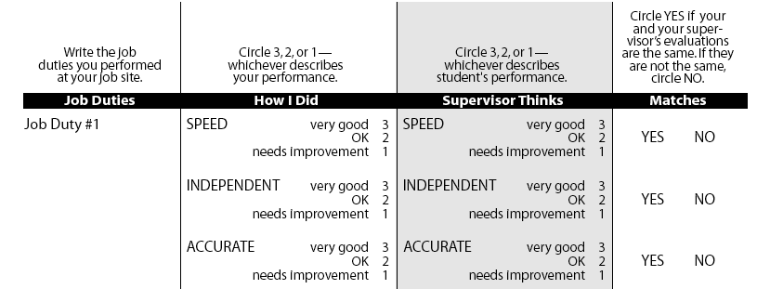
Uses self-evaluation methodology to teach job performance skills and to assess job duty skills

Slide 90


Work, Social, & Personal Skills
Student rates performance
Supervisor or teacher rate performance
Calculates what supervisor thinks
Calculates match between worker and supervisor

Slide 91
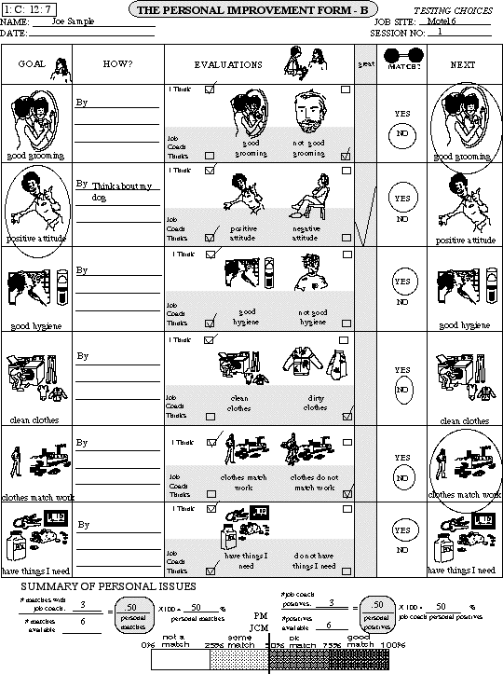
Personal Improvement Contract

Slide 92
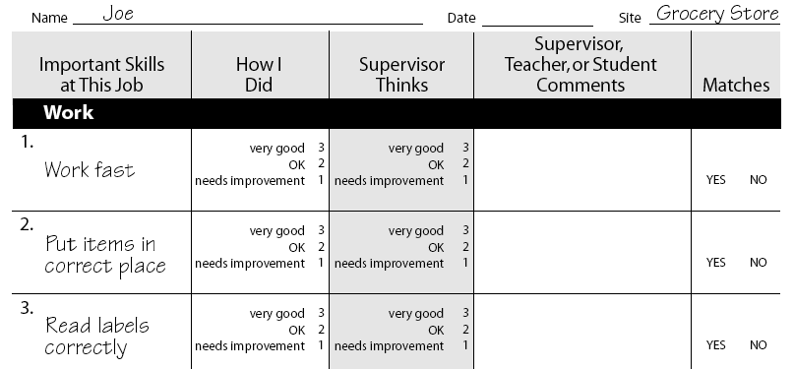
Self-Determination Contracts to solve on-the job problems

Slide 93
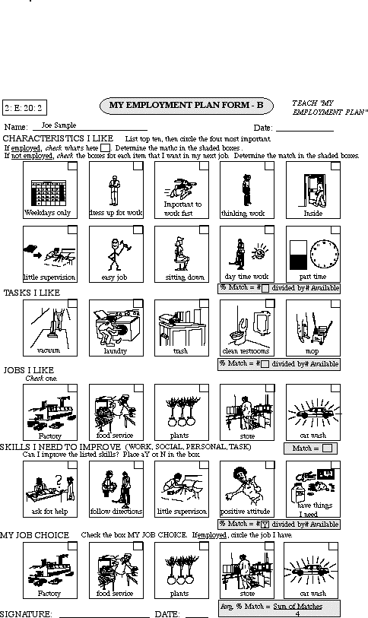
My Employment Plan

Slide 94
Illustrations Take From
Download free work illustrations
www.brookespublishing.com/picturebank
The forms and other situational assessment materials will on the Zarrow Center web site this spring semester.
Can do the same with digital pictures from your own camera
Often camera pick-up too much detail

Slide 95
Your Employment Selections (YES)
Uses videos of many jobs – some entry level, many complex
Student watches and picks desired jobs
Available at: http://www.yesjobsearch.com
Cost: Individual use for 3 months $20

Slide 96
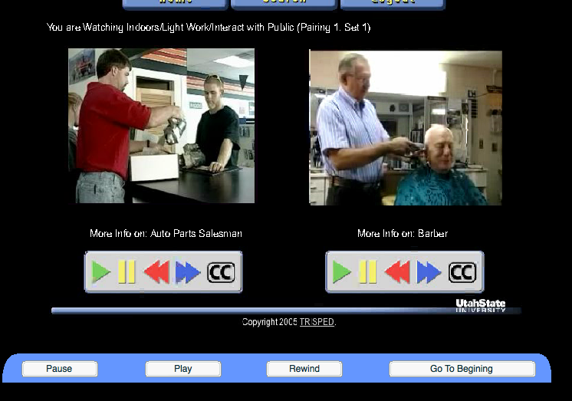

Slide 97
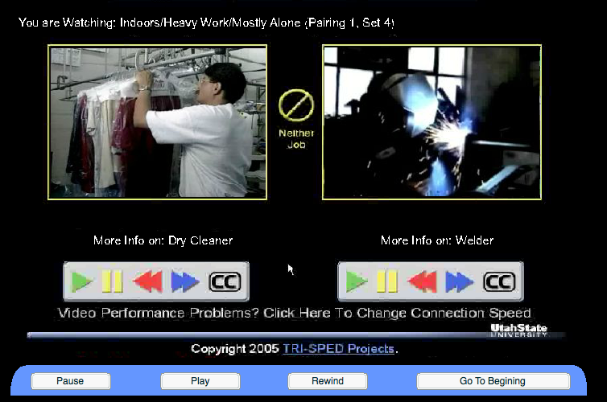

Slide 98
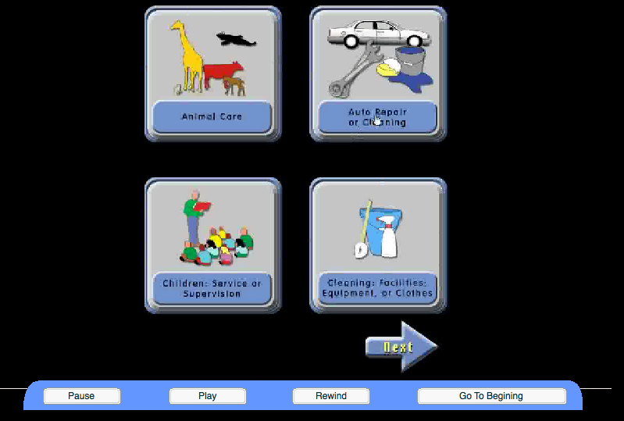

Slide 99
Career Awareness & Exploration via Video
Video by Job Clusters
Video
http://jobs4jersey.com/jobs4jersey/toolkit/video/englishvideos_captioned.html
Provides numerous videos for students to watch
English or Spanish
Job cluster and skill categories
Horse Training
Coast Guard Assistant
Construction Workers

Slide 100
Self-Determination Assessments
Part 4 of the 5-Part Transition Assessment Model
s.

Slide 101
Why SD Assessment?
Improved postsecondary outcomes
Goal setting during early adolescence
Awareness of disability
Goal attainment
Improved academic performance
Limited studies so far

Slide 102
AIR Self-Determination Assessment
Parent Version
Teacher Version
Student Version
Available at
http://www.ou.edu/content/education/centers-and-partnerships/zarrow/self-determination-assessment-tools/air-self-determination-assessment.html
Cost: free

Slide 103
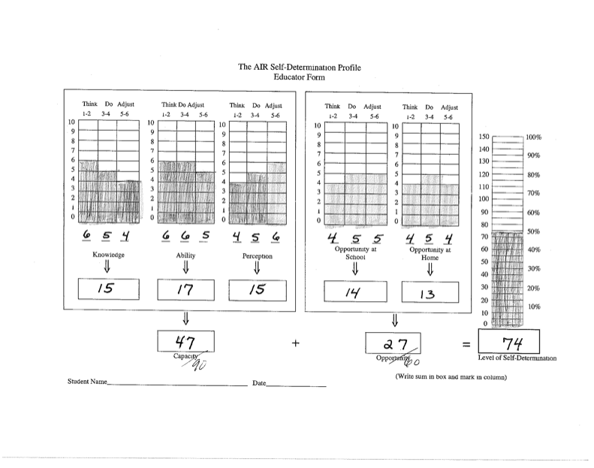

Slide 104
ARC Self-Determination Assessment
Student version
Must use the manual to score
Cost: free
Available at http://www.ou.edu/content/education/centers-and-partnerships/zarrow/self-determination-assessment-tools/arc-self-determination-scale.html

Slide 105
Field and Hoffman SD Assessments
Self-Determination Assessment
SD Student Scale
SD Parent Perception Scale
SD Advisor (Teacher) Scale
Cost: $3.25 each (minimum of 10)
Available at: http://www.ealyeducation.com

Slide 106
ChoiceMaker SD Assessment
Curriculum Referenced Assessment
Choosing Goals
Participating in IEP Meetings
Taking Action on Goals
Cost: Free (available spring semester)
Available at: http://www.ou.edu/content/education/centers-and-partnerships/zarrow/self-determination-assessment-tools.html

Slide 107
ChoiceMaker Assessment Example
Student Leading Meeting (1, 2, 3, 4 scale)
Begin meeting by stating purpose
Introduce participants
Review past goals
Ask for feedback
Ask question if don’t understand
Deal with differences in opinion
State need support
Close meeting by summarizing

Slide 108
Further Education Assessments
Part 5 of the 5-Part Transition Assessment Model

Slide 109
Guide to Assessing College Readiness
Five Domains
Academic Skills
Self-Understanding
Self-Advocacy
Executive Functioning
Motivation and Confidence
Read each item with student and discuss
Provides Assessment for Self-Advocacy to include in annual transition goals
Cost: Free.
Available fromhttp://www.landmark.edu/m/uploads/16721%20Guide%20to%20Readiness%20v5pgs(1).pdf

Slide 110
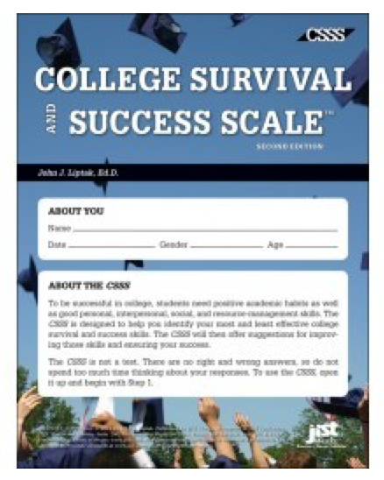
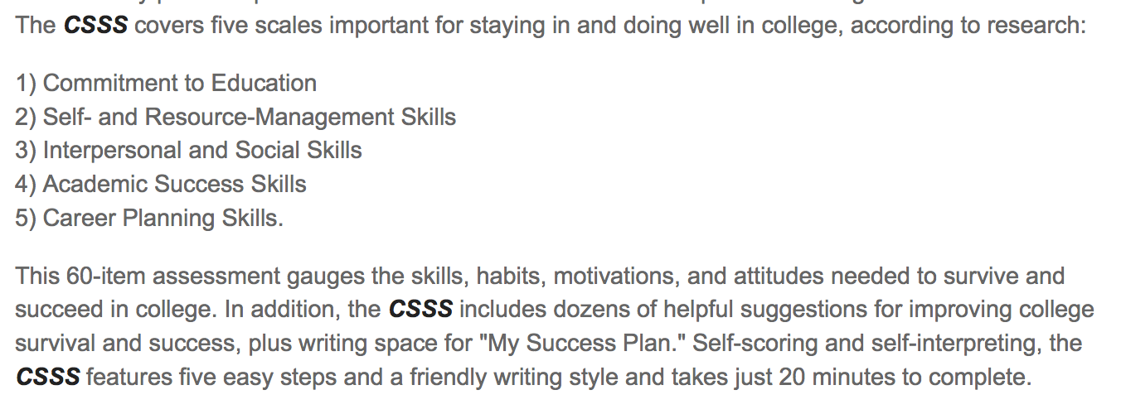
College Survival and Success Scale
http://jist.emcp.com/college-survival-and-success-scale.html
Price: $57.95

Slide 111

Collaborative Effort
Notes:
Lauren:
Here’s where you have the group do the pipe cleaner activity again…have them create something that tells us how they think of that student they addressed at the beginning…what’s their future like now??
They will also likely ask you lots of questions…and maybe some of the rest of us too!

Slide 113

University of Oklahoma
Zarrow Center
338 Cate Center Drive, Room 190
Norman, OK 73019
Phone: 405-325-8951
Web: http://zarrowcenter.ou.edu
For More Information Contact
E-mail Jim: jemartin@ou.edu
E-mail Amber: ambermcc@ou.edu
E-mail Jennifer: jennifer.burnes@ou.edu

