Slide 1
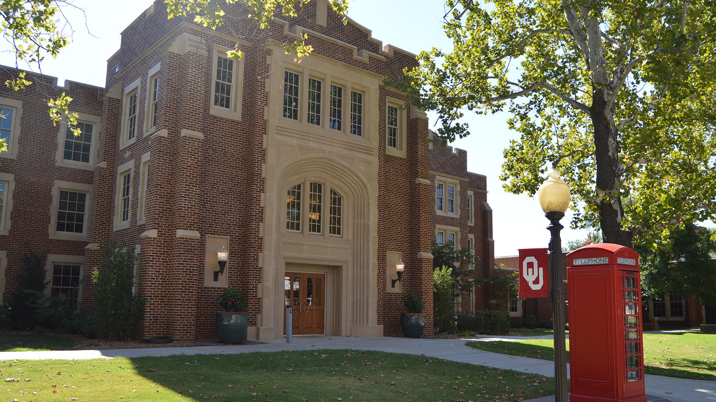
Welcome
We are happy that you are here. Let us know if you have questions. We want to help you get to know CESL, the University, and Norman!

Slide 2
9:15 Welcome and introductions
9:30 CESL Information Presentation
10:45 Complete forms, student survey
11:30 Campus Tour, Sooner Card Office
TODAY'S AGENDA

Slide 3
USCIS Information
from International Student Services
https://prezi.com/view/ls2M6vOd5xmyI47K2MVQ/

Slide 4

Students, faculty and staff on the Norman campus are expected to complete the Healthy Together App Passport whenever they can answer YES to any of the questions listed here:
•Have you experienced symptoms that could be consistent with COVID-19 in the past 10 days, such as fever or chills, cough, shortness of breath or difficulty breathing, muscle or body aches, headache, new loss of taste or smell, sore throat, congestion or runny nose, nausea or vomiting, and/or diarrhea?
•Have you tested positive for COVID-19 within the last 10 days?
•Have you had close contact, either at work, at home or in the community, with an individual diagnosed with COVID-19 in the last 10 days? (A close contact is generally someone who has been near a person with COVID-19 for at least 15 minutes when health and safety measures, e.g. wearing a mask, were not in place or were insufficient.)
•Have you traveled internationally (airplane, train, bus, boat, cruise, etc.) within the last 10 days?
USE THE
Healthy Together App

Slide 5
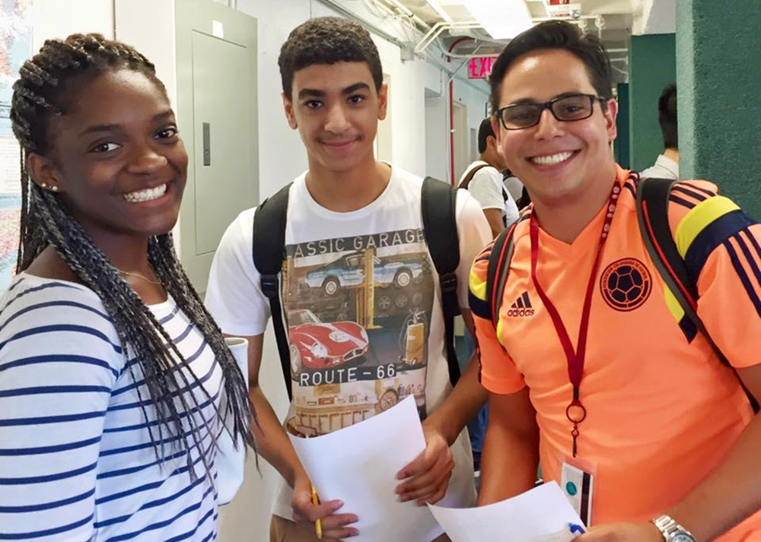
CESL SCHEDULE AND CLASSES

Slide 6
Beginning: A1/A2
Intermediate: B1
Advanced: B2
Your teachers will continue evaluating you in the first week.
Please talk to your teachers on the first day of class if you have any concerns about your level.
CEFR levels – for more information, see https://www.coe.int/en/web/common-european-framework-reference-languages/table-1-cefr-3.3-common-reference-levels-global-scale
CESL LEVELS

Slide 7
CESL STUDENT SCHEDULE
Morning 9:00 - 11:50 am:
Core classes: Reading, Writing, Listening, Speaking, Grammar, Attendance
Afternoon 1:00 - 2:50 pm:
IELTS Test Preparation
OU Track: University Preparation
Everyday English

Slide 8

Ping ID uses your OU NET ID (a.k.a. your 4x4 (four by four))
You MUST have Ping ID to access canvas, email, or other OU services at your house (or other places that aren’t OU) (e.g. when you do your homework)
You can either:
1. Log-in here and register a new device
OR
2. download the ping id app
PING ID

Slide 9
OU EMERGENCY ALERTS
OU Emergency alerts will tell you when school is closed
(and other important information)
CESL recommends all students sign up for emergency alerts

Slide 10
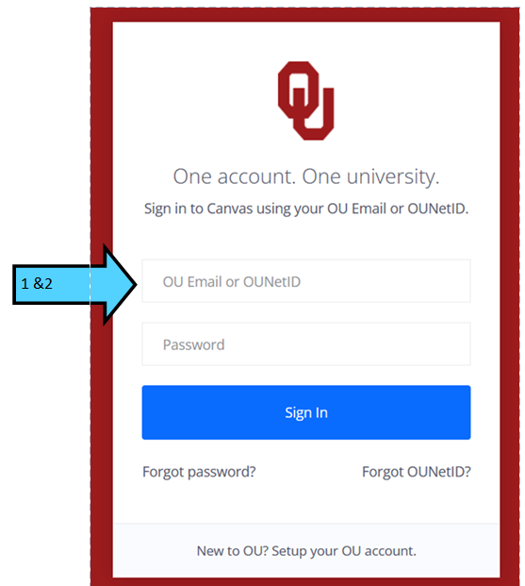

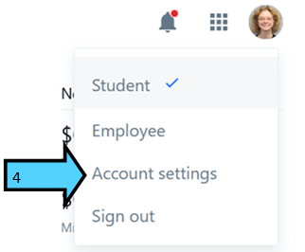
OU EMERGENCY ALERTS
How to sign up:
1. Go to one.ou.edu
2. log-in with your OU NET ID (your 4x4) and your password.
3. click on your picture
4. click “Account settings”

Slide 11
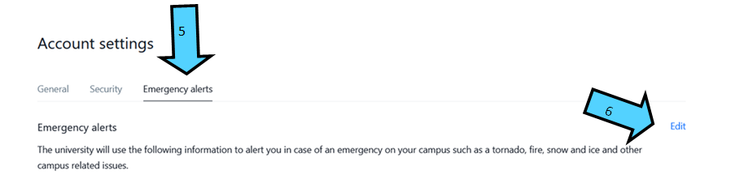
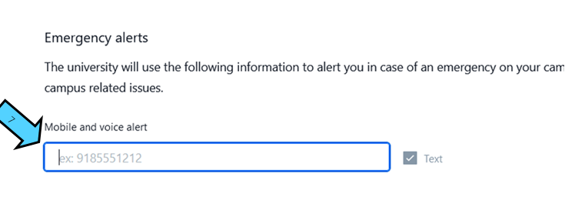
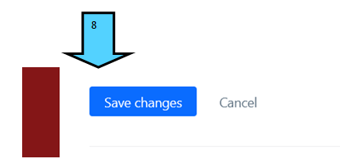
OU EMERGENCY ALERTS
How to sign up:
5. Click “Emergency Alerts”
6. Click “Edit”
7. type your phone number
8. click “save changes”

Slide 12
Meet with your morning instructor during their office hours to discuss…
•Schedule changes
•Problems you are having in class
•Questions about policies or homework
•Information about Norman and Oklahoma
Remember - if you have a problem, talk to your morning instructor.
INSTRUCTOR OFFICE HOURS

Slide 13
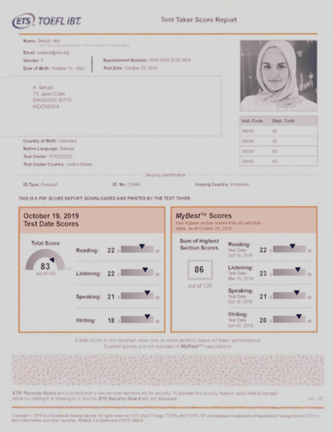
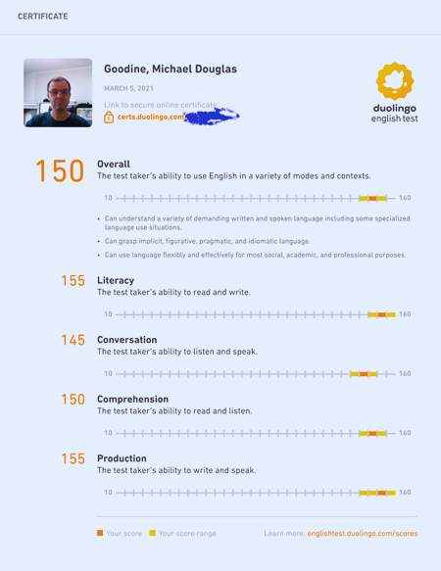
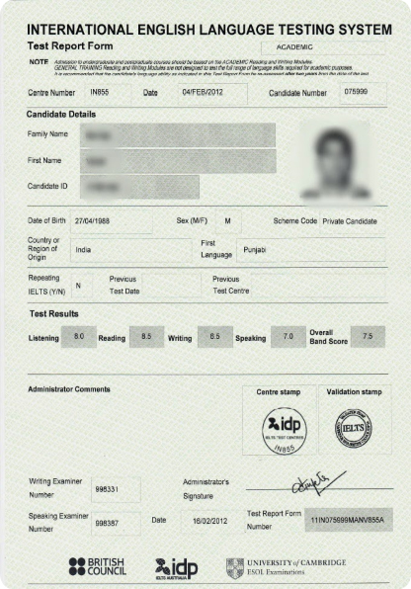
  If you have already taken an English proficiency test, please bring us a copy of your score as soon as possible.
  If you have registered to take an exam, please let us know what date you are taking the test.
TEST SCORES

Slide 14
OU requires the following test scores for admission to OU Track, followed by 2 sessions at the advanced level :
  Undergraduates: IELTS 5.5, TOEFL iBT 61, Pearson 45, Duolingo 90 (or higher)
  Graduate students: please check the OU website for the specific test requirements for your major and deadlines for acceptance into your degree program.
  If you have questions, please contact: Hilary Kirk, OU Track Program Coordinator, hilarykirk@ou.edu
OU TRACK

Slide 15
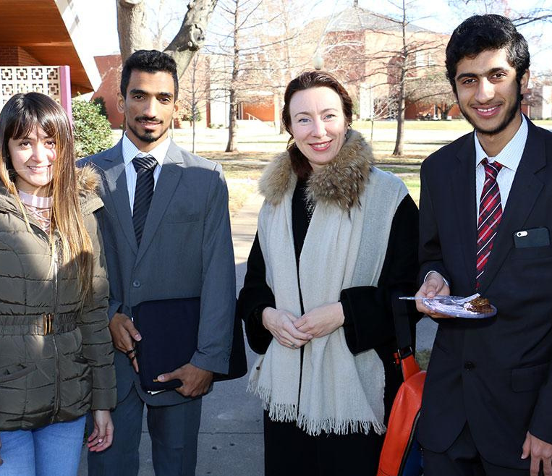
CESL POLICIES AND PROCEDURES

Slide 16
CESL GRADING POLICY
  Students move up levels by earning As and Bs in their courses.
  A grade of C indicates that the student has not yet achieved proficiency at that level and will need to repeat.
  Ds and Fs are considered failing grades. Students who achieve a D or an F in any course are automatically placed on Student Support and do not advance to the next level.

Slide 17
CESL GRADING POLICY
CESL uses a standard grading scale:
90-100% = A
80-89% = B
70-79% = C
60-69% = D
59% or lower = F

Slide 18
CESL ATTENDANCE POLICY
  If you must miss class, please send us a message
  If you are absent, please check the Syllabus for assignments due and call another student to find out what you missed in class. Then do the work.
  It is your responsibility to check your grades and attendance regularly and make sure you are not missing work. (If you do not know how to check, ask your teacher.)
  If you miss class more than 5 times, you automatically fail. (And a lot of absences can cause visa problems.)

Slide 19
CESL ATTENDANCE POLICY
If you arrive after class starts, you are considered late.
  Being late to class 3 times = One absence
You are also considered absent if you arrive after…
  30 minutes in a 3-hour class (core class)
  20 minutes in a 2-hour class (seminar class)
  You MUST pass the attendance class to move to the next level. (i.e. If you are in B1 and your Grammar, Reading, and Listening grades are 90% but your attendance grade is 59%, you will NOT go to B2)

Slide 20
CESL GRIEVANCE POLICY
If you have a problem with the University or CESL, we want to find a solution.
  First, talk with your core class teacher (i.e. your morning teacher).
  Talk with the director. Email Mary Martin at mary.martin@ou.edu to make an appointment.
  Talk with CIS Associate Dean, Dr. Rebecca Cruise. Make an appointment through Jennifer Grover at jgrover@ou.edu or 405.325.1396.

Slide 21
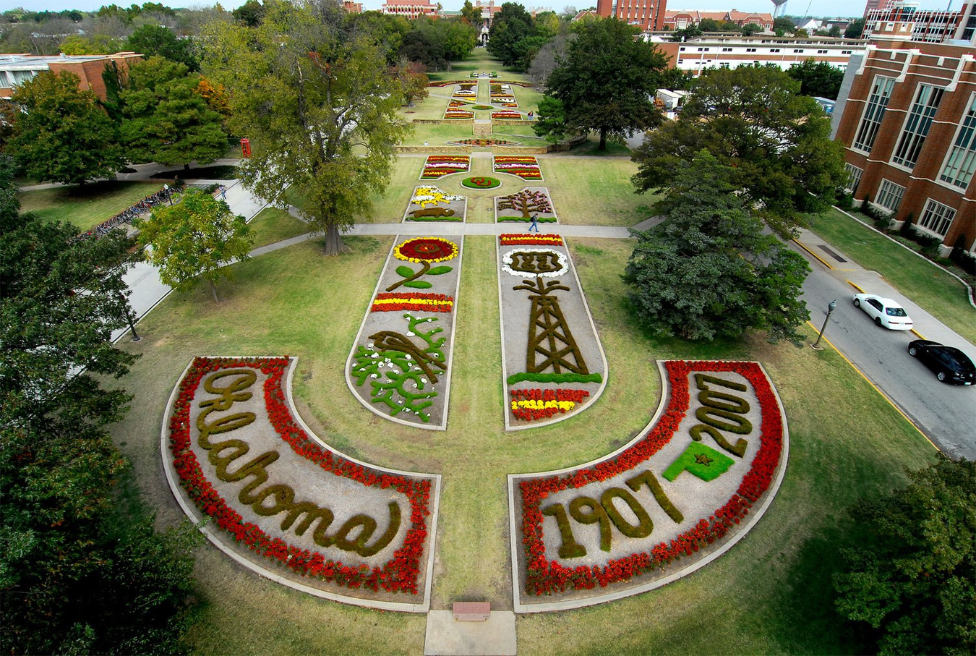
UNIVERSITY POLICIES

Slide 22

MASKING
For the health and safety of your peers and the OU community, masks will be strongly recommended while this class meets in person
If you do not have a mask, or forgot your mask, please see the instructor.

Slide 23

OU TOBACCO POLICY
Smoking (including vaping and e-cigarettes) is not allowed anywhere on the OU campus.
  If you are caught smoking on campus you will be fined.
  This includes smoking in your parked car and outside of a school building.

Slide 24
OU ALCOHOL AND DRUG POLICY
In the United States, you must be 21 years of age or older to drink.
  However, even if you are 21, OU is a dry campus - alcohol is not allowed on any university property.
  Two or more offenses in a semester mean you will have to leave OU.
Illegal drug use is prohibited on campus and in the state of Oklahoma.

Slide 25
OU POLICY ON STUDENT MISCONDUCT
Misconduct means unacceptable behavior. Examples are....
  Invading personal space – don’t get too close without asking
  Threatening someone – telling someone you will hurt them if they do not do what you want
  Stalking – following someone or trying to force them to spend time with you
  Discrimination – saying or acting like you are better than someone else because of their gender, race, religion, or sexual orientation. Everyone is equal here.
  Misconduct and harassment will be reported and investigated.

Slide 26
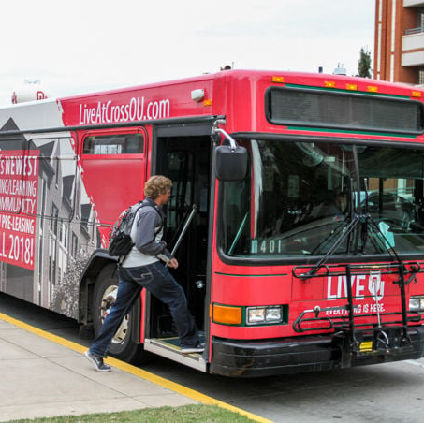
Getting Around

Slide 27

OU SAFE RIDE
SafeRide provides safe and free taxi transportation to OU students within the Norman City Limits (as outlined on the SafeRide webpage).
If you need of a ride on Thursday, Friday or Saturday evening from 10:00 p.m. to 3:00 a.m., download the OU SafeRide app.

Slide 28
OU SAFE RIDE
  Download the "OU SafeRide" app from the App Store or Google Play
  Select "Student Login"
  Enter your 4x4 and password
  Allow SafeRide to access your location
  Allow SafeRide to send notifications
  Enter your phone number
  Book a ride Thursday, Friday or Saturday from 10:00 p.m. to 3:00 a.m.
  Get your free ride!
For more information, guidelines, and policies, please visit saferide.ou.edu.

Slide 29
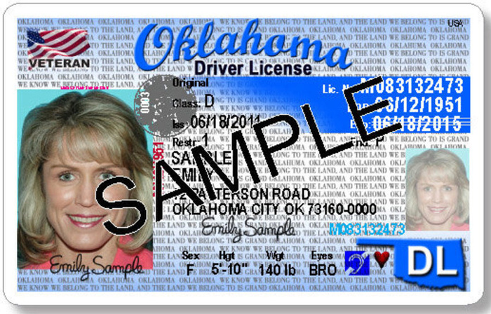
DRIVING IN OKLAHOMA
  A current, unexpired license from your home country is legal if it has your name on it.
  You must take written and driving tests to get an Oklahoma driver’s license.
  You must purchase car insurance if you own a car.

Slide 30
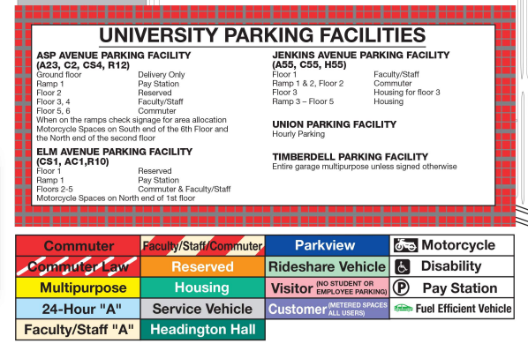
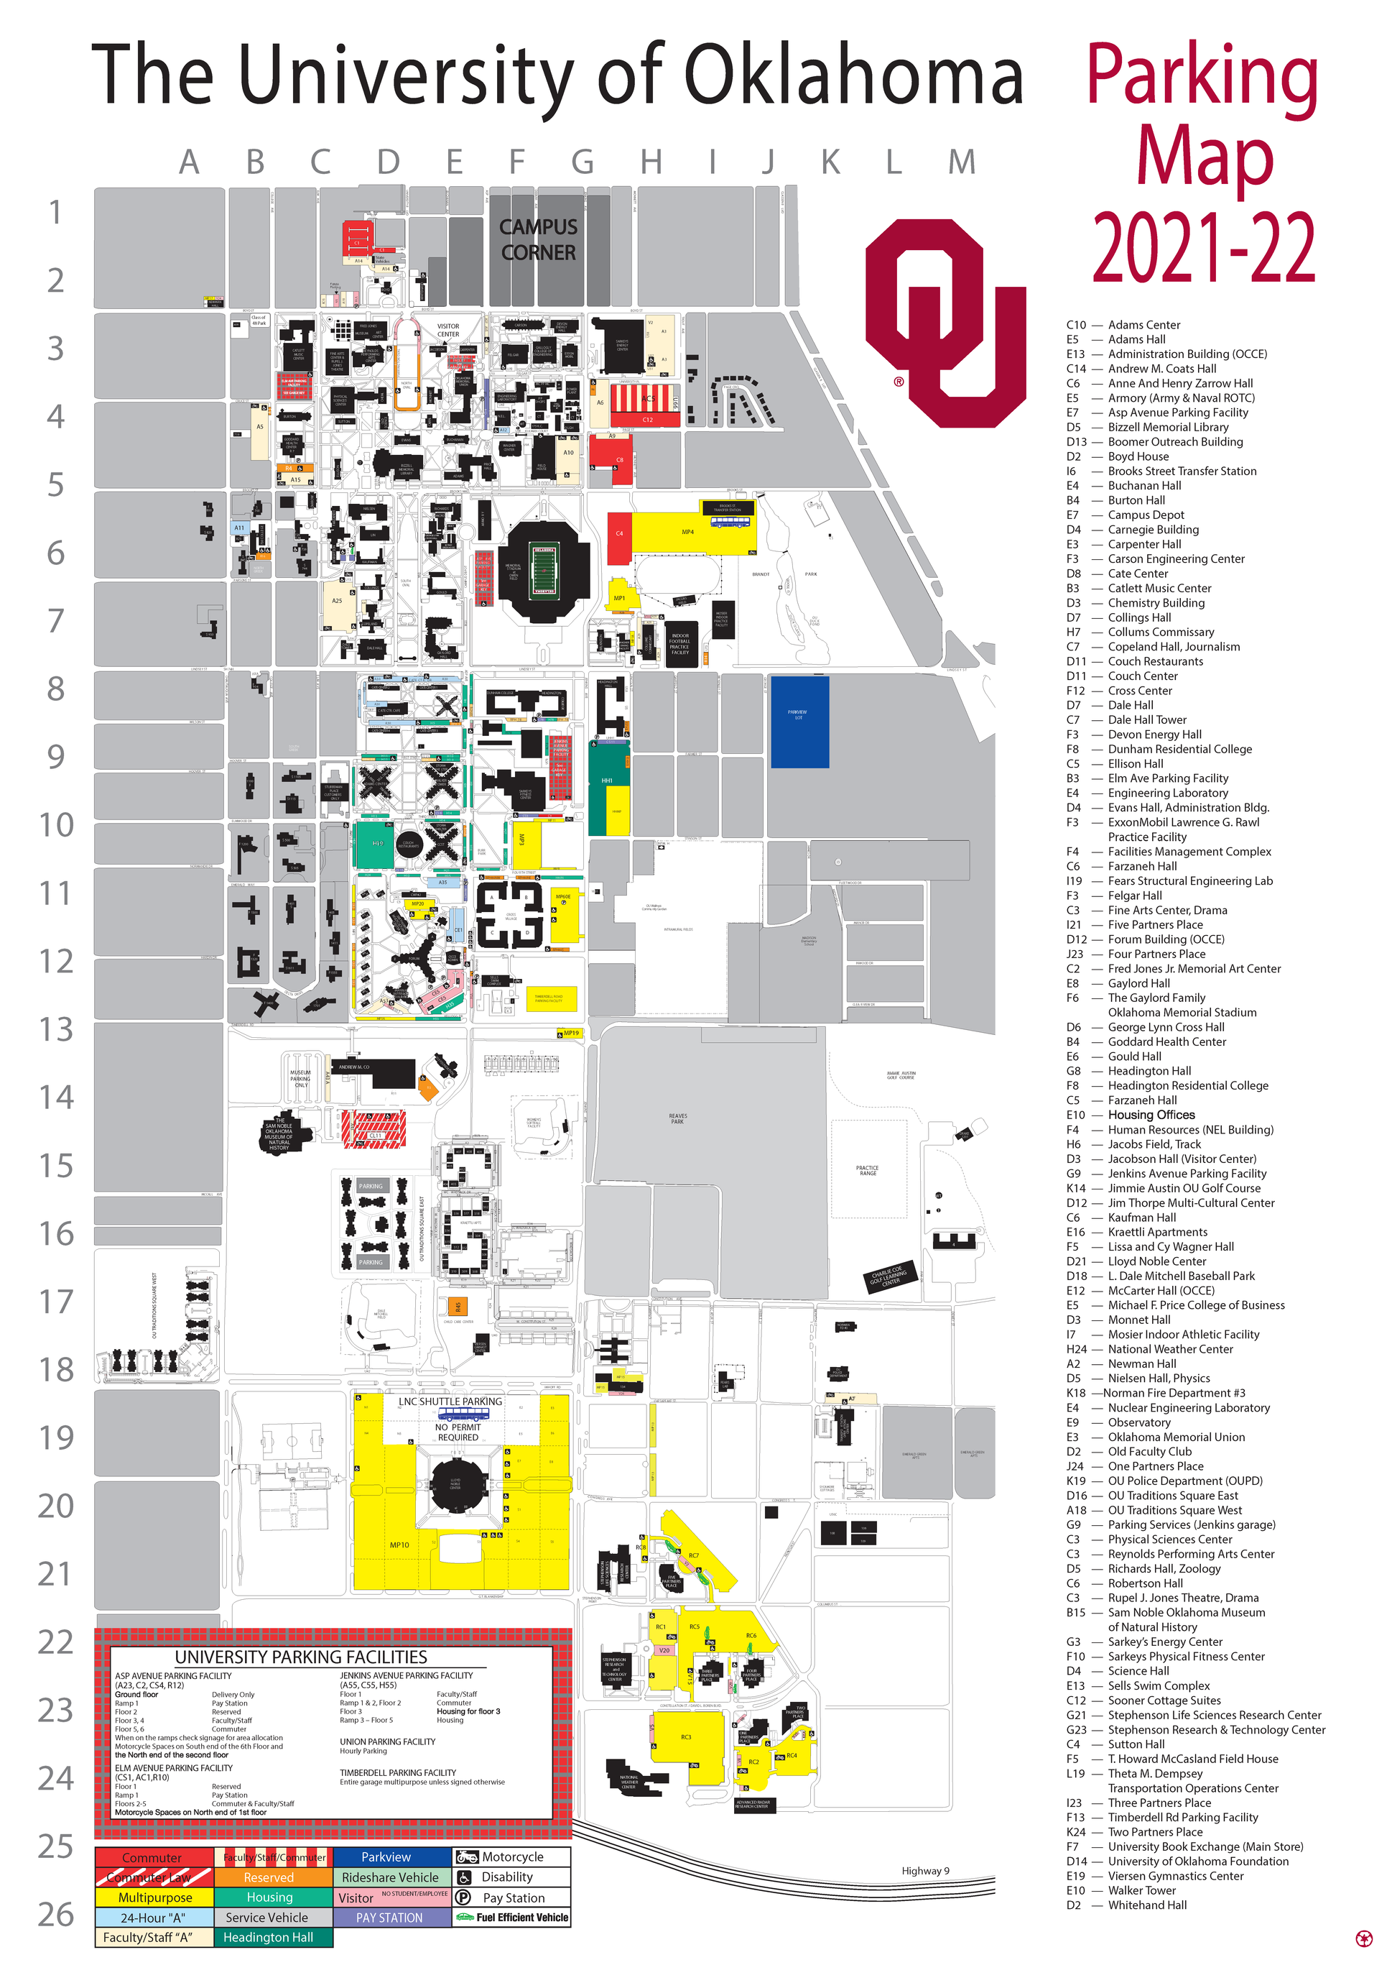
PARKING
You must purchase a student parking permit to park on campus.
There are many different kinds of parking permits.
When you park, your parking pass must match the sign on the parking lot. You will get a ticket if you park at OU without a permit or in the wrong place.
Click here to download a parking map: https://www.ou.edu/parking/maps
More information can be found on OU’s website: https://www.ou.edu/parking/faqs_section/parking_permits

Slide 31
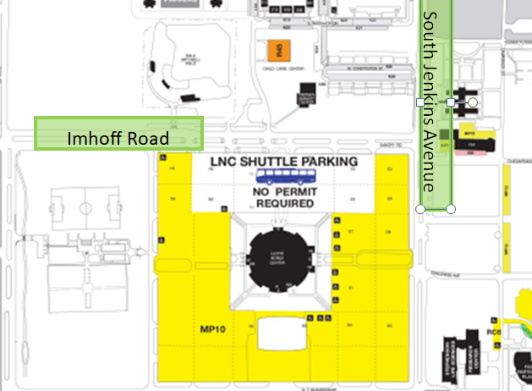
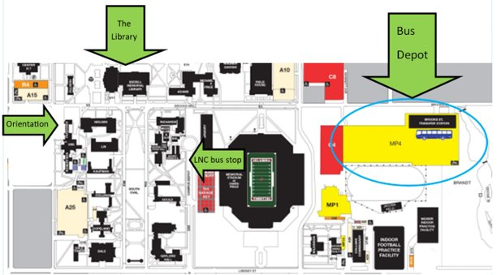
PARKING FOR FREE
You can park for free at Lloyd Noble center and ride a bus to campus
The bus is number 40 LNC shuttle
For more information about OU buses, go here:
https://www.ou.edu/cart/schedules

Slide 32
RIDING THE BUS
OU (CART) | NORMAN (EMBARK NORMAN) | OKLAHOMA CITY (EMBARK OKC)
Free! Sometimes has a different schedule (Check: https://www.ou.edu/cart/schedules ) Does NOT run on Sundays There is NOT a bus to OKC | Free! Sometimes has a different schedule (Check: https://embarkok.com/norman ) Does NOT run on Sundays Look up your bus here: https://embarkok.com/use/real-time There is a bus to OKC! (Bus 024 Norman Express Fare: $3 M-F) | Not free $1-$3 fare You can buy a pass (1 day, 1 week, 1 month, value) For more information about Oklahoma City Bus passes, go here: https://embarkok.com/learn/fares/ There is a bus to Norman! ( Bus 024 Norman Express M-F Fare: $3) DOES run on Sundays (https://embarkok.com/use/weekend-service)

Slide 33
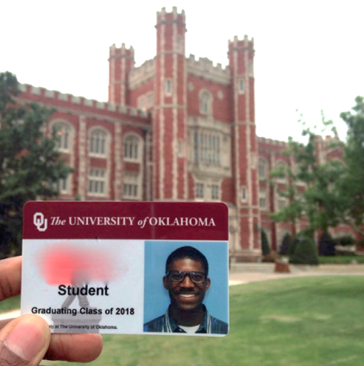

OU ID CARDS = Sooner Card
  WHY: Use your ID to access OU facilities, campus bus, or online services
  WHERE: Sooner Card Office - Student Union room 127 Monday-Friday, 9:00 am-5:00 pm
OR
Stubbeman Place, near the dormitories
Monday-Friday, 9:00 am-5:00 pm
  YOU WILL NEED: Passport identification and $30

Slide 34
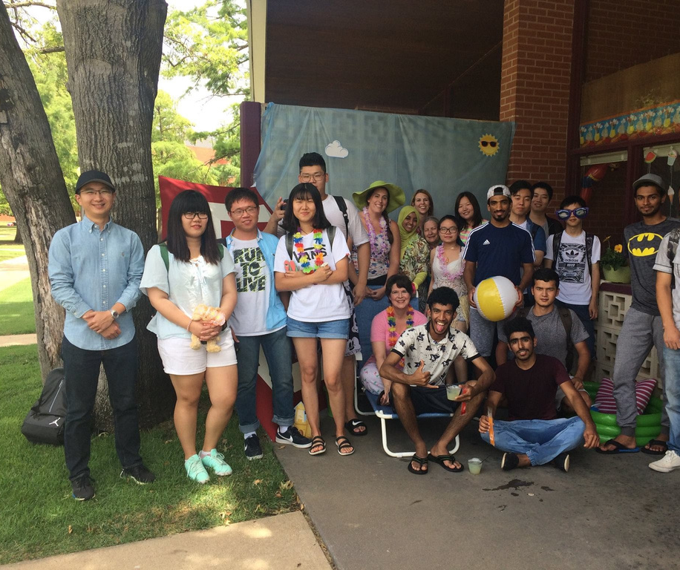


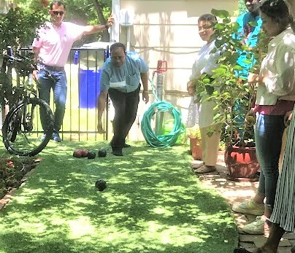


EVENTS

Slide 35

FOLLOW ISS and CESL ON SOCIAL MEDIA FOR MOR EVENTS!
Facebook
CESL: https://www.facebook.com/eslou/
Instagram
CESL: @oucesl
ISS: @ouinternational
IAC: @ou_iac

Slide 36
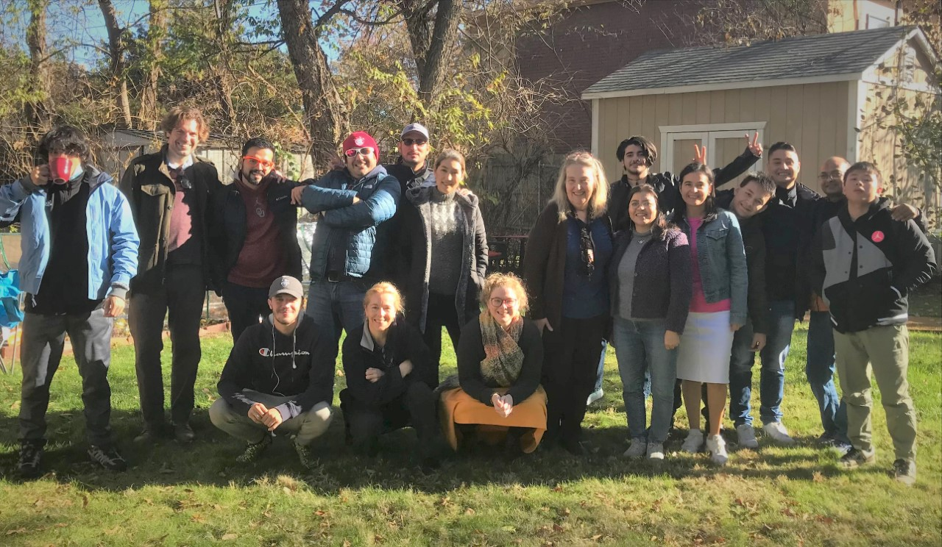

HAVE A GREAT SESSION!

Slide 37
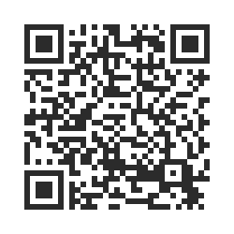
STUDENT SURVEY
Please use the QR code to complete the student survey – we need this information for our records!

