Slide 1

Step by step user scoring guide
AIR Self-Determination Assessment
ARC Self-Determination Scale

Slide 2
Scoring AIR

Slide 3
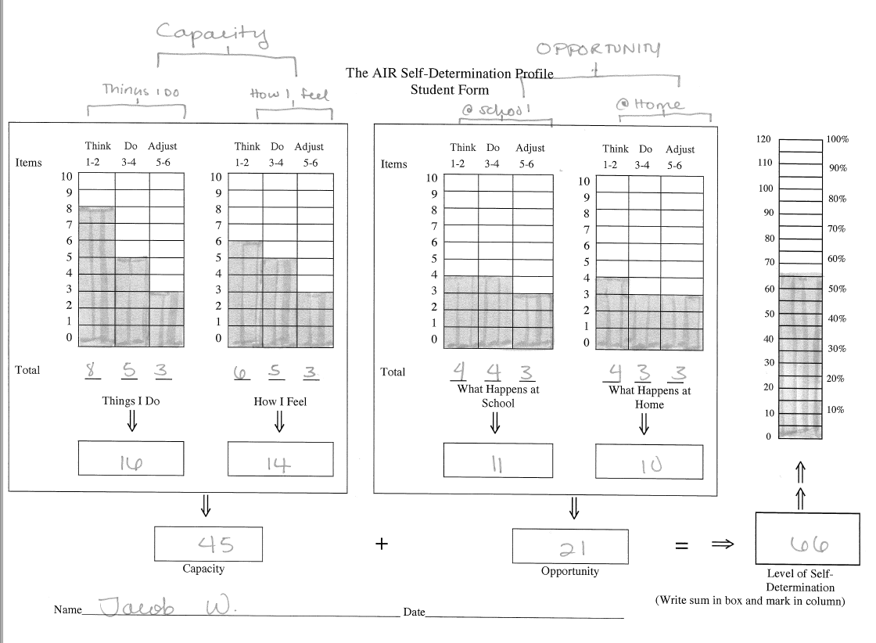
AIR scoring example

Slide 4
AIR
Page 3 – Things I do
  Question 1-2: Think
  Questions 3-4: Do
  Questions 5-6: Adjust
Page 4 – How I feel
  Question 1-2: Think
  Questions 3-4: Do
  Questions 5-6: Adjust
Page 5 – What happens at school
  Question 1-2: Think
  Questions 3-4: Do
  Questions 5-6: Adjust
Page 6 – What happens at home
  Question 1-2: Think
  Questions 3-4: Do
  Questions 5-6: Adjust
Capacity to be self-determined
Total SD score
Opportunity to practice Self Determination

Slide 5
Write in questions
Are not included in the final self-determination score, BUT
Are great starting points for conversations about SD and goal creation with students.

Slide 6
Total SD score
After students complete the AIR you can see specific areas where students show low capacity or opportunity for SD.
This information can be used to create new IEP goals for the student. You can also set an increase goal for students.
Ex: James will increase SD by 5% by end of year as determined by the AIR.
Then, use the items in the assessment as a basis for goals.

Slide 7
Scoring ARC

Slide 8
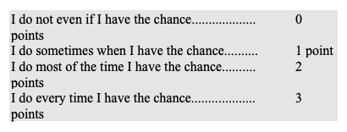
Section 1 - #1-32
0-3 scale
Sum the scores for each sub-section 1A-1F

Slide 9
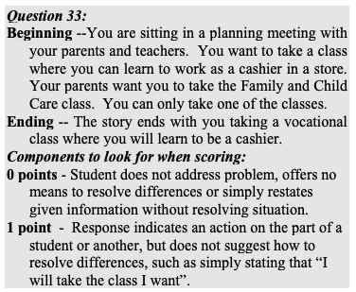
Section 2 - #33-38
The scoring guides gives examples on how to judge written answers
Questions 33-38 are on pages 80-89.

Slide 10
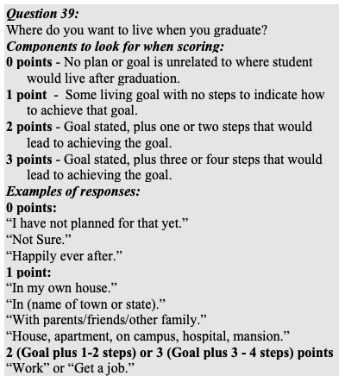
Section 2 – #39- 41
Page 90-92

Slide 11
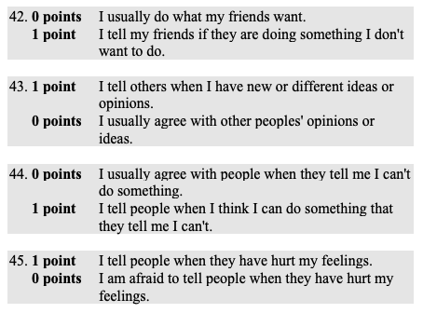
Section 3 - #42-57
Pages 93-94

Slide 12
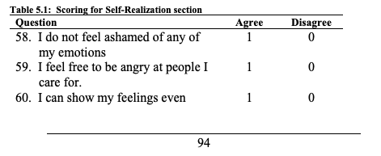
Section 4 – #58-72
Page 94-95

Slide 13
Converting Scores

Slide 14
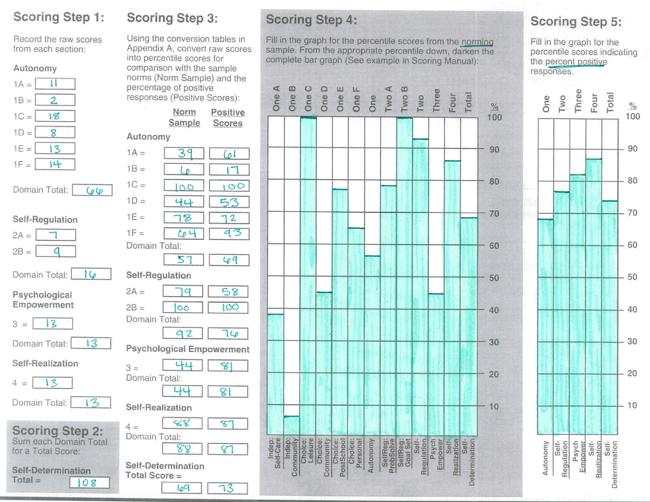
Sample Score Sheet

Slide 15
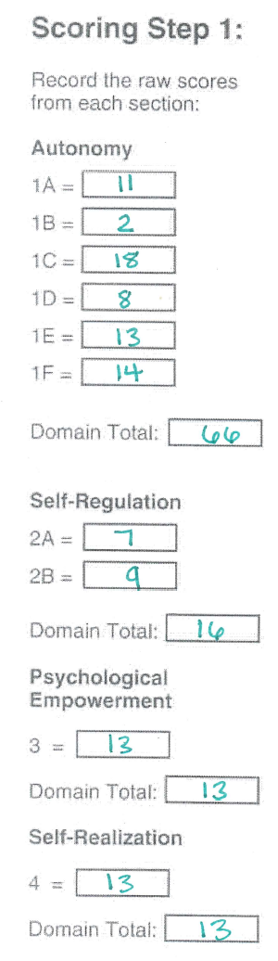
Scoring step 1
These are raw scores from your initial scoring.
Just sum the sections from the students’ answers.

Slide 16
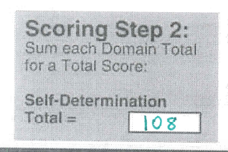
Scoring step 2
Sum each raw score domain total
(from section 1) for a total score

Slide 17
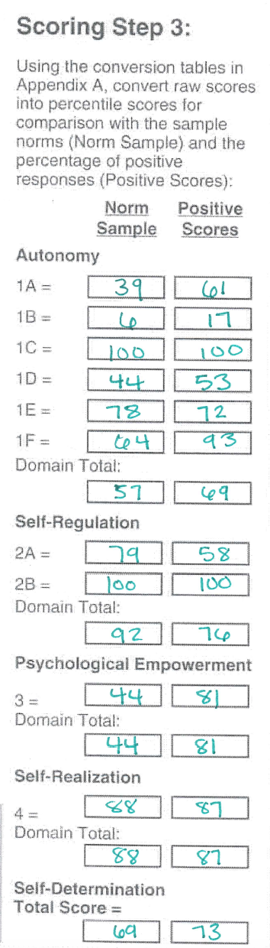
Scoring step 3

Slide 18
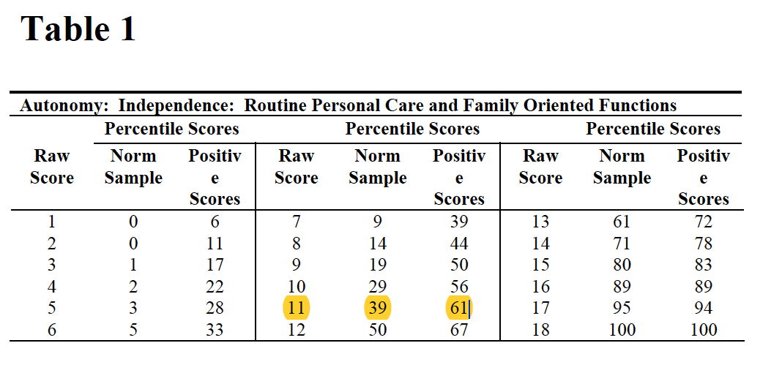
Converting raw scores
Conversion tables begin on page 146.
Each table corresponds to a sub-section of the test.
Convert the raw score (from the assessment) to BOTH the norm and positive score.
  Ex: if your student scored 11 on the raw score of 1A, then we look at table 1 and see that raw score 11 = norm score 39 and positive score 61
Appendix A – pg. 146

Slide 19
Autonomy
1A – table 1 (page 146)
1B – table 2 (page 146)
1C – table 3 (page 146)
1D – table 4 (page 147)
1E – table 5 (page 147)
1F – table 6 (page 147)
Domain total: table 7 (page 148)
  Total from raw score, not total from converted scores

Slide 20
Self-Regulation
2A – table 8 (page 149)
2B – table 9 (page 149)
Domain total: table 10 (page 149)
  Total from raw score, not total from converted scores

Slide 21
Psychological Empowerment
3 – table 11 (page 150)
Domain total: table 11 (page 150)
  Total from raw score, not total from converted scores
  Same table since there is only one question

Slide 22
Self-Realization
4 – table 12 (page 150)
Domain total: table 12 (page 150)
  Total from raw score, not total from converted scores
  Same table since there is only one question

Slide 23
Self-Determination
Self-determination total score
  From step 2
  Table 13 (page 152)

Slide 24

Scoring step 4

Slide 25
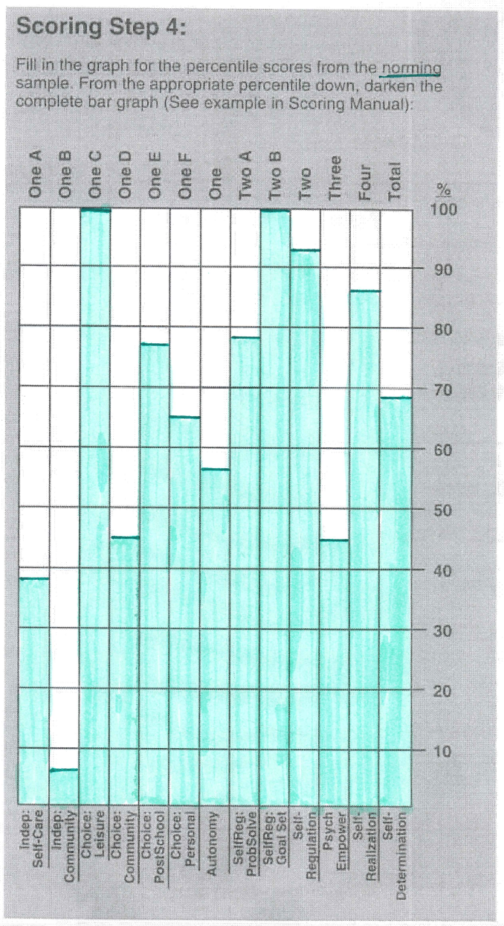
Graphing NORM sample scores
From step 3, look at norm sample column.
Graph the results

Slide 26
Scoring step 5

Slide 27
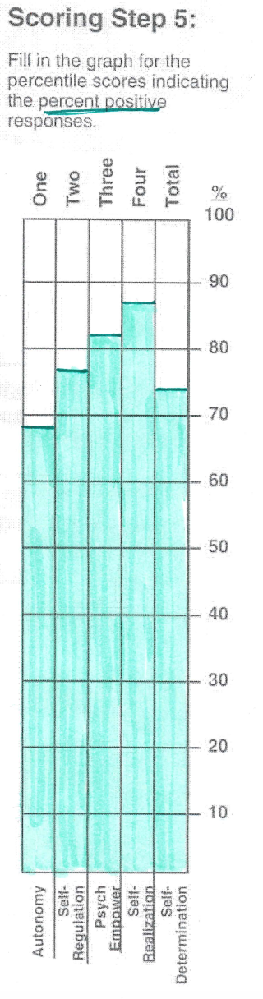
Graph Percentile Scores
Graph the positive scores from step 3
Look at the positive scores column
  Only the domain total score for each area:
    Autonomy
    Self-regulation
    Psychological empowerment
    self-regulation
    Self-determination
Graph results

