Slide 1
Intro to Transition
Bell Ringers
By Peighton Pratt M.Ed.,
Christy Jolliff M.Ed.,
& Melissa Wicker, Ph.D.

Slide 2
1. All About Me
2. Taking Care of Myself
3. Understanding Money
4. Who I Want to Be
5. Would You Rather?
6. What Would You Do?
7. Relationships with Others
Intro to Transition
Bell Ringers
Section Headers

Slide 3
Introduce your students to the bell ringer routine. Use the "I do, We do, You do" method and model how and when students are expected to complete bell ringers in your class. (Be sure to include clear expectations about the length and depth of response you expect from students.)
Display a slide with your desired prompt.
Instruct students to read the prompt and respond in a journal, on paper, or on an online document.
Inform students of the amount of time they have to complete the task and set a timer.
Monitor students and assist as needed.
Use a timer, visuals, or verbal cues to alert students when time is up.
Invite students to share their thoughts in whole or small group discussions.
After each session, reflect on student engagement, depth of discussion, and routine effectiveness to determine what adjustments need to be made to the process.
Intro to Transition
Bell Ringers
Instructions

Slide 4
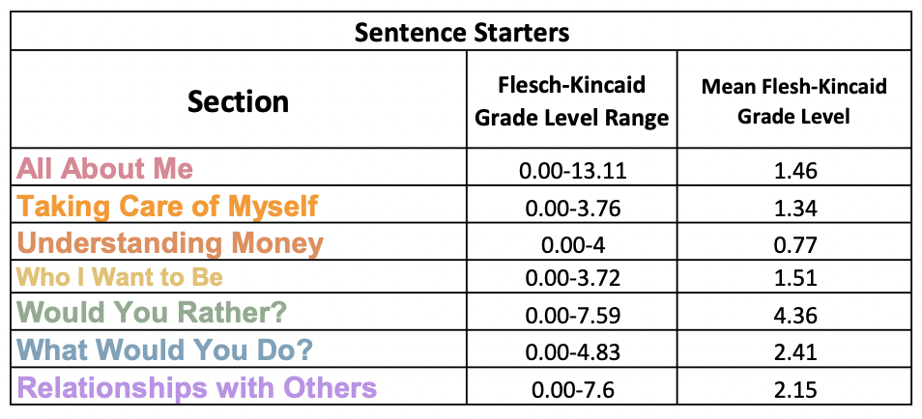
Have students write the sentence starter on a piece of paper or virtual document. Have students pick a word or phrase to write in the blank(s) in the sentence starter.
Optional: Provide examples of completed sentences starters or a word bank. Provide pictures that students can select to fill in the blanks instead of writing their answers.
Note: The Flesch-Kincaid Grade Level can be found within the notes under each slide. The reading level range 0-13.11 with the mean at 2.43.
Using the Intro to Transition
Bell Ringers Sentence Starters
Instructions

Slide 5
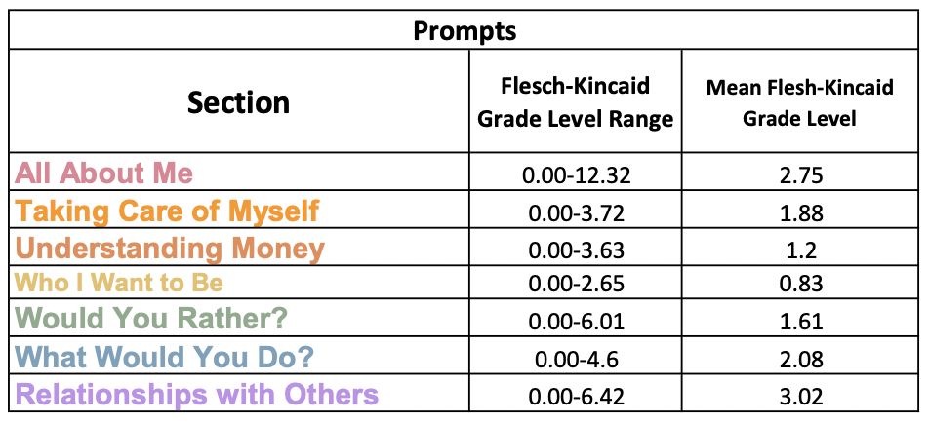
Bell ringers can be utilized to help students transition as they enter class, as part of a daily or weekly routine, as discussion prompts, and as exit tickets at the end of class.
Slides can be used in sequential order or customized for your classroom. (Example: If you only teach math, you may choose to only use the "Understanding Money" section)
Note: The Flesch-Kincaid Grade Level can be found within the notes under each slide. The reading level range is 0 to 12.32 with the mean at 1.89.
Intro to Transition
Bell Ringers
Tips & Tricks

Slide 6
All About Me

Slide 7
All About Me
Name two words that describe you.
I am ____ and ____.
Notes:
Flesch-Kincaid Grade Level: 0.52 & 0

Slide 8
All About Me
Name two things you like about yourself.
I like my ____ and ____.
Notes:
Flesch-Kincaid Grade Level: 2.31 & 0

Slide 9
All About Me
When do you feel happy?
I am happy when ____.
Notes:
Flesch-Kincaid Grade Level: 0.52 & 0.72

Slide 10
All About Me
Name a nice thing someone has said about you.
____ said that I ____.
Notes:
Flesch-Kincaid Grade Level: 3.65 & 0

Slide 11
All About Me
What is the best thing about school?
The best thing about school is ____.
Notes:
Flesch-Kincaid Grade Level: 0.63 & 0.52

Slide 12
All About Me
What do you like to do at school?
I like ____ at school.
Notes:
Flesch-Kincaid Grade Level: 0 & 0

Slide 13
All About Me
What do you NOT like to do at school?
I do not like ____ at school.
Notes:
Flesch-Kincaid Grade Level: 0 & 0

Slide 14
All About Me
Name something at school you are good at.
At school, I am good at ____.
Notes:
Flesch-Kincaid Grade Level: 2.34 & 0

Slide 15
All About Me
Name something at school that is hard for you.
At school, ____ is hard for me.
Notes:
Flesch-Kincaid Grade Level: 2.34 & 0

Slide 16
All About Me
Name something at home you are good at.
At home, I am good at ____.
Notes:
Flesch-Kincaid Grade Level: 2.28 & 0

Slide 17
All About Me
Name something at home that is hard for you.
At home, ____ is hard for me.
Notes:
Flesch-Kincaid Grade Level: 2.34 & 0

Slide 18
All About Me
Name something you like to do in your free time. Why do you like doing that?
I like to ____ in my free time because ____.
Notes:
Flesch-Kincaid Grade Level: 2.47, 0.52, & 0.81

Slide 19
All About Me
Name something you do NOT like to do in your free time. Why don't you like doing that?
I do not like to ____ in my free time because ____.
Notes:
Flesch-Kincaid Grade Level: 2.86, 0.52 & 1.29

Slide 20
All About Me
Name two things at school you need help with.
At school, I need help with ____ and ____.
Notes:
Flesch-Kincaid Grade Level: 0 & 0

Slide 21
All About Me
Name two things at home you need help with.
At home, I need help with ____ and ____.
Notes:
Flesch-Kincaid Grade Level: 0 & 0

Slide 22
All About Me
Who can you ask for help?
I ask ____ for help.
Notes:
Flesch-Kincaid Grade Level: 0 & 0

Slide 23
All About Me
How do you ask someone for help?
I ask someone for help by ____.
Notes:
Flesch-Kincaid Grade Level: 2.31 & 2.48

Slide 24
All About Me
What can help you do hard things?
____ can help me do hard things.
Notes:
Flesch-Kincaid Grade Level: 0 & 0

Slide 25
All About Me
How do you feel when you have something hard to do?
I feel ____ when I have something
hard to do.
Notes:
Flesch-Kincaid Grade Level: 2.65 & 0.59

Slide 26
All About Me
All About Me
Name a test you took at school.
I took a ____ test at school.
Notes:
Flesch-Kincaid Grade Level: 0 & 0

Slide 27
All About Me
All About Me
What would make tests easier?
____ would make tests easier.
Notes:
Flesch-Kincaid Grade Level: 0.52 & 0.72

Slide 28
All About Me
Independently means you can do something by yourself.
What can you do independently?
I can do ____ independently.
Notes:
Flesch-Kincaid Grade Level: 9.66, 7.6, & 9.57
*The word "independently" is a technical vocabulary term that students should learn and use regularly. Including the word in this bell ringer will help students learn the meaning of the word authentically. Substituting "by yourself" for "independently" makes the Flesch-Kincaid Grade Level: 0.52 & 0.52.

Slide 29
All About Me
All About Me
Responsible means you can be trusted to take care of things.
How are you responsible?
I am responsible when I ____.
Notes:
Flesch-Kincaid Grade Level: 4.79, 6.62, & 5.24
*The word "responsible" is a technical vocabulary term that students should learn and use regularly. Including the word in this bell ringer will help students learn the meaning of the word authentically.

Slide 30
All About Me
Patient means you can wait for something without getting mad.
When do you need to be patient?
I need to be patient when ____.
Notes:
Flesch-Kincaid Grade Level: 3.76, 0.63, & 0.52

Slide 31
All About Me
Name two classroom rules you follow.
The classroom rules I follow
are ____ and ____.
Notes:
Flesch-Kincaid Grade Level: 2.48 & 2.31

Slide 32
All About Me
Disability means that someone’s body or brain works differently, so it may be harder for them to do certain things.
Name someone with a disability.
___ has a disability.
Notes:
Flesch-Kincaid Grade Level: 11.09, 12.32, & 13.11
*The word "disability" is a technical vocabulary term that students should learn and use regularly. Including the word in this bell ringer will help students learn the meaning of the word authentically.

Slide 33
Taking care of myself

Slide 34
Taking Care of Myself
Name a healthy choice you make in the morning at home.
In the morning, I choose ____ to be healthy.
Notes:
Flesch-Kincaid Grade Level: 2.65 & 2.28

Slide 35
Taking Care of Myself
What do you do at home to get ready for school?
To get ready for school, I ____.
Notes:
Flesch-Kincaid Grade Level: 1.57 & 0.52

Slide 36
Taking Care of Myself
Name a healthy choice you make at school.
At school, I choose ____ to be healthy.
Notes:
Flesch-Kincaid Grade Level: 0.81 & 0

Slide 37
Taking Care of Myself
Name a healthy choice you make in the evening at home.
In the evening, I choose ____ to be healthy.
Notes:
Flesch-Kincaid Grade Level: 3.72 & 3.76

Slide 38
Taking Care of Myself
What do you do to get ready for bed?
To get ready for bed, I ____.
Notes:
Flesch-Kincaid Grade Level: 1.03 & 0.52

Slide 39
Taking Care of Myself
What do you do on school mornings that you don't do on the weekend?
On school mornings, I ____ , but on the weekend, I ____.
Notes:
Flesch-Kincaid Grade Level: 3.36 & 3.65

Slide 40
Taking Care of Myself
What do you do on a school night that you don't do on the weekend?
On a school night, I ____ , but on the weekend, I ____.
Notes:
Flesch-Kincaid Grade Level: 2.85 & 1.29

Slide 41
Taking Care of Myself
What do you do during the day on school breaks?
During the day on school breaks,
I ____.
Notes:
Flesch-Kincaid Grade Level: 1.29 & 0.52

Slide 42
Taking Care of Myself
Name two things you do to stay healthy.
I ____ and ____ to stay healthy.
Notes:
Flesch-Kincaid Grade Level: 0.81 & 0.52

Slide 43
Taking Care of Myself
Name two things you like to do to exercise.
I like to exercise by ____ and ____.
Notes:
Flesch-Kincaid Grade Level: 2.34 & 2.48

Slide 44
Taking Care of Myself
Name two things you can do to keep yourself clean.
I stay clean by ____ and ____.
Notes:
Flesch-Kincaid Grade Level: 1.29 & 0

Slide 45
Taking Care of Myself
What do you do when you are resting?
When I am resting, I ____.
Notes:
Flesch-Kincaid Grade Level: 0.81 & 0.52

Slide 46
Understanding money

Slide 47
Understanding Money
Name one reason you should learn about money.
I need to learn about money
because ____.
Notes:
Flesch-Kincaid Grade Level: 3.65 & 4.0

Slide 48
Understanding Money
Name two ways you can pay for something.
I can pay for something with ____ or ____.
Notes:
Flesch-Kincaid Grade Level: 2.28 & 2.31

Slide 49
Understanding Money
Compare dollar bills (cash) and coins.
Dollar bills are ____, but
coins are ____.
Notes:
Flesch-Kincaid Grade Level: 2.48 & 0.52

Slide 50
Understanding Money
Compare cash and credit cards.
Cash is ____, but
credit cards are ____.
Notes:
Flesch-Kincaid Grade Level: 2.88 & 0.52

Slide 51
Understanding Money
Compare gift cards and credit cards.
Gift cards are ____, but
credit cards are ____.
Notes:
Flesch-Kincaid Grade Level: 2.48 & 0.63

Slide 52
Understanding Money
Name two things you can do with money.
I can use money to _____ or _____.
Notes:
Flesch-Kincaid Grade Level: 0.81 & 0.52

Slide 53
Understanding Money
Name two ways you can keep your money safe.
I can keep my money safe by ____ or ____.
Notes:
Flesch-Kincaid Grade Level: 1.03 & 0.81

Slide 54
Understanding Money
What does it mean to save your money?
When I save my money, I _____.
Notes:
Flesch-Kincaid Grade Level: 0.81 & .52

Slide 55
Understanding Money
Name two things you would save money for.
I would save my money for ____ and ____.
Notes:
Flesch-Kincaid Grade Level: 0.81 & 0.63

Slide 56
Understanding Money
Name two ways you can earn money.
I can earn money by _____ or _____.
Notes:
Flesch-Kincaid Grade Level: 0.63 & 0.56

Slide 57
Understanding Money
When you earn money at a job, will you save or spend it?
Why?
I would _____ because _____.
Notes:
Flesch-Kincaid Grade Level: 2.19 & 0 & 1.31

Slide 58
Understanding Money
Name three things you need that
you can buy.
I need to buy _____, _____, and _____.
Notes:
Flesch-Kincaid Grade Level: 0 & 0

Slide 59
Understanding Money
Name three things you want that
you can buy.
I want to buy _____, _____, and _____.
Notes:
Flesch-Kincaid Grade Level: 0 & 0

Slide 60
Understanding Money
Compare the prices of two games
you may want.
Which one costs less?
_____ costs less than _____.
Notes:
Flesch-Kincaid Grade Level: 0.11 & 0 & 0

Slide 61
Understanding Money
Compare the price of two toys you may want.
Which one costs more?
_____ costs more than _____.
Notes:
Flesch-Kincaid Grade Level: 0.11 & 0 & 0

Slide 62
Understanding Money
Compare the price of two meals you can order when you go out to eat.
Which one costs less?
_____ costs less than _____.
Notes:
Flesch-Kincaid Grade Level: 3.63 & 0 & 0

Slide 63
Who I want to be

Slide 64
Who I Want To Be
Who is your role model?
Why?
_____ is my role model because _____.
Notes:
Flesch-Kincaid Grade Level: 0.52 & 0 & 2.88

Slide 65
Who I Want To Be
Name two things you might do for fun in middle school.
In middle school, I want to _____
and _____ for fun.
Notes:
Flesch-Kincaid Grade Level: 1.57 & 1.03

Slide 66
Who I Want To Be
Name two things you want to learn about in middle school.
In middle school, I want to learn
about _____ and _____.
Notes:
Flesch-Kincaid Grade Level: 2.65 & 0.59

Slide 67
Who I Want To Be
Name two things you might do for fun in high school.
In high school, I want to
do _____ and _____ for fun.
Notes:
Flesch-Kincaid Grade Level: 0.5 & 0.11

Slide 68
Who I Want To Be
Name two things you want to learn about in high school.
In high school, I want to learn
about _____ and _____.
Notes:
Flesch-Kincaid Grade Level: 1.57 & 1.03

Slide 69
Who I Want To Be
Name one thing that sounds fun about being a grown-up.
One thing that sounds fun about
being a grown-up is _____.
Notes:
Flesch-Kincaid Grade Level: 2.65 & 0.5

Slide 70
Who I Want To Be
Name one thing that worries you
about being a grown-up.
One thing that worries me about
being a grown-up is _____.
Notes:
Flesch-Kincaid Grade Level: 1.57 & 3.72

Slide 71
Who I Want To Be
What job do you want when you grow up?
Why?
When I grow up, I want to be a _____
because _____.
Notes:
Flesch-Kincaid Grade Level: 0 & 0 & 1.29

Slide 72
Who I Want To Be
Do you want to go to college when you grow up?
Why?
When I grow up, I [do/don't] want to go to college because _____.
Notes:
Flesch-Kincaid Grade Level: 1.57 & 0 & 3.1

Slide 73
Who I Want To Be
Where do you want to live when you grow up?
Why?
When I grow up, I want to live _____ because _____.
Notes:
Flesch-Kincaid Grade Level: 0.11 & 0 & 1.03

Slide 74
Who I Want To Be
Who do you want to live with when you grow up?
Why?
When I grow up, I want to live with _____ because _____.
Notes:
Flesch-Kincaid Grade Level: 0.5 & 0 & 1.29

Slide 75
Would you
Rather?

Slide 76
Would You Rather?
Would you rather learn about reading or math?
Why?
I would rather learn about [reading/math] because _____.
Notes:
Flesch-Kincaid Grade Level: 3.76 & 0 & 5.23

Slide 77
Would You Rather?
Would you rather learn about science or history?
Why?
I would rather learn about [science/history] because _____.
Notes:
Flesch-Kincaid Grade Level: 5.23 & 0 & 6.71

Slide 78
Would You Rather?
Would you rather go to music or PE?
Why?
I would rather go to [music/PE] because _____.
Notes:
Flesch-Kincaid Grade Level: 2.28 & 0 & 3.76

Slide 79
Would You Rather?
Would you rather go to art or STEM?
Why?
I would rather go to [art/STEM] because _____.
Notes:
Flesch-Kincaid Grade Level: 0.81 & 0 & 2.28

Slide 80
Would You Rather?
Would you rather do class work by yourself or in a group?
Why?
I would rather do class work [by myself/in a group] because _____.
Notes:
Flesch-Kincaid Grade Level: 2.86 & 0 & 3.84

Slide 81
Would You Rather?
Would you rather do class work on the computer or on paper?
Why?
I would rather do class work on [the computer/paper] because _____.
Notes:
Flesch-Kincaid Grade Level: 4.82 & 0 & 5.86

Slide 82
Would You Rather?
Would you rather take a test or write about what you have learned?
Why?
I would rather [take a test/write] about what I learned because _____.
Notes:
Flesch-Kincaid Grade Level: 3.1 & 0 & 3.84

Slide 83
Would You Rather?
Would you rather get help from your classmates or help your classmates?
Why?
I would rather [get help from my classmates/help my classmates]
because _____.
Notes:
Flesch-Kincaid Grade Level: 3.84 & 0 & 4.82

Slide 84
Would You Rather?
Would you rather work when it’s quiet or loud?
Why?
I would rather work when it’s [quiet/loud] because _____.
Notes:
Flesch-Kincaid Grade Level: 1.03 & 0 & 2.34

Slide 85
Would You Rather?
Would you rather work during the week or on weekends?
Why?
I would rather work [during the week/on weekends] because _____.
Notes:
Flesch-Kincaid Grade Level: 3.65 & 0 & 4.83

Slide 86
Would You Rather?
Would you rather work during the day or at night?
Why?
I would rather work [during the day/at night] because _____.
Notes:
Flesch-Kincaid Grade Level: 2.47 & 0 & 3.65

Slide 87
Would You Rather?
Would you rather work an easy job or a hard job?
Why?
I would rather work [an easy/a hard] job because _____.
Notes:
Flesch-Kincaid Grade Level: 2.65 & 0 & 3.65

Slide 88
Would You Rather?
Would you rather dress up for work or wear a uniform?
Why?
I would rather [dress up for work/wear a uniform] because _____.
Notes:
Flesch-Kincaid Grade Level: 3.72 & 0 & 4.79

Slide 89
Would You Rather?
Would you rather sit down, stand up, or move around at your job?
Why?
I would rather [sit down/stand up/move around] at my job because _____.
Notes:
Flesch-Kincaid Grade Level: 3.1 & 0 & 4

Slide 90
Would You Rather?
Would you rather work with your hands or brain?
Why?
I would rather work with my [hands/brain] because _____.
Notes:
Flesch-Kincaid Grade Level: 1.03 & 0 & 2.34

Slide 91
Would You Rather?
Would you rather work with people or things?
Why?
I would rather work with [people/things] because _____.
Notes:
Flesch-Kincaid Grade Level: 3.76 & 0 & 5.23

Slide 92
Would You Rather?
Would you rather work inside or outside?
Why?
I would rather work [inside/outside] because _____.
Notes:
Flesch-Kincaid Grade Level: 4 & 0 & 5.68

Slide 93
Would You Rather?
Would you rather work by yourself or with others?
Why?
I would rather work [by myself/with others] because _____.
Notes:
Flesch-Kincaid Grade Level: 3.65 & 0 & 4.96

Slide 94
Would You Rather?
Would you rather work for yourself or someone else?
Why?
I would rather work for [myself/ someone else] because _____.
Notes:
Flesch-Kincaid Grade Level: 4.96 & 0 & 6.28

Slide 95
Would You Rather?
Would you rather be an artist or an athlete?
Why?
I would rather be an [artist/athlete] because _____.
Notes:
Flesch-Kincaid Grade Level: 3.65 & 0 & 5.23

Slide 96
Would You Rather?
Would you rather be a teacher or a dentist?
Why?
I would rather be a [teacher/dentist] because _____.
Notes:
Flesch-Kincaid Grade Level: 3.65 & 0 & 5.23

Slide 97
Would You Rather?
Would you rather be a farmer or a banker?
Why?
I would rather be a [farmer/banker] because _____.
Notes:
Flesch-Kincaid Grade Level: 3.65 & 0 & 5.23

Slide 98
Would You Rather?
Would you rather be a firefighter or a vet? Why?
I would rather be a [firefighter/vet] because _____.
Notes:
Flesch-Kincaid Grade Level: 4.96 & 0 & 6.71

Slide 99
Would You Rather?
Would you rather be a doctor or a police officer?
Why?
I would rather be a [doctor/police officer] because _____.
Notes:
Flesch-Kincaid Grade Level: 6.01 & 0 & 7.59

Slide 100
Would You Rather?
Would you rather live alone or with others?
Why?
I would rather live [alone/with others] because _____.
Notes:
Flesch-Kincaid Grade Level: 3.76 & 0 & 5.23

Slide 101
Would You Rather?
Would you rather live in an apartment or a house?
Why?
I would rather live in [an apartment/
a house] because _____.
Notes:
Flesch-Kincaid Grade Level: 3.65 & 0 & 2.88

Slide 102
Would You Rather?
Would you rather live in a big city or a small town?
Why?
I would rather live in a [big city/
small town] because _____.
Notes:
Flesch-Kincaid Grade Level: 2.86 & 0 & 1.57

Slide 103
Would You Rather?
Would you rather cook dinner or wash the dishes?
Why?
I would rather [cook dinner/wash the dishes] because _____.
Notes:
Flesch-Kincaid Grade Level: 3.65 & 0 & 4.96

Slide 104
Would You Rather?
Would you rather clean the kitchen or the bathroom?
Why?
I would rather clean the [kitchen/bathroom] because _____.
Notes:
Flesch-Kincaid Grade Level: 3.65 & 0 & 5.23

Slide 105
Would You Rather?
Would you rather do the laundry or take out the trash?
Why?
I would rather [do the laundry/take out the trash] because _____.
Notes:
Flesch-Kincaid Grade Level: 2.65 & 0 & 3.72

Slide 106
Would You Rather?
Would you rather sweep the floor or vacuum the carpet?
Why?
I would rather [sweep the floor/
vacuum the carpet] because _____.
Notes:
Flesch-Kincaid Grade Level: 3.65 & 0 & 4.83

Slide 107
Would You Rather?
Would you rather have a big pet or small pet?
Why?
I would rather have a [big/small] pet because _____.
Notes:
Flesch-Kincaid Grade Level: 1.29 & 0 & 2.34

Slide 108
Would You Rather?
Would you rather have an inside pet or outside pet?
Why?
I would rather have an [inside/outside] pet because _____.
Notes:
Flesch-Kincaid Grade Level: 3.65 & 0 & 4.96

Slide 109
Would You Rather?
Would you rather have a pet bird or a pet fish?
Why?
I would rather have a pet [bird/fish] because _____.
Notes:
Flesch-Kincaid Grade Level: 1.57 & 0 & 2.34

Slide 110
Would You Rather?
Would you rather have a pet cat or pet dog?
Why?
I would rather have a pet [cat/dog] because _____.
Notes:
Flesch-Kincaid Grade Level: 1.57 & 0 & 2.34

Slide 111
Would You Rather?
Would you rather watch a movie or read a book?
Why?
I would rather [watch a movie/
read a book] because _____.
Notes:
Flesch-Kincaid Grade Level: 2.47 & 0 & 1.7

Slide 112
Would You Rather?
Would you rather play a sport or play an instrument?
Why?
I would rather play [a sport/
an instrument] because _____.
Notes:
Flesch-Kincaid Grade Level: 3.65 & 0 & 4.96

Slide 113
Would You Rather?
Would you rather ride your bike or go swimming?
Why?
I would rather [ride my bike/
go swimming] because _____.
Notes:
Flesch-Kincaid Grade Level: 2.34 & 0 & 3.65

Slide 114
Would You Rather?
Would you rather sleep in or stay up late? Why?
I would rather [sleep in/stay up late] because _____.
Notes:
Flesch-Kincaid Grade Level: 1.03 & 0 & 2.34

Slide 115
Would You Rather?
Would you rather visit the beach or the mountains?
Why?
I would rather visit the [beach/mountains] because _____.
Notes:
Flesch-Kincaid Grade Level: 3.65 & 0 & 5.23

Slide 116
Would You Rather?
Would you rather play outside or inside? Why?
I would rather play [outside/inside] because _____.
Notes:
Flesch-Kincaid Grade Level: 4 & 0 & 5.68

Slide 117
Would You Rather?
Would you rather play video games or board games? Why?
I would rather play [video games/board games] because _____.
Notes:
Flesch-Kincaid Grade Level: 3.65 & 0 & 4.96

Slide 118
What would you do?

Slide 119
What Would You Do?
If you were having a party, who would you invite?
Why?
If I was having a party, I would invite _____ because _____.
Notes:
Flesch-Kincaid Grade Level: 3.65 & 0 & 4.83

Slide 120
What Would You Do?
If you were having a party, what would your theme be?
Why?
If I was having a party, my theme would be _____ because _____.
Notes:
Flesch-Kincaid Grade Level: 2.65 & 0 & 3.72

Slide 121
What Would You Do?
If you were having a party, what fun things would you do?
Why?
If I was having a party, I would _____ because _____.
Notes:
Flesch-Kincaid Grade Level: 2.86 & 0 & 3.65

Slide 122
What Would You Do?
If you were having a party, what would you eat?
Why?
If I was having a party, I would eat _____ because _____.
Notes:
Flesch-Kincaid Grade Level: 2.47 & 0 & 3.65

Slide 123
What Would You Do?
What would you do during a fire drill?
If I was in a fire drill, I would _____.
Notes:
Flesch-Kincaid Grade Level: 0.81 & 0

Slide 124
What Would You Do?
What would you do if there was a substitute teacher?
If there was a substitute teacher, I would _____.
Notes:
Flesch-Kincaid Grade Level: 3.65 & 0 & 3.76

Slide 125
What Would You Do?
What would you do during a tornado drill?
If I was in a tornado drill, I would _____.
Notes:
Flesch-Kincaid Grade Level: 3.76 & 2.34

Slide 126
What Would You Do?
What would you do if you did the first steps of your class work but forgot what to do next?
If I forgot what to do next, I would _____.
Notes:
Flesch-Kincaid Grade Level: 4.6 & 1.03

Slide 127
What Would You Do?
What would you do if you forgot your homework at home?
If I forgot my homework at home, I would _____.
Notes:
Flesch-Kincaid Grade Level: 3.72 & 3.65

Slide 128
What Would You Do?
What would you do if there is a new student in class?
If there is a new student in class, I would _____.
Notes:
Flesch-Kincaid Grade Level: 1.87 & 1.29

Slide 129
What Would You Do?
What would you do if your friend is being bullied?
If my friend was being bullied, I would _____.
Notes:
Flesch-Kincaid Grade Level: 2.47 & 2.28

Slide 130
What Would You Do?
What would you do if someone needs help?
If someone needs help, I would _____.
Notes:
Flesch-Kincaid Grade Level: 2.28 & 2.48

Slide 131
What Would You Do?
What would you do if someone is hurt?
If someone is hurt, I would _____.
Notes:
Flesch-Kincaid Grade Level: 2.28 & 2.48

Slide 132
What Would You Do?
What would you do if you are being bullied?
If I was being bullied, I would _____.
Notes:
Flesch-Kincaid Grade Level: 2.34 & 2.31

Slide 133
What Would You Do?
What would you do if you forgot how to do something?
If I forgot how to do something, I would _____.
Notes:
Flesch-Kincaid Grade Level: 3.72 & 3.65

Slide 134
What Would You Do?
What would you do if a stranger tried to talk to you?
If a stranger tried to talk to me, I would _____.
Notes:
Flesch-Kincaid Grade Level: 1.87 & 1.29

Slide 135
What Would You Do?
What would you do if you felt unsafe?
If I felt unsafe, I would _____.
Notes:
Flesch-Kincaid Grade Level: 0.81 & 0.52

Slide 136
What Would You Do?
What would you do if you got lost?
If I got lost, I would _____.
Notes:
Flesch-Kincaid Grade Level: 0 & 0

Slide 137
What Would You Do?
What would you do if you heard it was going to rain today?
If I heard it was going to rain today, I would _____.
Notes:
Flesch-Kincaid Grade Level: 3.1 & 2.65

Slide 138
What Would You Do?
What would you do if you heard it was going to snow today?
If I heard it was going to snow today, I would _____.
Notes:
Flesch-Kincaid Grade Level: 3.1 & 2.65

Slide 139
Relationships with others

Slide 140
Relationships With Others
Name three people who are important to you.
_____, _____, and _____ are important to me.
Notes:
Flesch-Kincaid Grade Level: 5.23 & 2.88

Slide 141
Relationships With Others
Name two things you want your friends to know about you.
I want my friends to know _____ and _____.
Notes:
Flesch-Kincaid Grade Level: 1.57 & 0

Slide 142
Relationships With Others
Compare good and bad friendships.
Good friends _____, but bad friends _____.
Notes:
Flesch-Kincaid Grade Level: 2.88 & 0

Slide 143
Relationships With Others
What does it mean to be a good friend?
Being a good friend means _____.
Notes:
Flesch-Kincaid Grade Level: 0 & 0.52

Slide 144
Relationships With Others
Name two things you want your teachers to know about you.
I want my teachers to know ____ and _____.
Notes:
Flesch-Kincaid Grade Level: 2.65 & 0.63

Slide 145
Relationships With Others
Name two ways you are a good friend to someone else.
I am a good friend because I _____ and _____.
Notes:
Flesch-Kincaid Grade Level: 2.65 & 0.81

Slide 146
Relationships With Others
Name two people at school who can help you.
At school, _____ and _____ can help me.
Notes:
Flesch-Kincaid Grade Level: 2.34 & 0

Slide 147
Relationships With Others
When you take a test, how can your teacher help you?
When I take a test, my teacher can _____.
Notes:
Flesch-Kincaid Grade Level: 1.57 & 0.81

Slide 148
Relationships With Others
If you need help on a math problem, what can your teacher do?
If I need help with a math problem, my teacher can _____.
Notes:
Flesch-Kincaid Grade Level: 3.1 & 2.65

Slide 149
Relationships With Others
If you don’t know how to spell a word, how can your teacher help you?
If I don't know how to spell a word, my teacher can _____.
Notes:
Flesch-Kincaid Grade Level: 2.85 & 1.87

Slide 150
Relationships With Others
Name two people in your community who can help you.
In my community, _____ and _____ can help me.
Notes:
Flesch-Kincaid Grade Level: 6.01 & 4

Slide 151
Relationships With Others
How do community helpers help you?
Community helpers can help me _____.
Notes:
Flesch-Kincaid Grade Level: 6.42 & 7.6

Slide 152
Relationships With Others
Who is in your family?
_____, _____, and _____, are in my family.
Notes:
Flesch-Kincaid Grade Level: 2.88 & 2.88

Slide 153
Relationships With Others
What does it mean to be a good family member?
Being a good family member means _____.
Notes:
Flesch-Kincaid Grade Level: 3.65 & 6.42

Slide 154
Relationships With Others
Name two ways you are a good family member.
I am a good family member because _____ and _____.
Notes:
Flesch-Kincaid Grade Level: 3.65 & 5.23

Slide 155
Relationships With Others
Name two things you want your family to know about you.
I want my family to know _____ and _____.
Notes:
Flesch-Kincaid Grade Level: 3.72 & 2.31

Slide 156
Relationships With Others
Name someone at home who can help you.
At home, _____ can help me.
Notes:
Flesch-Kincaid Grade Level: 2.28 & 0

Slide 157
Relationships With Others
Name two things your family can help you with.
My family can help me with _____ and _____.
Notes:
Flesch-Kincaid Grade Level: 2.34 & 2.31

Slide 158
Relationships With Others
Name one person in your life that you look up to.
I look up to _____.
Notes:
Flesch-Kincaid Grade Level: 1.57 & 0

Slide 159
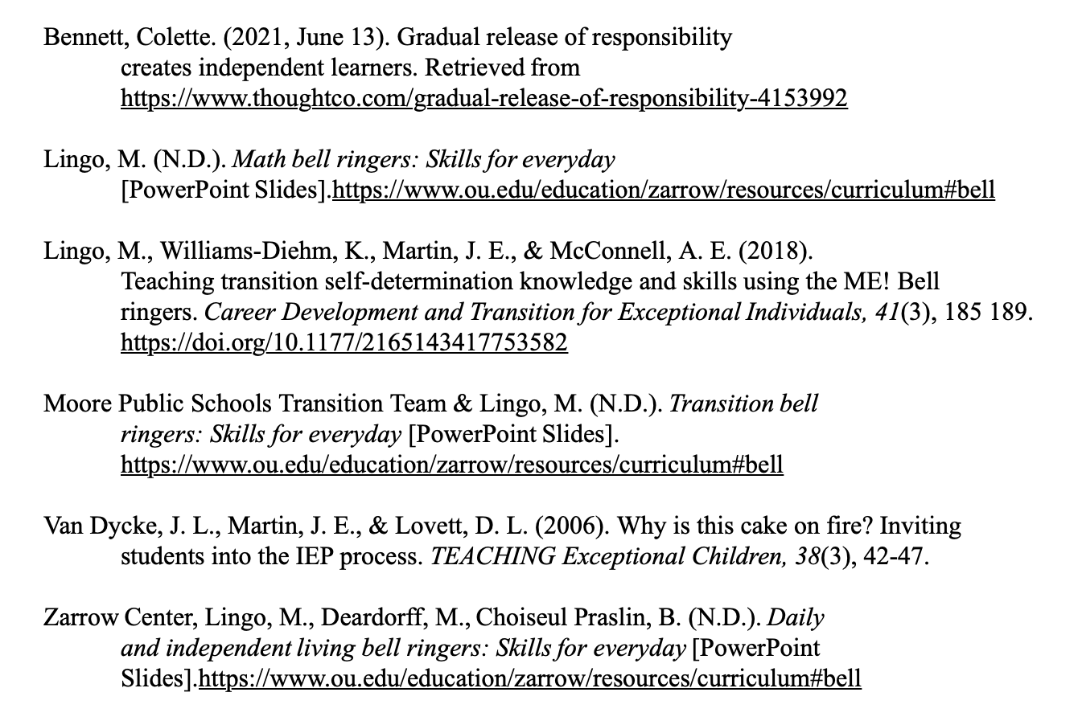
References

