Slide 1
Unit 1: Getting Started
Self-Awareness & Self-Advocacy

Slide 2
Bell Ringer Activity 1
Watch Mike’s Story Clip:
Mike’s Story
How is Mike’s school situation similar or different than yours?
Do you know what an IEP is? If so, what is it?

Slide 3
Bell Ringer Activity 2
Name 3 of your biggest strengths
Name 3 of your biggest weaknesses
Explain how each of those strengths and weaknesses affect you here at school

Slide 4
Bell Ringer Activity 3
Write down the word Self-Awareness
What does “Self” mean?
What does “Awareness” mean?
What does the word mean when you put it together?

Slide 5
Bell Ringer Activity 4
Take a minute to think of answers to the following questions (about school):
  What are some things you do well at school?
  What are some things you need to improve at school?
  What are things you enjoy doing at school? Why do you like these things?
  What are things you dislike doing at school? Why do you dislike these things?
  What is important to you at school? Why?

Slide 6
Bell Ringer Activity 5
On the next sheet of paper in your journal, draw a box that takes up nearly all of the page.
Inside that box, write down everything that is important in your life. Draw pictures if it is easier. Try and fill up the box and make sure the most important things are easiest to see.
See example on the board

Slide 7
Bell Ringer Activity 6
Think about a time where a teacher or another adult was not doing what they were supposed to, and it affected you directly (Teacher yelling, Principal not being fair, etc.)
In 2-3 sentences, what did you do? Why?

Slide 8
Bell Ringer Activity 7
Lucy is a high school student who wears contacts. Even though she wears contacts, she cannot see small things from far away. When Lucy arrived to Algebra class on Monday, her teacher had made a new seating chart that left Lucy sitting at the back of the room. Lucy stayed after class to explain to her teacher that she needed to sit closer to the front because she could not see the board even when she wears her contacts.
Why was it important for Lucy to speak up for herself?
Do you think Lucy did the right thing?
Have you ever been in a situation that you needed something changed in order to do your best? If so, did you speak up for yourself?
Was it difficult for you to speak up for yourself? Explain.
What would you have done in Lucy’s situation?
How could Lucy’s actions in this situation impact her future?

Slide 9
Bell Ringer Activity 8
Write down the word “Self-Advocacy”
What does the word “Self” mean
What does the word “Advocacy” mean? *look it up on your cell phone ☺*
How does that word apply to Lucy’s Story?

Slide 10
Bell Ringer Activity 9
Where are some places or situations where you might need to advocate for yourself?
Is it possible to advocate for yourself if you lack self-awareness? Why or why not?

Slide 11
Bell Ringer Activity 10
Please take a Me! Scale and fill it out about yourself (5 minutes)
Take a You! Scale home with you today and have your parents fill it out. Bring it back on Monday!

Slide 12
Bell Ringer Activity 11
Pull out the completed You! Scale.
Look at both scales (Me! and You!)
How are they similar?
How are they different?

Slide 13
Bell Ringer Activity 12
Define Self-Awareness:
Define Self-Advocacy:
Write down “Self-Determination”
What does “Determination” mean? *Look it up on your cell phone ☺*
What do those 3 words mean to you?

Slide 14
Bell Ringer Activity 13
Watch the following clip:
3rd Rock from the Sun: Self-Determination
Why do you think being able to say “No” to something is important?

Slide 15
Bell Ringer Activity 14
Think back to your 3 biggest strengths/weaknesses.
What are some ways you can improve on your weaknesses this week?
This month?
This whole school year?

Slide 16
Bell Ringer Activity 15
Watch the following clip: Self-Advocacy
What does Self-Advocacy mean to you?
Have you ever had to speak up for yourself in a classroom?

Slide 17
Bell Ringer Activity 16
Watch the following Clip: Carly’s Café
What did you think?
How can the girl in the video advocate for herself? Can she? Who would advocate for her instead?

Slide 18
Bell Ringer Activity 17
Get with a partner.
You are going to create a story about a student needing to advocate for him/herself.
Answer the following questions in your story:
  1. What is your character’s name?
  2. What grade is your character in?
  3. What does your character struggle with most at school?
  4. What is your character doing to improve in the areas he/she struggles with?
  5. Does your character attend class in the lab/resource room? If so, for what subject(s)?

Slide 19
Bell Ringer Activity 18
Continue your story! Answer the following questions in your story:
1. Does your character take tests in the lab/resource room?
2. What are some things your character does well?
3. Give an example of when and how your character uses self-advocacy.
4. What are your character’s plans after high school graduation?
5. You can add information to your story as your group sees necessary.
6. You may also create a picture of your character.

Slide 20
Bell Ringer Activity 19
Stella Young TED Talk
Listen to this speech
What does it mean to be treated equally and fairly in your life?

Slide 21
Bell Ringer Activity 20
Think about the most difficult time you’ve had with a teacher.
What are some things that happened that made you feel like you were unfairly treated?
If you could go back and do anything about it, what would you do?

Slide 22
Bell Ringer Activity 21
Define the following words:
Self-Awareness
Self-Advocacy
Self-Determination
Specialized Education: What do you think this means?

Slide 23
Bell Ringer Activity 22
Define our 4 words: Self-Awareness, Self-Advocacy, Self-Determination, Specialized Education.
How do those words apply to you directly? (All four)

Slide 24
Bell Ringer Activity 23
Watch the following Clip (start at 13:54 and end at 18:38)
What does a successful future look like for you? What would need to happen for you to consider it a success?

Slide 25
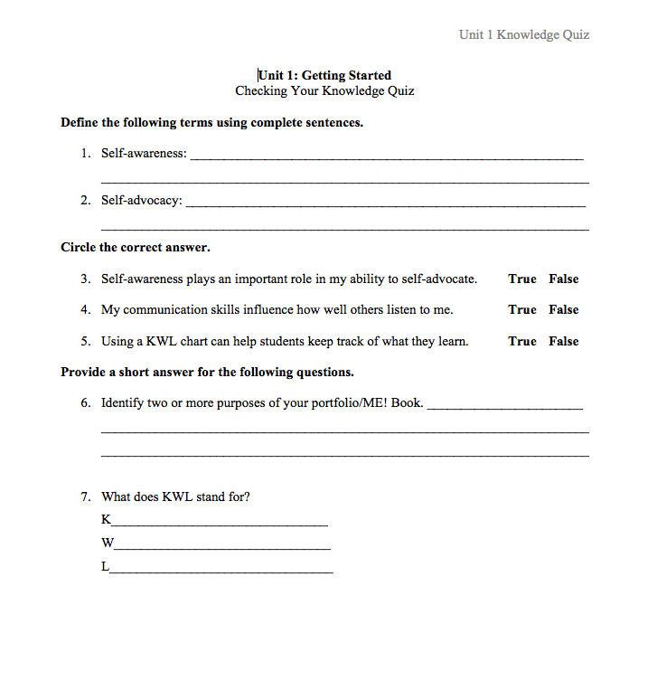
Unit 1 QUIZ

Slide 26
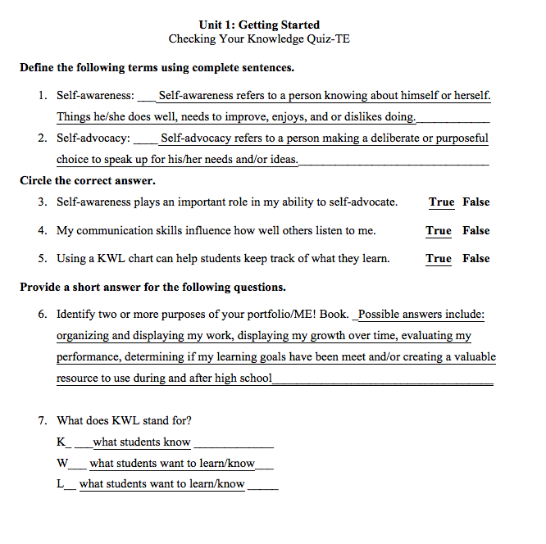
UNIT 1 Answers

