Slide 1
Learning About Special Education
ME! Lessons for Teaching Self-Awareness and Self-Advocacy – Updated 9/14
© 2015 Board of Regents of The University of Oklahoma

Slide 2
Acronyms
A word formed from the first letter of several words
Example
Laugh
Out
Loud
Other Examples?

Slide 3


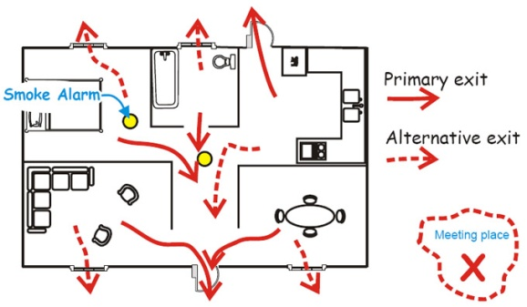
Most Common in Special Ed
IEP
I- Individual
E- Education
P- Plan

Slide 4


IDEA
I –individuals (with)
D- disabilities
E- education
A- act
A federal law that requires schools to provide special education to students with disabilities

Slide 5
Goals/Objectives
Goals are things you, your family, and the school plan for you to achieve and these are written in your IEP
Example
Given an 8th grade passage, Pauline will answer 8 out of 10 comprehension questions correctly.

Slide 6
Objective
Steps to reaching your goal
Example
By the end of the first nine weeks, given an 8th grade passage Pauline will answer 5 out of 10 comprehension questions correctly.

Slide 7

**Accommodations**
Changes made to HOW a student completes his/her work.
Example
-Extended Time
-Read aloud
-Separate Setting

Slide 8
Modifications
Changes to WHAT a student is expected to do.
Example
-OCS curriculum, Regular Curriculum

Slide 9
TYPES of MEETINGS

Slide 10

Eligibility Meeting
Meeting held to review student test scores and other information to determine if a student qualifies for special education

Slide 11
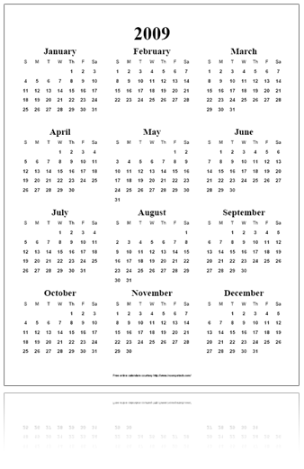
Annual Review
Annual (year)
A yearly meeting held to review a student’s IEP and progress made

Slide 12
Reevaluation Meeting
A meeting held every 3 years to review new testing results, IEP, and testing results

Slide 13


Transition Meeting
A meeting held to discuss and plan for a students future.

Slide 14
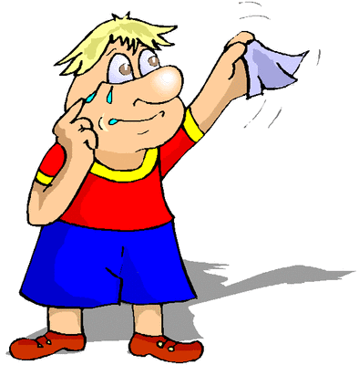

Exit Meeting
Meeting held before graduation to review student progress and discontinue special education services

