Slide 1
Unit 3: Understanding my Individualized Education Plan
Getting to know the IEP

Slide 2
Bell Ringer Activity 1
Think back to the definitions we’ve discussed.
In your own words, define these words:
Self-Advocacy Barriers
Self-Determination Prejudice
Special Education IEP
Disability Goals
Accommodations Objectives
Modifications *Transitions* (This is New-look it up!)

Slide 3
Bell Ringer Activity 2
Answer the following questions using one sentence:
  What is the overall purpose of an IEP?
  Who takes care of the IEP?
  Who is involved in the IEP process?
  Where is your IEP kept?
  Who is your IEP case-manager/Teacher
  Have you ever seen your IEP?

Slide 4
Bell Ringer Activity 3
An IEP must have the following 8 things:
Present levels of academic achievement and functional performance
Measurable annual goals
Special education, related services, and supplementary aids and services
Amount of time students will not participate in general education classes
Participation in state or district-wide academic assessments (including accommodations to be provided and reasons for using an alternate assessment if the child will not participate in the regular assessment)
Initiation date and projected duration of IEP
Transition services
How student progress toward annual goals will be measured and when periodic reports will be provided to parents
The definition of an IEP is as follows:
The Individualized Education Program (IEP) is a written document required for each child who is eligible to receive special education services. It is provided to a student who has been determined first to have a disability and, second, to need special education services because of that disability.

Slide 5
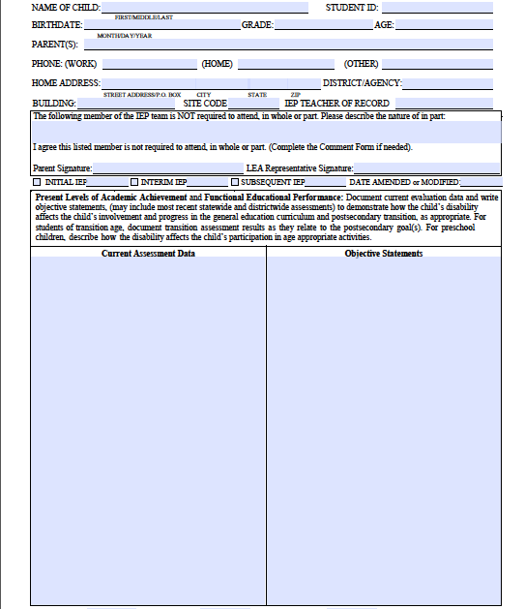
Bell Ringer Activity 4
Time to look at each Section of the IEP!
This is the front Page of the IEP.
*copy down each section’s purpose*
This is Information about who you are and where you live (Demographics)
This section contains all the data from assessments that were done with you (grades, tests, End of Year assessments, etc.) Snapshot of you academically.
This is an intro to your Specialized Education Program. Should contain necessary information for someone to know who you are, how you learn, and how to help you succeed
*This is a great place for you to contribute, YOU ARE THE EXPERT!*
Notes:
This Presentation of the IEP utilizes the Oklahoma Individualized Education Plan. It can be modified to use in your state.

Slide 6
Bell Ringer Activity 5
  Remember this Page?
  The “Objective Statement” box is a snapshot of who you are!
  Write a paragraph introducing yourself. Here are several questions to guide your sentences:
  1. What is your name, age, grade in school?
  2. What is your disability? (If you don’t know, tell what is your biggest struggle in school)
  3. What are your strengths?
  4. What are your weaknesses?
  5. What are 3 things that a teacher can do to help you be successful in their class?
  6. Anything else you think is RELEVANT.
Notes:
This Presentation of the IEP utilizes the Oklahoma Individualized Education Plan. It can be modified to use in your state.

Slide 7
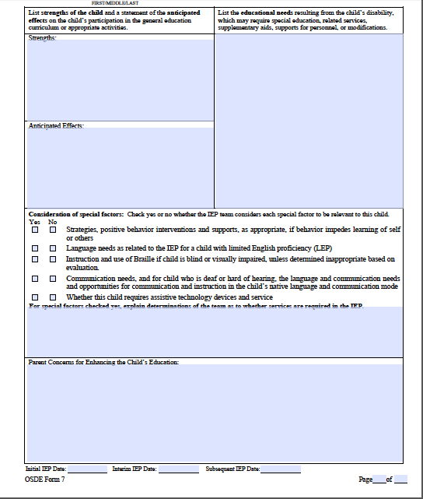
Bell Ringer Activity 6
Let’s keep looking at the IEP!
This is Page 2 of the IEP
Strengths- Lists your strengths
Anticipated Effects-It’s anticipated that with help and your strengths, you will succeed
Educational Needs- What you struggle with in school
Parent Concerns- What your parents are concerned about with you and your success
Do you notice that it doesn’t ask for YOUR concerns? How do you feel about that? Answer on this same page.

Slide 8
Bell Ringer Activity 7
Let’s keep looking at the IEP!
This is Page 2 of the IEP
*Now, let’s put your voice into it*
Strengths- Write down 3 strengths you have
Educational Needs- List 3 things that you need help with or that you struggle with in high school
*Answer each with 3 complete sentences*

Slide 9
Bell Ringer Activity 8
Let’s keep looking at the IEP!
This is Page 2 of the IEP
*Now, let’s put your voice into it*
Parent Concerns- What do you think your parents are worried about?
Student Concerns-Now what are you worried about in school (fears)?
*Answer each with 3 complete sentences*

Slide 10
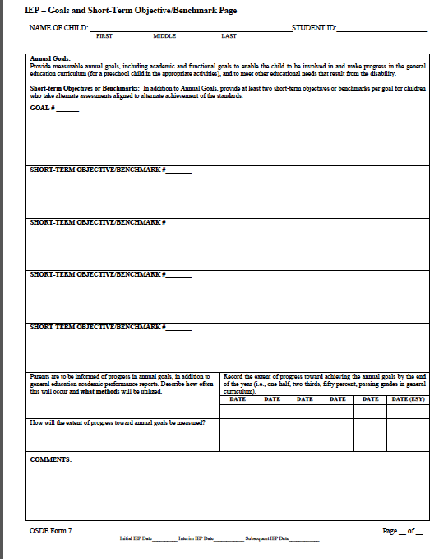
Bell Ringer Activity 9
Let’s keep looking at the IEP!
This is Page 3 of the IEP (The Goal Page)
Typically, you have one goal page for each *academic need* that was listed on page 2
Goal- The overall thing you want to achieve this year (according to your need)
Short-Term Benchmark- Where a goal is broken down into small chunks to make it easier to achieve
This is where you see how much progress is made through the year on that goal.

Slide 11
Bell Ringer Activity 10
Let’s keep looking at the IEP!
This is Page 3 of the IEP (The Goal Page)
Now let’s give it a try!
1st- Think of a goal you want to achieve this year. It can be anything from “Pass all my classes” to “Getting on the football team”
2nd-Write that goal down like this: “Johnny will_______ by what date (Johnny will make it on the football team by doing well at the tryout on February 15th)”
3rd- Now break down your goal into three steps (for example if Johnny wants on the football team he will need to 1. Gain Weight (ex:30 lbs.) 2. Get faster below 5 second forty yard dash 3. Get 100% on my Linebacker Drills.) When will all these things need to be done?
*Complete this activity in your notebooks*

Slide 12
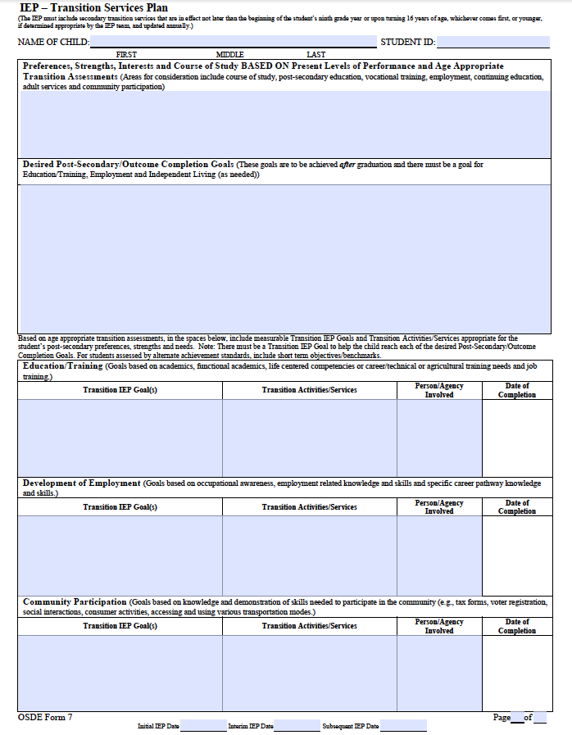
Bell Ringer Activity 11
Let’s Keep Going with the IEP
This is the Transitions Page
*Think about what Transition means*
Course of Study- This contains any assessment info and/or classes that are recommended to help you get ready for future careers.
Post Secondary Goal-This is the ultimate goal of what you want to do after high school (Live, Work, Learn)
Each of these Annual goals below talk about what we will do This Year in order to help you achieve your Post-Secondary Goal.
*Write down the definitions of Transition, Course of Study, Post Secondary Goal, and Annual Goal in your notebook*

Slide 13
Bell Ringer Activity 12
Let’s Keep Going with the IEP
Now it’s your turn!
Answer the following questions:
1. Where do you want to live one year after high school
2. Where do you want to be learning (college, tech school, academy, etc.) one year after high school? What career will you be studying?
3. Where do you want to be working one year after high school is complete?

Slide 14
Bell Ringer Activity 13
Let’s Keep Going with the IEP
Now it’s your turn!
Think about your answers from yesterday…
1. What is something you can do/learn this school year to help you prepare to live where you chose (one year after high school)?
2. What is something that you can do to get ready for learning after high school? (apply to colleges, scholarships, study skills, etc.)
3. What is something you can do this year to get you ready to have a job after high school?

Slide 15
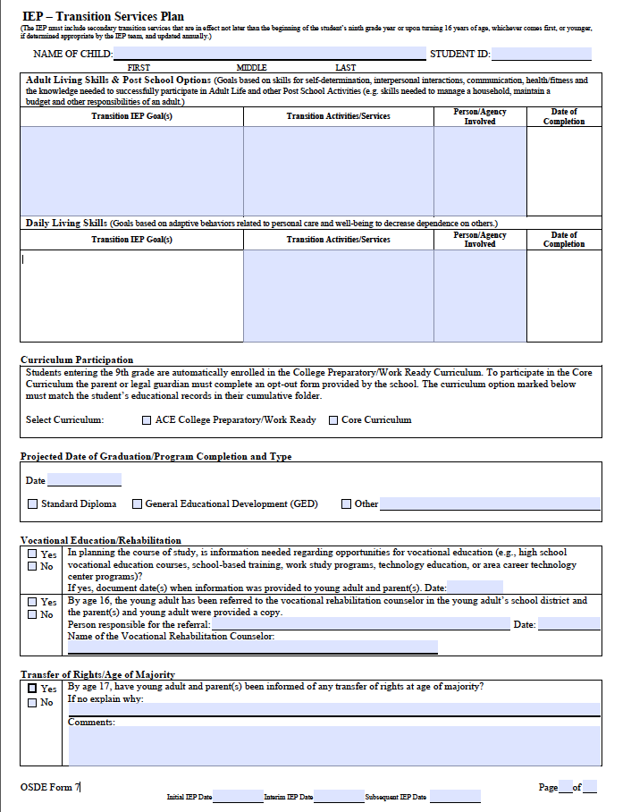
Bell Ringer Activity 14
Keep Going with the IEP!
This is the 2nd Transition Page - More Annual Goals
Curriculum Participation- This indicates whether or not you are taking the regular class load.
Projected Graduation Date- Ask yourself, does this seem right?
Vocational Rehab- Services to help you succeed once you graduate from high school
Transfer of Rights- When you’re 18 years old, this WHOLE thing becomes your responsibility (Be prepared!)

Slide 16
Bell Ringer Activity 15
IEP! IEP! IEP!
Wait a Minute…..Does this mean that there is life after high school????
I have to have a plan?
Watch this video and answer the following question:
How do you think your disability will affect your life after high school? How can you overcome and succeed?

Slide 17
Bell Ringer Activity 16
IEP! IEP! IEP!
Go back and define these words:
Self-Advocacy Self-Determination
Self-Awareness Transition
Goals Accommodations
Modifications Services *Look it up*
IEP Case Manager *Think about it*

Slide 18
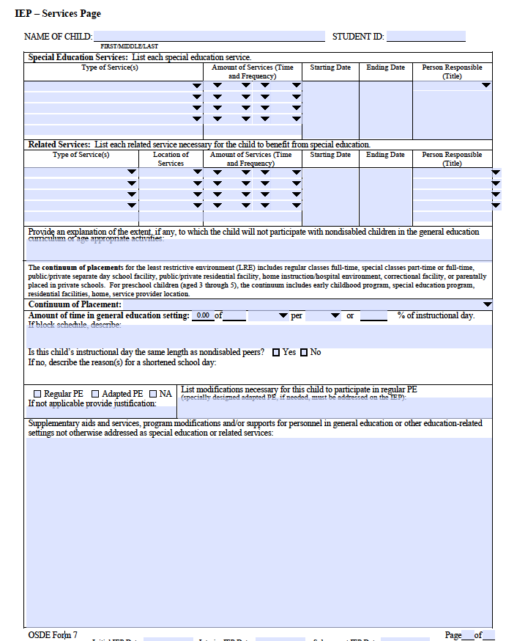
Bell Ringer Activity 17
Keep Going with the IEP!
This is the Services Page
Write down each Section’s definition:
Special Education Services- Talks about the classes you will take that need special education services.
Related Service- Anything extra (Speech, Occupational Therapy, Physical Therapy, etc.)
Continuum of Placement- How long you are not in the general education classroom
Supplementary Aids and Services: ONE OF THE MOST IMPORTANT BOXES! This box tells EVERY single accommodation and/or modification you receive in the classroom. This box is read and must be followed by every teacher you see.

Slide 19
Bell Ringer Activity 18
Keep Going with the IEP!
Now It’s Your Turn!
Think about the Services Box
Write down at least 3 things that teachers can let you do/give you/do extra, that will help you be successful in their class.
*ex: Extra time, test in another room*
o

Slide 20
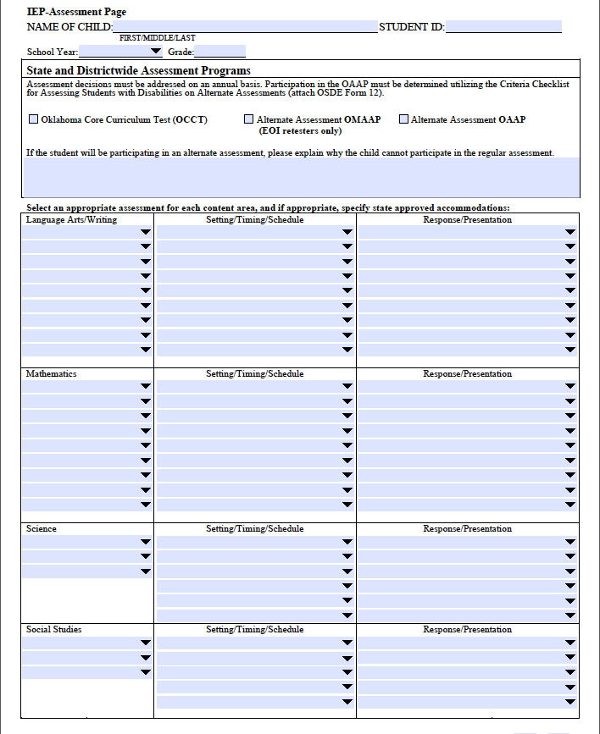
Bell Ringer Activity 19
More More More
IEP ASSESSMENT PAGE
This page tells all of the accommodations and modifications that are allowed on state testing.
Answer these questions:
1. What is the hardest part about state tests (EOI’s)?
2. What would be some things that can be done to help you on those tests?

Slide 21
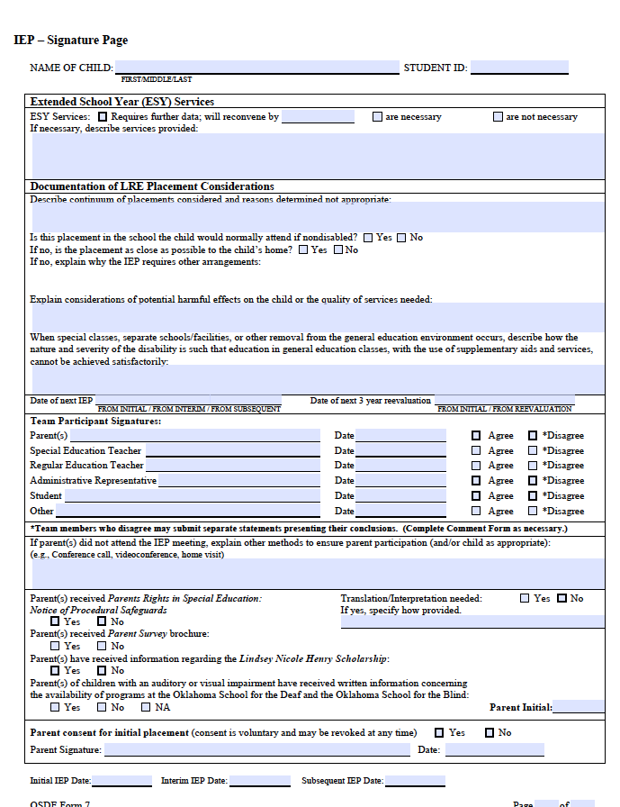
Bell Ringer Activity 20
More More More
Final Page!
The Signature Page
Extended Year Services- Summer School-Do you need it?
Documentation of Least Restrictive Environment (LRE)- This states that the program you are using is not too easy or too hard.
Signatures- This is where everyone signs the document to make it LEGALLY BINDING
This means that everyone involved (including you) is legally required to do everything this document says…cool, huh?

Slide 22
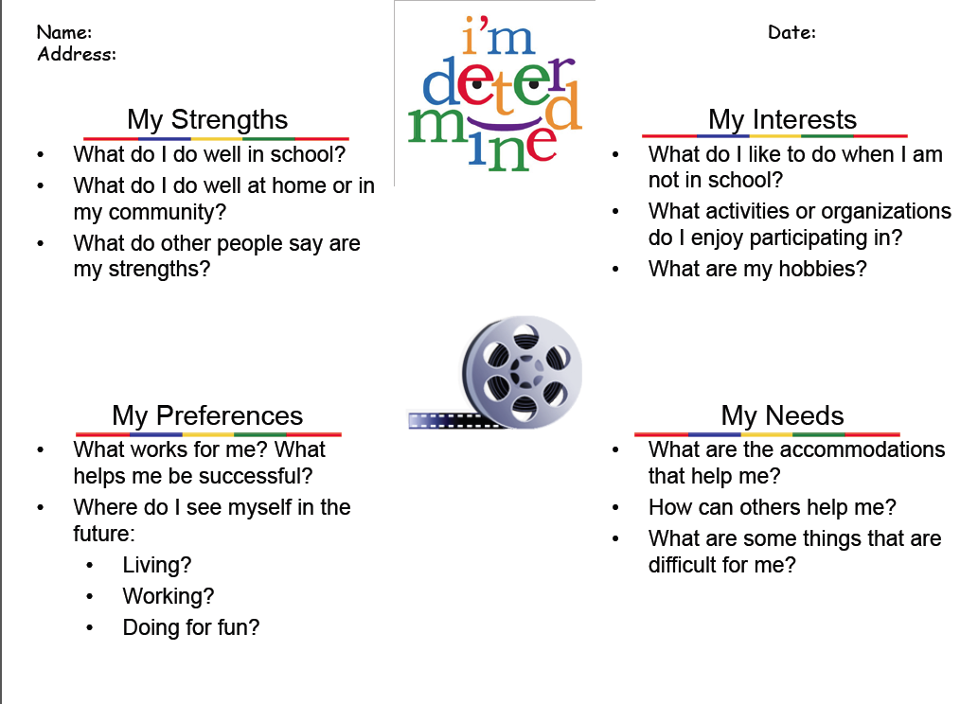
Bell Ringer Activity 21
Hmmmm…What now?
I’m Determined!
1. Turn your Notebook sideways
2. Make four bubbles on the outside connected to one bubble in the middle:
3. Create the chart using the questions provided
4. Draw a picture of yourself in the middle

Slide 23
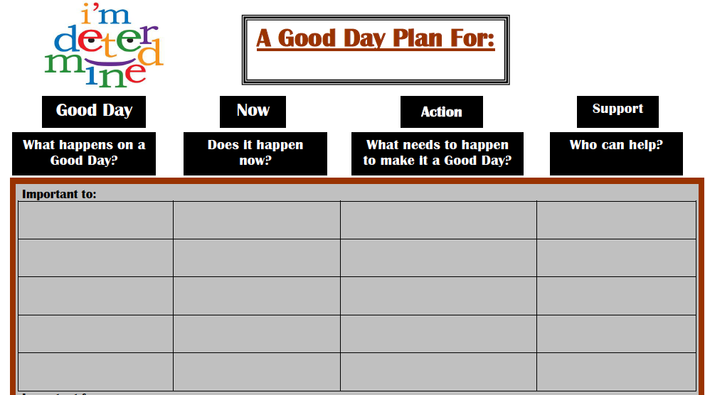
Bell Ringer Activity 22
I’m Determined
Complete the following chart:
1. Turn paper horizontally
2. Write what needs to happen to make your day a “good day”
3. Does it happen everyday for you?
4. What action needs to happen to make sure it happens?
5. Who can help you with that?

Slide 24
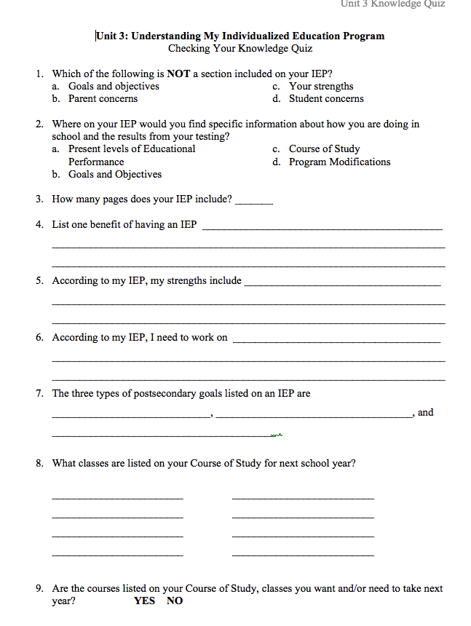
Unit 3 Quiz

Slide 25
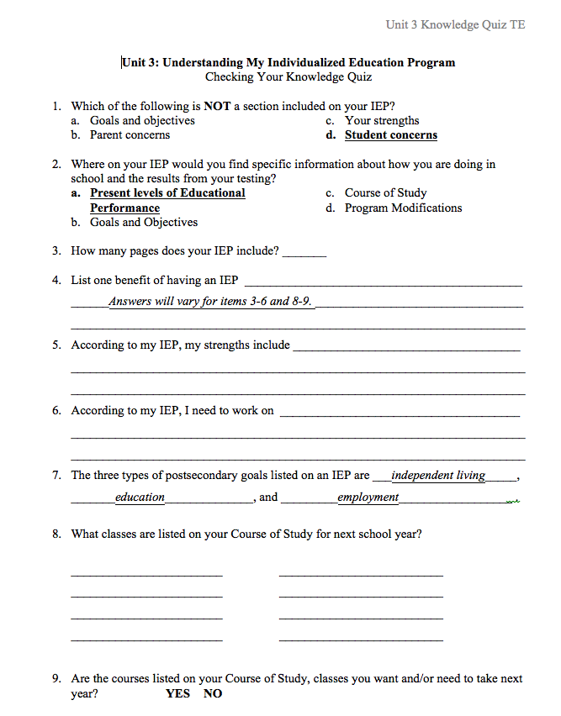
Unit 3 Answers

