Slide 1
Student-Directed Transition Planning
Lesson 1
Awareness
By
Lorraine Sylvester, Lee L. Woods, and James E. Martin
University of Oklahoma
College of Education
Department of Educational Psychology
Zarrow Center for Learning Enrichment
Preparation of SDTP supported in part by funding provided by the U.S. Dept. of Education, Office of Special Education Programs, Award #: H324C040136
Copyright 2007 by University of Oklahoma
Permission is granted for the user to duplicate the student materials and PowerPoint files for educational purposes. If needed, permission is also granted for the user to modify the PowerPoint files and lesson materials to meet unique student needs.

Slide 2

Awareness of Self, Family, Community, and Disability

Slide 3
Awareness of Self, Family, Community, and Disability
This is the first lesson in a series of lessons that will help you plan, with your family, for your life after high school.

Slide 4
Introduction and Lessons Overview
Review transition planning process
  What is transition?
    • Transition is change.
  What will change after you graduate?
    Job, more education, different friends, living on your own or with family.
  What do you have to do now to get ready for this change?
    Set goals; gather skills and supports; implement and manage plan; reflect, adjust and celebrate progress

Slide 5
Throughout the lessons,
you will learn a lot about yourself…your preferences, interests, strengths, and needs for what you will do after graduation.
you will be talking with your family and other people about very personal things that relate to how you will live your life after graduation.

Slide 6
Confidentiality
Together with your family and teachers, you will be compiling information that is personal and private. This means you do not have to reveal or discuss this information with anyone else, unless you want to.
However, there are times that it will be important to reveal certain information about yourself so that you can get help if you need it for a job or further education after graduation.

Slide 7
Confidentiality
These laws help ensure that your educational
and medical information remains confidential.
FERPA: Family Educational Rights and Privacy Act. This act keeps your educational records and information out of the hands of people who should not have them.
HIPAA: Health Insurance Portability and Accountability Act. This act keeps your personal health and medical information out of the hands of people who should not have it.

Slide 8
Overview of Lessons
Terms &
Concepts of
Transition
Awareness
Course of
Study
Connecting with
Adult Support
Services
Summary of
Performance
Vision for
Employment
Vision for
Adult
Living
Transition
Goals
Vision for
Postsecondary
Education

Slide 9
Let’s begin with
Self-Awareness
Self-awareness means knowing your own interests, skills and limits.
It also means knowing what your family or other adults think about your future and how they can help.
Notes:
Title Slide

Slide 10
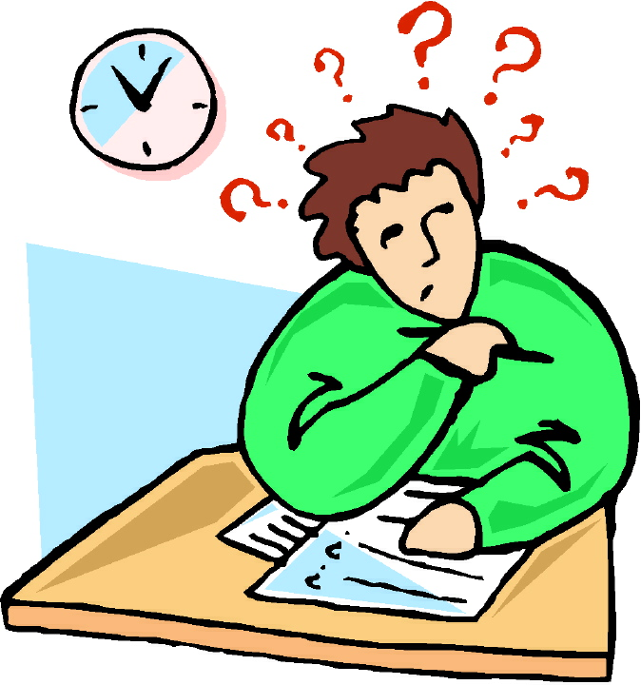
Self-Awareness Survey
Be very honest with yourself!
Get feedback from others!
You will be adding more information as we move through the lessons.
Image is the copyrighted property of JupiterImage and is used with permission under license

Slide 11

Awareness Survey Results
What did you find out about yourself?
Image is the copyrighted property of JupiterImage and is used with permission under license

Slide 12
What’s Important to Me?
Family
Free Time
Humor
Health
Creativity/The Arts
Helping Others
Spirituality/Religion
Recreation
Friends
Work
Learning
Nature
Notes:
Add the website to the circle worksheet so students can do on line at home if they want, with their family.

Slide 13
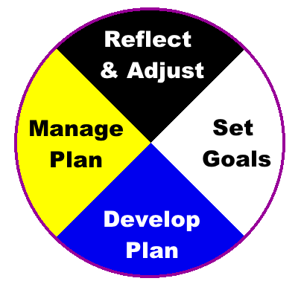
Transition Planning

Slide 14
Transition Planning
Begins early! (no later than 16, and sometimes earlier!)
Helps you identify career interests, abilities, and experiences
Helps you decide your post-secondary career, education, and living goals
Helps identify community services and prepare applications for college and/or adult support services
Means preparing and keeping a file with references and skills you have acquired.

Slide 15
Setting Goals
Knowing what’s important to you and your family:
  can help you set realistic and achievable goals.

Slide 16
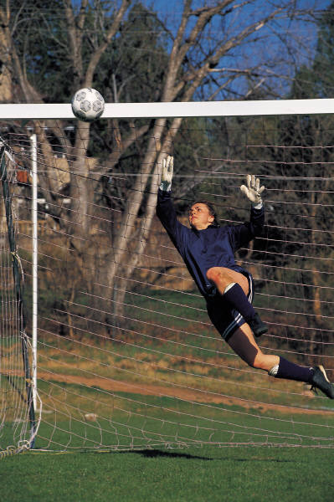
Developing a Plan
What do I want?
Why do I want to do it?
How am I going to do it?
When will I do it?
What help do I need
How will I find out how I’m doing?
Do I need to make changes?

Slide 17

Managing the Plan
Did I get what I wanted?
Was I motivated to do it?
What steps did I take?
Did I follow my schedule?
Did I get the help I needed?
Did I get information on how I did?
Image is the copyrighted property of JupiterImage and is used with permission under license

Slide 18
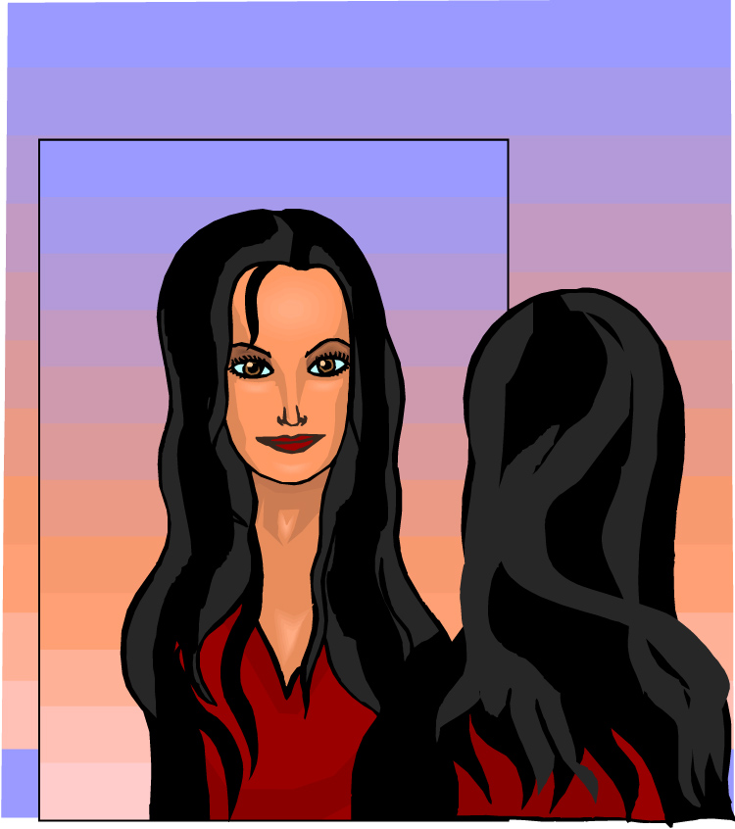
Reflect and
Adjust
Experience Outcomes and Learn
Image is the copyrighted property of JupiterImage and is used with permission under license

Slide 20
Activity 1
Toss and catch one ball (goal).
Now, try to keep your goal ball going while juggling obstacle #1.
Then add obstacle #2.
Can you keep your goal in sight while juggling both obstacles?
Image is the copyrighted property of JupiterImage and is used with permission under license

Slide 21
Activity 1 - Discussion
Did keeping track of your goal ball get more difficult as you added more balls (obstacles)?
What can you do to prevent the obstacles from becoming barriers to achieving your goals?
Image is the copyrighted property of JupiterImage and is used with permission under license

Slide 22
Different Abilities
In the games, we showed some of our strengths and skills.
Some of our limits showed as well.
Limits may be caused by a disability.
Image is the copyrighted property of JupiterImage and is used with permission under license

Slide 23
Defining Disability - Worksheet
Describe what disability means to you.
Describe your disability in clear terms.
How does your disability affect your performance at school, home, or in the community?
Take a blank form home and have your family complete the survey.

Slide 24
Disability Awareness Discussion
What does having a learning disability mean to you?
How does your family see your learning difficulties?
How did your answers compare with your family’s?
Do you or your family know anyone with learning difficulties?
What information can your teacher provide?

Slide 25
Disability Awareness Summary - Using the Input Circle
We’ll use the Input Circle as a way to organize your thoughts and input from your family and teacher about your disability.
You’ll use this type of circle in future lessons.
Let’s look at an example.

Slide 26
Disability Awareness Circle
Maria completed her disability awareness circle like this.
Maria thought ….
Her family thought…
Her teacher thought….
Summary: My family, my teacher, and I agree that I have a reading disability.
Now…do one your own!
Reading is hard for me. Having things read aloud is easier for me.
Maria struggles
with reading. She
can do the
work, but
needs a
little help.
My family, my teacher, and I agree that I have a reading disability.
,
Maria qualifies for special education under the category of Learning Disabilities. Her reading is the
main concern.

Slide 27
Disability
Some disabilities you may not be able to see, like learning disabilities or attention deficit disorder.
Some disabilities are easier to see because of special supports like a wheelchair or guide dog.
Schools provide supports for students with disabilities to help them learn.
Your Individual Education Program identifies your disability-related needs, and is a plan to help you be successful.

Slide 28
Comparing apples to apples…
What’s the same about the two apples?
What’s different about them?
When you get down to the core, they’re both just apples!
Image is the copyrighted property of JupiterImage and is used with permission under license

Slide 29

Disability is Natural
But what’s that got to do with apples?
The red apple is more like the green apples than it is different.
People with disabilities are more like people without disabilities than they are different.
Image is the copyrighted property of JupiterImage and is used with permission under license
Notes:
Add graphics….reference Kathie S

Slide 30
Disability is Natural
Apples are natural.
Having a disability is a natural part of the human experience
The sun shines equally on all the apples in the bowl!
    Snow, 2005

Slide 31
Does having a disability mean you can’t be successful?
Your disability only limits you if you let it!
Let’s meet some successful people!

Slide 32
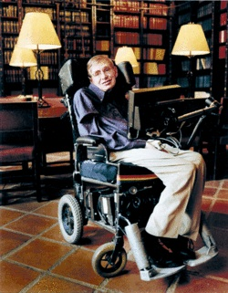
Successful People
This man is considered one of the world’s foremost experts on “Black Holes” and was professor of mathematics at Cambridge University. He is the author of several books on the nature of the universe.
Dr. Stephen Hawking
Notes:
Picture of famous people with disabilities. Collage ADD powerpoint

Slide 33
Successful People
Bloom is most famously known by his role in Pirates of the Caribbean. He was diagnosed with dyslexia at age 7. Acting helped him learn material in a different way that allowed him to be successful.
Orlando Bloom
Notes:
Picture of famous people with disabilities. Collage ADD powerpoint

Slide 34
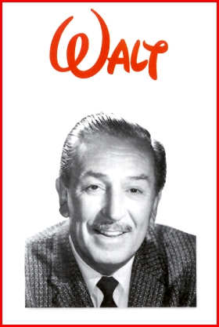
Successful People
This man struggled in school
and had a learning disability
called dyslexia (a reading disability). He went on to become a successful movie producer, director, screen writer, animator, and theme park developer. He founded one of the largest media and entertainment corporations in the world.
Walt Disney
Notes:
Picture of famous people with disabilities. Collage ADD powerpoint

Slide 35
Successful People
This champion swimmer was constantly in trouble at school because he would not sit still. He was diagnosed with ADHD in the 5th grade. He turned to swimming to help him focus. He is now the most highly decorated Olympian of all time (22 medals – 18 of them gold).
Michael Phelps
Notes:
Picture of famous people with disabilities. Collage ADD powerpoint

Slide 36
Successful People
Singer, songwriter, and actor Justin Timberlake revealed that he has both Attention Deficit Disorder and Obsessive Compulsive Disorder. His OCD manifests in the need to have things line up correctly, and only allowing certain foods in his refrigerator. Despite battling his obsessive thoughts, Timberlake has had an incredibly successful career in the entertainment industry, even winning nine Grammy Awards and four Emmy Awards.
https://www.special-education-degree.net/25-famous-people-with-learning-disorders/
Justin Timberlake
Notes:
Picture of famous people with disabilities. Collage ADD powerpoint

Slide 37
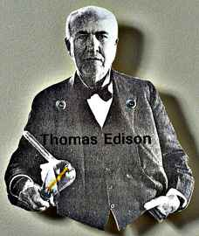
Successful People
This man had a disability and
struggled in school. He
went on to be become the
most prolific American inventor,
holding over 1000 patents.
Thomas Edison
Notes:
Picture of famous people with disabilities. Collage ADD powerpoint

Slide 38
Successful People
Steve Jobs struggled in school due to his dyslexia. He even dropped out of school because of his frustration and hard time learning. Jobs was able to create Apple, one of the world’s most successful technology empire despite his disability.
Steve Jobs
Notes:
Picture of famous people with disabilities. Collage ADD powerpoint

Slide 39
Successful People
Tim Tebow was a professional baseball player and professional football player, has a form of dyslexia. Tebow had difficulties learning in school but did best when he was active. His love for sports helped him learn better. He has a successful career and contributes to charities for youth with disabilities.
Tim Tebow
Notes:
Picture of famous people with disabilities. Collage ADD powerpoint

Slide 40
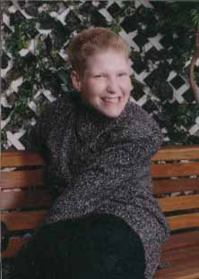
Successful People
This woman with severe cerebral palsy graduated from high school with a 4th grade education. She now holds a 3.2 GPA, working on a degree in computer and information technology at Rose State College. She also holds down 2 jobs, owns her own business, and is the reigning Ms. Wheelchair Oklahoma.
Sherri Kelly
Notes:
Picture of famous people with disabilities. Collage ADD powerpoint

Slide 41
Successful People
Adam Levine is a famous musician and entertainment personality. As a student, he had difficulties focusing, sitting down and getting work done. Adam received the diagnosis of ADHD in his early teen years and used music as a way to focus and present understanding.
Adam Levine
Notes:
Picture of famous people with disabilities. Collage ADD powerpoint

Slide 42
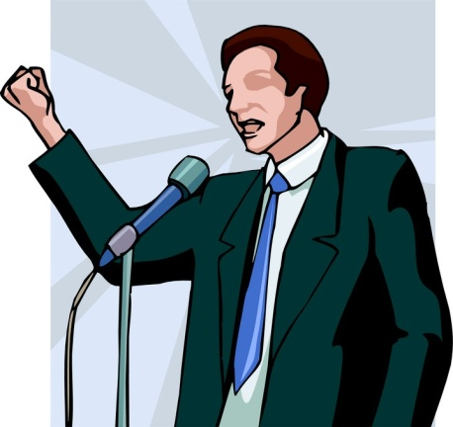
All of these people became successful with help
from other people…friends, family, teachers, others.
This process is called…
ADVOCACY
Advocacy means active verbal support for a cause or a
position; speaking up or acting in favor of something.
  You advocate for yourself and for others.
  Others advocate for you too.

Slide 43
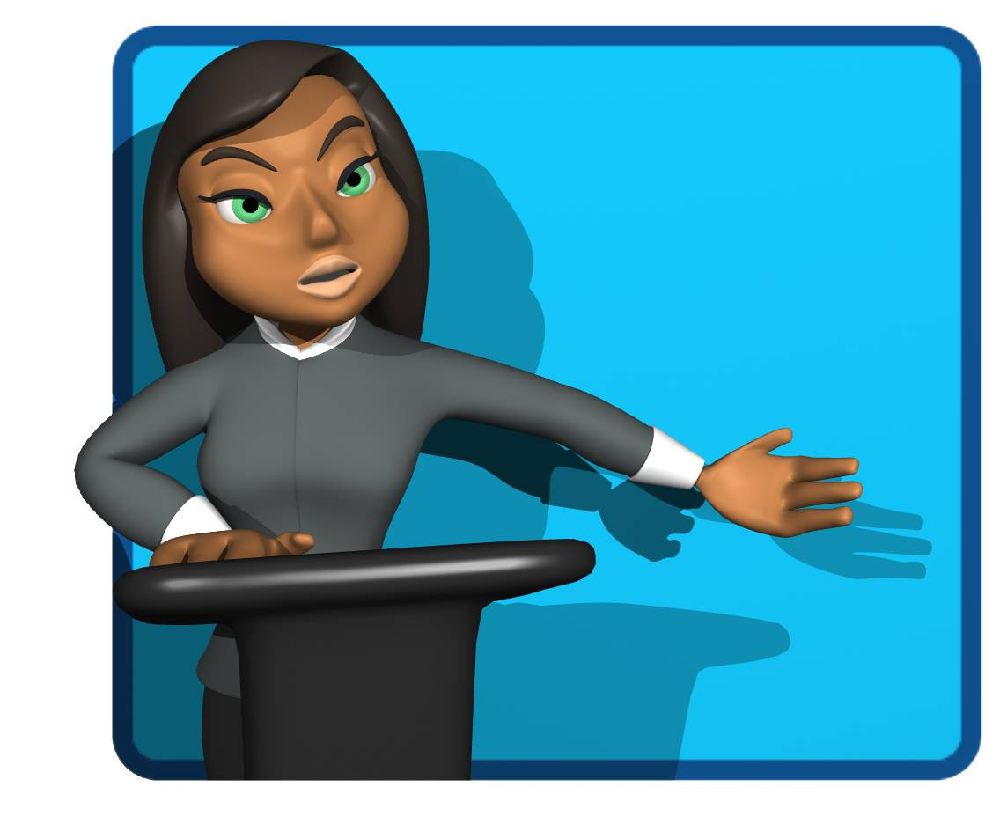
Advocacy
Self-Advocacy happens when you lead your own IEP meeting, or when you ask for help, or accommodations, to make learning easier for you.
Image is the copyrighted property of JupiterImage and is used with permission under license

Slide 44

Advocacy
Your parents and teachers advocate when they speak up for you and help you get what you need so you can learn better.
Image is the copyrighted property of JupiterImage and is used with permission under license

Slide 45
Timeline for Transition

Slide 46
What’s Next?
Connecting with
Adult Support
Services
Terms &
Concepts of
Transition
Course of
Study
Summary of
Performance
Awareness
Vision for
Employment
Vision for
Adult
Living
Transition
Goals
Vision for
Postsecondary
Education

