Slide 1
Student-Directed Transition Planning
Lesson 2
Terms and Concepts for Transition Planning
By
Lorraine Sylvester, Lee L. Woods, and James E. Martin
University of Oklahoma
College of Education
Department of Educational Psychology
Zarrow Center for Learning Enrichment
Preparation of SDTP supported in part by funding provided by the U.S. Dept. of Education, Office of Special Education Programs, Award #: H324C040136
Copyright 2007 by University of Oklahoma
Permission is granted for the user to duplicate the student materials and PowerPoint files for educational purposes. If needed, permission is also granted for the user to modify the PowerPoint files and lesson materials to meet unique student needs.

Slide 2
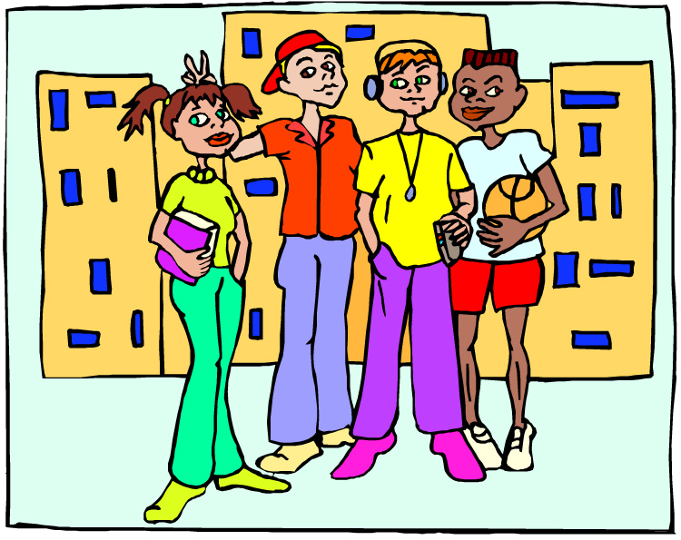
Concepts and Terms for Transition Planning
Image is the copyrighted property of JupiterImage and is used with permission under license

Slide 3
Concepts and Terms for Transition Planning
Developing Transition Plans for Graduation, Postsecondary Education, Employment, and Living Arrangements
1

Slide 4

Think About This…
Remember your first day of school here…
What was your first day like?
How did you feel?
2
Image is the copyrighted property of JupiterImage and is used with permission under license
Notes:
Discussion Points:
Did you know your way around?
Did you know where to go for help?
Did you know what to do?

Slide 5
Imagine…
You just graduated from high school!
What are you going to do
now?
What type of work will you do?
Where are you going to live?
Will you get more education?
3
Image is the copyrighted property of JupiterImage and is used with permission under license

Slide 6

Transition Journey
4
Concepts and Vocabulary
Visions
Planning

Slide 7
Transition Planning Terms
5
Transition planning involves identifying and openly talking with others about your visions for living, working and being a part of your community after high school.

Slide 8

Transition
Transition is about change and how to prepare for that change.
The more prepared you are for change the more likely the change will be what you want.
6
Image is the copyrighted property of JupiterImage and is used with permission under license

Slide 9

VISION
A vision is an image about your future.
You can picture where you will work, get more education, and live after graduation from high school.
You can picture your life in the next year, the next five years, or more.
7
Image is the copyrighted property of JupiterImage and is used with permission under license

Slide 10


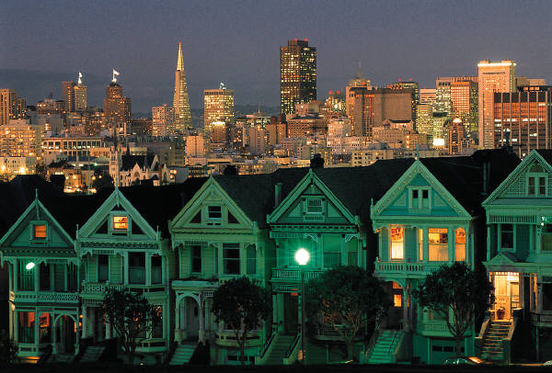
Transition Visions. Your dreams for employment, further education and where you will live as an adult.
8
Image is the copyrighted property of JupiterImage and is used with permission under license

Slide 11
Your Transition Visions Will
be developed with your family.
consider your interests, skills and strengths.
recognize the need for supports because of disability.
be based on measurable outcomes.
9

Slide 12

Interests
Interests are things that you like and want to learn more about or do.
What are some of your interests?
10
Image is the copyrighted property of JupiterImage and is used with permission under license

Slide 13

Strengths
Your strengths are those qualities or abilities that are extremely useful and valuable to you and others. Your strengths are also things that you do well.
What are some of your strengths?
11
Image is the copyrighted property of JupiterImage and is used with permission under license

Slide 14
Educational Needs
Needs are things you require to be successful.
Your educational needs relate to your disability, and what you want to do after graduation from high school.
Your IEP addresses your educational needs and support services.
Image is the copyrighted property of JupiterImage and is used with permission under license
12

Slide 15
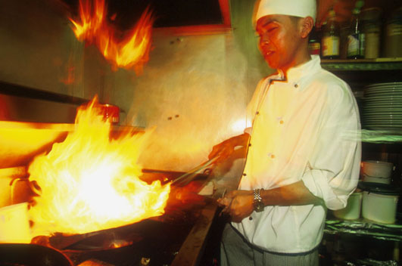
Vision for Employment
To earn money, help others, feel good about yourself, and to live and have fun.
13
Image is the copyrighted property of JupiterImage and is used with permission under license

Slide 16

Vision for Employment
Example:
“I discussed my vision for employment with my parents, family, and other people and I will become a chef.”
14
Image is the copyrighted property of JupiterImage and is used with permission under license

Slide 17

Vision for Further Education
Dreams about you learning how to do a job, learning new skills, or getting a career after you graduate from high school.
15
Image is the copyrighted property of JupiterImage and is used with permission under license

Slide 18

Vision for Further Education
Example:
“I discussed my vision for further education with my family and I will attend a career technology program to learn how to work in an auto body repair shop.”
16
Image is the copyrighted property of JupiterImage and is used with permission under license

Slide 19
Vision for Adult Living
Dreams of where you will live, sleep, pay bills, and have fun with the money you earn. What will your community be like?
17

Slide 20
Vision for Adult Living
Example:
“I discussed this with my family and I will live with them and help at home while I work and attend the career tech program in my home town.”
18

Slide 21
Life’s Pathway
Student
Birth-Kindergarten
Elementary/Middle School
High School
Young Adult
Elder
Friends;
Love;
Job;
Money;
Car
Health;
Family;
Independence;
Travel;
Home
Play safely;
Fun;
Food;
School
Friends; fun;
School;
Play games;
Job; money;
Home’
Marriage;
Family;
Promotion;
Travel
Birth-Kindergarten
Elementary/Middle School
High School
Young Adult
Elder
Family
19

Slide 22

Life’s Pathway Homework Discussion
How did your dreams throughout the Life’s Pathway compare to those of your parents?
What was similar?
What was different?
20
Image is the copyrighted property of JupiterImage and is used with permission under license

Slide 23
Transition Planning Process Terms:
IEP
Do you know what an “IEP” is?
It is an Individualized Education Program that helps you be successful while you are in school.
Your IEP changes as your needs change throughout school.
21
Image is the copyrighted property of JupiterImage and is used with permission under license

Slide 24
Transition Planning Process Terms:
IEP Team
Your IEP team has been developing your IEP from the time you started receiving special education services.
You are part of your IEP team.
Who else is on your IEP team now?
Who else could you invite?
Image is the copyrighted property of JupiterImage and is used with permission under license
22

Slide 25
Your IEP is Confidential
Together with your family and teachers, you will be compiling information that is personal and private. This means you do not have to reveal or discuss this information with anyone else, unless you want to.
However, there may be times that you’ll need to reveal information about yourself so that you can get help if you need it for work, more education, or living.
Do your remember what “confidential” means?
23

Slide 26

Confidentiality Reminder:
These laws help ensure that your educational
and medical information remains confidential.
*FERPA: Family Educational Rights and Privacy Act. This act keeps your educational records and information out of the hands of people who should not have them. Your school protects your records.
HIPAA: Health Insurance Portability and Accountability Act. This act keeps your personal health and medical information out of the hands of people who should not have it.
24

Slide 27

Transition IEP: A Blueprint
Your transition IEP is different now compared to the IEP you had in elementary school.
It includes strategies to help you achieve your employment, living and further education goals.
Let’s look at an IEP and find some terms.
Image is the copyrighted property of JupiterImage and is used with permission under license
25

Slide 28

Terms Included On Your Transition IEP
Transition Goals
Parent Concerns
Present Levels of Academic
Achievement and Functional Performance
Course of Study
26

Slide 29

Transition Goals
Goals describe what you are working toward. They are what you, your family, and your teachers hope you will achieve in the long run, and what you will do to get there.
27
Image is the copyrighted property of JupiterImage and is used with permission under license

Slide 30
Transition Goals
Goals your IEP team develops annually to help you achieve your postsecondary visions.
Parent Concerns
Things that your family worries about and discusses during the IEP meeting.
Image is the copyrighted property of JupiterImage and is used with permission under license
28

Slide 31
Transition Goal & Coordinated Activities
Goal: I will enroll in a four-year college and nursing school.
Coordinated Activities:
Visit at least one in-state nursing school
Determine entry requirements and cost
Take the ACT
29

Slide 32
Present Levels of Academic Achievement and Functional Performance (Present Levels) includes your
interests, strengths and skills
needs that result from your disability
progress toward meeting your
goals in the classroom
present levels of transition
performance
Image is the copyrighted property of JupiterImage and is used with permission under license
30

Slide 33
Present Levels Also Includes
information on how you are doing in school and with your skills needed for success after high school.
results from special tests
or assessments that you
have taken.
information about how your disability affects your learning.
31
Image is the copyrighted property of JupiterImage and is used with permission under license

Slide 34

Example
On the Wechsler Intelligence Scale for Children (WIAT-II), I scored at the 25th percentile in reading and 34th percentile for math skills.
My difficulties with reading make it hard for me to succeed in general education English classes.
32
Image is the copyrighted property of JupiterImage and is used with permission under license

Slide 35

Present Levels of Functional Educational Performance
Jackie wants to be a nurse’s aide. Results from the Employability Life Skills Assessment (ELSA) show that she needs needs to stay focused on her job task, and follow her supervisor’s directions.
Jackie uses word processing and auditory screen readers to complete projects successfully.
Image is the copyrighted property of JupiterImage and is used with permission under license
33

Slide 36
Functional Educational Performance Goal
Jackie will demonstrate good work habits by turning in her homework on time and by getting positive feedback from her work-study supervisor on her job evaluation.
34

Slide 37

Course of Study
A listing of classes, electives, and community experiences that students will complete while in high school.
Examples:
Jackie will take English II, Geometry,
American History, Spanish I,
and Anatomy.
Jackie will attend Health Services
classes at Career Tech.
35
Image is the copyrighted property of JupiterImage and is used with permission under license

Slide 38

Transition Assessments
Information collected over time about
your strengths, skills, interests,
and needs about your future.
Assessments may include:
Employment interests and skills.
Self-Determination skills.
Community living skills.
Image is the copyrighted property of JupiterImage and is used with permission under license
36

Slide 39

Transition Assessment Identifies
Your future goals
Your interests
The adult life skills you have
The adult life skills you need to learn
What your parents think about your adult life skills
37

Slide 40
Goals
Strengths
Skills
Assessments
Family Concerns
Needs
Present levels of academic and functional performance
Disability impact which would include needed supplemental aids or services.
Find and Discuss Transition IEP Terms
38
Image is the copyrighted property of JupiterImage and is used with permission under license

Slide 41
IEP Terms - Review
39
Let’s list the terms you found on your IEP and define them.
What terms did you find that you did not know? Let’s write them on the board, define, and discuss them.

Slide 42

Transition Planning Meeting
You gather with your IEP team to plan for your future.
You use your Transition IEP as a guide.
Image is the copyrighted property of JupiterImage and is used with permission under license
40

Slide 43
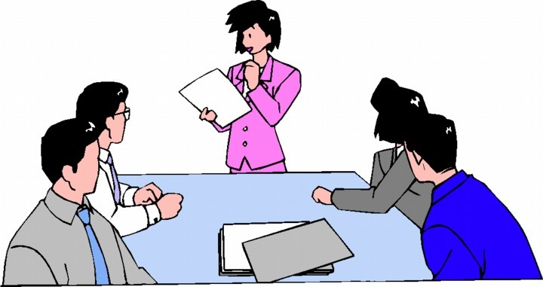
Transition IEP Meeting
Have you participated in any of your IEP meetings?
It is important for you to participate in and maybe even lead your transition IEP meeting.
41
Image is the copyrighted property of JupiterImage and is used with permission under license

Slide 44

Homework Assignment #1 Family Interview
Interview one or two adults about what it was like planning for the future when they were your age.
You have a form with questions.
42
Image is the copyrighted property of JupiterImage and is used with permission under license

Slide 45
Family Interview Homework
43
You will ask a family member these and other questions.
When you were my age, what did you think you would do after high school?
Where did you think you would work?
Where did you think you would live?
How do you think they will answer?

Slide 46
Transition Planning Process Share your family interview discussions.
What did you learn?
What surprised you?
44

Slide 47

Transition Services
People and activities that will help you achieve your work, living, education and transition goals.
These will be addressed on your transition IEP.
Services can be formal or informal.
45
Image is the copyrighted property of JupiterImage and is used with permission under license

Slide 48
Transition Services
46
Vocational Education
Functional Vocational Evaluation
Community Experiences
Adult Living Skills
Community Living Skills
Related Services
Vocational Rehabilitation Services
Accommodations

Slide 49

Vocational Education
A transition service that helps you learn a career and how to get and keep a job.
47
Image is the copyrighted property of JupiterImage and is used with permission under license

Slide 50
Functional Vocational Evaluation
A transition service that matches your interests and skills to actual jobs.
48
Image is the copyrighted property of JupiterImage and is used with permission under license

Slide 51
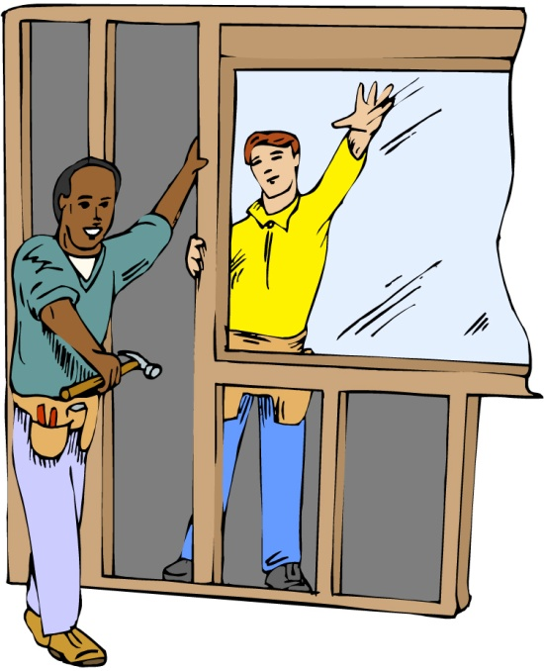
Community Experiences
A transition service that includes job shadowing, career internships, on-the-job training, and visiting colleges, career tech, or other postsecondary educational programs.
49
Image is the copyrighted property of JupiterImage and is used with permission under license

Slide 52



Adult (home) Living Skills
A transition service that will teach you housekeeping, good hygiene and proper nutrition.
50
Images are the copyrighted property of JupiterImage and are used with permission under license

Slide 53
Community Living Skills
A transition service that teaches you how to use the grocery store, bank, laundromat, and find services to help with further education, getting a job, paying for food, and getting health care.
51

Slide 54

Related Services
May include transportation, speech and language therapy, career counseling, transportation, assistive technology, and health services that may be needed to help you meet your transition goals.
52

Slide 55
Supplementary Aids and Services
These include program modifications or supports from other staff in your educational programs.
These include accommodations which help you access educational material, like a screen reader.
These are things that are not otherwise listed as special education or related services.
53

Slide 56

Vocational Rehabilitation Services
Transition services often begin in high school.
Services help you get a job.
You will need to apply and you will have to demonstrate that you have a disability.
54

Slide 57
Who’s Who in Transition Services in your Community?
Choose one of the transition services listed above. Then, find out about that service in any way you wish. Suggestions include:
Locate a person associated with that service by calling or visiting with this person to find out how the service could be of benefit.
Research the internet for information about the service.
Invite someone from the community to talk about a service.
55

Slide 58

Review of Who’s Who in Transition Services
Who did you find that was most helpful?
Did you and your family think that the
information you found would be helpful?
56

Slide 59
Transition Terminology Review
Getting to Know the IEP
Now that we have reviewed the transition concepts and vocabulary, let’s locate them on the transition pages of the IEP.
57

Slide 60
What’s Next?
Connecting with
Adult Support
Services
Terms &
Concepts of
Transition
Course of
Study
Summary of
Performance
Awareness
Vision for
Employment
Vision for
Adult
Living
Transition
Goals
Vision for
Postsecondary
Education

