Slide 1
Student-Directed Transition Planning
Lesson 3
Vision for Employment
By
Lorraine Sylvester, Lee L. Woods, and James E. Martin
University of Oklahoma
College of Education
Department of Educational Psychology
Zarrow Center for Learning Enrichment
Preparation of SDTP supported in part by funding provided by the U.S. Dept. of Education, Office of Special Education Programs, Award #: H324C040136
Copyright 2007 by University of Oklahoma
Permission is granted for the user to duplicate the student materials and PowerPoint files for educational purposes. If needed, permission is also granted for the user to modify the PowerPoint files and lesson materials to meet unique student needs.

Slide 2

Gathering Input
Vision for Employment
Employment Strengths & Needs

Slide 3
Input Circle

Slide 4
Transition Journey
In the Awareness lesson you talked with your family and identified:
  Important values that you share.
  Dreams that you share about your future.
Image is the copyrighted property of JupiterImage and is used with permission under license

Slide 5
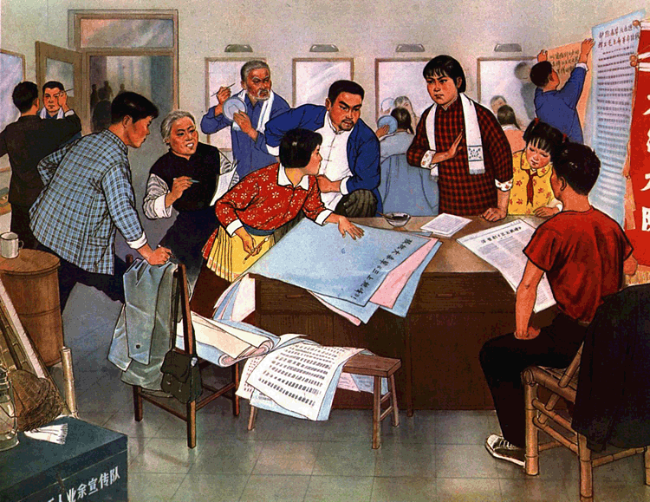
Transition Journey
You and your family discussed:
how your disability impacts your learning while you’re in school and
how it may impact your life after high school.
Image is the copyrighted property of JupiterImage and is used with permission under license

Slide 6

Transition Journey…continued
In Transition Terms and Concepts you learned:
concepts and terms used to discuss your post-high school plans.
about the transition planning process.
Image is the copyrighted property of JupiterImage and is used with permission under license

Slide 7
Vision for Employment
This lesson will help you to identify, talk with others about, and record your employment preferences, interests, strengths and needs.
Your employment vision will become clearer as you develop plans with your family, teachers, and other people who you respect.

Slide 8

Imagine…
You just graduated from high school.
What are you going to do now?
Where are you going to live?
What kind of job do you want?
Image is the copyrighted property of JupiterImage and is used with permission under license

Slide 9
Vision for Employment
Your dream job to earn money so you can help others, feel good about yourself, live where you want, and have fun.
Your family may have a vision for what kind of job you might do.

Slide 10
What did you want to be:
In Elementary School?
In Middle School or Junior High?
Now?
  How have your ideas changed over the years? Why?

Slide 11
Homework Activity
You will take the activity sheet home and have 1 or 2 family members answer questions about what they thought you would be when you grew up.
We’ll discuss your thoughts and those of your family members in class.

Slide 12
Vision for Employment
How did you know what kind of job you wanted as you got older?
What made you want to do these jobs?
What ideas did your family members come up with for you?
Image is the copyrighted property of JupiterImage and is used with permission under license

Slide 13
Vision for Employment
Your preferences guide you toward what you want to be.
Your interests, strengths, and needs also affect your choices.
Your parents consider these things, and what is good for your whole family.

Slide 14
Vision for Employment
Preferences - A preference is liking one job over another.
  You may have a preference for a welding career rather than construction.
  You might have a preference to work with animals in a veterinarian’s office rather than in a pet store.
What are your preferences for employment after high school?
What are your family’s preferences for your employment?

Slide 15
Vision for Employment
Interests - Jobs you like and want to learn more about or do.
What are your job interests?
What are the interests your family has for you?

Slide 16
Vision for Employment
Strengths - What you do well on a job
What are your strengths?
What does your family think are your strengths?
What are your family’s strengths?
Describe some strengths of your community.

Slide 17
Vision for Employment
Needs - Needs are what you have trouble doing that may require supports or accommodations to achieve your employment goal after graduation.
What do you need to be successful on the job?
What does your family think you need to be successful on the job?

Slide 18
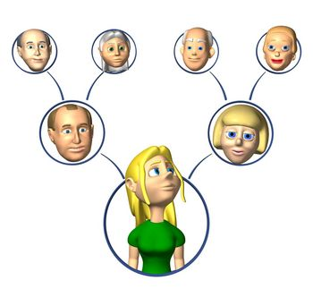
What do you need from your family?
What does your family need from you?
Image is the copyrighted property of JupiterImage and is used with permission under license

Slide 19
Transition IEP
In the Terms & Concepts lesson you found where your interests, strengths and needs were located on an IEP.
The transition pages of your IEP specifically address your interests and preferences, strengths, and needs about employment.
Find this section.
Notes:
Students should already have their IEP from Lesson 2. Have them look at the transition pages.

Slide 20

How do you know what your employment-related preferences, interests, strengths and needs are?
Transition Assessment
Image is the copyrighted property of JupiterImage and is used with permission under license

Slide 21
Transition Assessment for Employment
The process of collecting information about your preferences, interests, strengths, and needs for employment.

Slide 22
Assessment
Measures of your job interests, strengths, needs, and performance
Job locations could be on school or in your community.
Observations, on-the-job try-outs and internships, interviews, comments from supervisors, or paper/pencil tests.

Slide 23
Functional Vocational Evaluation
A transition service that matches your interests and skills to actual jobs, or that matches your needs with those of your family to jobs that you can do.
Can be done at school, or in the community.

Slide 24
Present Levels Section
May include:
A written statement that combines information gathered from assessments and your thoughts about your employment interests, strengths and needs.

Slide 25
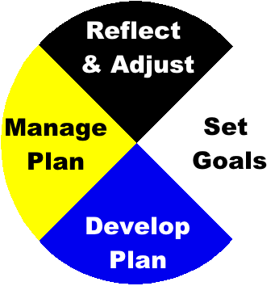
You’ll gather information so
that you can develop
a shared employment
vision with your family.
This process will help you:
Set employment goals.
Develop an employment plan.
Manage your employment plan.
Reflect and adjust your plan with
your family.

Slide 26
Activity: Putting it all Together
Let’s review how to use the Input Circle
Then, we’ll see an example of a student using the Input Circle to detail his interests, strengths, and needs regarding his employment vision.

Slide 27
Input Circle
The Input Circle helps pull your thoughts together for your transition planning meeting.
It helps clarify your thoughts so you can talk about your employment vision.

Slide 28
Input Circles
You gathered information about your disability in the Awareness lesson.
Let’s review what goes in each section.
Information
from you
Information
from your
family.
Statement that
combines your
Ideas and input
with family’s &
teachers’.
Information from
your teachers.
Notes:
Make circle words appear separately

Slide 29
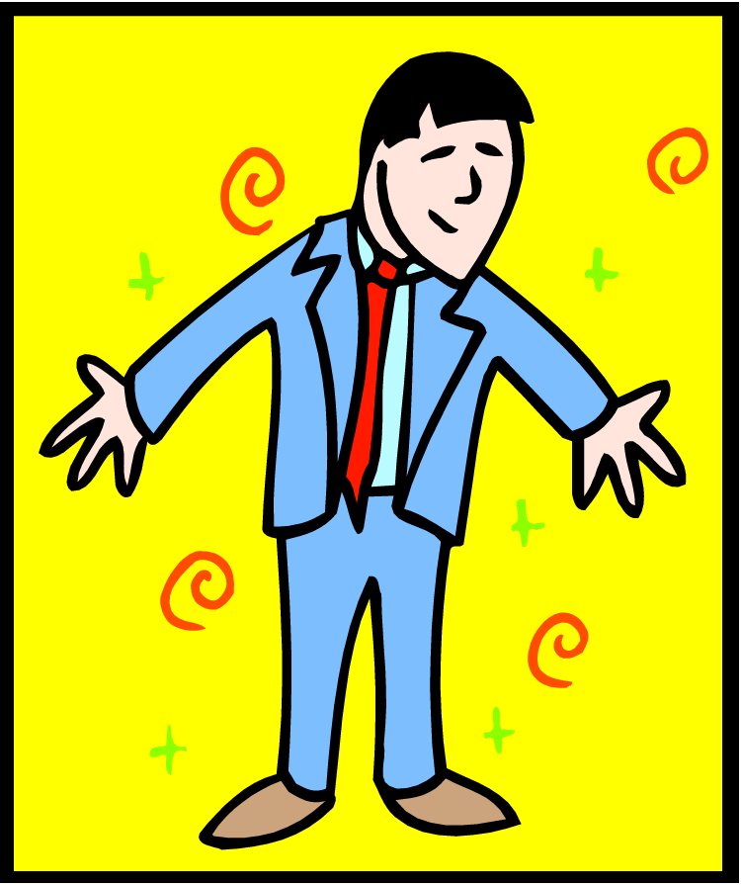
Case Study 1
Bob is a 17 year old boy in 11th grade who has a learning disability.
Image is the copyrighted property of JupiterImage and is used with permission under license

Slide 30
Employment Interests
Bob wrote a statement about the things he was interested in doing.
His answer showed some of the work experience he had with scouting and a summer camp.
I’ve always liked
being outdoors.
I like teaching
other kids
about
things
in nature.
.

Slide 31
Employment Interests
Bob asked his parents what job they think he would like to do after high school.
They gave answers based on things he had done at home and in his community.
They talked about his interests and skills.
Bob is very
I’ve always liked
being outdoors.
I like teaching
other kids
about
things
in nature.
responsible and
likes working
with people
and with kids
at his church.
We’d like him
to work in a
park, and teach
nature to kids,
hopefully, near
home.
.

Slide 32
Employment Interests
Bob’s teacher talked about the things that seemed to interest him most at school.
Natural science and environmental issues are strong areas for Bob. His Vocational Interest Inventory showed his strong preference for environmental work.
I’ve always liked
being outdoors.
I like teaching
other kids
about
things
in nature.
Bob is very
responsible and
likes working
with people
and with kids
at his church.
We’d like him
to work in a
park, and teach
nature to kids,
hopefully, near
home.
.
Bob is interested in natural science and
environmental issues. His Vocational Interest
Inventory showed a strong preference for
environmental jobs.

Slide 33
Employment Interests
Bob and his teacher then combined information from all three sections into a summary statement in the center.
Bob looked for similarities and reworded long phrases to get all the information included.
His interests were written into a summary statement.
I’ve always liked
being outdoors.
I like teaching
other kids
about
things
in nature.
Bob is very
responsible and
likes working
with people
and with kids
at his church.
We’d like him
to work in a
park, and teach
nature to kids,
hopefully, near
home.
I like being outside and working with people. My vocational Interest Inventory ranked environmental jobs the highest.
.
Bob is interested in natural science and
environmental issues. His Vocational Interest
Inventory showed a strong preference for
environmental jobs.

Slide 34
Employment Strengths
Bob asked his parents what they thought were his strong job skills.
They gave answers based on jobs he had done around the house, as well as how he did with his summer job.
They talked about his strengths.
Bob is very
responsible and
respectful. He
likes working
with people
and is good
with money.

Slide 35
Employment Strengths
Bob wrote down what he thought he was good at and what an employer might like about him.
He thought about his past paid and unpaid work experience.
He talked about his interests and skills.
I’m responsible
Bob is very
and I always show up
responsible and
on time and ready
respectful. He
to work.
likes working
I did well
at my
camp
job with
the park.
with people
and is good
with money.

Slide 36
Employment Strengths
Bob talked with his teacher about what he was good at and what an employer might like about him.
She talked about his strengths based on formal and informal assessments.
I’m responsible
Bob is very
and I always show up
responsible and
on time and ready
respectful. He
to work.
likes working
I did well
at my
camp
job with
the park.
with people
and is good
with money.
Bob scored a 77% on the ESTR-J employment readiness scale. Strengths
include respect for authority figures
punctuality and attendance,
and interpersonal skills.

Slide 37
Employment Strengths
Bob and his teacher then combined information from the three sections into a summary statement.
Bob again looked for similarities and shortened some phrases.
His strengths were written into a summary statement.
I’m responsible
Bob is very
and I always show up
responsible and
on time and ready
respectful. He
to work.
likes working
I have a
positive
attitude.
I am responsible,
with people
punctual, respectful,
friendly, and have a
positive attitude.I get along
well with others and I’m
good with money.
and is good
with money.
Bob scored a 77% on the ESTR-J employment readiness scale. Strengths
include respect for authority figures,
punctuality and attendance,
and interpersonal skills.

Slide 38
Employment Needs
Bob asked his parents what employment-related skills they thought he needed to work on.
They gave answers based on jobs he had done around the house, as well as how he did with his summer job.
They shared how his disability might affect his job performance.
Bob can be very
messy. His reading
and writing
problems may
affect his work.
Sometimes, he
wants to have
fun, like the
kids, and may
forget he’s
working.

Slide 39
Employment Needs
Bob wrote down what he saw as employment-related needs.
He thought about his paid and unpaid job experience.
He thought about how his learning difficulties might affect his job performance.
These are areas where he might need support.
My writing is
Bob can be very
pretty messy, and
messy. His reading
I have trouble
and writing
remembering
problems may
what I read.
affect his work.
Sometimes, he
wants to have
fun, like the
kids, and may
forget he’s
working.
Sometimes
I get distract-
ed and I don’t
finish my work.

Slide 40
Employment Needs
Bob asked his teacher what she thought about his employment-related needs.
She talked about his needs based on formal and informal assessments.
Because of his learning disability, he needs help with these things in school, and might need support on a job after high school.
My writing is
Bob can be very
pretty messy, and
messy. His reading
I have trouble
and writing
remembering
problems may
what I read.
affect his work.
Sometimes he
wants to have
fun like the kids
and forgets he
is working.
Sometimes
I get distract-
ed and I don’t
finish my work.
Bob needs a work
environment with limited distractions. He
needs to explore different job options.
He needs verbal and/or picture
instructions for new tasks

Slide 41
Employment Needs - Summary
Bob and his teacher combined his needs into a summary statement.
Bob again looked for similarities and reworded some phrases.
Bob’s employment needs were written into the center summary circle.
My writing is
Bob can be very
pretty messy, and
messy. His reading
I have trouble
and writing
remembering
problems may
what I read.
affect his work.
Sometimes he
wants to have
fun like the kids
and forgets he
is working.
Sometimes
My writing is messy,,
Which makes jobs
Requiring writing hard.
I do best with picture
instructions. Sometimes
I get distracted and need
Reminding to stay on my
work tasks.
I get distract-
ed and I don’t
finish my work.
Bob needs a work
environment with limited distractions. He
needs to explore different job options.
He needs verbal and/or picture
instructions for new tasks

Slide 42
Employment Vision - Statement
Everyone gave their vision summary for Bob.
Bob summarized everyone’s input for his central vision statement.
After high school, I see myself in a paying job with
City Parks,
We see Bob working
near our home
with the parks
system. That
way he could
help us when
we need it.
Vision
that involves
teaching
kids about
nature.
My employment vision is working for pay at City Parks where I can teach others about nature. I can ask my boss to give me picture or verbal directions. I’ll work near
my home.
Bob will do well at a paid job
that is outdoors teaching others
about nature. This job could
use picture or verbal directions
rather than reading.

Slide 43
Activity: Write your own Vision for Employment using the Input Circles
Take 4 blank input circles home so you and your family can complete a circle for your:
  Interests
  Strengths
  Needs
  Employment Vision
Vision
Notes:
Question regarding the need for circles for all of these…vs. just looking at strengths, needs, and finally coming up with a vision statement., IS THIS TOO MUCH TO DO FOR HOMEWORK IN ONE NIGHT? IT WOULD BE LIKE GOING THROUGH BOB’S EXAMPLE WITH THE STUDENTS….???

Slide 44

Activity:Teacher Input
Gather information provided by your teacher regarding results of any formal or informal employment assessments that you’ve completed.

Slide 45
Activity: Interests, Strengths & Needs Summary Statements
Students review all input from their outer circles to make summary statements for
1) strengths input circle
2) interests input circle
3) needs input circle.

Slide 46
Interests Summary Statement
Write your “Inner Circle” summary statement about your employment interests that includes your family’s and teachers’ outer circle input.

Slide 47
Strengths Summary Statement
Write your “Inner Circle” summary statement about your employment strengths that includes your family‘s and teacher’s outer circle input.

Slide 48
Needs Summary Statement
Write your “inner circle” summary statement about your employment needs including your family’s and teacher’s outer circle input.

Slide 49
Vision for Employment Statement
After reviewing everyone’s summary statements for your interests, strengths and needs, your Employment Vision is written in the center of the Vision Input Circle.
Vision
Notes:
Need to change wording in the circle to say “VISION”,..,.

Slide 50
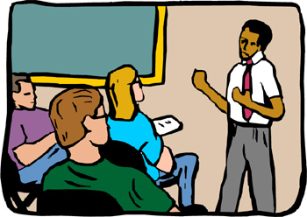
Share Employment Vision
Share your Employment Vision with the class

Slide 51

Homework
Share your Employment Vision with your family.
Make changes as needed.
Have a family member sign the homework.

Slide 53
What’s Next?
Terms &
Concepts of
Transition
Connecting with
Adult Support
Services
Awareness
Course of
Study
Summary of
Performance
Vision for
Employment
Vision for
Adult
Living
Transition
Goals
Vision for
Postsecondary
Education

