Slide 1
Student-Directed Transition Planning
Lesson 5
Vision for Adult Living
By
Lorraine Sylvester, Lee L. Woods, and James E. Martin
University of Oklahoma
College of Education
Department of Educational Psychology
Zarrow Center for Learning Enrichment
Preparation of SDTP supported in part by funding provided by the U.S. Dept. of Education, Office of Special Education Programs, Award #: H324C040136
Copyright 2007 by University of Oklahoma
Permission is granted for the user to duplicate the student materials and PowerPoint files for educational purposes. If needed, permission is also granted for the user to modify the PowerPoint files and lesson materials to meet unique student needs.

Slide 2

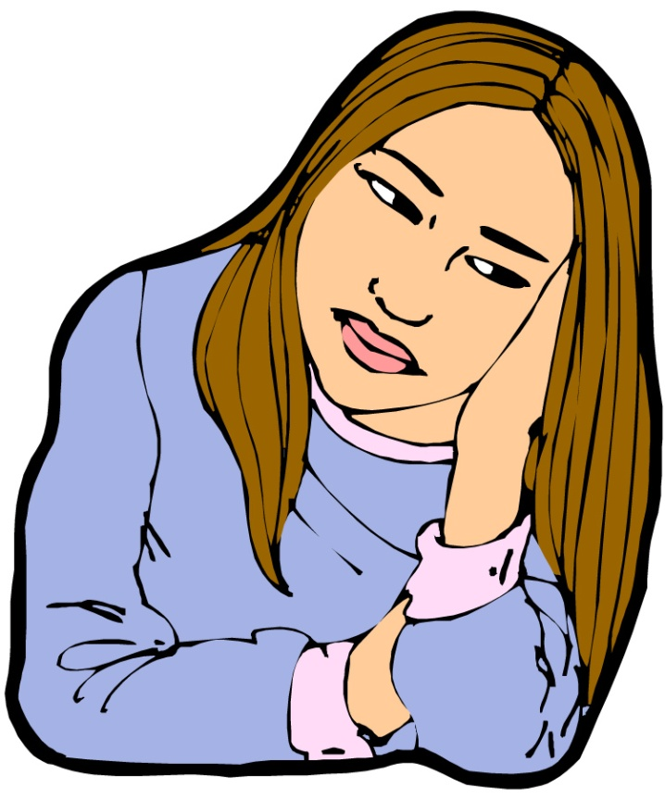

Vision for Adult Living
Where will you live after high school?

Slide 3
Imagine you just
graduated from
high school.
What kind of job do you want?
Will you get more education?
Where and how will you live?
Image is the copyrighted property of JupiterImage and is used with permission under license

Slide 4

Vision for Adult Living
You and your family
will determine
where and how you
will live after you
graduate from high
school.

Slide 5
Input Circle
Adult
Living
We’ll use
the Input Circle
to gather
information for
your transition
IEP about…

Slide 6

Vision for Adult Living
You and your family will
consider:
where you will live.
how you will take care of yourself.
how you will participate in your community.
Image is the copyrighted property of JupiterImage and is used with permission under license

Slide 7
Vision for Adult Living
Considerations
housing
healthy living
paying bills
community life.
Image is the copyrighted property of JupiterImage and is used with permission under license

Slide 8
Remember this question: “What do you want to be when you grow up”?
Have your visions for
life after graduation
changed?
Elementary School?
Middle School?
High School?

Slide 9
Where Will I Live?
There are many things to consider before deciding if you will live at home with your family, on your own, or with other people.

Slide 10
Considerations about Adult Living
Living on your own?
Living with your family?
Living with friends?
Close to family, or far away?
What does it take to live on your own?
What does your family think?

Slide 11
Considerations for Adult Living
Living with your family | Living on your own
Can be supportive for family and for you. | You will have to arrange to take care of your home.
Keeps you involved in your familiar community. | You may have to establish new supports to live on your own.
May limit school or job opportunities that are beyond a reasonable drive. | You will live close to the school or job you really want.
May cost less. | Costs are higher.

Slide 12
Where Will I Live?
Family Discussion Activity
Complete the “Where Will I Live” worksheet with an adult family member.
Share this discussion in any way you choose.

Slide 13
Family Discussion
How did your answers compare with those of your family?
How did your answers compare with those of your family?
You will include this information on the Input Circle that you’ll do later in this lesson.

Slide 14
Vision for Adult Living
Your preferences and interests guide you toward what you want to do.
Your strengths and needs also affect your choices.
How do your needs fit within the needs of your family?

Slide 15
Vision for Adult Living
Preferences - A preference is liking one place to live over another.
What are your preferences for living arrangements after high school?
What are your family’s preferences for where you will live?

Slide 16
Vision for Adult Living
Interests - Living options you like and want to learn more about.
Will your job or educational interests require you to live somewhere else?
Will your job or educational interests enable you to live with your family?

Slide 17
Vision for Adult Living
Strengths - Skills for adult living that you can do.
What are some of your adult living strengths?

Slide 18
Vision for Adult Living
Needs - Needs are what you have trouble doing that may require supports or accommodations to achieve your adult living goals after graduation.
What help will you need regarding living arrangements after high school?
What needs do your family members have?
What do you have to do to get the supports you need to live the way you and your family envision?
Do you need to live with your family because of cost?

Slide 19
Determining your strengths, skills, and needs for adult living involves knowing: what you think; what your family thinks; and what your teachers think.

Slide 20
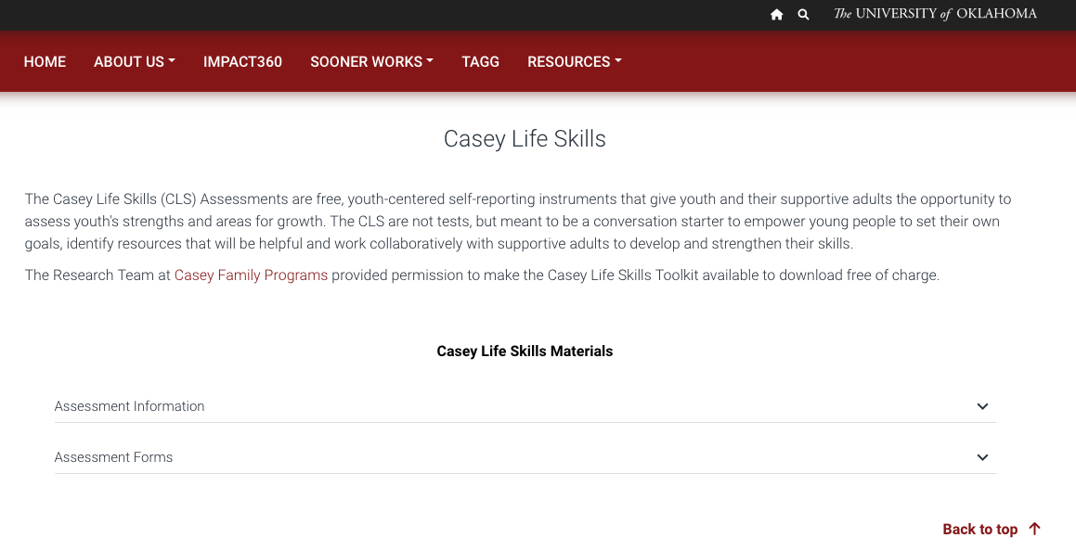
Activity: Casey Life Skills Assessment
There is a website designed to gather information about your adult living strengths and needs.
Go to: https://www.ou.edu/education/zarrow/resources/assessments#casey

Slide 21
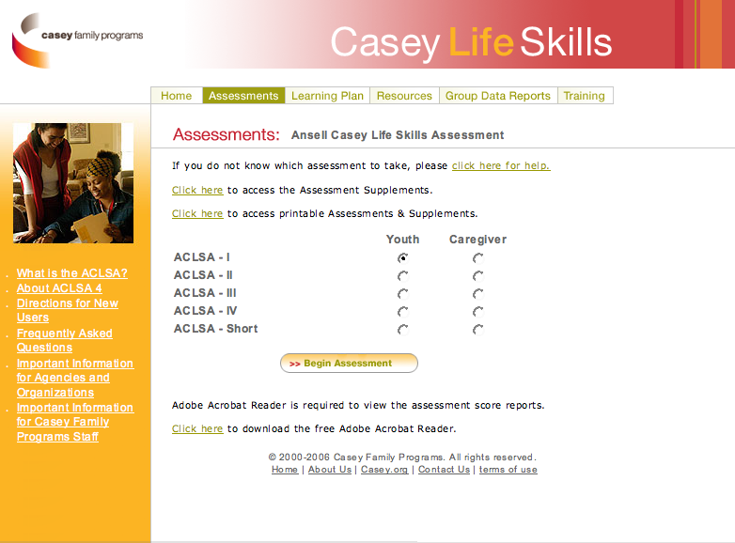
Activity: Casey Life Skills Assessment
Your teacher will advise you on which assessment you should take.
A family member and your teacher will also take an assessment on what they think are your strengths and needs.

Slide 22
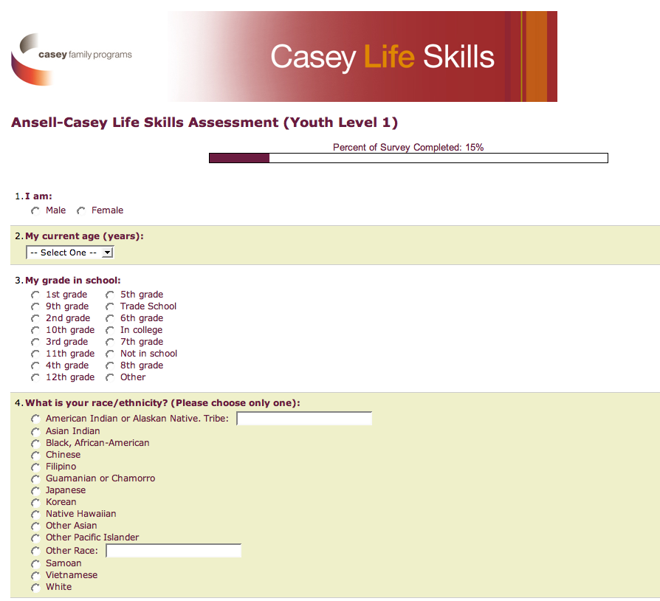
Activity: Casey Life Skills Assessment
Answer the questions as best as you can.
The assessment will not be graded, but you will get a score that describes your adult living strengths and needs.

Slide 23
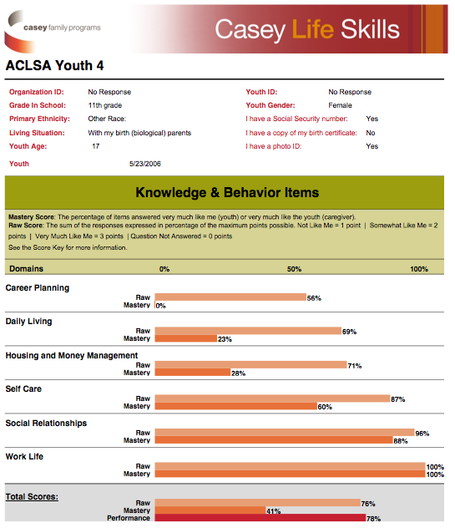
Activity: Casey Life Skills Assessment
You will use your results when completing the Adult Living input circles.

Slide 24

Planning for Adult Living
Use the Transition IEP as the blueprint to help you achieve your adult living plan.
Your Transition IEP can help you and your family see your vision for adult life become a reality.

Slide 25
Transition IEP
The transition pages of your IEP specifically address your adult living vision.
There are different ways to assess your present performance and needs for adult living. (Talking with your parents is one way.)
Look at your IEP pages and find where this information would go.
Notes:
Students should already have their IEP from Lesson 2. Have them look at the transition pages.

Slide 26
Adult Living Considerations:
Three Big Areas
Home Living/Home Care
Self-Care
Community Participation

Slide 27
Home Living
What are the bills I’ll have to pay?
  Rent
  Food
  Clothes
  Utilities (lights, heat or air conditioning, fuel)
  Health Care

Slide 28
Home Care Skills
Home care skills include
  Grocery shopping and cooking
  Cleaning and vacuuming
  Washing and drying clothes
  Washing dishes
  Making sure where you live is safe on the inside and outside
  Paying bills on time

Slide 29
Home Living
Complete the worksheet, Can I Take Care of Myself?
Have your family complete a worksheet on what they think you do at home.
Compare your worksheet with your family’s.
Role play your similarities and differences in class.

Slide 30
Homework discussion
In groups of 3 or 4, act out your discussion regarding your thoughts and your family’s thinking about you living on your own.

Slide 31
Home Living
Whether you live with your family, friends, or on your own, you’ll need money!
Where will it come from?
Jobs?
Family?
Social Security?
Savings?

Slide 32


Home Living Activity
“Show Me (what you will do with) the Money!”

Slide 33
Where will my money go?
I have to spend $ on these:
Rent
2. Food
I want to spend $ on these:
Dancing
2. Traveling

Slide 34

Health Care
What does health care mean to you?
Who are your health care providers?
Public Health Service, Indian Health Service, Other free or reduced-cost health services
Private health care providers such as local doctors or hospitals.

Slide 35

Who pays for your health care?
Employer
Further Education/College
Public
Private/Family
YOU!

Slide 36
SELF CARE
YOUR BODY:
You should have a
doctor you can call if
you need medical
help, and for regular
checkups.

Slide 37
Nutrition & Fitness
Eating healthy food
Drinking water
Physical Activity

Slide 38
Oral Hygiene
YOUR TEETH
Help you eat.
Brushing and flossing keep your teeth healthy, clean, and your mouth smelling good.
People like to be around you when your teeth are clean.

Slide 39
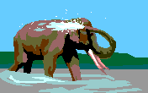
Body Hygiene
Bathing: Staying clean helps you stay healthy.
Grooming: Looking neat helps you make a better impression at work or school.

Slide 40
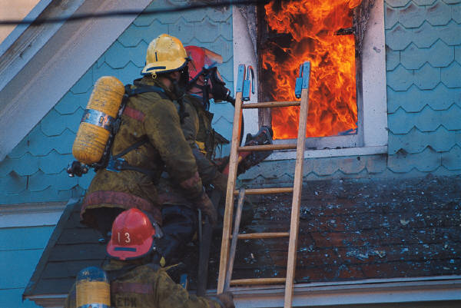


Problems at Home
What would you do if:
There’s a fire at home?
Someone breaks into your home?
You smell gas in your home?
Your toilet overflows or water pipes break?
Images are the copyrighted property of JupiterImage and are used with permission under license

Slide 41
Community Participation
Civic Duties
Recreation
Religious activities
Volunteer organizations
Cultural or community traditions and activities

Slide 42
Community Participation
Transportation is how you will get from one place to another in your community. How will you get there?
Do you drive?
Bus? Taxi?
Bike? Train?
Walk?

Slide 43
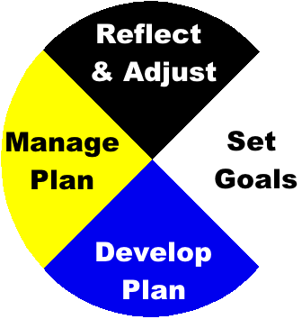
Now, you’ll take the information
you’ve gathered so that you can develop a shared vision for adult living with your family.
This process will help you:
Set adult living goals
Develop a plan for adult living.
Manage your plan for adult living.
Reflect on and adjust your plan with your family.

Slide 44
Putting it all Together
Let’s review how to use the Input Circle
Then, we’ll see an example of a student using the Input Circle to detail interests, strengths, and needs to help develop her adult living vision.

Slide 45
Input Circle
You will use the Input Circle to clarify your
vision for adult living.

Slide 46
Input Circles Review
Information
from you
Information
from your
family.
The Awareness lesson introduced the Input Circle
You gathered information about your disability.
Let’s review what goes in each section.
Statement that
combines student,
family, and
teacher input.
Information from
your teachers.
Notes:
Make circle words appear separately

Slide 47
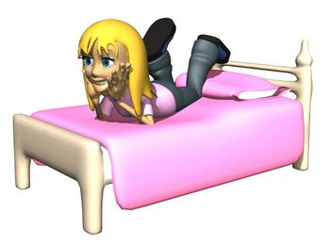
Case Study 1
C.J. is a 17 year old girl in 11th grade who has a learning disability.
Image is the copyrighted property of JupiterImage and is used with permission under license

Slide 48
Adult Living Interests
C. J. either wants to live
at home with her parents or with a roommate in the same town.
She wants to find out more about what living with a roommate would be like, but she also wants her family nearby for support.
I would like to either
live at home with my
family or close by
with a roommate

Slide 49
Adult Living Interests
C. J.’s parents would like for her to continue to live with them and help support the family.
I would like to either
live at home with my
family or close by
with a roommate
We would like for C. J.
to stay with us. We will
be able to help her with schoolwork,
and she can help
with childcare and
home expenses.

Slide 50
Adult Living Interests
C. J.’s teacher thought she could eventually live independently if she chose to.
She acknowledged that C. J. needed to learn several skills of independent living before she moved out on her own.
I would like to either
live at home with my
family or close by
with a roommate
We would like for C. J.
to stay with us. We will be
able to help her with schoolwork,
and she can help
with childcare and
home expenses.
I think C.J will be able to live on
her own someday. We are working on
budgeting and other aspects of
independent living.

Slide 51
Adult Living Interests
Since everyone had different input, the summary statement is just a retelling of everyone’s opinion.
That is OK at this point because it has started a discussion of a decision that has to be made in the future.
I would like to either
live at home with my
family or close by
with a roommate
We would like for C. J.
to stay with us. We will be
able to help her with schoolwork,
and she can help
with childcare and
home expenses.
C. J. would like to live at
home or with a roommate
in an apartment close to her parents.
Her parents want her to live at home. Her teacher thinks she can live independently.
I think C.J will be able to live on
her own someday. We are working on
budgeting and other aspects of
independent living.

Slide 52
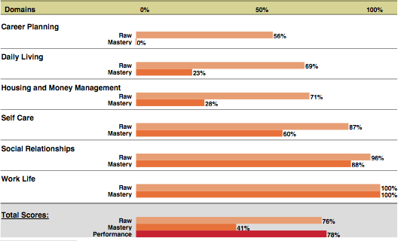
C. J.’s Assessment of her Strengths and Needs

Slide 53
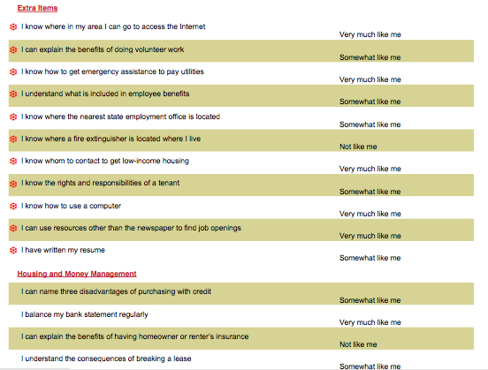
She used specific items that she answered “Very much like me” in her strengths input circle.

Slide 54
Adult Living Strengths
C. J. wrote down her current strengths for Adult Living.
She used some of the the information from the Casey Life Skills Assessment to fill in her section of the input circle.
My strengths
include self-care, social
relationships and
work life. I
balance my
bank statement
regularly and I
know how to
get assistance
for housing and
paying bills.

Slide 55
Adult Living Strengths
C. J. asked her parents what they thought her strengths were for adult living.
Her parents used some of the information from the Casey Life Skills Assessment combined with their observations for their input.
My strengths
include self-care, social
relationships and
work life. I
C. J. is very responsible
and can take care of
herself. She is good with
laundry and cooking.
She is very social
and respectful of
her elders.
balance my
bank statement
regularly and I
know how to
get assistance
for housing and
paying bills.

Slide 56
Adult Living Strengths
C. J. talked with her teacher about her strengths for adult living.
Her teacher also used some of the information from the Casey Life Skills Assessment for her input.
My strengths
include self-care, social
relationships and
work life. I
C. J. is very responsible
and can take care of
herself. She is good with
laundry and cooking.
She is very social
and respectful of
her elders.
balance my
bank statement
regularly and I
know how to
get assistance
for housing and
paying bills.
C.J. scored highest in work life, social relationships, and self-care on the Casey Life Skills assessment. She is improving her budgeting skills and
gets around well in her community.

Slide 57
Adult Living Strengths
C. J. and her teacher then combined information from the three sections into a summary statement.
They again looked for similarities, and shortened some phrases.
Her Adult Living strengths were written into a summary statement.
My strengths
include self-care, social
relationships and
work life. I
C. J. is very responsible
and can take care of
herself. She is good with
laundry and cooking.
She is very social
and respectful of
her elders.
balance my
bank statement
regularly and I
know how to
get assistance
for housing and
paying bills.
My strengths for adult living include taking care of myself, social relationships, and work life. I can cook, do laundry, and balance my bank statement.
C.J. scored highest in work life, social relationships, and self-care on the Casey Life Skills assessment. She is improving her budgeting skills and
gets around well in her community.

Slide 58
Adult Living Needs
C. J. wrote down what she thought she needed to work on for adult living.
She used the results of the Casey Life Skills Assessment for her section of the needs input circle.
I need to work on my daily living skills and money management.
I need to learn how
to budget my
money and
shop for and
prepare
healthy
meals.

Slide 59
Adult Living Needs
C. J. asked her parents what things they thought she needed to work on in order to live like an adult.
They focused on the financial aspects of adult life.
I need to work on my daily living skills and money management.
C. J. needs to learn
how to budget her
money and pay bills
on time. Keeping
track of her
expenses will
help her to
contribute to the
family
expenses as
she lives here.
I need to learn how
to budget my
money and
shop for and
prepare
healthy
meals.

Slide 60
Adult Living Needs
C. J.’s teacher saw her adult living needs related to her difficulties with reading and math.
Her housing and money management section of the Casey Life Skills Assessment was relatively low.
I need to work on my daily living skills and money management.
C. J. needs to learn
how to budget her
money and pay bills
on time. Keeping
track of her
expenses will
help her to
contribute to the
family
expenses as
she lives here.
I need to learn how
to budget my
money and
shop for and
prepare
healthy
meals.
C. J.’s difficulties with reading and math might cause problems when it comes time to fill out various paperwork forms and budgeting for household goods
and maintenance.

Slide 61
Adult Living Needs
C. J. and her teacher combined her needs into a summary statement.
C. J. looked for similarities and reworded some phrases.
She then wrote her summary needs statement.
I need to work on my daily living skills and money management.
C. J. needs to learn
how to budget her
money and pay bills
on time. Keeping
track of her
expenses will
help her to
contribute to the
family
expenses as
she lives here.
I need to learn how
to budget my
money and
shop for and
prepare
healthy
meals.
My adult living needs include math concerns like budgeting and keeping track of expenses, reading forms and labels, and having a more healthy diet.
C. J.’s difficulties with reading and math might cause problems when it comes time to fill out various paperwork forms and budgeting for household goods
and maintenance.

Slide 62
Adult Living Vision
I would like to live
either at home with my
family or close to
home with a
roommate.
We would like for C. J.
to live with us and help
support the family.
I will live at home at least for a while. I will get information about what it takes to live away from home with a roommate.
C. J. will do well living independently or with a roommate.

Slide 63
Activity: Write your own Vision for Adult Living using the Input Circles
Take 4 blank input circles home so you and your family can complete a circle for your Adult Living:
  Interests
  Strengths
  Needs
  Vision
Notes:
Question regarding the need for circles for all of these…vs. just looking at strengths, needs, and finally coming up with a vision statement., IS THIS TOO MUCH TO DO FOR HOMEWORK IN ONE NIGHT? IT WOULD BE LIKE GOING THROUGH BOB’S EXAMPLE WITH THE STUDENTS….???

Slide 64
Activity: Interests, Strengths & Needs Summary Statements
You will review all input statements to make a summary for
1) strengths
2) interests
3) needs

Slide 65
Vision for Adult Living Statement
After reviewing everyone’s summary statements for your interests, strengths and needs and their input about your further education vision, you write the Adult Living Vision in the center of the Vision Input Circle.
Notes:
Need to change wording in the circle to say “VISION”,..,.

Slide 66

Vision for Adult Living
Share your vision for Adult Living with the class.
Your vision may change over time.

Slide 67

Homework - Summary of Lesson
Share your Vision for Adult Living with your family. Make changes as needed.
Have your family sign the homework.
We’ll refer to this vision in the coming lessons.
Notes:
This needs work…may not be needed??? Can’t expect that it will have changed much over the last day or so.

Slide 68
Vision for Adult Living
Do you and your family agree with your vision and plans?
Has your vision for Adult
Living changed?
What has changed?
You can expect some changes
as you move toward achieving
your vision!

Slide 69
What’s Next?
Terms &
Concepts of
Transition
Connecting with
Adult Support
Services
Course of
Study
Summary of
Performance
Awareness
Vision for
Employment
Vision for
Adult
Living
Transition
Goals
Vision for
Postsecondary
Education

