Slide 1
Student-Directed Transition Planning
Lesson 6
Course of Study
By
Lorraine Sylvester, Lee L. Woods, and James E. Martin
University of Oklahoma
College of Education
Department of Educational Psychology
Zarrow Center for Learning Enrichment
Preparation of SDTP supported in part by funding provided by the U.S. Dept. of Education, Office of Special Education Programs, Award #: H324C040136
Copyright 2007 by University of Oklahoma
Permission is granted for the user to duplicate the student materials and PowerPoint files for educational purposes. If needed, permission is also granted for the user to modify the PowerPoint files and lesson materials to meet unique student needs.

Slide 2
Course of Study

Slide 3

Section 1
Course-of-Study Definitions and Purpose
Image is the copyrighted property of JupiterImage and is used with permission under license

Slide 4
Course-of-Study
A course-of-study lists classes and community experiences you will complete to graduate and achieve your post-high school visions of where you want to work, learn, and live.

Slide 5
Developing the Course-of-Study
You will need:
    Your transcript
    Upcoming class schedule
    Graduation requirement checklist
    List of extracurricular options
    Requirements to achieve post-high school visions

Slide 6
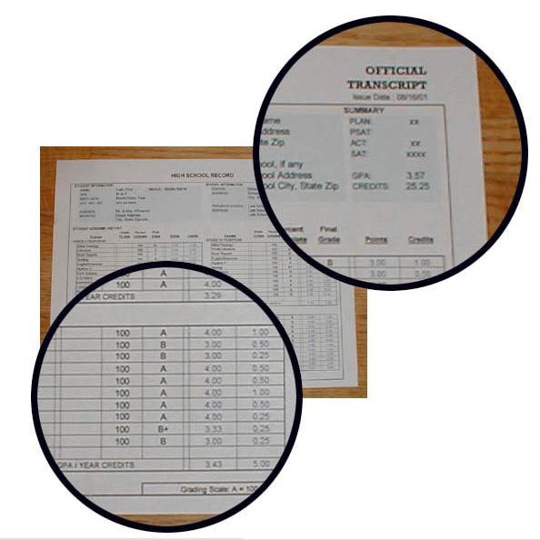
Transcript
Official report that lists:
  Completed classes
  Grades and GPA
  Credits earned
  Class rank
  Test results
Have you seen your transcript?

Slide 7
Credits
A credit is a number that represents successful completion of a class.
Credits may differ from school to school but often:
    Year long course = 1 credit
    Semester course = .5 credit

Slide 8
Required Course Credits
Courses that you must take to graduate.
Can you give me an example of a required course?

Slide 9
Elective Course Credits
Courses that you get to choose. You must take a certain number of electives to graduate.
What are three examples of elective courses?

Slide 10

Section 2
Course-of-Study Examples
Image is the copyrighted property of JupiterImage and is used with permission under license

Slide 11

How does the Course-of-
Study Help Me Meet My Transition Visions?
Jake wants to be a welder.
Lets look at an example of a course of study that will help Jake become a welder.
Image is the copyrighted property of JupiterImage and is used with permission under license

Slide 12
Example: Graduation Requirements
Graduation requirements vary from state to state and may even be different between school districts.
Credits
4 English
3 Math
3 Science
3 Social Studies
1 Arts
1 P.E./Health
8 Electives
23 Total Credits

Slide 13
Example: Course-of-Study
Vision for Employment: Welder
Vision for Further Education: Career Tech program
Freshman Year
1. English I
2. Math I
3. Physical Science
4. U.S. History
5. P.E./Health
6. Career Exploration and Transition
7. Study Skills
8. Participate in DECA
Sophomore Year
1. English II
2. Math II
3. Biology
4. World History
5. Art
6. Tech Ed
7. Language or Other Elective
8. Participate in DECA

Slide 14
Example: Course-of-Study
Vision for Employment: Welder
Vision for Further Education: Career Tech program
Junior Year
1. English III
2. Algebra I
3. Earth Science
4. State History/Civics
5. Career Tech program
6. Career Tech program
7. Career Tech program
8. Job Shadow at Bob’s Welding Shop
Senior Year
1. English IV
2. Business Math
3. Career Prep
4. Applied Technology
5. Career Tech program
6. Career Tech program
7. Career Tech program
8. Welding Internship at Bob’s Welding Shop

Slide 15
YOUR COURSE-OF-STUDY SHOULD NOT LOOK LIKE THE NEXT EXAMPLES.

Slide 16
BAD EXAMPLE 1: Course-of-Study
Vision for Employment: Welder
Vision for Further Education: Career Tech program
Freshman Year
Will take courses necessary to graduate
Sophomore Year
Will take courses necessary to graduate
Junior Year
Will take courses necessary to graduate
Senior Year
Will take courses necessary to graduate

Slide 17
BAD EXAMPLE 2: Course-of-Study
Vision for Employment: Welder
Vision for Further Education: Career Tech program
Freshman Year
1. English I
2. Math I
3. Physical Science
4. U.S. History
5. P.E./Health
6. Electives
Sophomore Year
1. English II
2. Math II
3. Biology
4. World History
5. Electives

Slide 18
BAD EXAMPLE 2: Course-of-Study
Vision for Employment: Welder
Vision for Further Education: Career Tech program
Junior Year
1. English III
2. Algebra I
3. Earth Science
4. State History/Civics
5. Electives
Senior Year
1. English IV
2. Business Math
3. Career Prep
4. Electives

Slide 19

SECTION 3
DEVELOPING YOUR COURSE-OF-STUDY
?
Image is the copyrighted property of JupiterImage and is used with permission under license

Slide 20
Developing Your Course-of-Study
You will need:
Your transcript;
Graduation requirements of your high school;
Entry requirements for where you want to work or go to school after graduation;
Course-of-study worksheet; and
Schedule of upcoming courses.

Slide 21
Developing Your Course-of-Study
Count the number of credits you have completed.
Determine how many credits you still need to graduate.

Slide 22
Developing Your Course-of-Study
Check off the required courses you have completed.
Determine what required courses you still need to graduate.

Slide 23
Developing Your Course-of-Study
Check off the elective courses you have completed.
Determine what elective courses you still need to graduate.

Slide 24
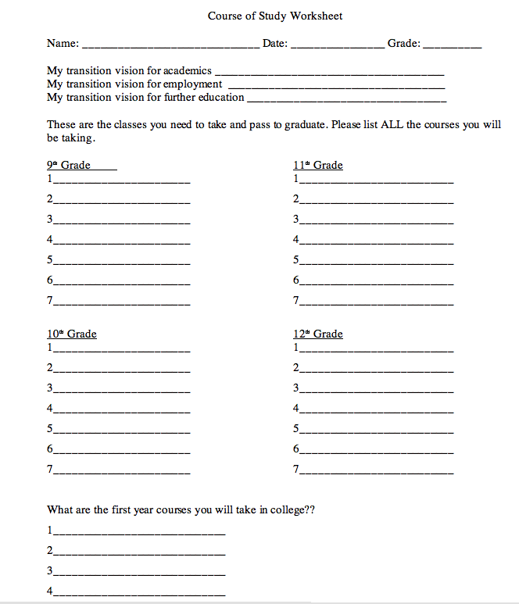
Developing Your Course-of-Study
You are ready to begin to develop your course-of-study.
Place all the classes you have taken and passed onto the course-of-study worksheet.

Slide 25
Developing Your Course-of-Study:
Class Assignment
You will need a partner for this section of the Lesson.
You and your partner will help each other develop a course-of-study to meet your transition visions.
You’ll share your course of study with me once you think it is complete.

Slide 26
Developing Your Course-of-Study:
Discussing your Homework!
What did your family think of your course of study?
What changes did your family suggest?

Slide 27
What’s Next?
Terms &
Concepts of
Transition
Course of
Study
Connecting with
Adult Support
Services
Awareness
Summary of
Performance
Vision for
Employment
Vision for
Adult
Living
Transition
Goals
Vision for
Postsecondary
Education

