Slide 1
Student-Directed Transition Planning
Lesson 7
Connecting with Adult Supports and Services
By
Lorraine Sylvester, Lee L. Woods, and James E. Martin
University of Oklahoma
College of Education
Department of Educational Psychology
Zarrow Center for Learning Enrichment
Preparation of SDTP supported in part by funding provided by the U.S. Dept. of Education, Office of Special Education Programs, Award #: H324C040136
Copyright 2007 by University of Oklahoma
Permission is granted for the user to duplicate the student materials and PowerPoint files for educational purposes. If needed, permission is also granted for the user to modify the PowerPoint files and lesson materials to meet unique student needs.

Slide 2
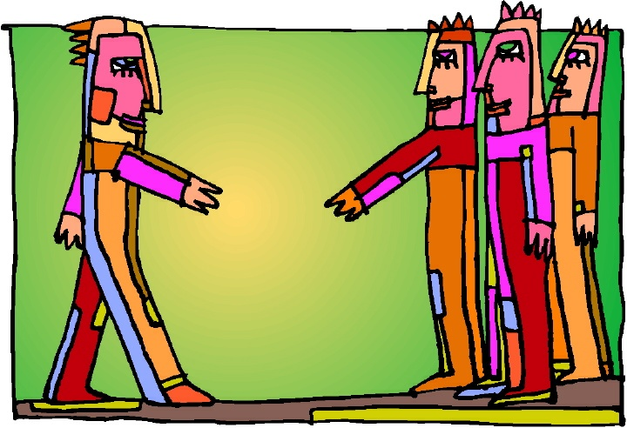
Connecting with Adult Supports and Services

Slide 3
Connecting with Adult Supports and Services
You will learn about supports and services that are available after you graduate to help achieve your work, living, or further education goals.

Slide 4
Adult Supports and Services
Your IEP addresses special supports that you need to be successful while you are in school.
These supports stop when you leave school.
If you need help to get a job, further education, or a place to live, you will have to seek and apply for these special supports or services…they don’t happen automatically!

Slide 5
Adult Supports and Services
What are some adult services and supports that are available to help you achieve your post-secondary career, education, and living goals?

Slide 6
Transition Areas
Coordinated activities will help you achieve your goals in these transition areas:
    Post-high school education
    Employment
    Place to live
    Community participation

Slide 7
Sample Coordinated Activities
Post-high school education | Visit disability service office
Employment | Sign up with Voc Rehab
Place to live | Visit homes and apartments for rent
Community participation | Register to vote

Slide 8
Who Makes Connections?
  You and your family
  Teachers
  Agency people
  Others

Slide 9
Possible Agency Connections
Transportation
Disability Support Services at Post-secondary Education (Career Tech, Community or 4-Yr. Colleges)
One-Stop Career Centers (Offices of Workforce Development)
Department of Rehabilitation Services (Vocational Rehabilitation)
    Independent Living Supports
    Employment Supports
Department of Human Services (Funds, food, transportation, health care)
Financial Planning Counseling
Mental Health

Slide 10
Transportation
How will you get where you need to go?
    Will you drive?
      You need a valid driver’s license.
    Carpool with friends and family?
    Public Transit?
      Bus, train, taxi?

Slide 11
Post-high School Education
  Career and Technical Education
  Community College (usually 2 years)
  College or University (at least 4 years)
  Military Education

Slide 12
Review: Career & Technical Education
Offers you the opportunity to learn about and have experiences in a career that interests you, even before you graduate from high school.
Provides either a vocational certificate or license, or associate’s degree.
Association for Career and
Technical Education,
www.actonline.org

Slide 13
Review: Community College
Usually a 2-year program that offers both educational and technical training opportunities.
Usually offers reading, math, and writing remedial courses.
Degrees offered:
  Associate (2 year degree)
  Certifications
  Licensures

Slide 14
Review: University or Four Year College
A program that offers a degree after four years of study.
A variety of program offerings are available, each with their own specific requirements.
If you think you might want to go to a 4-year college, you can start out at a community college. You need to be sure your classes will transfer to the 4-year college or university later.
Notes:
Maybe add a slide that talks about transferring from a community college to a 4-year college, and avoiding having to meet high admission requirements, like GPA??

Slide 15
Review: Military Education
The military can train you for a variety of jobs.
You are eligible for educational benefits if you are active or reserve duty in the Army, Navy, Air Force, Marines or Coast Guard, but you must first enlist in one branch of the service.

Slide 16
One-Stop Career Centers
  These centers may be available in your community and offer some of the following services:
    Youth services (summer employment and other workshops)
    Career Counseling
    Employment/Job Search Workshops
    Job Search Assist (resume assist and prep)
    Testing/Assessment in many areas
    Labor Market and Economic Information

Slide 17

Find a One-Stop Career Center
Find out about the One-Stop Career Center close to where you live by going to: http://www.servicelocator.org/

Slide 18

Voc Rehab
Helps you find and keep a job, or to get post-secondary education and training.
You need to apply for these services at your local Voc Rehab office.

Slide 19
Voc Rehab Employment Supports
Finding a job
Job Training
Job Coaching
Providing Assistive Technology
Coordinating other needed supports
Remember: You must apply for adult services and
meet certain requirements

Slide 20
Voc Rehab Independent Living Centers
Provide supports and teach skills so adults with disabilities can live where and how they want.

Slide 21
Department of Rehabilitation Services
Locate the Department of Rehabilitation Services (DRS or Voc Rehab) near where you live.
http://www.jan.wvu.edu/SBSES/VOCREHAB.HTM
Find out about the services that are available through DRS.
Find out how to apply for DRS services if you need them in the future.

Slide 22
Financial Planning
You can get help to meet your financial obligations related to adult living, working, or going to college.
One-Stop, Voc Rehab, DHS, your local Social Security Office, and sometimes a separate group called Office of Benefits Planning and Supports

Slide 23
Other Supports
Where can you get?
  Food Stamps
  Emergency food
  Mental Health services
  Emergency health care
  Assistance for utility bills
  Clothing assistance

Slide 24
Homework Assignment
Talk with your family about the activity and agency connections you should make to help you achieve your adult living, working, or educational visions.
Using the Activity Sheet, make a list of the adult service providers that you could use.
Contact three agencies that may help you, and find out what they can do.
Include this information in your transition IEP.

Slide 25
What’s Next?
Terms &
Concepts of
Transition
Course of
Study
Connecting with
Adult Support
Services
Awareness
Summary of
Performance
Vision for
Employment
Vision for
Adult
Living
Transition
Goals
Vision for
Postsecondary
Education

